Slide 1
General Virology 1st Lecture

Slide 2
Topics
Week l: -Introduction and General characters of viruses
(History ,definition, and importance of study)
Viral structure
Virus structure and morphology
composition and function of viral structure
Week 2: Virus Architecture and Nomenclature
Viral shape(Symmetry) and different figure of virus
Classification of Animal Viruses (ICV and Baltimore scheme)
Week 3: Virus replication Strategies
Principal events involved in replication: Adsorption, penetration, uncoating nucleic acid and protein synthesis, assembly, maturation and release.

Slide 3
Week 4 : Chemical and physical agent reaction
To discuss the effect of pH, temperature ,Heat, cold and salts upon
Viral activities.
Viral Immunopathology-Viral Immune response and viral evasion Mechanisms
Week 5 : Laboratory Diagnosis of Virus Infections (Method of Diagnosis)
Direct method
In Direct method
Serological and molecular method
Week 6 : Double stranded DNA Virus (Adenoviruses, Herpesviruses, Poxviruses
Week 7: Single strand DNA viruses (+ sense) DNA (e.g. Parvoviruses)
Week 8: Positive single strand (+)ssRNA viruses (+ sense) RNA (e.g. Picornaviruses, Togaviruses)
Week 9: Double strand RNA viruses (e.g. Reoviruses)

Slide 4
Week 10 : Negative single strand (−)ssRNA viruses (antisense) RNA (e.g. Orthomyxoviruses, Rhabdoviruses)
Week 11 : Single strand RNA-RT viruses (+ sense) RNA with DNA intermediate in life-cycle (e.g. Retroviruses)
Week 12 : Double strand DNA-RT viruses (e.g. Hepadnaviruses)
Week 13: Viral Persistence: Chronic & Latent Virus Infections, Effect of Host Age.
Week 14: Antiviral Chemotherapy, Viral Vaccines.

Slide 5
General Virology
Introduction to the viruses

Slide 6
Viruses
Viruses= Latin for ‘slimy liquid’ or ‘poison’
are non-cellular or Acellular infectious agents
Virology=study of viruses
Virologists =scientists who study viruses

Slide 7
Why Study Viruses
Viruses are capable of infecting all forms of life Vertebrates, prokaryotes, fungi, algae
Most abundant form of life-Bacteriophages are extremely abundant
Recognizing the shape, size, and structure of different viruses is critical to the study of disease
Excellent molecular biology tools

Slide 8
Some viruses are useful:-
• Phage typing of bacteria: Some groups of bacteria, such as some Salmonella species, are classified into strains on the basis of the spectrum of phages to which they are susceptible.
• Sources of enzyme: A number of enzymes used in molecular biology are virus enzymes. Examples include reverse transcriptase from retroviruses and RNA polymerases from phages.
• Pesticides: Some insect pests are controlled with baculoviruses and myxoma virus.
• Anti-bacterial agent: phages were used to treat some bacterial infections of humans.
• Anti-cancer agents: Genetically modified strains of viruses, such as herpes simplex virus and vaccinia virus, are being investigated for treatment of cancers.
• Gene vectors for protein production: Viruses such as certain adenoviruses are used as vectors to take genes into animal cells growing in culture.
• Gene vectors for treatment of genetic disease

Slide 9
Evolutionary Origin of Viruses
The origin of viruses is not known.
There are profound differences among the DNA viruses, the RNA viruses, and viruses that utilize both DNA and RNA as their genetic material during different stages of their life cycle. It is possible that different types of agents are of different origins.
Two theories of viral origin can be summarized as follows:
Viruses may be derived from DNA or RNA nucleic acid components of host cells that became able to replicate autonomously and evolve independently. They resemble genes that have acquired the capacity to exist independently of the cell.
(2) Viruses may be degenerate forms of intracellular parasites. There is no evidence that viruses evolved from bacteria, though other obligatory intracellular organisms, e.g. rickettsia and chlamydia presumably did so. However, poxviruses are so large and complex that they might represent evolutionary products of some cellular ancestor.

Slide 10
The Position of Viruses in the Biological Spectrum
Viruses are infectious agents with both living and nonliving characteristics.
1. Living characteristics of viruses
(a). They reproduce at a fantastic rate, but only in living host cells
(b). They can mutate.

Slide 11
The Position of Viruses in the Biological Spectrum
2. Nonliving characteristics of viruses
They are acellular, that is, no cytoplasm or no cellular organelles.
No metabolism on their own and must replicate using the host cell's metabolic machinery.

Slide 12
Edward Jenner 1796 Vaccinations Cowpox cross protection against small pox (Variola virus) Similar infection in cows Milkmaids infected by cowpox do not get smallpox
History & Landmarks in Virology

Slide 13
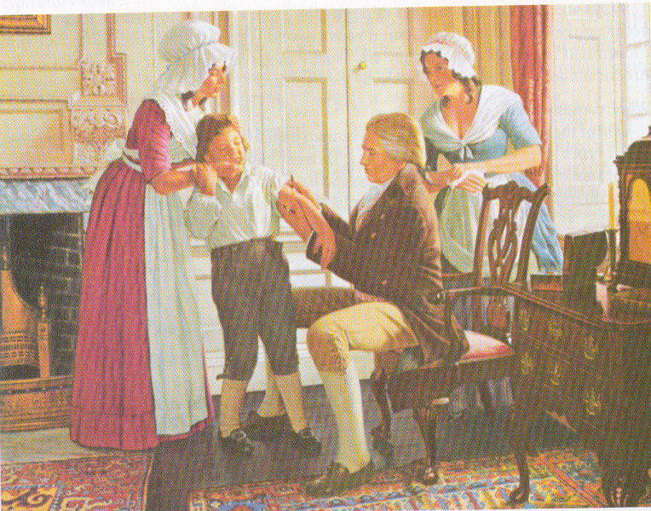
Used the pus from cowpox lesions to inoculate and prevent smallpox
Termed “vaccination” (vaccinus, cow)

Slide 14
Rabies vaccination by Louis Pasteur in 1886. The nature of viruses however was not clear.
Introduction of concept of ‘filterable agents’ for plant pathogens (Dimitri Ivanofsky, Beijerinck in late 1880’s) showed that a disease in tobacco was caused by a virus
First filterable agent from animals described – foot and mouth disease in cattle (Loeffler and Frosch in 1898)
First human filterable agent described - yellow fever virus (Reed in 1901)
Linkage of viruses with cancer (Ellerman, Bang 1908; Rous 1911)

Slide 15
Satellite or defective viruses
Viruses which require a second (helper) virus for replication
Example: hepatitis delta virus requires hepatitis B
Bacteriophage
Virus that infects prokaryotic (bacterial) cells
Pseudovirus:
During viral replication the capsid sometimes encloses host nucleic acid rather than viral nucleic acid. Such particles look like ordinary virus, particles when observed by electron microscopy, but they do not replicate. Pseudovirions contain the “wrong” nucleic acid.

