Slide 1
General Virology
2nd Lecture

Slide 2
General characters of viruses:
Virus particles are very small in size; they are between 20-500 nm (nanometer) in diameter. For this Viruses cannot be seen by ordinary microscope, but only by Electron microscope (EM).
Viruses are obligate intracellular parasites. They replicate only inside living cells.
Multiply inside the cells by replicating their genomes which either DNA or RNA, but never both.
Viruses lack cellular organelles, such as mitochondria and ribosomes.
Virus does not affect with antibiotics.
Most viruses sensitive to interferon.
Viruses cannot grow on artificial media, but only in living cells (specific host, Lab. Animals, chicken embryonated eggs & tissue culture).

Slide 3
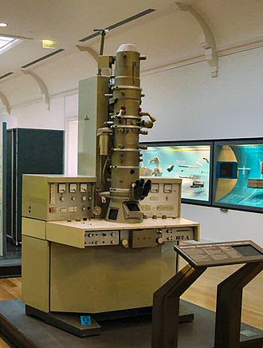
Size Range
Smallest infectious agents
Most are so small, they can only be seen with an electron microscope
  A small virus (Proviruses)- around 20 nm in diameter
  A large virus (Mimi viruses)- up to 450 nm in diameter

Slide 4
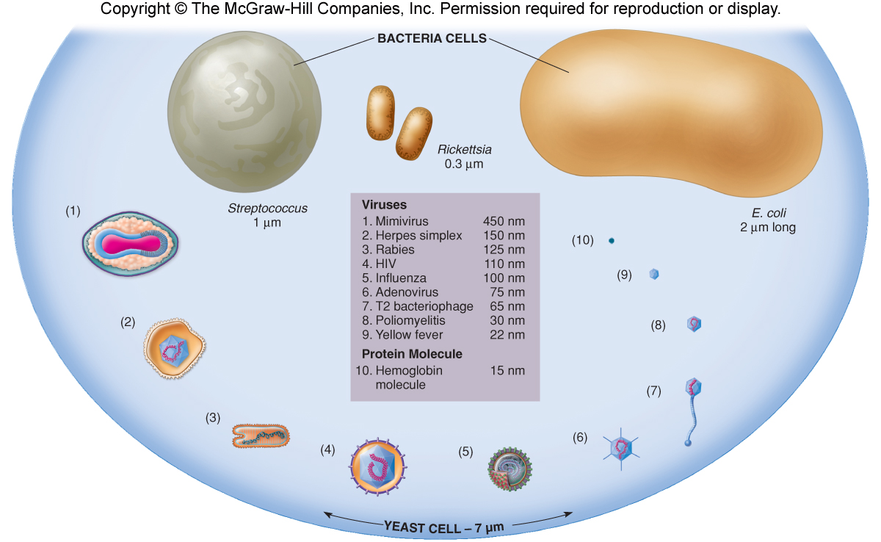

Slide 5
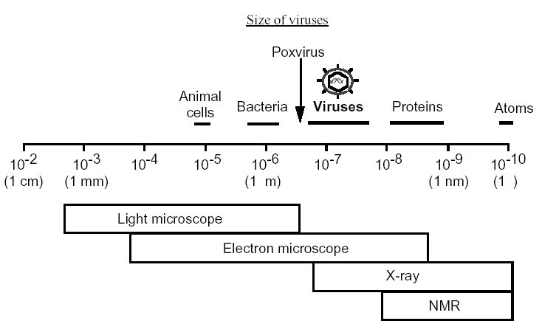

Slide 6
Reaction to physical and chemical agents
Heat and cold: Viral infectivity is generally destroyed by heating at (50-60 °C) for 30 min. Viruses can be preserved at -20 °C or -196 °C (liquid nitrogen).
2. PH: Viruses can be preserved at physiological PH (7.3).
3. Ether susceptibility: Ether susceptibility can be used to distinguish viruses that possess an envelope from those that do not.
4. Detergents: Nonionic detergents solubilize lipid constituents of viral membranes. The viral proteins in the envelope are released. Anionic detergents also solubilize viral envelopes; in addition, they disrupt capsids into separated polypeptides.
5. Salts :Many viruses can be stabilized by salt in concentrations of 1 mol/L. e.g. MgCl2, MgSO4, Na2SO4
6. Radiation :Ultraviolet, X-ray, and high-energy particles inactivate viruses.
7. Formaldehyde :Destroys viral infectivity by reacting with nucleic acid.
8. Antibiotics: Antibacterial antibiotics have no effect on viruses.

Slide 7
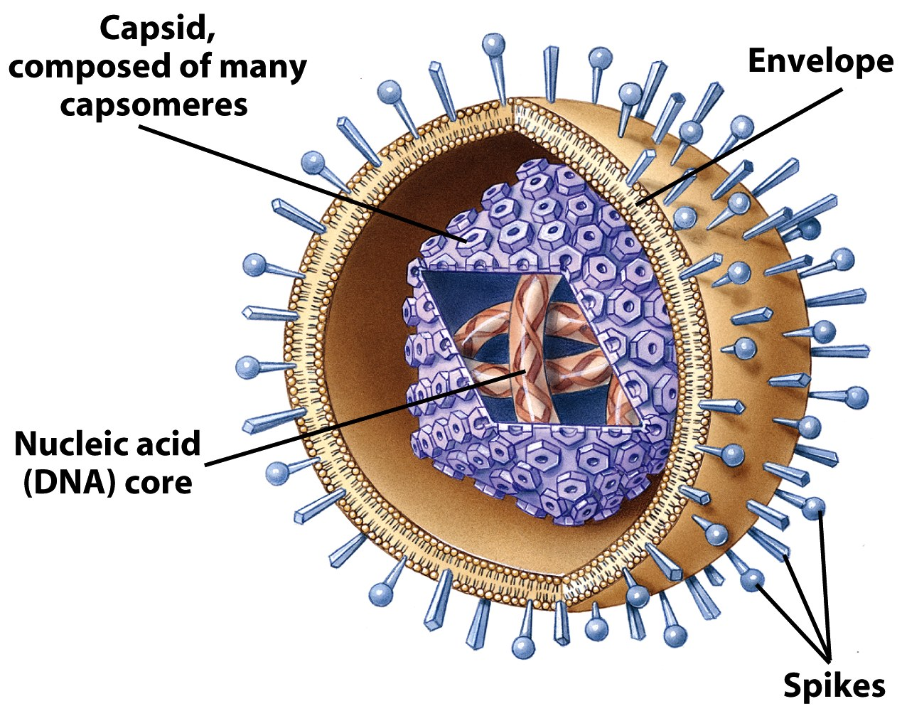
Generalized Structure of Viruses
Viral components
  Nucleic acids
  Capsid
  Envelope
  Glycoprotein

Slide 8
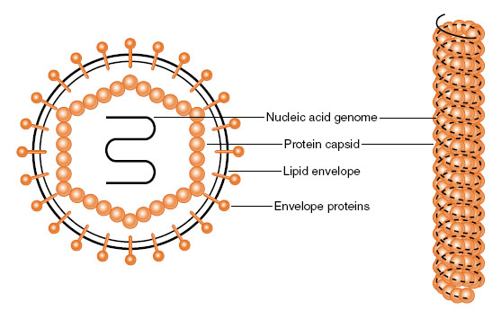
Nature of Viruses
Viral genome is packaged in protein coat

Slide 9
Virus Symmetry
Virus particles exhibit 3 types of capsid symmetry:
  helical - tubular: most helical viruses possess an outer envelope (eg. measles)
  icosahedral - isometric or cubic; (eg. herpes)
  complex - does not conform to either of above (eg. vaccinia)

Slide 10
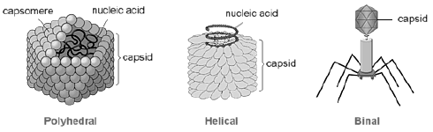
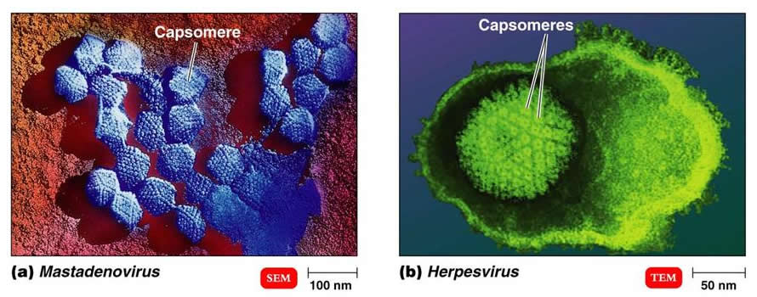
Capsomeres are capsid subunits

Slide 11
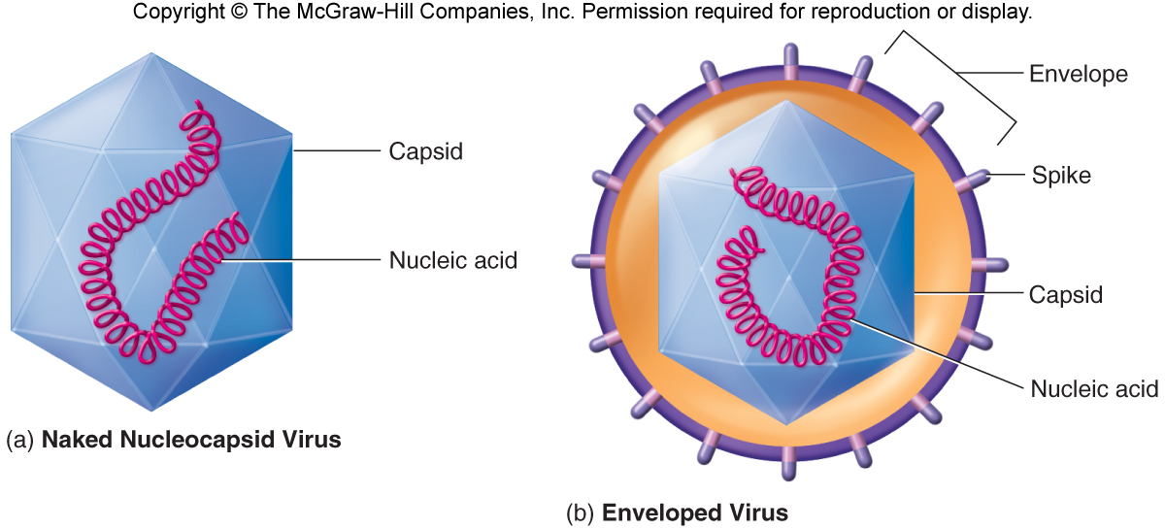

Slide 12
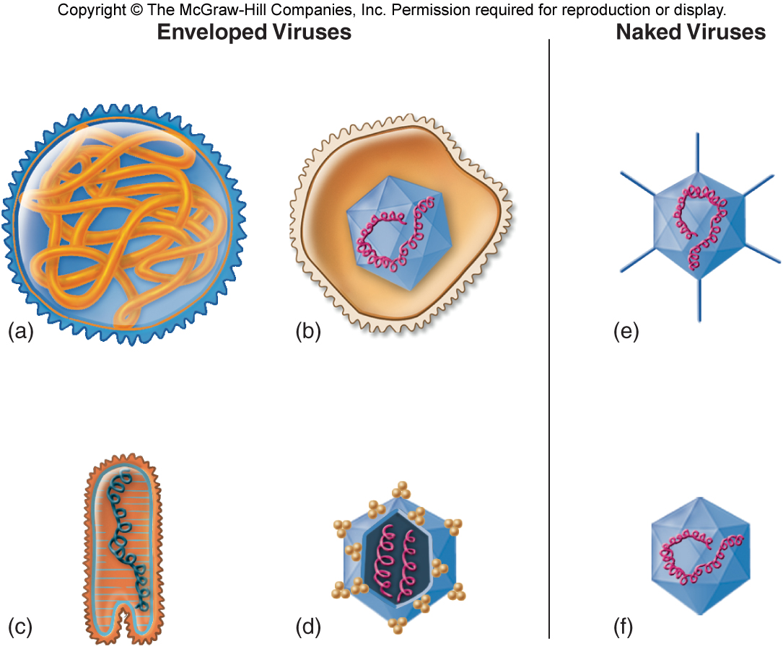

Slide 13
Virus Genomes

Slide 14
Terminology and Definition
Virus is a broad general term for any aspect of the infectious agent and includes:
• the infectious or inactivated virus particle
• viral nucleic acid and protein in the infected cell
Virion is the physical particle in the extra-cellular phase which is able to spread to new host cells; complete intact virus particle
Viroids
  Small, autonomously replicating molecules
  Single stranded circular RNA, 240-375 residues in length
  Plant pathogens
Prions
  Infectious particles that are entirely protein
  No nucleic acid
  Highly heat resistant
  Animal disease that affects nervous tissue
  Affects nervous tissue and results in
    Bovine spongiform encephalitis (BSE) “mad cow disease”,
    Scrapie in sheep
    kuru & Creutzfeldt-Jakob Disease (CJD) in humans

Slide 15
Satellite or defective viruses
  Viruses which require a second (helper) virus for replication
    Example: hepatitis delta virus requires hepatitis B
Bacteriophage
Virus that infects prokaryotic (bacterial) cells
Pseudovirus:
During viral replication the capsid sometimes encloses host nucleic acid rather than viral nucleic acid. Such particles look like ordinary virus, particles when observed by electron microscopy, but they do not replicate. Pseudovirions contain the “wrong” nucleic acid.

