Slide 1
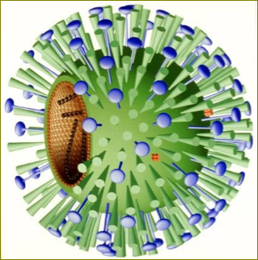
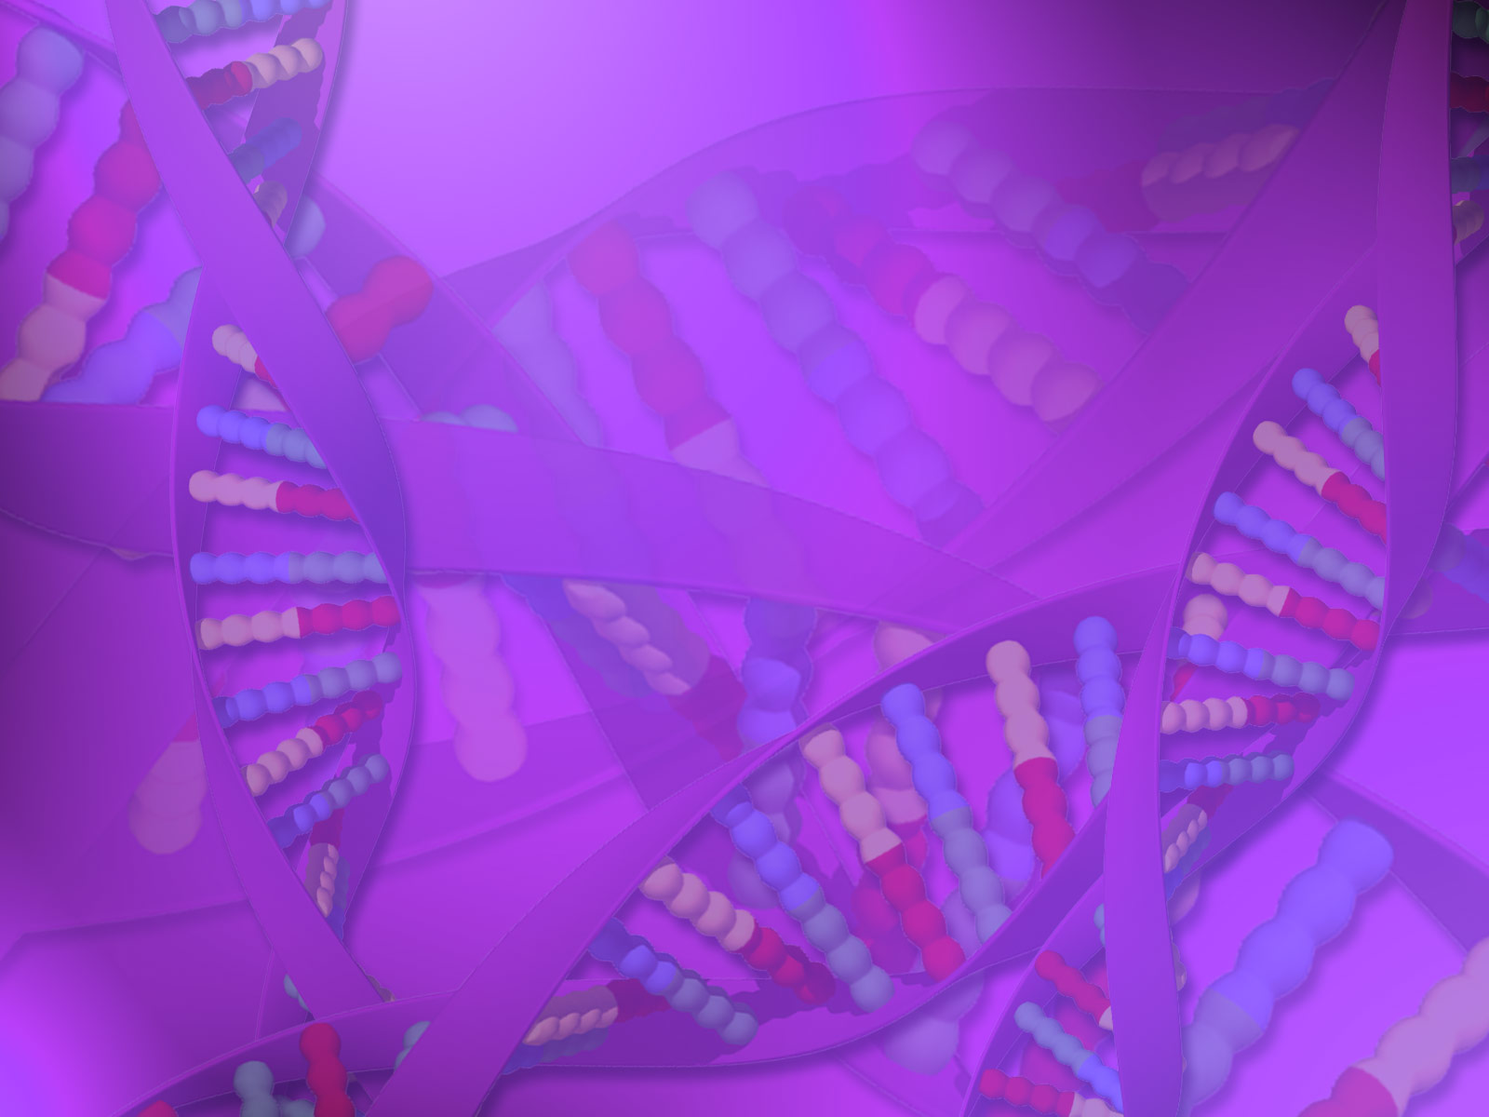
VIRAL Classification and Nomenclature
^{3rd} Lecture

Slide 2
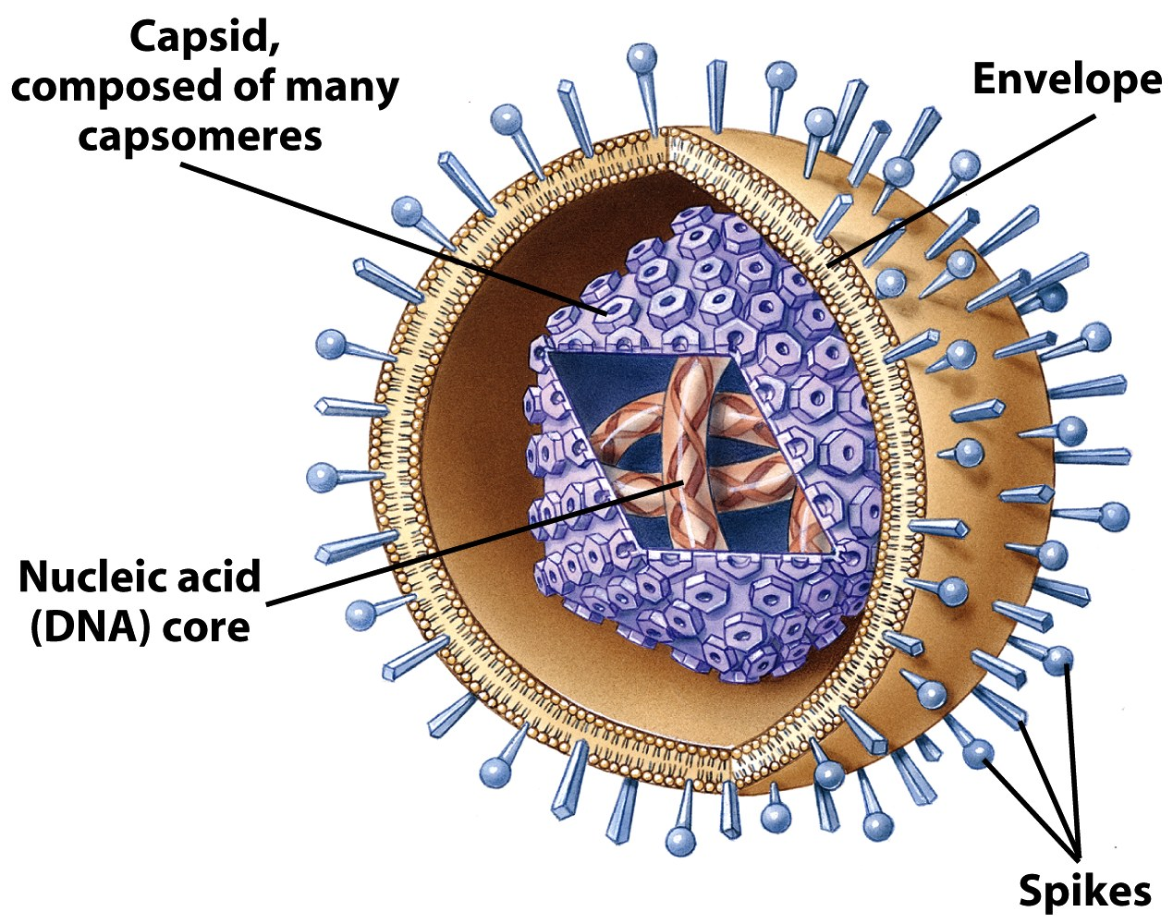
Generalized Structure of Viruses
Viral components
  Nucleic acids
  Capsid
  Envelope
  Glycoprotein

Slide 3
Basic virus structure
DNA
Capsid protein
Naked capsid virus
or
+
Nucleocapsid
=
RNA
Lipid membrane, glycoproteins
Nucleocapsid
+
Enveloped virus

Slide 4
General characters of viruses:
Virus particles are very small in size; they are between 20-500 nm (nanometer) in diameter. For this Viruses cannot be seen by ordinary microscope, but only by Electron microscope (EM).
Viruses are obligate intracellular parasites. They replicate only inside living cells.
Multiply inside the cells by replicating their genomes which either DNA or RNA, but never both.
Viruses lack cellular organelles, such as mitochondria and ribosomes.
Virus does not affect with antibiotics.
Most viruses sensitive to interferon.
Viruses cannot grow on artificial media, but only in living cells (specific host, Lab. Animals, chicken embryonated eggs & tissue culture).

Slide 5
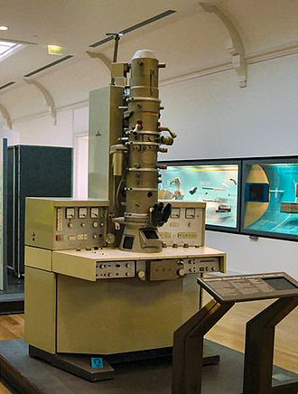
Size Range
Smallest infectious agents
Most are so small, they can only be seen with an electron microscope
  A small virus (Proviruses)- around 20 nm in diameter
  A large virus (Mimi viruses)- up to 450 nm in diameter

Slide 6
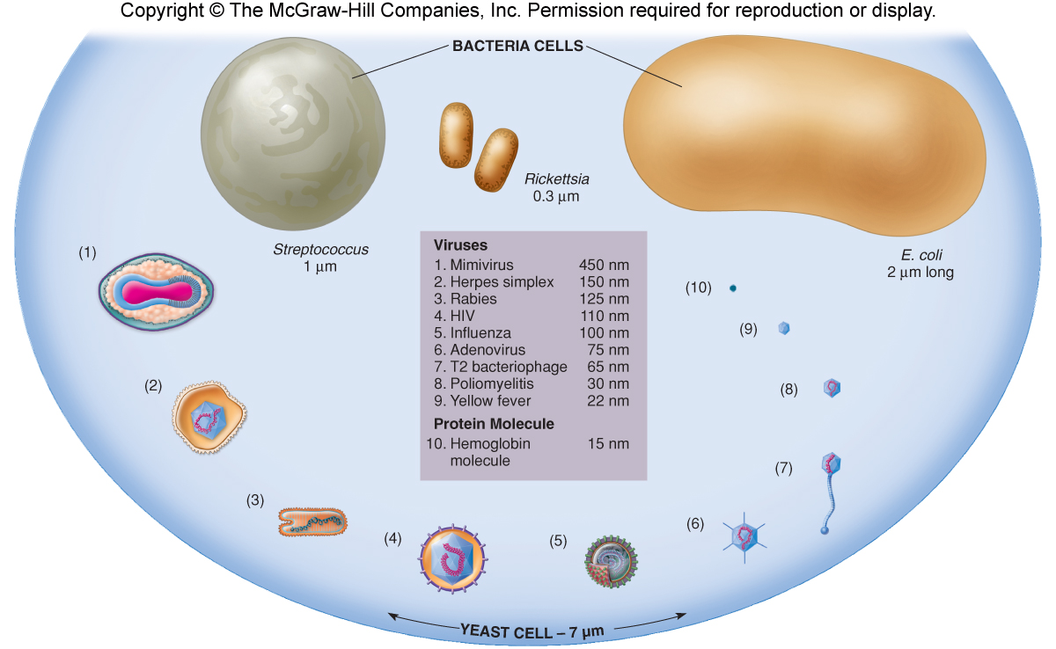

Slide 7
Generalized Structure of Viruses
Viral components
  Nucleic acids
  Capsid
  Envelope
  Glycoprotein

Slide 8
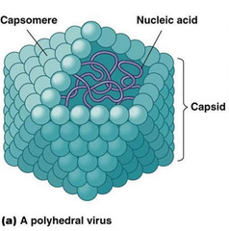
Viral Components: Capsid
Molecular structure- composed of regular, repeating subunits that give rise to their crystalline appearance
Constructed from identical subunits called capsomers (protomers)

Slide 9
Function of Capsid
Their major purpose is to facilitate transfer of the viral nucleic acid from one host cell to another.
They serve to protect the viral genome against inactivation by nucleases.
Participate in the attachment of the virus particle to a susceptible cell.
Provide the structural symmetry of the virus particle.
The proteins determine the antigenic characteristics of the virus.
Some surface proteins may also exhibit specific activities, e.g. influenza virus hemagglutinin agglutinates red blood cells.

Slide 10
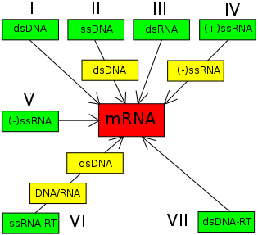
Viral Nucleic Acids
Genome- the sum total of the genetic information carried by an organism
They only have the genes necessary to invade host cells and redirect their activity

Slide 11
Viral Envelope
Envelopes vary in:
  Size
  Morphology
  Complexity
  Composition
Enveloped viruses take a bit of the host cell membrane in the form of an envelope (lipoprotein envelope containing viral and host cell components destroyed by lipid solvents)
Many viruses that infect humans and other animals are enveloped.
Envelopes form when viral glycoproteins and oligosaccharides associate with the plasma membrane of the host cell.
  virions having envelopes = enveloped viruses
  virions lacking envelopes = naked viruses
-

Slide 12
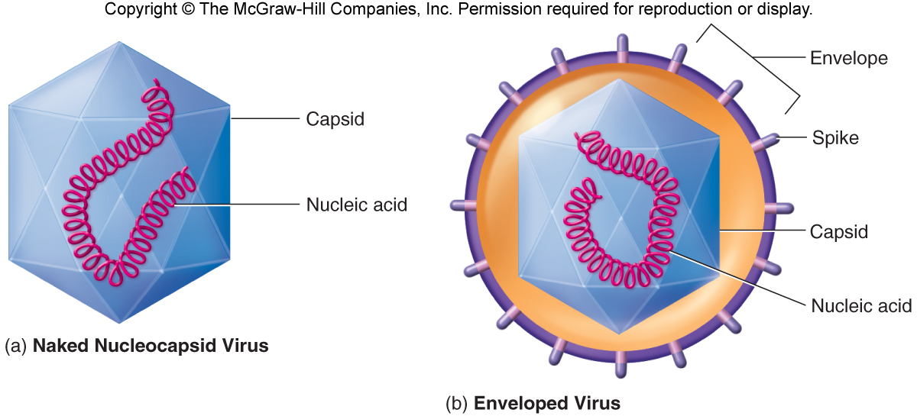

Slide 13
Viral Glycoprotein
They are firmly embedded in the envelope bilayer.
In contrast to the lipids in viral membranes, which are derived from the host cell, the envelope glycoproteins are virus-encoded. However, the sugars added to viral glycoproteins often reflect the host cell in which the virus is grown.
Function
It is the surface glycoproteins of an enveloped virus that attach the virus particle to a target cell by interacting with a cellular receptor.
They are also often involved in the membrane fusion step of infection.
The glycoproteins are also important viral antigens.

Slide 14
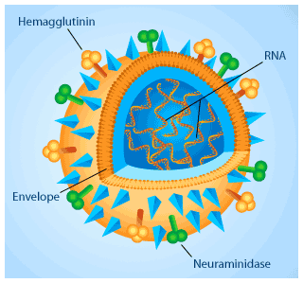
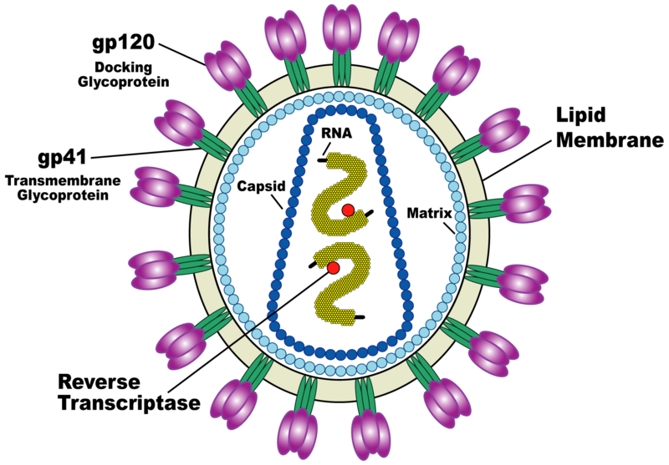
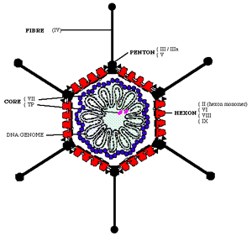
Envelope Glycoprotein Spikes

Slide 15
Other Substances in the Virus Particle
Other Substances in the Virus Particle
  Can contain enzymes for specific operations within the host cell
  Polymerases to synthesize DNA and RNA
  Replicases to copy RNA

