Slide 1
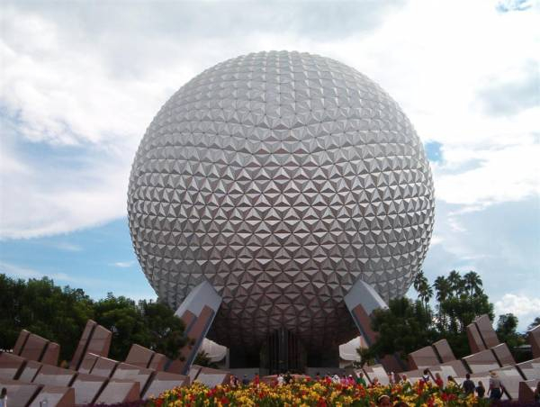
Viral Replication 5th Lecture

Slide 2
Viral Replication
Viruses multiply only in living cells (As viruses are obligate intracellular pathogens they cannot replicate without the machinery and metabolism of a host cell).
The host cell must provide the energy and synthetic machinery and the low-molecular-weight precursors for the synthesis of viral proteins and nucleic acids.
The viral nucleic acid carries the genetic specificity to code for all the virus-specific macromolecules in a highly organized fashion.
In order for a virus to replicate, viral proteins must be synthesized by the host cell protein-synthesizing machinery. Therefore, the virus genome must be able to produce a usable mRNA.
Various mechanisms have been identified which allow viral RNAs to compete successfully with cellular mRNAs to produce adequate amounts of viral proteins.

Slide 3
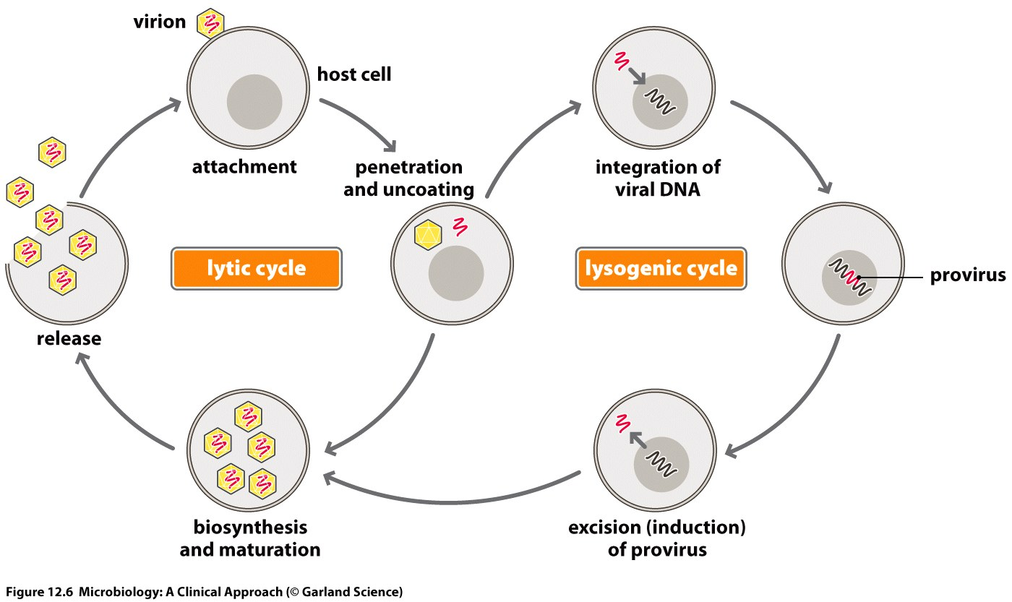
Two methods of replication:
1. Lytic Cycle The virus enters the cell, replicates itself hundreds of times, and then bursts out of the cell, destroying it (cell death).
2. Lysogenic Cycle The viral genome becomes incorporated into the host cell’s DNA. It can remain this way for an extended period. The host cell remain lives.

Slide 4
Virus Growth Phases
Eclipse phase
Phase during which the virion has entered the cell and before progeny virus are made. No infectious virus is present during this phase.
Period in which virus gains control of host synthetic machinery and produce components required to assemble into virus
Defined as the period between addition of virus and the appearance of assembled virus progeny inside the cell
Latent phase
The period following the eclipse phase from the time of disappearance of the infecting virus to the appearance of infectious virus in the surroundings virus are internal and must be released.

Slide 5
LYTIC INFECTION (Multiplication Cycles in Animal Viruses)
For animal viruses, there are six steps in lytic infection:
Attachment (Adsorption)
Penetration
Uncoating
Biosynthesis
1- Early viral mRNA synthesis
2- Early viral protein synthesis
3- Viral genome replication
4- Late viral mRNA synthesis
5- Late viral protein synthesis
Maturation (Assembly)
Release

Slide 6
Attachment (Adsorption)
recognition & attachment to specific host receptor → determines the host range of the virus
Receptor sites:
Specific surface structures on host to which viruses attach
Can be proteins, lipopolysaccharides, techoic acids, etc.
Viruses typically can only infect a limited number of hosts (also known as host range). The "lock and key"
Does not require energy
> HIV – CD4 + T cells
> HSV-1 – fibroblast growth factor receptor

Slide 7
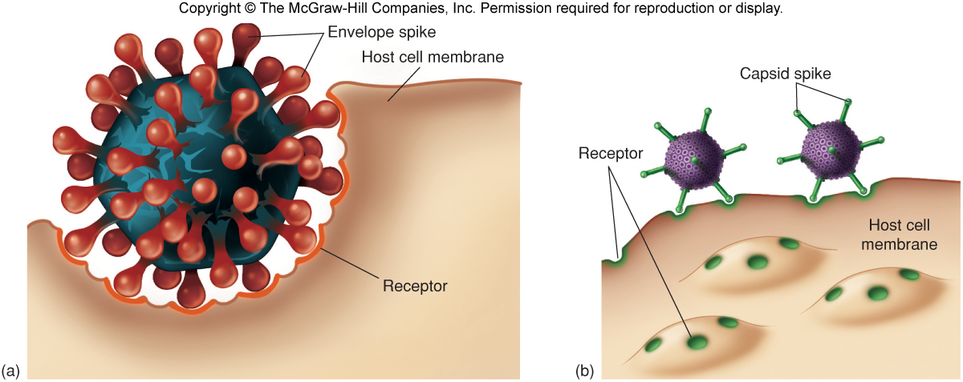

Slide 8
Penetration
Flexible cell membrane of the host is penetrated by the whole virus or its nucleic acid
energy-dependent step
Temperature-dependent step (37 °C)
3 mechanisms
endocytosis ; entire virus engulfed by the cell and enclosed in a vacuole or vesicle
fusion of virus envelope with cell membrane
Direct Penetration (viropexis)

Slide 9
Uncoating
Release of Genome= (uncoating)
Cell Enzymes (lysosomes) in the vacuole dissolve the envelope and capsid
virion can no longer be detected; known as the “eclipse period”

Slide 10
Synthesis
Free viral nucleic acid exerts control over the host’s synthetic and metabolic machinery
DNA viruses- enter host cell’s nucleus where they are replicated and assembled
DNA enters the nucleus and is transcribed into RNA
The RNA becomes a message for synthesizing viral proteins (translation)
New DNA is synthesized using host nucleotides
RNA viruses- replicated and assembled in the cytoplasm
Protein synthesis-2 types
1-structural protein
2- Non-structural (enzyme for replication)
Components of capsid synthesis directed by late genes

Slide 11
Assembly
Mature virus particles are constructed from the growing pool of parts. Progeny particles assembled by packaging the viral nucleic acid within the capsid proteins
Assembly of enveloped viruses needs interaction with plasma membrane which has been modified
Naked viruses accumulate in cytoplasm and released during lysis

Slide 12
Release
Non-enveloped and complex viruses are released when the cell lyses or ruptures
Enveloped viruses are liberated by budding or exocytosis
Anywhere from 3,000 to 100,000 virions may be released, depending on the virus
Entire length of cycle- anywhere from 8 to 36 hours
2 processes of Release:
1. Rupture or lysis of cell membrane
2. Budding through the outer membrane

