Slide 1
Survey of DNA Viruses

Slide 2
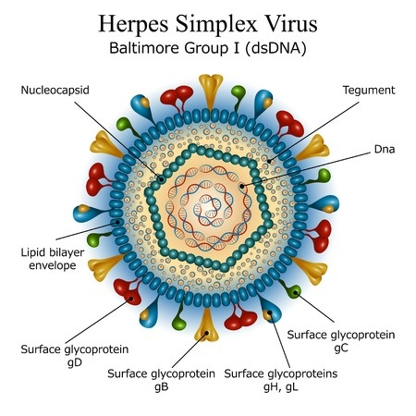
Herpesviruses (Persistent Human Viruses)
1- Large family of viruses 150–200 nm in diameter.
2-The nucleocapsid is 100 nm in diameter, with cubic symmetry and 162 capsomeres, surrounded by a lipid-containing envelope.
3-The genome is linear, double-stranded DNA, 125–240 kbp in size. The presence of terminal and internal reiterated sequences results in several isomeric forms of genomic DNA.
4-Virions contain over 30 proteins.
5-Latent infections may last for the life span of the host, usually in ganglial or lymphoblastoid cells.
6- Replicates within nucleus

Slide 3
6- Clinical complications of latency and recurrent infections become more severe with advancing age, cancer chemotherapy, or other conditions that compromise the immune defenses.
Human herpesviruses include:-
Herpes simplex types 1 and 2 (oral and genital lesions)
Varicella-zoster virus (chickenpox and shingles)
Cytomegalovirus, Epstein-Barr virus (infectious mononucleosis)
Human herpesviruses 6 and 7 (T lymphotropic)
Human herpesvirus 8 (associated with Kaposi's sarcoma).
Other herpesviruses occur in many animals

Slide 4
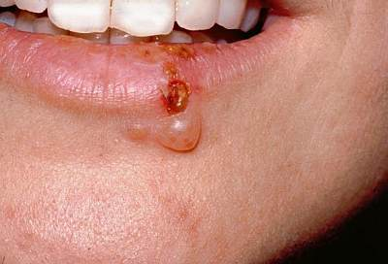
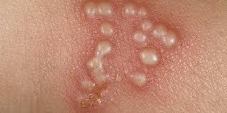
Herpes Simplex Viruses
HSV-1- usually lesions on the oropharynx, cold sores, fever blisters
HSV-2 - lesions on the genitalia, possibly oral
occurs in ages 14-29
can be spread without visible lesions

Slide 5
Epidemiology
Transmission by direct exposure to secretions containing the virus; active lesions most significant source; genital herpes can be transmitted in the absence of lesions
HSV multiplies in sensory neurons, moves to ganglia
HSV-1 enters 5th cranial nerve
HSV-2 enters lumbosacral spinal nerve trunk ganglia
Recurrent infection is triggered by various stimuli – fever, UV radiation, stress, mechanical injury. Newly formed viruses migrate to body surface, producing a local skin or membrane lesion.

Slide 6
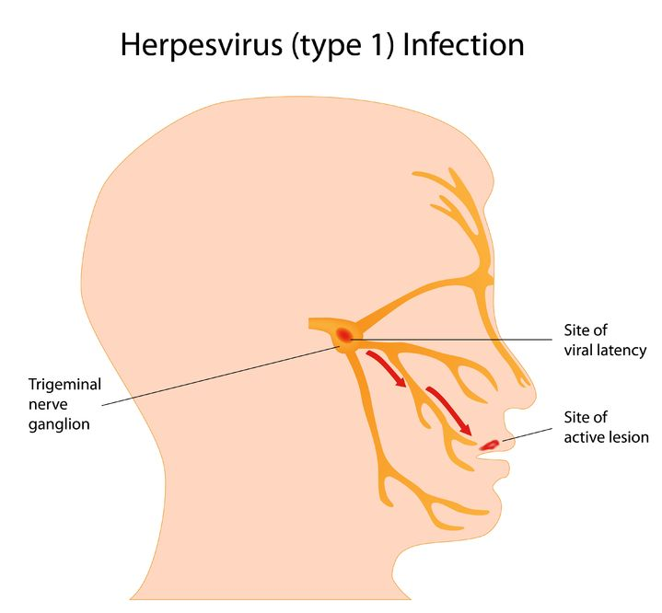
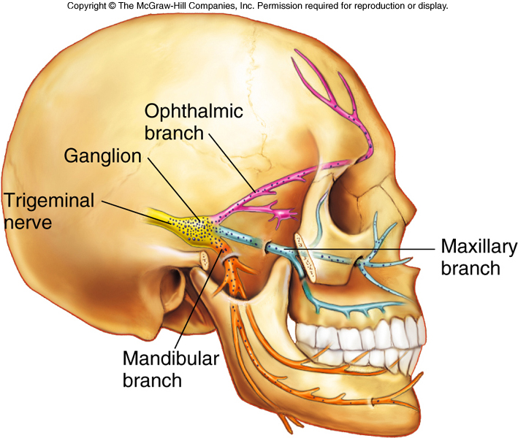

Slide 7
Type 1 Herpes Simplex in Children and Adults
Herpes labials – fever blisters, cold sores, vesicles occur on mucocutaneous junction of lips or adjacent skin; itching and tingling prior to vesicle formation; lesion crusts over in 2-3 days and heals.
Herpetic gingivostomatitis – infection of oropharynx in young children; fever, sore throat, swollen lymph nodes
Herpetic keratitis – ocular herpes – inflammation of eye; gritty feeling in the eye, conjunctivitis, sharp pain, and sensitivity to light

Slide 8
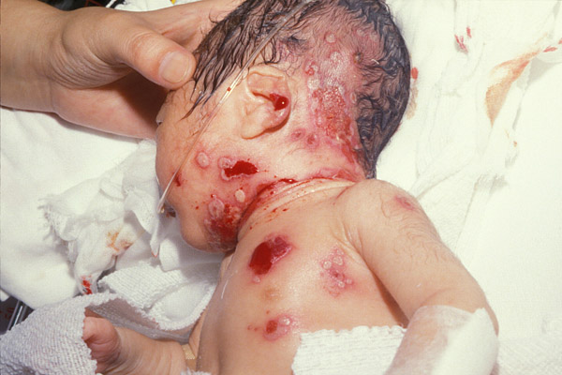
Type 2 Herpes Infections
Genital herpes – starts with malaise, anorexia, fever, and bilateral swelling and tenderness in the groin; clusters of sensitive vesicles on the genitalia, perineum, and buttocks; urethritis, painful urination, cervicitis, itching; vesicles ulcerate
Recurrent infection usually less severe, triggered by menstruation, stress, and concurrent bacterial infection

Slide 9
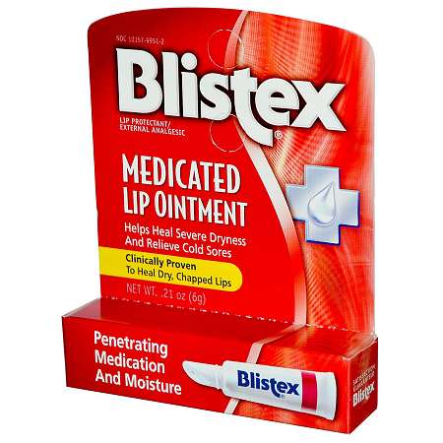
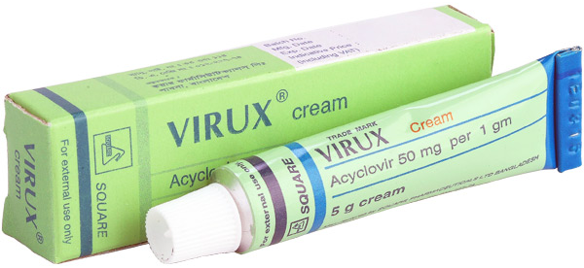
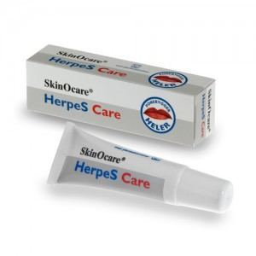
Diagnosis, Treatment, and Control of Herpes Simplex
Vesicles and exudate are typical diagnostic symptoms, scrapings from base of lesions showing giant cells, culture and specific tests for diagnosing severe or disseminated HSV; direct fluorescent antibody tests
Treatment: acyclovir, famciclovir, valacyclovir; topical medications

Slide 10
Varicella-Zoster Virus (VZV)
Causes chickenpox and shingles
Humans only natural host
Transmitted by respiratory droplets and contact
Primary infection – chickenpox – characteristic vesicles
Virus enters neurons and remains latent
Later, reactivation of the virus results in shingles with vesicles localized to distinctive areas, dermatomes.
More common in older patients
Treatment: treat symptoms in uncomplicated infections; acyclovir, famciclovir, interferon for systemic disease
Live attenuated vaccine for chickenpox and shingles

Slide 12
(A) Chicken pox (B) Zoster

