Slide 1
Survey of DNA Viruses

Slide 2
Cytomegalovirus (CMV)
Produce giant cells with nuclear and cytoplasmic inclusions
Transmitted in saliva, respiratory mucus, breastmilk, urine, semen, cervical secretions
Commonly latent in various tissues
Most infections are asymptomatic.
3 groups develop a more virulent form of disease: fetuses, newborns, immunodeficient adults.

Slide 3
Cytomegalovirus
Newborns may exhibit enlarged liver and spleen, jaundice, capillary bleeding microcephaly, and ocular inflammation; may be fatal.
Babies who survive develop neurological sequelae, hearing, visual disturbances and mental retardation.
AIDS patients – CMV mononucleosis, disseminated CMV, retinitis,
Transplant patients - pneumonitis, hepatitis, myocarditis, meningoencephalitis
Treatment - ganciclovir, foscarnet

Slide 5
Epstein-Barr Virus (EBV)
Infects lymphoid tissue and salivary glands
Transmission – direct, oral contact and contamination with saliva
In industrialized countries (kissing disease).
90-95% of all people are infected.
Infectious mononucleosis – sore throat, high fever, cervical lymphadenopathy; develop after 30-50 day incubation
Dormancy in B cells; reactivated; may be asymptomatic

Slide 6
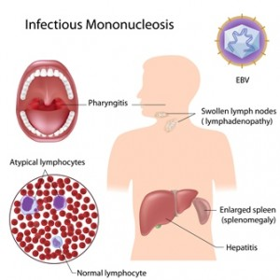
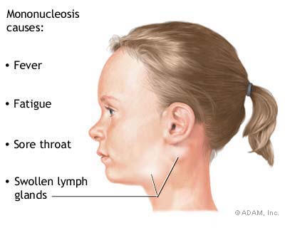

Slide 7
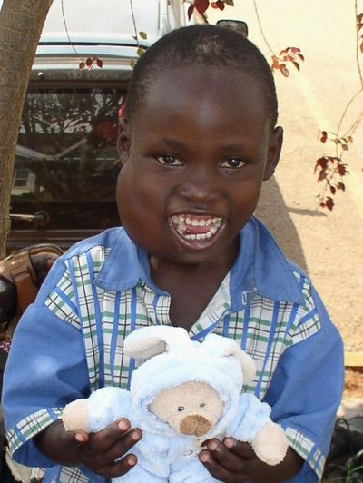
Tumors and Other Complications Associated with EBV
Burkitt lymphoma – B cell malignancy; usually develops in jaw and grossly swells the cheek; central African children 4-8 years old; may be associated with chronic coinfections with malaria, etc.
Nasopharyngeal carcinoma – malignancy of epithelial cells; occurs in older Chinese and African men.

Slide 8
Human herpes virus 6 (HHV-6)-human T-lymphotropic virus
Transmitted by close contact with saliva and other secretions; very common
Causes roseola, an acute febrile disease in babies 2-12 months; begins with fever, followed by a faint maculopapular rash; usually self-limited
Adults may get mono-like symptoms, lymphadenopathy and hepatitis
Can cause encephalitis, cancer–Hodgkin lymphoma, oral carcinoma, certain T-cell leukemia

Slide 9
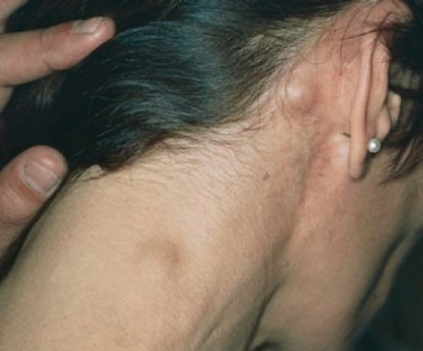
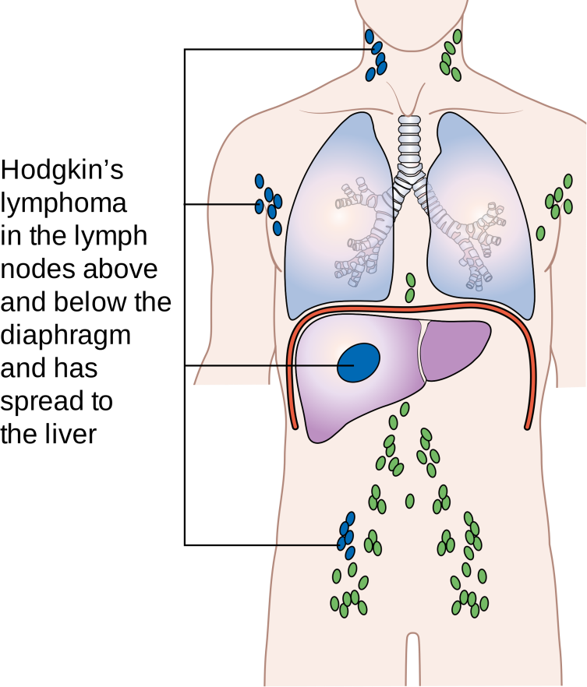
cancer–Hodgkin lymphoma

Slide 10
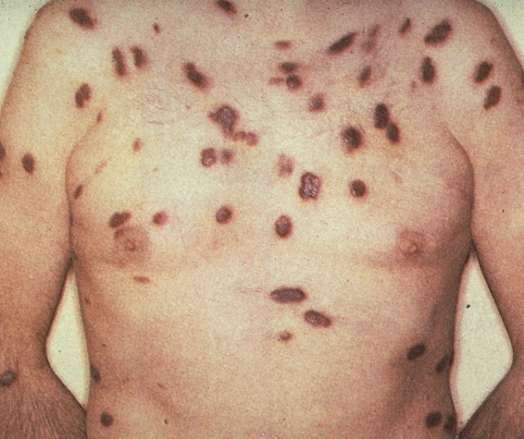
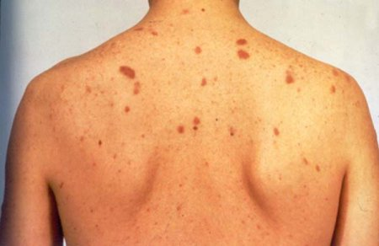
- HHV-7 is closely related to HHV-6 and causes similar diseases.
- Kaposi’s sarcoma-associated virus or HHV-8 is linked with common tumor of AIDS patients; also may be involved in multiple myeloma.

Slide 11
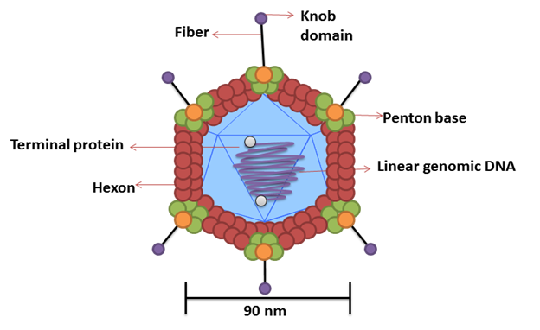
Adenoviruses
1-Medium-sized (70–90 nm)
2- non-enveloped viruses exhibiting cubic symmetry, with 252 capsomeres.
3- Fibers protrude from the vertex capsomeres.
4-The genome is linear, double-stranded DNA, 26–45 kbp in size.
5- Replication occurs in the nucleus.
6- At least 51 types infect humans, especially in mucous membranes, and some types can persist in lymphoid tissue. Some adenoviruses cause acute respiratory diseases, conjunctivitis, and gastroenteritis. Some human adenoviruses can induce tumors in newborn hamsters. There are many serotypes that infect animals.

Slide 12
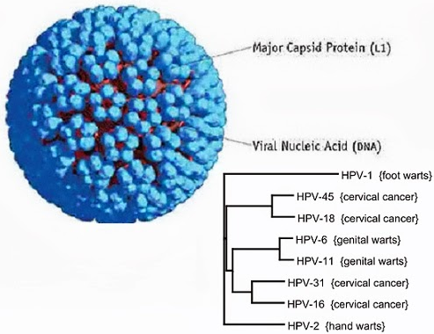
Polyomaviruses
1-Small (45 nm), non-enveloped, heat-stable, ether-resistant viruses exhibiting cubic symmetry, with 72 capsomeres
2-The genome is circular, double-stranded DNA, 5 kbp in size.
3-These agents have a slow growth cycle, stimulate cell DNA synthesis, and replicate within the nucleus.
4-Known human polyomaviruses are JC virus, the causative agent of progressive multifocal leukoencephalopathy, and BK virus, associated with nephropathy in transplant recipients. SV40 also infects humans and has been recovered from human tumors. Most animal species harbor one or more polyomaviruses. They produce chronic infections in their natural hosts, and all can induce tumors in some animal species.
5-Polyomaviruses were formerly a part of the Papovaviridae family before it was split into two families.

