Slide 1
Survey of DNA Viruses

Slide 2
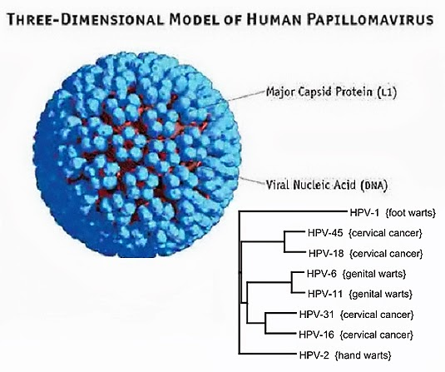
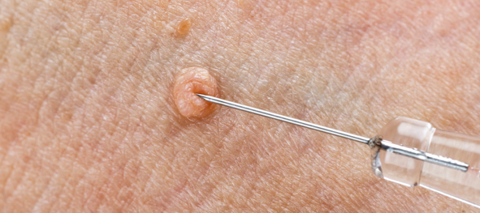
Papillomaviruses
1- Former member of the Papovaviridae family. Similar to polyomaviruses in some respects, but with a larger genome (8 kbp) and particle size (55 nm).
2-There are many genotypes of human papillomaviruses, also known as "wart" viruses; certain types are causative agents of genital cancers in humans.
3-Papillomaviruses are very host and tissue-specific. Many animal species carry papillomaviruses.

Slide 3
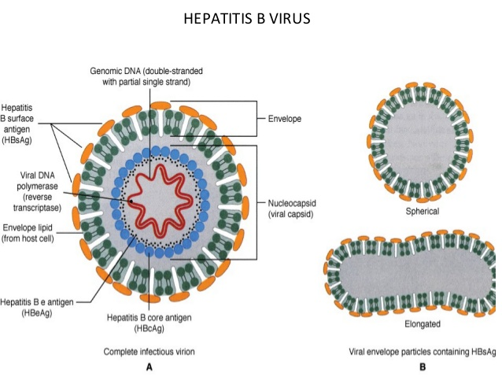
Hepadnaviruses
1- Small (40–48 nm) viruses
2- Circular double-stranded DNA molecules that are 3.2 kbp in size. The viral DNA in the particles contains a large single-stranded gap. The virion carries a DNA polymerase able to make fully double-stranded molecules.
3- Replication involves repair of the single-stranded gap in the DNA, transcription of RNA, and reverse transcription of the RNA to make genomic DNA.
4-The virus consists of a 27-nm icosahedral nucleocapsid core within a closely adherent envelope that contains lipid and the viral surface antigen.

Slide 4
5-The surface protein is characteristically overproduced during replication of the virus, which takes place in the liver, and is shed into the bloodstream.
6-Hepadnaviruses cause acute and chronic hepatitis; persistent infections are associated with a high risk of developing liver cancer. Three viral types are known that infect mammals (humans, woodchucks, and ground squirrels) and another that infects ducks.

Slide 5
Parvoviruses
1- Very small viruses with a particle size of about 18–26 nm.
2- The particles have cubic symmetry, with 32 capsomeres, but they have no envelope.
3-The genome is linear, single-stranded DNA, 5.6 kb in size.
4- Replication occurs only in actively dividing cells; capsid assembly takes place in the nucleus of the infected cell. Many parvoviruses replicate autonomously, but the adeno-associated satellite viruses are defective, requiring the presence of an adenovirus or herpesvirus as "helper." Human parvovirus B19 replicates in immature erythroid cells and causes several adverse consequences, including aplastic crisis, fifth disease (Erythema infectiousm), and fetal death.

Slide 6
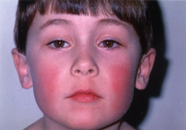
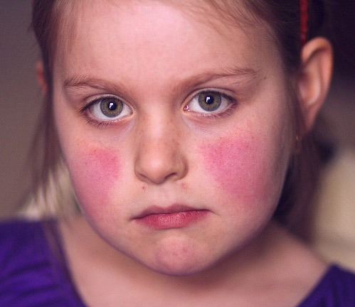
Slapped cheek (fifth disease)

Slide 7
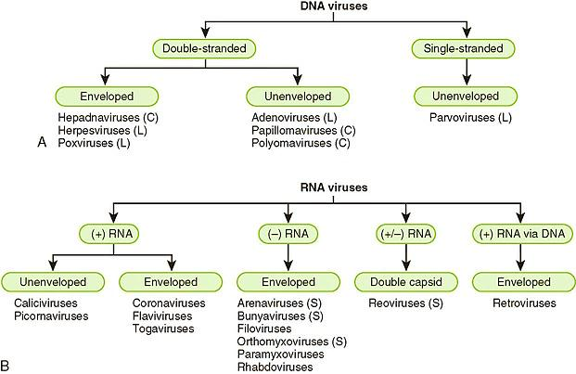

Slide 8
Picornaviruses
1- Small (28–30 nm), cubic symmetry.
2- Genome is single-stranded and positive-sense (act as an mRNA), and is 7.2–8.4 kb in size.
3-The groups infecting humans are enteroviruses (poliovirus, coxsackievirus, and echoviruses and unclassified viruses), rhinoviruses (more than 100 serotypes causing common colds), and hepatovirus (hepatitis A).
4- Rhinoviruses are acid-labile and have a high density; enteroviruses are acid-stable and have a lower density. Picornaviruses infecting animals include foot-and-mouth disease of cattle and encephalomyocarditis of rodents.

Slide 9
Astroviruses
1- Similar in size to picornaviruses (28–30 nm), but particles display a distinctive star-shaped outline on their surface.
2- The genome is linear, positive-sense, single-stranded RNA, 6.4–7.4 kb in size.
3- These agents may be associated with gastroenteritis in humans and animals.
Caliciviruses
1- Similar to picornaviruses but slightly larger (27–40 nm). Particles appear to have cup-shaped depressions on the surface.
2- The genome is single-stranded, positive-sense RNA, 7.4–8.3 kb in size; the virion has no envelope.
3- An important human pathogen is Norwalk virus, the cause of epidemic acute gastroenteritis.

Slide 10
Reoviruses
1-Medium-sized (60–80 nm), non-enveloped viruses having icosahedral symmetry. Particles have two or three protein shells with channels extending from the surface to the core; short spikes extend from the virion surface.
2- The genome is linear, double-stranded, segmented RNA (10–12 segments), totaling 16–27 kbp in size. Individual RNA segments range in size from 680 to 3900 bp.
3- Replication occurs in the cytoplasm; genome segment reassortment occurs readily.
4-Reoviruses of humans include Rotaviruses, which have a distinctive wheel-shaped appearance and cause gastroenteritis. Antigenically similar reoviruses infect many animals. The genus Coltivirus includes Colorado tick fever virus of humans.

Slide 11
Arboviruses
1- An ecologic grouping (not a virus family) of viruses with diverse physical and chemical properties. All of these viruses (there are over 350 of them) have a complex cycle involving arthropods as vectors that transmit the viruses to vertebrate hosts by their bite.
2- Viral replication does not seem to harm the infected arthropod. Arboviruses infect humans, mammals, birds, and snakes and use mosquitoes and ticks as vectors.
3- Human pathogens include dengue, yellow fever, encephalitis viruses, and others.
4- Arboviruses belong to several virus families, including togavirus, flavivirus, bunyavirus, rhabdovirus, arenavirus, and reovirus.

