Slide 1
Web Programming
Convenor: Shakhawan H. Mahmood
MSc in Advanced Computer Science
Computer Science & IT Department
College of Science
Salahaddin University/Erbil
Email: shakhawan.mahmood@su.edu.krd 2021-2022

Slide 2
Timetable
- Sunday: Theory (Hall-3): 10:30-12:30
Tuesday: Practical Lecture (Lab 7) : 08:30 – 14:30
Assessment
Coursework Mark Weight
Theory Exam 15 Marks
Practical (Lab Test + 35 Marks
Assignments and Quizzes):
Total Mark
Coursework : 50%
Final exam : 50%

Slide 3
Syllabus & Coursebook

Slide 4
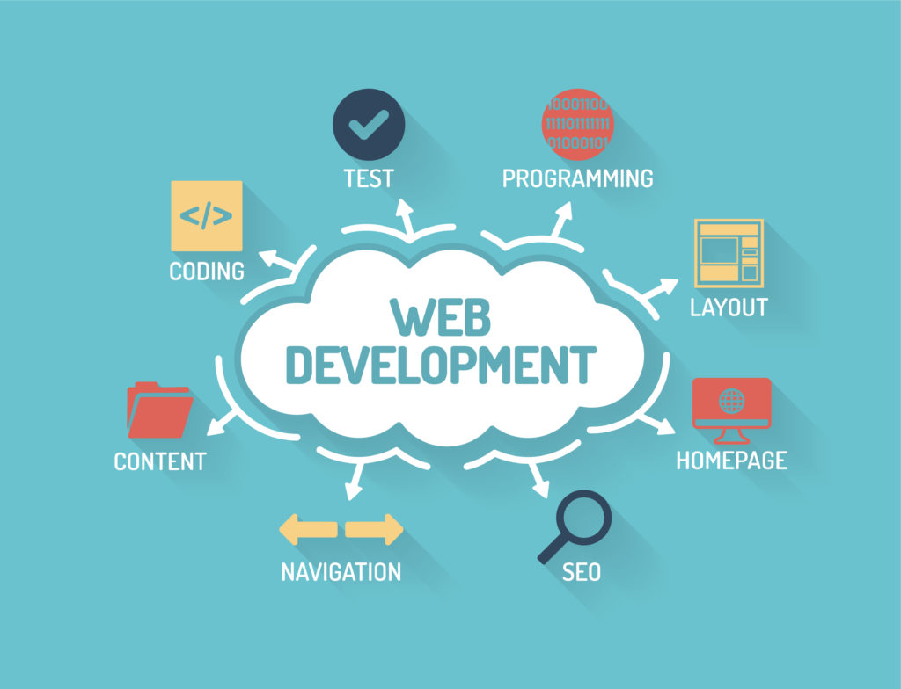
Lecture 1: Introduction to Web Programming

Slide 5
Outline
History of Web Programming
Introduction
What is a Web Page?
What is a Website?
Web Programming Languages
HTML Definition
HTML Editors

Slide 6
History
Leonard Kleinrock,1961 published the first paper on packet switching theory.
Joseph Carl Robnett "Lick" Licklider created the idea of a universal network, spread his vision throughout the IPTO(Information Processing Techniques Office),
Lick inspired his successors to realize his dream by inventing the ARPANET(It was the first wide area packet switching network,), which led to the Internet.
In 1965 Lawrence G. Roberts worked with Thomas Merrill, they connected the TX-2 computer in Massachusetts to the Q-32 in California.
Using low speed dial-up telephone line they created the first (however small) wide-area computer network ever built.
In late 1966 Roberts developed computer network concept and quickly put together his plan for the “ARPANET”, U.S. Advanced Research Projects Agency (ARPA), published in 1967.
Notes:
With packet switching a message that is sent from one computer to another is broken down into small packets of digital data.
TX-2 computer : released in 1958

Slide 7
History
The first host-to-host message was sent from Kleinrock’s
laboratory to Stanford Research Institute (SRI) in 1969.
LAN began to appear in 1970s.
In 1972, electronic mail, was introduced. by March Ray Tomlinson.
The Web was introduced by Sir Timothy John Berners-Lee in 1991. To facilitate exchange of information and data at CERN, “Conseil Europeen pour le Recherche Nucleaire”
Web has become the universal form of communication and commercial.
The Web was originally designed to deliver static Web pages from a Web server connected somewhere on the Internet to a Web browser sitting on a user’s desktop computer. Basically, all a user could do was click on a hotspot or hypertext link to retrieve a new page, read it, and then go on to the next page.
Later, the Internet became the main method in exchanging cultures and transferring knowledge between people.
It has found its way onto devices such as smartphones, tablets, TVs, and more.
Notes:
Hotspot: A hotspot is a physical location where people can access the Internet, typically using Wi-Fi, via a wireless local area network (WLAN) with a router connected to an Internet service provider.

Slide 8
Introduction
The Web was not designed to support EC sites, especially B2C sites.
In its original state, it was not possible to create pages that would allow consumers to easily determine what products were for sale, to select products as they moved from page to page (i.e., an electronic shopping cart), to place an order, or to verify an order. Similarly, there was no simple way to integrate a Web server with a database system containing product, pricing …etc.
First “CERN” web site
http://info.cern.ch/hypertext/WWW/TheProject.html
Notes:
EC → E-Commerce

Slide 9
What is a Web Page
Web page: Is a digital file or a text document that is published on a Web server, has HTML tags in it, almost always includes hypertext links, and usually includes graphics.(Smith, B. E., 2009)
Read by a web browser, parsed and displayed to the user based on the instructions in HTML tags.
Multimedia “images, audio and video or Flash animations could be seen when web page is browsed.
The multimedia files are separate and are included in the web page through HTML tags.

Slide 10
Web Page Structure

Slide 11
What is a Website
Website: A collection of Web pages that share a common theme and purpose, and that users generally access through the site’s home page
A website can be only one web page (the home page).
Home page: The Web page that people generally access first within a Web site. You let people know the URL (address) of your home page and try to get other Web page creators to provide links to it.
For a website to be available on the net it must be stored “hosted” on a host computer (server).
Host computer “Web server” must be connected to internet.

Slide 12
Website Diagram
A site diagram indicates the structure of the site as a whole and how individual pages relate to one another.

Slide 13
Types of Websites
The websites vary tremendously — from an individual putting up family photos to a large corporation creating an online commerce site. For another, several different types of Web sites exist.
The major types of Web pages are personal, picture, topical, commercial, and entertainment sites. Increasingly, you can combine different kinds of sites in mashups.
Example of mashup sites are: MapYourBoddies(google map, facebook and amazon), TwitterVision(twitter and map), Cloud Me(yahoo, flicker and youtube search).

Slide 14
Types of Websites
Websites can be divided into two broad categories:
Static Website
Dynamic (Interactive) Website
A static website is one that has web pages stored on the server in the format that is sent to a client web browser. It is primarily coded in HTML (Hypertext Markup Language) and CSS (Cascading Style Sheets).
A dynamic website is one that changes or customizes itself frequently and automatically. Programming languages used for creating dynamic websites are ASP, JSP, PHP, …etc.

Slide 15
What is HTML
Hyper Text Markup Language.
The Web is defined by two specifications: HyperText Transfer Protocol (HTTP) and Hyper Text Markup Language (HTML).
The underlying idea behind the Web is hypertext — text that can contain links to other pieces of text and other files, such as graphics files, stored anywhere on the Internet.
The Markup indicates the document’s underlying structure.
HTML is a standard language used to design web page documents to be displayed by web browser.
HTML is not a programming language but it’s a markup language.

Slide 16
What is HTML
HTML elements are the building blocks of HTML pages.
HTML can embed programs written in a scripting language such as JavaScript, which affects the behavior and content of web pages. And Inclusion of CSS defines the look and layout of content.
HTML is composed of number of Tags or Elements.
Tags such as <img /> and <input /> directly introduce content into the page.
Other tags such as <p> surround and provide information about document text and may include other tags as sub-elements.
Browsers do not display the HTML tags, but use them to interpret the content of the page.

Slide 17
HTML Editors
A simple text editor is all you need to learn HTML.
Web pages can be created and modified by using professional HTML editors.
Simple text editors are recommended to write HTML codes in.
Text Editors:
Notepad for PC
TextEdit for Mac

Slide 18
Summary
History of Web Programming
Introduction
What is a Web Page?
What is a Website?
Web Programming Languages
HTML Definition
HTML Editors

Slide 19
References
Smith, B. E. 2009. Creating Web Pages For Dummies, 9th ed. Wiley Publishing, Inc., Indianapolis: Indiana.
Deitel, H. M. and Deitel, P. J. 2008, Internet and World Wide Web How to Program, 4th Ed1424 pp, Paperback; Publisher: Prentice Hall; 4th Ed. (Septembar 5, 2007); ISBN-10: 0-131-75242-1; ISBN-13: 978-0131752429.
Refsnes, H. et.al. 2010, Learn HTML and CSS, Wiley Publishing, Inc., Indianapolis, Indiana
Meyer, E., Cascading Style Sheets (CSS): The Definitive Guide, 3rd Ed., O’Reilly, 2006.
Zakas, N. C.2009. Professional JavaScript® for Web Developers, 2nd Edition. Wiley Publishing, Inc., Indianapolis: Indiana
www.w3schools.com
www.tutorialspoint.com

