Slide 1
COMMON MINERAL CLASSES

Slide 2
COMMON MINERAL CLASSES

Slide 3
COMMON MINERAL CLASSES

Slide 4
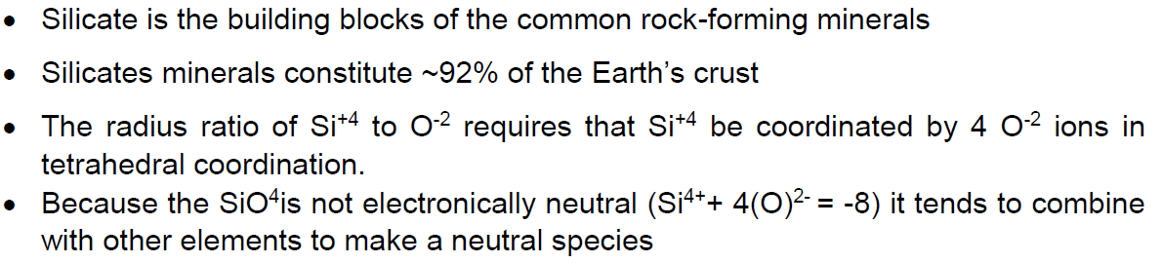
SILICATE MINERALS CLASS

Slide 5
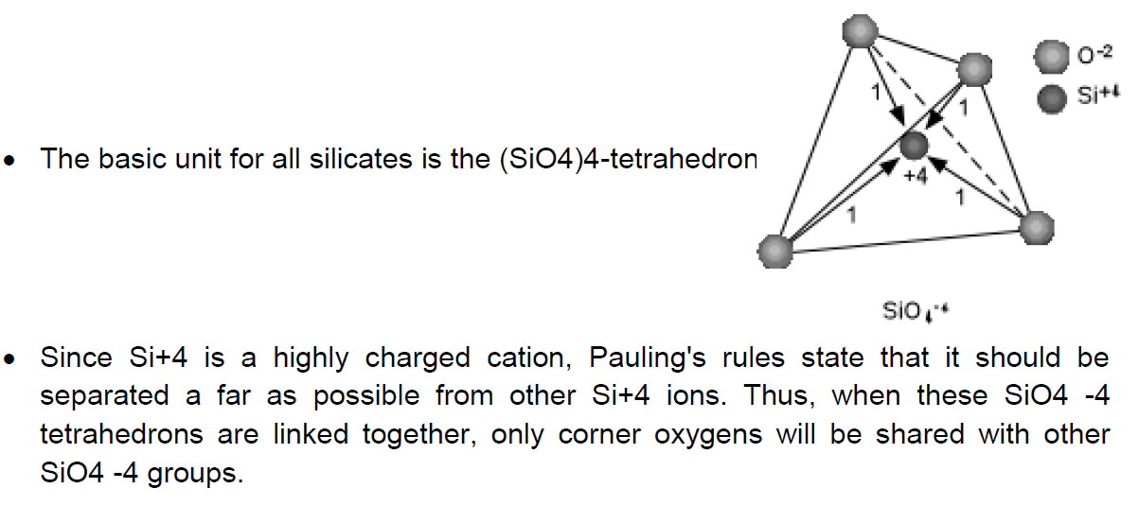
SILICATE MINERALS CLASS

Slide 6
SILICATE MINERALS CLASS

Slide 7
SILICATE MINERALS CLASS

Slide 8
SILICATE MINERALS CLASS

Slide 9
SILICATE MINERALS CLASS

Slide 10
SILICATE MINERALS CLASS

