Slide 1
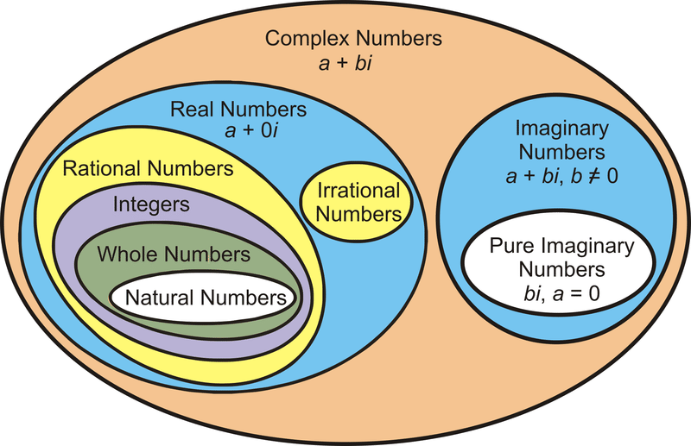
Complex numbers

Slide 2
Complex numbers
Complex number :Is a number that can be expressed in the form a + bi, where a and b are real numbers, and i is a solution of the equation x² = −1. Because no real number satisfies this equation, i is called an imaginary number. For the complex number a + bi, a is called the real part, and b is called the imaginary part
Complex numbers : Is an order pair written as
$z=\left(x,y\right)$ ; where $x,y∈ℝ$
or $z=x+iy ;x,y∈ℝ ;i=\sqrt{−1}$
The real numbers $x$ and $y$ are, moreover, known as the real and imaginary parts of z, respectively; and we write$x = Rez,y = Imz$
Complex set :$ℂ=\left\{z:z=x+iy:x,y ∈ℝ\right\}$

Slide 3
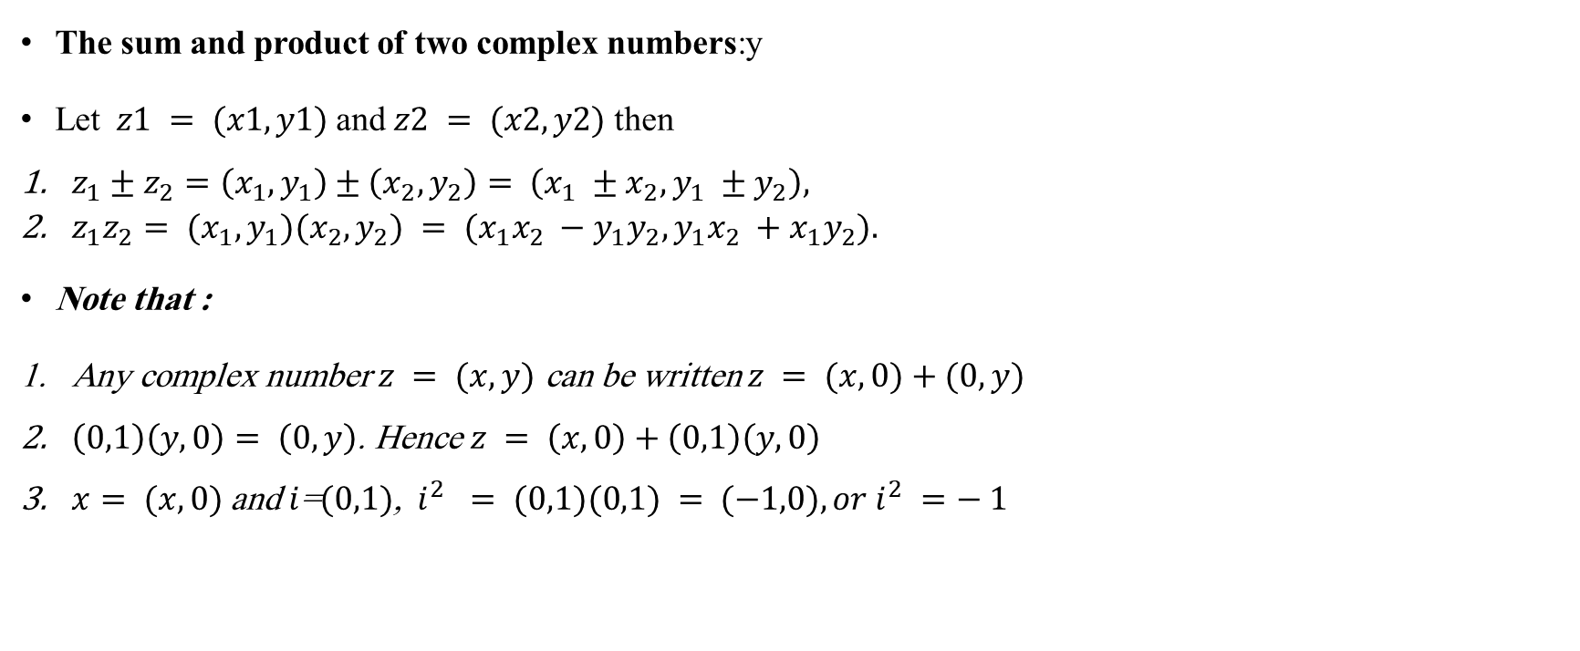
The sum and product of two complex numbers:y
Let $z1 = (x1,y1)$and$z2 = (x2,y2)$ then
$z_{1}±z_{2}=\left(x_{1},y_{1}\right)±\left(x_{2},y_{2}\right)= \left(x_{1} ±x_{2},y_{1} ±y_{2}\right),$
$z_{1}z_{2}= (x_{1},y_{1})(x_{2},y_{2}) = (x_{1}x_{2} −y_{1}y_{2},y_{1}x_{2} +x_{1}y_{2}).$
Note that :
Any complex number $z = (x,y)$ can be written $z = (x,0)+(0,y)$
$\left(0,1\right)\left(y,0\right)= \left(0,y\right)$. Hence $z = \left(x,0\right)+\left(0,1\right)\left(y,0\right)$
$x= (x,0)$and $i$=$(0,1)$, $i^{2} = (0,1)(0,1) = (−1,0), or i^{2} =− 1$

Slide 4
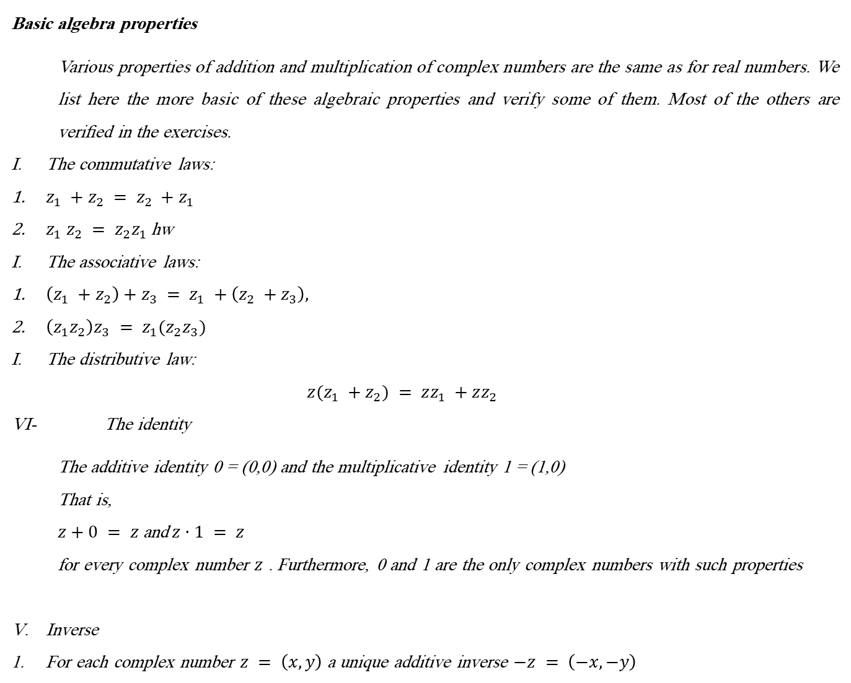
Basic algebra properties
Various properties of addition and multiplication of complex numbers are the same as for real numbers. We list here the more basic of these algebraic properties and verify some of them. Most of the others are veriﬁed in the exercises.
The commutative laws:
$z_{1} +z_{2} = z_{2} +z_{1}$
$z_{1} z_{2} = z_{2}z_{1}$ hw
The associative laws:
$\left(z_{1} +z_{2}\right)+z_{3} = z_{1} +\left(z_{2} +z_{3}\right),$
$\left(z_{1}z_{2}\right)z_{3} = z_{1}(z_{2}z_{3})$
The distributive law:
$$z(z_{1} +z_{2}) = zz_{1} +zz_{2}$$
VI- The identity
The additive identity 0 = (0,0) and the multiplicative identity 1 = (1,0)
That is,
$z+0 = z$ and$z·1 = z$
for every complex number $z$ . Furthermore, 0 and 1 are the only complex numbers with such properties
Inverse
For each complex number $z = \left(x,y\right)$ a unique additive inverse $−z = \left(−x,−y\right)$

Slide 5
Example : write the following as complex number
$\frac{1}{2−3i}\frac{1}{1+i}$ Ans:$\frac{5}{26}+\frac{1}{26}i$
$\frac{4+i}{2−3i}$

