Slide 1
The honey Bee products :
A - The Royal Jelly:
Produced in hypophryngeal glands of worker honey bees are used:
1 - To treat skin diseases (dermatitis).
2 - To control microscopic pathogens.
3 - Strengthening the sex to contain the Sex hormones.
4 - Treat disorder digestion, fatigue, wasting and exhaustion.
5 – Treated the Inflammation (infection)of the stomach , intestines and
stimulate the metabolism.
6 – Treated the nervous breakdown (collapse), diseases of aging (geriatrics)and
inflammation of Prostate gland (prostatitis).

Slide 2
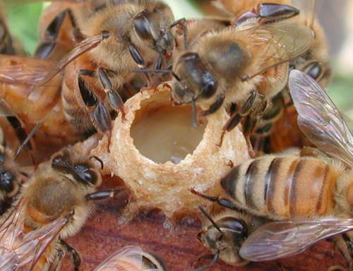

Slide 3
7- To stimulate the adrenal gland , treated the leukemia and inhibition of the tumor
cells (in rabbits and mice).
8 - Increase the fertility of insects and sexual maturity.
9- Increase appetite in humans.
10 - Regulating blood pressure and cholesterol, treated arteritis.
11- It is a good diet for the silk worm larvae to increase the weight of larvae and
pupae.
12 - Act as antibiotic for bacteria Staphylococcus aureus that causes blisters and acne
of skin (used mixed with the Cream).

Slide 4
The Honey:
1 - Honey acidity PH (3.2-4.5), is acidic , but it does worked as abase .
2 - Honey contains fructose 38%.
3 - Honey works as Antibiotic result of the interaction Glucose Oxidase with Glucose producing (Hydrogen Peroxide), which is spreading in the honey.
4 - Honey quick absorption , easy digestion and compensates for the lost sugar (glucose) from the body , does not occur fainting Hypoglycemia in people with diabetes.
5 - Treated the cases of obstruction in the metabolism , absorption of starch and sugars in the intestine in children as recommended by the American pediatrician, Dr. Paulluttinger 1922.
6 - To treat bronchitis, pneumonia.
7 -To treat summer diarrhea by a teaspoon of honey +8 part of the Barley water.

Slide 5
8 - Compensates of Fe redusing and treatment of appetite and increases the non voluntary contractions of the intestine to push contents forward as soothing effect, which reduces disturbance.
9 - To treat anemia (Paula Emerich 1922) and curing constipation and diarrhea.
10 - To treat rickets, intestinal infections, malnutrition, and for premature children also compensate Ca and nullifies the influence of alcohol in the blood.
11 - Avitable & Sammataro (1918) they warn the cleanness and safety honey and never be fed to children under two years, because of the botulism poisoning bacteria spores caused by bacteria Clostridium botulinus because infants at this age there is no sufficient acid in the stomach to remove the effect of the poison (Flottum 1988 and Huhtanen 1981).
12 - the sweetness of pure honey or unadulterated honey is 130 times sweeter than the cane sugar.

Slide 6
Bee venom:
1 - Causes relaxation of blood vessels and lower blood pressure(hypotention).
2 - Inhibits some of the activities associated with the cell membrane Acetyl cholin Esterase.
3 - Control some types of Bacteria and fungi.
4 - To treat the vertibral infections (sciatica).
5 - To treat rheumatic fever.
6 - To treat skin diseases(dermatitis) and Optic diseases, including inflammation of the iris of the eye.

Slide 7
7 - Destroys red blood cells hemolysis get out their contents and causing flow out of some enzymes from white blood cells.
8 - Affects on some body tissues, causing the secretion of some components of histamine .
9 – To treat enlargment of thyroid gland and attenance of eyes then treated the hypotention.
10- To treat the Rhumatic Arthritis.

Slide 8
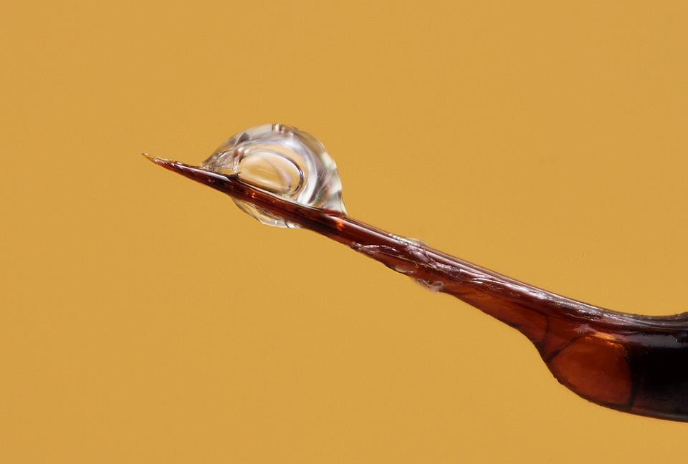

Slide 9
The Bees Wax
The Bees Wax Consists of Asters, wax , fatty acid and alcohol with a long hydrocarbon chain , high molecular weights ,it used in different states.
1 -Preparing Cosmotics for women who have allergy to chemical substances.
2 - To produce the printing , Roneo ink and dyes.
3 - Used in the industries of petrochemical, plastic.
4 - Making candles.
5 – The bee wax used in tree grafting proces ,document sealing and ground arnic .
6- Production of cold-Krim, eye shadow, lipstick, hair removal cream and moisturizer cream.

Slide 10
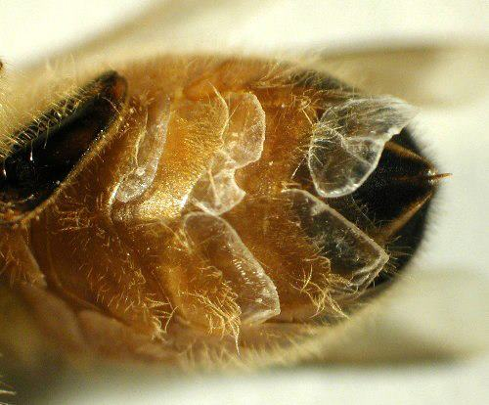

Slide 11
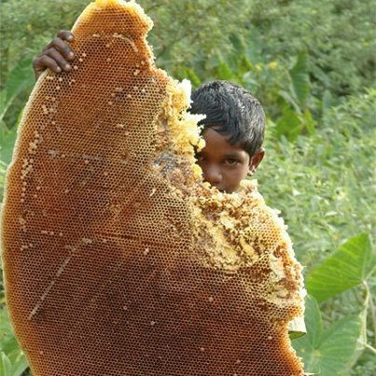

Slide 12
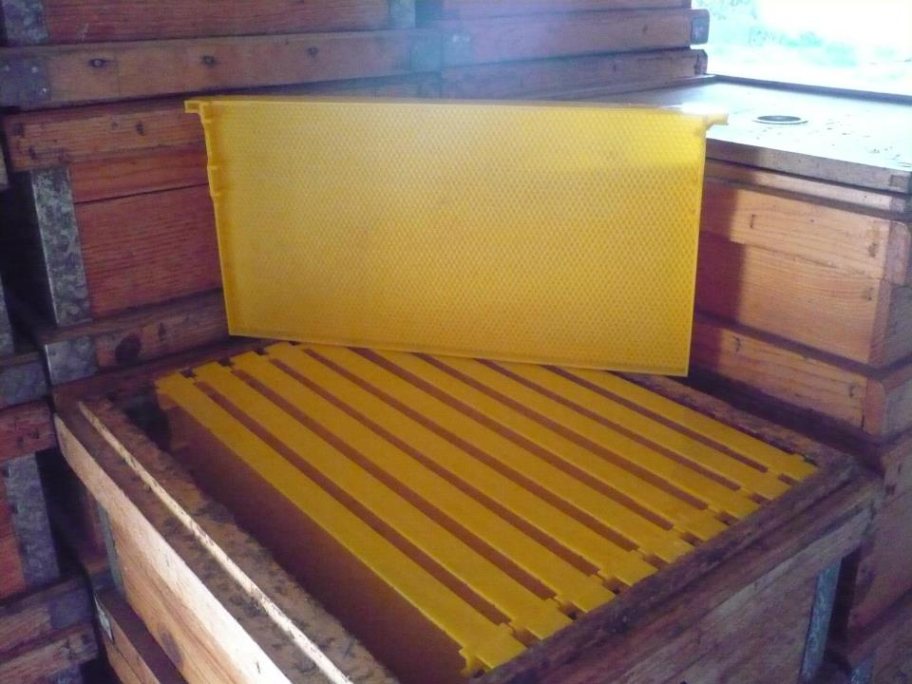

Slide 14
Propolis
A mixture of various amounts of beeswax with glue or resin material collected from plants, especially from flowers and leaves buds.
1 – It is work as Antibacterial, antifungal and anti viruses.
2 – As a treatment of jaundice ( hepatitic viral infection) as anti viruse and the induced body cells to produce interferon.
3 - To treat Colitis(inflammation of the intestines) caused by poisoning.
4 - Treated the Ulcers and intestinal infections.
5- Inhibited tumor cells.

Slide 15
6 - Increased the natural and mental activities.
7 - Anti-fever , anti-inflammatory and Prostatitis (prostatic inflammation).
8 -Treated influenza , the chest sensitivity and Para nasal sinuses.
9 - Strengthens the natural resistance against infection , alert the immune system and soothed(reducing) sensitivity.
10 -Useful to diabetes, bone fractures and atherosclerosis and Hyper lipidemia hypercholesterolemia .

Slide 16
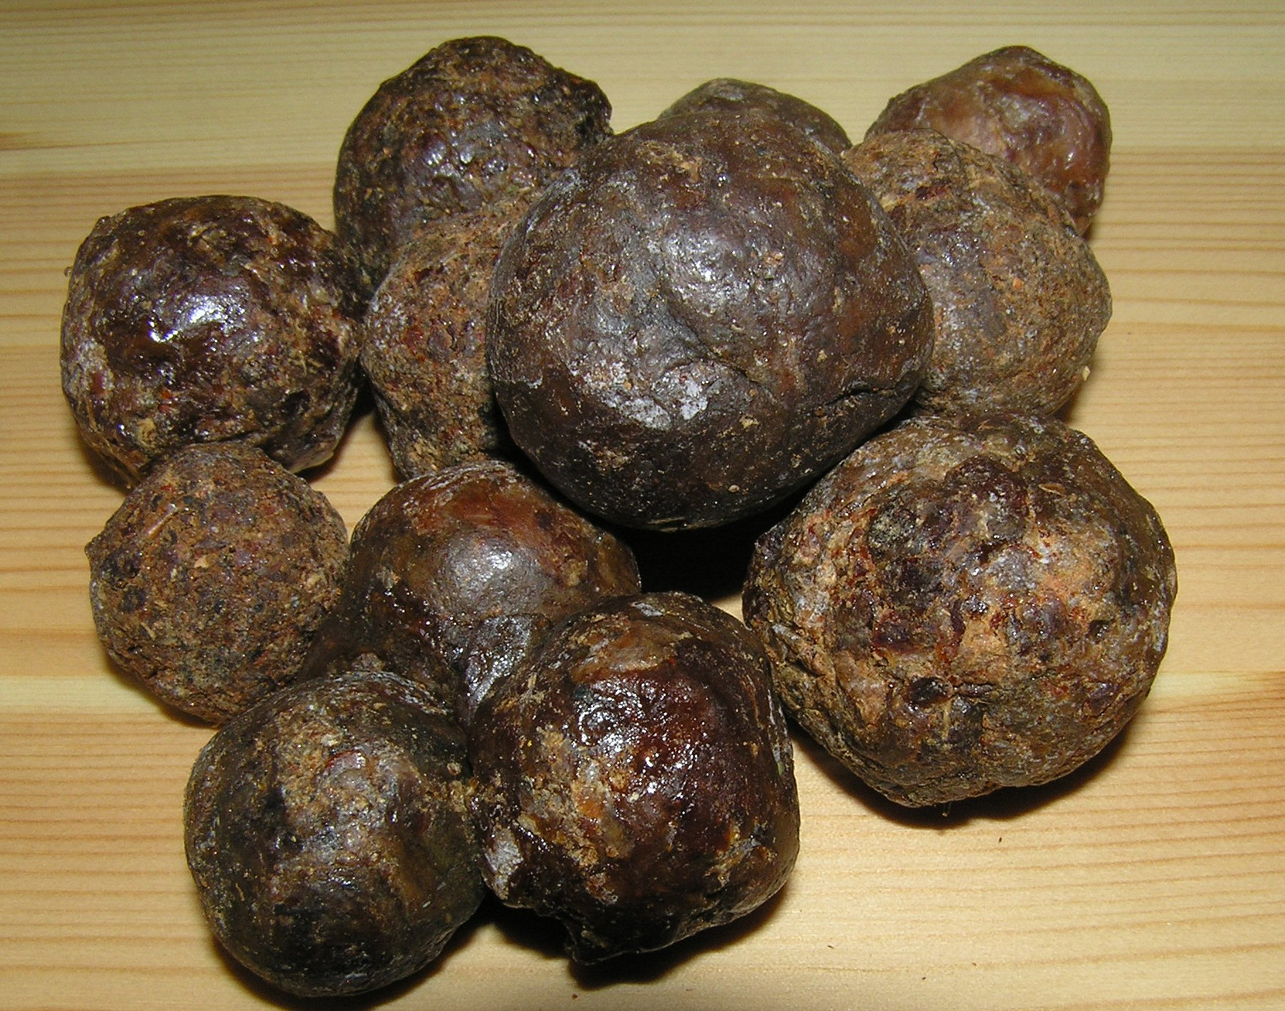

Slide 17
