Slide 1
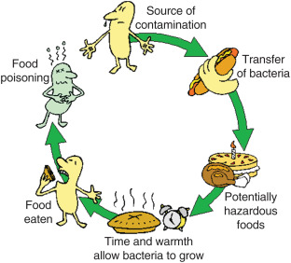
Food Microbiology
Is the study of the role that microorganisms play in food spoilage, food poisoning, food production, food preservation and food borne diseases.

Slide 2
Groups of microorganisms and their association with food. Bacteria
Food spoilage
Food borne diseases
Food Fermentations
Production of food additives and enzymes

Slide 3
Moulds
Food Spoilage
Food borne diseases
Food fermentations
Production of enzymes
Production of single cell protein

Slide 4
Yeasts Viruses
Food spoilage
Food fermentations
Production of food additives and enzymes
Food borne disease
Failure of dairy fermentations
Identification of food poisoning bacteria

Slide 6
Food fermentations
Laboratory management
Food hygiene
Water Quality
Topics of major interest to the food microbiologist
Food preservations
Food spoilage
Quality Control
Food borne Diseases

Slide 7
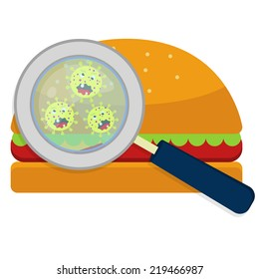
Food and Microorganisms
The interactions between microorganisms, plants, and animals are natural and constant. The ecological role of microorganisms and their importance in all the geochemical cycles in nature is well documented.
Since the human food supply consists basically of plants and animals or products derived from them, it is understandable that our food supply can contain microorganisms in interaction with the food.

Slide 8
In most cases microorganisms use our food supply as a source of nutrients for their own growth. This, of course, can result in deterioration of the food. By increasing their numbers, utilizing nutrients, producing enzymatic changes, and contributing off-flavors by means of breakdown of a product or synthesis of new compounds they can “spoil” a food. . To prevent this we minimize the contact between microorganisms and our foods (prevent contamination) and also eliminate microorganisms from our foods, or at least adjust conditions of storage to prevent their growth (preservation).

Slide 9
When the microorganisms involved are pathogenic, their association with our food supply is critical from a public health point of view. Many of our foods will support the growth of pathogenic microorganisms or at least serve as a vector of them. Here again, we attempt to prevent their entrance and growth in our foods or eliminate them by processing.

Slide 10
Interactions between microorganisms and our foods are sometimes beneficial, as exemplified by the many cultured products consumed and enjoyed. What are the governing factors in these interactions? Why is this interaction beneficial at some times and not at others? Why do some foods support the growth of microorganisms more readily than other? Why are some foods very stable in regard to microbial deterioration? Food is the substrate, and so the characteristics of a food are an important consideration. The type of microorganisms present and the environmental conditions also are important. However, the food or substrate dictates what can or cannot grow. By understanding the characteristics of the food or substrate one can make predictions about the microbial flora that may develop.

Slide 11
Groups of Bacteria Important in Food Bacteriology
Bacteria important in foods often are grouped on the basis of one common characteristic without regard for their systematic classification. It is obvious that some bacterial species might be included in two or more of these artificial groups.
Lactic Acid-Forming Bacteria
The most important characteristic of the lactic acid bacteria is their ability to ferment sugars to lactic acid. This may be desirable in making products such as sauerkraut and cheese but undesirable in terms of spoilage of wines.
The major genera include Leuconostoc, Lactobacillus, Streptococcus, and Pediococcus .
Acetic Acid-Forming Bacteria
Most of acetic acid bacteria now belong to one of two genera, Acetobacter and Gluconobacter. Both oxidize ethyl alcohol to acetic acid, but Acetobacter is capable of oxidizing acetic acid further to carbon dioxide.
e.g., Acetobacter aceti subsp, suboxydans

Slide 12
Butyric Acid-Forming Bacteria- Clostridium
Propionic Acid-Forming Bacteria-Propionibacterium
Proteolytic Bacteria- Clostridium sporogenes
Lipolytic Bacteria -Serratia & Micrococcus
Saccharolytic Bacteria – Clostridium butyricum
Thermophilic Bacteria - Bacillus stearothermophilus
Thermoduric Bacteria -Lactobacillus
Psychrotrophic Bacteria- Flavobacterium & Achromobacter
Halophilic Bacteria – Pediococcus & Alcaligenes
Slime- or Rope-Forming bacteria-Klebsiella oxytoca
Coliform and Fecal coliform group - Escherichia coli
Gas-Forming Bacteria- Proteus

Slide 13
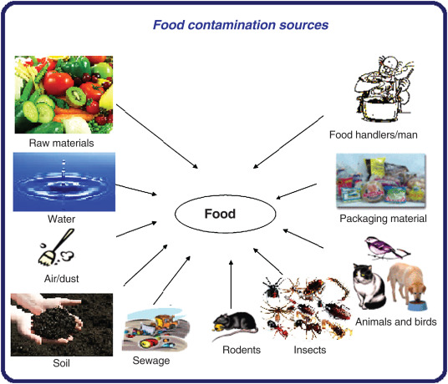

Slide 14
Contamination of Foods
Growing plants carry a typical flora of microorganisms on their surfaces and may become contaminated from outside sources. Animals likewise have a typical surface flora plus an intestinal one, give off organisms in excretions and secretions, and also become contaminated from outside sources. Plants and animals with parasitic disease, of course, carry the pathogen causing the disease. The inner, healthy tissues of plants and animals, however, have been reported to contain few living microorganisms or none.

Slide 15
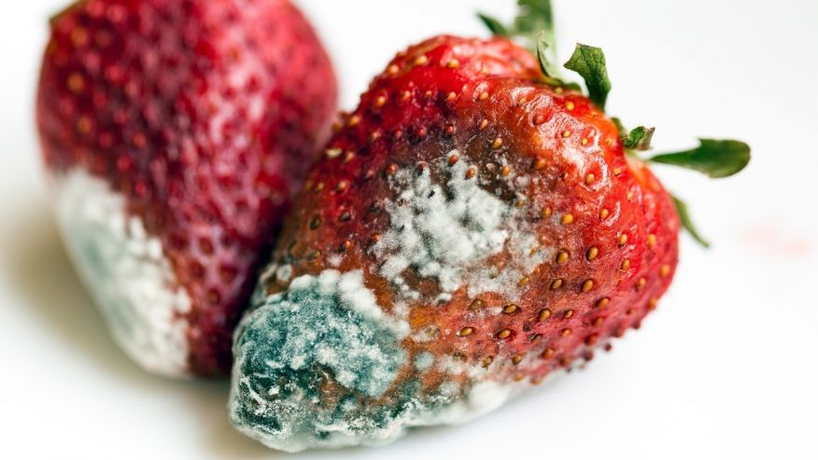
Main sources of food Contamination
Green plants and fruits
The natural surface flora of plants varies with the plant but usually includes species of Pseudomonas, Alcaligenes, Flavobacterium, and Micrococcus and coliforms and lactic acid bacteria. Lactic acid bacteria include Lactobacillus brevis and plantarum, Leuconostoc mesenteroides and dextranicum, and Streptococcus faecium and faecalis. Bacillus species, yeasts, and molds also may be present. The numbers of bacteria will depend on the plant and its environment and may range from a few hundred or thousand per square centimeter of surface to millions. The surface of a well-washed tomato, for example, may show 400 to 700 microorganisms per square centimeter, while an unwashed tomato would have several thousand.
Corynebacterium, and yeasts have been found inside undamaged fruits. Organisms also have been found in health root and tuber vegetables.

Slide 16
2, Animals
Sources of microorganisms from animals include the surface flora, the flora of the respiratory tract, and the flora of the gastrointestinal tract. The natural surface flora of meat animals usually is not as important as the contaminating microorganisms from their intestinal or respiratory tracts. However, hides, hooves, and hair contain not only large numbers of microorganisms from soil, manure, feed, and water but also important kinds of spoilage organisms. Feathers and feet of poultry carry heavy contamination from similar sources. The skin of many meat animals may contain micrococci, staphylococci and beta-hemolytic streptococci. Staphylococci on the skin or from the respiratory tract may find their way onto the carcass and then to the final raw product. The feces and fecal-contaminated products of animals can contain many enteric organisms, including Salmonella. Salmonellosis in animals can result in contamination animal products or by-products and thus contaminate foods derived from them with Salmonella.

Slide 17
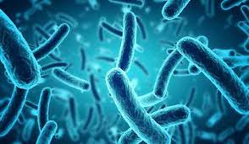
3. Sewage
When untreated domestic sewage is used to fertilize plant crops, there is likelihood that raw plant foods will be contaminated with human pathogens, especially those causing gastrointestinal diseases. The use of “night soil” as a fertilizer still persists in some parts of the world but is rare in the United States. In addition to the pathogens, coliform bacteria, anaerobes, enterococci, other intestinal bacteria, and viruses can contaminate the foods from this source. Natural waters contaminated with sewage contribute their microorganisms to shellfish, fish, and other seafood. Treated sewage going onto soil or into water also contributes microorganisms, although it should contain smaller numbers and fewer pathogens than does raw sewage.

Slide 18
4. Soil The soil contains the greatest variety of microorganisms of any source of contamination. Whenever microbiologists search for new kinds of microorganisms or new strains for special purposes, they usually turn first to the soil. Not only numerous kinds of microorganisms but also large total numbers are present in fertile soils, ready to contaminate the surfaces of plants growing on or in them and the surfaces of animals roaming over the land. Soil dust is whipped up by air currents, and soil particles are carried by running water to get into or onto foods. The soil is an important source of heat-resistant spore-forming bacteria. No attempt will be made to list the microorganisms important in food microbiology that could come from the soil, but it can be stated with certainty that nearly every important microorganism can come from soil. Especially important are various molds and yeasts and species of the bacterial genera Bacillus, Clostridium, Enterobacter, Escherichia, Micrococcus, Alcaligenes, Flavobacterium, Chromobacterium, Pseudomonas, Proteus, Streptococcus, Leuconostoc, and Acetobacter as well as some of the higher bacteria such as the actinomycetes and the iron bacteria.

Slide 19
5. Water Natural waters contain not only their natural flora but also microorganisms from soil and possibly from animals or sewage. Surface waters in streams or pools and stored waters in lakes and large ponds vary considerably in their microbial content, from many thousands per milliliter after a rainstorm to the comparatively low numbers that result from self-purification of quiet lakes and ponds or of running water. Ground waters from springs or wells have passed through layers of rock and soil to a definite level; hence most of the bacteria, as well as the greater part of other suspended material, have been removed. Bacterial numbers in these waters may range from a few to several hundred bacteria per milliliter.

Slide 20
6. Air Contamination of foods from the air may be important for sanitary as well as economic reasons. Disease organisms, especially those causing respiratory infections, may be spread among employees by air, or the food product may become contaminated. Total numbers of microorganisms in a food may be increased from the air, especially if the air is being used for aeration of the product, as in growing bread yeast, although the numbers of organisms introduced by sedimentation from air usually are negligible. Spoilage organisms may come from air, as may those interfering with food fermentations. Mold spores from air may give trouble in cheese, meat, sweetened condensed milk, and sliced bread and bacon.

Slide 21
7. During handling and processing The contamination of foods from the natural sources just discussed may take place before the food is harvested or gathered or during handling and processing of the food. Additional contamination may come from equipment coming in contact with foods, from packaging materials, and from personnel. The processor attempts to clean and “sanitize” equipment to reduce such contamination and to employ packaging materials that will minimize contamination. The term “sanitize” is used here rather than “sterilize” because although an attempt is made to sterilize the equipment, i.e., free it of all living organisms, sterility is seldom attained.

