Slide 1
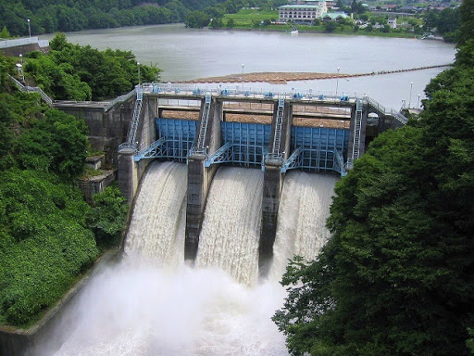
Engineering Hydraulics

Slide 2
B.Sc. 1992 Irrigation and Drainage Eng. Mosul University
M.Sc. 2001 Irrigation and Drainage Eng. Baghdad University (Hydraulics)
PhD 2013 Civil Engineering Plymouth University UK (Dam Engineering)
Dr. Abdulla Botany abdulla.abo@su.edu.krd
Area of interest:
Dam Engineering, Ground water

Slide 3
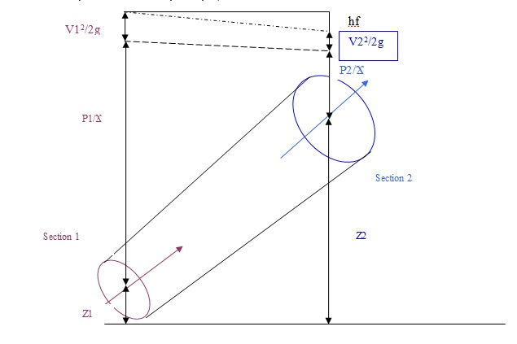
Introduction
Conservation of mass:
Every fluid flow must satisfy the equation of conservation of mass or, as it is commonly termed, the equation of continuity.
A1 * V1 * ρ1 = A2 * V2 * ρ2
For incompressible fluid ρ1 = ρ2, then: A1 V1 = A2 V2 = Q

Slide 4
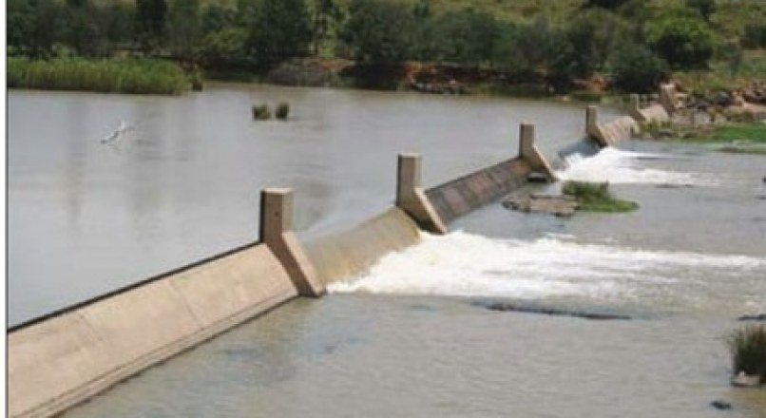
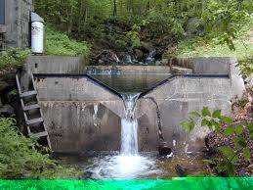
c- Flow over Weirs

Slide 5
Open channel
Is a conduit for flow, which has a free surface, i.e; a boundary exposed to the atmosphere. The free surface is essentially interference between two fluids of different densities. Gravitational effects usually cause the flow motion. The pressure distribution within the fluid is generally hydrostatic. Open channel flows are almost turbulent. The study of open channels is important for:

Slide 6
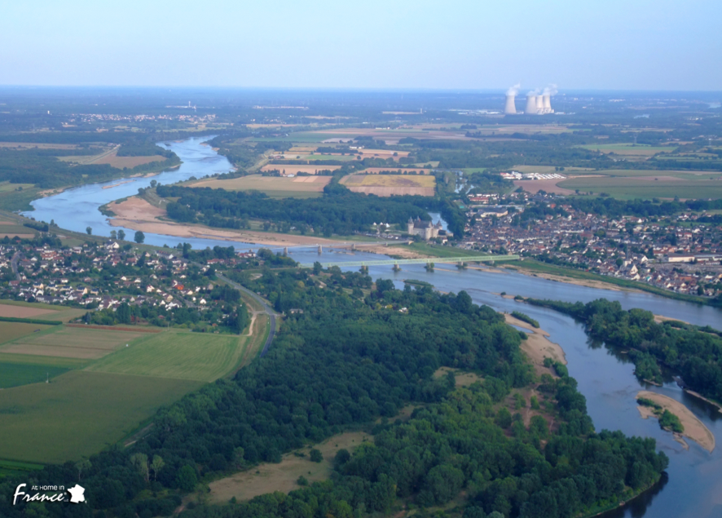
Studying the flow in rivers and streams

Slide 7
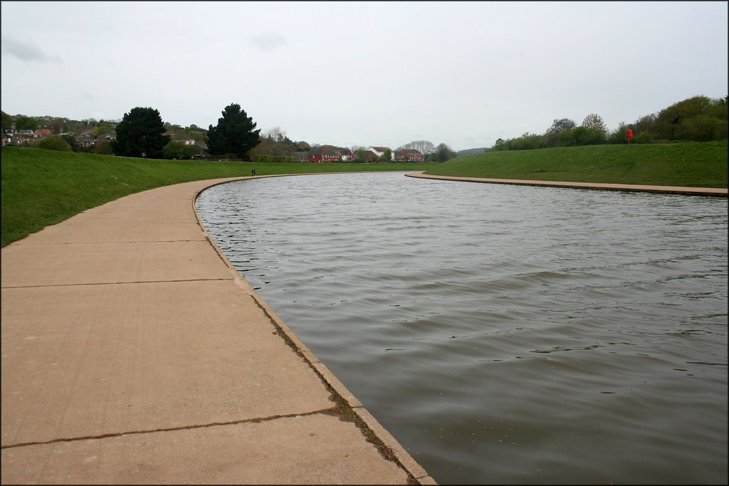
Studying the flow in artificial canals

Slide 8
Uniform
GVF
Steady
RVF
SVF
Open channel flow
GVF
Unsteady
RVF

Slide 9
Types of open channel:
Natural channels:
Natural channels can be very different. They are neither regular nor prismatic and their materials of construction can vary widely (although they are mainly of earth this can possess many different properties.) The surface roughness will often change with time distance and even elevation. Consequently it becomes more difficult to accurately analyze and obtain satisfactory results for natural channels than is does for man made ones. The situation may be further complicated if the boundary is not fixed i.e. erosion and deposition of sediments.

Slide 10
Artificial canals
These are channels made by man. They include irrigation canals, navigation canals, spillways, sewers, culverts and drainage ditches. They are usually constructed in a regular cross-section shape throughout – and are thus prismatic channels (they do not widen or get narrower along the channel). In the field, they are commonly constructed of concrete, steel or earth and have the surface roughness reasonably well defined (although this may change with age – particularly grass lined channels.) Analysis of flow in such well-defined channels will give reasonably accurate results

