Slide 1
A Brief Overview about
Electricity and Magnetism Lab. (2nd Course)
What is the difference between DC and AC current?
The difference between AC and DC lies in the direction in which the electrons flow. In DC circuits, electricity flows
in one direction. In AC circuits, the electricity switches directions, sometimes going forward and sometimes going
backward. It describes the flow of charge that changes direction periodically. As a result, the voltage level also
reverses along with the current.
Power factor of AC circuit lies between 0 & 1.
Power factor of DC is always 1.
Sinusoidal, Trapezoidal, Triangular, Square are the types of AC circuit.
Pure and pulsating are the types of DC Circuit.

Slide 2
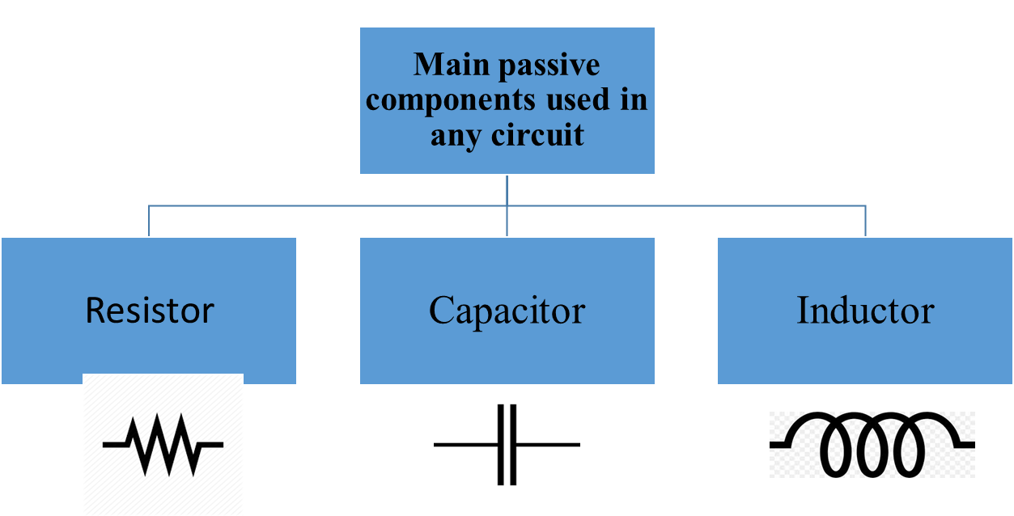
Passive Components in AC Circuits
Passive components are those circuit devices which can only reduce the electrical power applied to them and not increase it.
The three main passive components used in any circuit are the:
The opposition to current flow through a passive component in an AC circuit is called: resistance, R for a resistor, capacitive reactance, XC for a capacitor and inductive reactance, XL for an inductor. The combination of resistance and reactance is called Impedance.

Slide 3
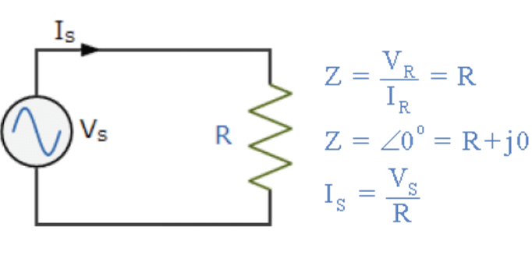
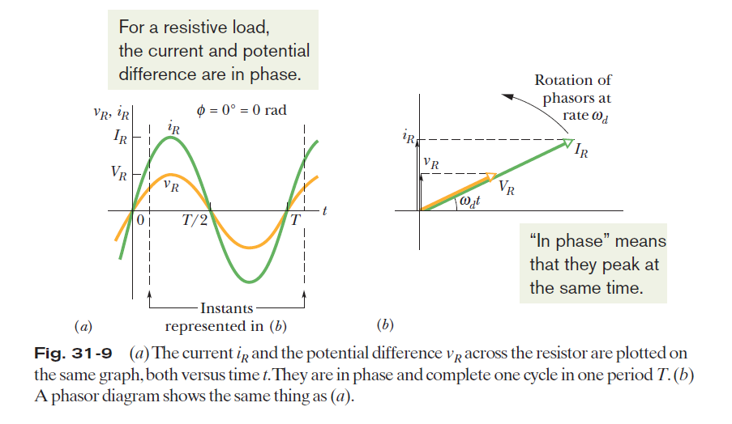
Three Simple Circuits
Purely Resistive Circuit (A Resistive Load)
Resistor – Resistors regulate, impede or set the flow of current through a particular path or impose a voltage reduction in an electrical circuit as a result of this current flow.
For a purely resistive load the phase constant φ = 0°
# We are concerned with the potential drop (voltage) along the current flow, and the phase lag of the current w.r.t. the voltage.

Slide 4

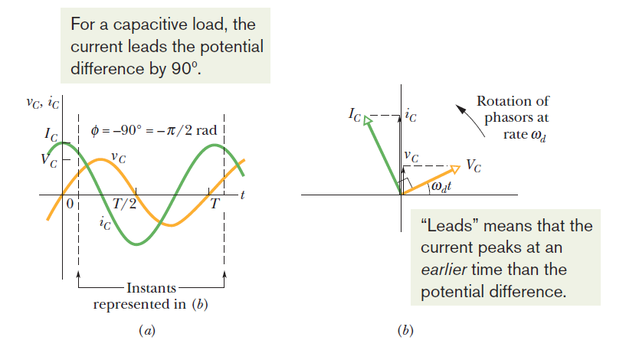

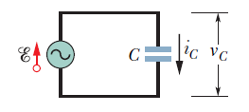



Purely Capacitive Circuit (A Capacitive Load)
Capacitor – The capacitor is a component which has the ability or “capacity”
to store energy in the form of an electrical charge like a small battery.
The capacitance value of a capacitor is measured in Farads,
F. At DC a capacitor has infinite (open-circuit) impedance, ( X_{C} ) while at
very high frequencies a capacitor has zero impedance (short-circuit).
X_{C} is called the capacitive reactance of a capacitor. The SI unit of X_{C} is the ohm, just as for resistance R.

Slide 5







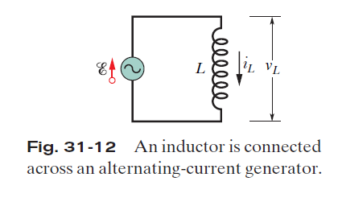

Purely Inductive Circuit (An Inductive Load)
Inductor – An inductor is a coil of wire that induces a magnetic field within itself or within a central core as a direct result of current passing through the coil. The inductance value of an inductor is measured in Henries, H. At DC an inductor has zero impedance (short-circuit), while at high frequencies an inductor has infinite (open-circuit) impedance, ( XL ).
The X_{L} is called the inductive reactance of an inductor.
The SI unit of X_{L} is the ohm.

Slide 6
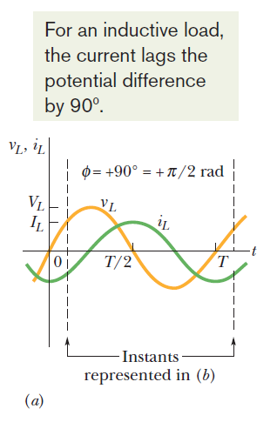
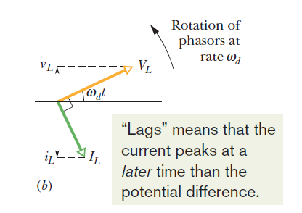

Slide 7
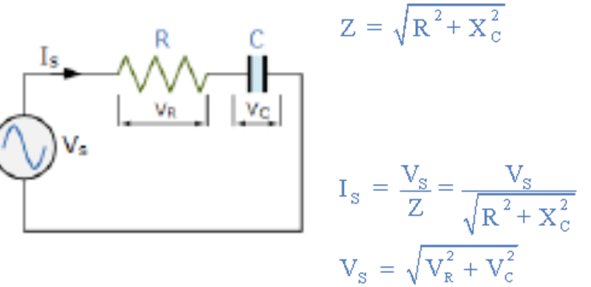
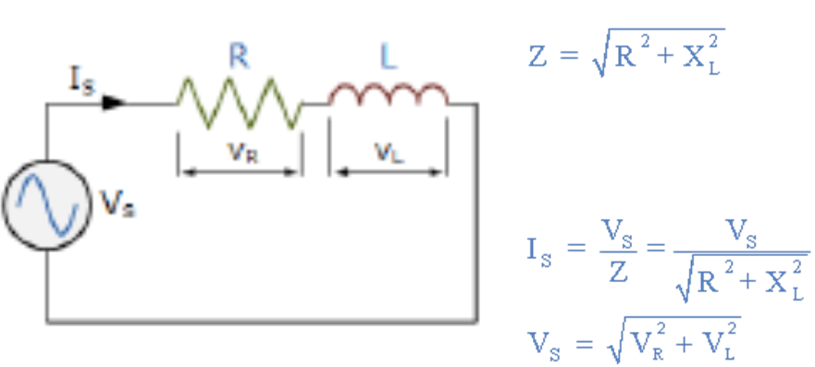
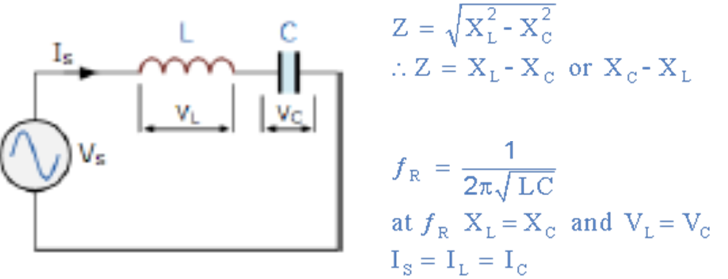
Series AC Circuits
Passive components in AC circuits can be connected together in series combinations to form RC, RL and LC circuits as shown.
Series RC Circuit
Series RL Circuit
Series LC Circuit

Slide 8
Parallel AC Circuits
Passive components in AC circuits can be connected together in Parallel combinations to form RC, RL and LC circuits as shown.
Parallel RC Circuit
Parallel RL Circuit
Parallel LC Circuit

Slide 9
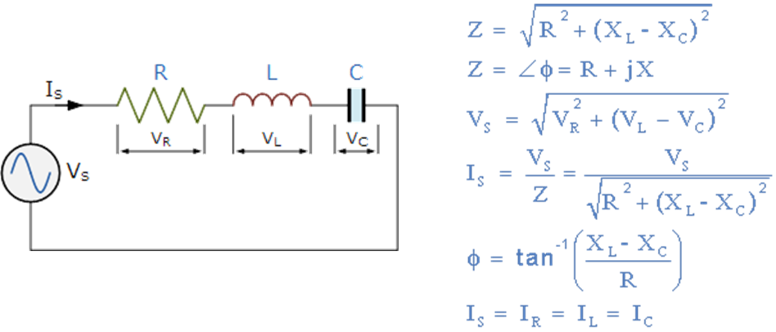
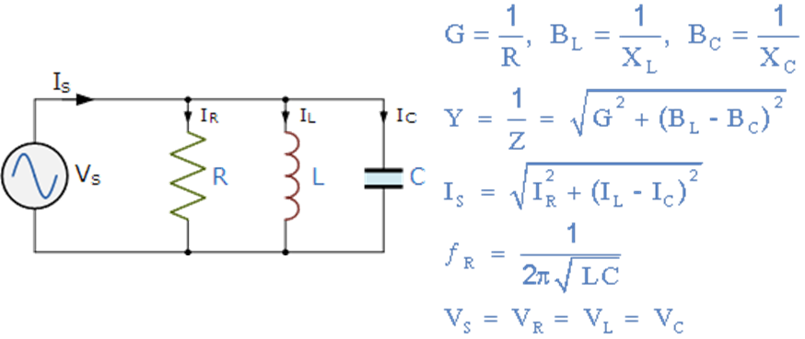
RLC Circuits
All three passive components in AC circuits can also be connected together in both series RLC and parallel RLC combinations as shown below.
Series RLC Circuit
Parallel RLC Circuit
Admittance ( Y )
Conductance ( G )
Susceptance ( B )

Slide 10
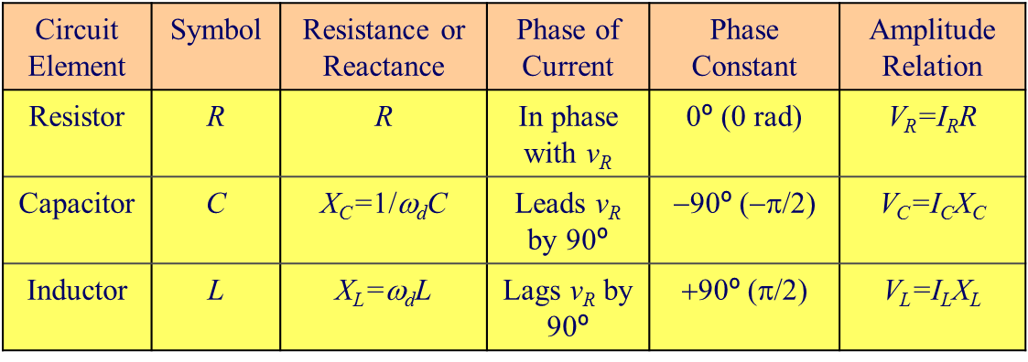
Phase and Amplitude Relations for Alternating Currents and Voltages

