Slide 1
Calculation of Penetrated Electric Field of Mobile Phone handset Radiations on various Tissues of Human Body
1
Salahaddin University
College of Science
Physics Department
Prepared By:
Kasrawan M.Askander - Reband Kawa
Supervisor : Dr. Abdullah Othman
2022- 2023
4/10

Slide 2
Content:
2
General Introduction
Microwave Radiation
Physical Effects of Mobile Phone
Review
Results and Conclusion
Recommendation and future works
References

Slide 3
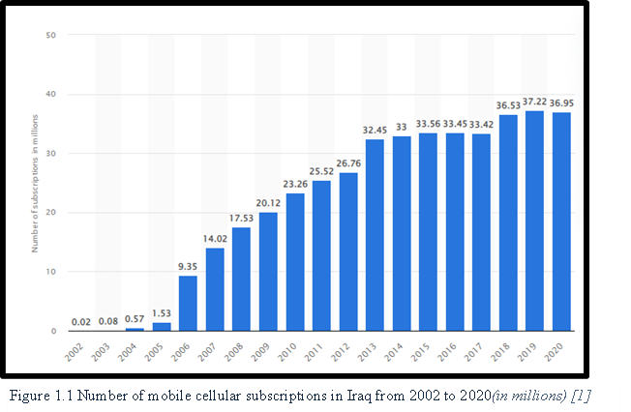
General Introduction
3
In the last two decades the use of mobile phone is wide spread in our society. According to the recent statistics, there have been more than 6 billion people are subscribing mobile phones worldwide in which high frequency waves are used and this number is ever growing such as the number of mobile-cellular subscriptions in Iraq from 2002 to 2020 growth from 0.02 million to 36.5 million.
In Iraq most common mobile phone communication technologies are GSM 900 and GSM 1800 or GSM 2400

Slide 4
Microwave Radiations
4

Slide 5
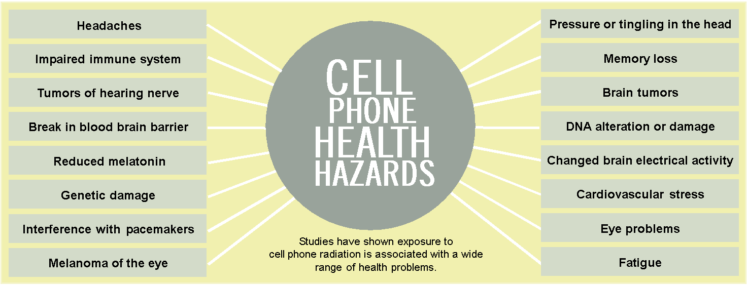
Physical Effects of Mobile Phone Radiation on the Humanity.
5
The European Commission Scientific Committee on Emerging and Newly Identified Health Risks (SCENIHR) published a recent assessment to access overall risks [3].

Slide 6
Review
6
Oberfeld Gerd et. al [10]. Reported ill effects for the people who are living within vicinity of two global system of mobile communication (GSM) base stations. The five strongest associations were found, fatigue, depressive tendency, cardiovascular problems, sleeping disorder and difficulty in concentration.
Ronni Wolf et. al [11]. Reported that people living within the range of 350 meters of a long mobile phone mast, have fourfold effect of increased incidence cancer in comparison with the general population of whole world.
Lennart Hardell et al [12]. conducted large number of experimental and theoretical as well as case control studies for more than 10 years on mobile phones. They found that the use of mobile phones for more than 10 years gives a consistent pattern of increased risk for acoustic glioma and neuroma.

Slide 7
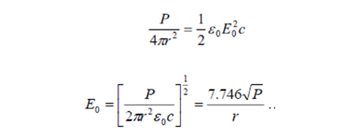
Results and Conclusion Calculation of Penetrated Electric Field
7
If we consider a mobile phone as point source, the radiation is emitted around mobile phone as spherical wave front of radius r. Let the incident electric field is E0 and power of radiation
of mobile phone or around the transmission tower is P, the radiating power per unit area is represented by the equation:

Slide 8
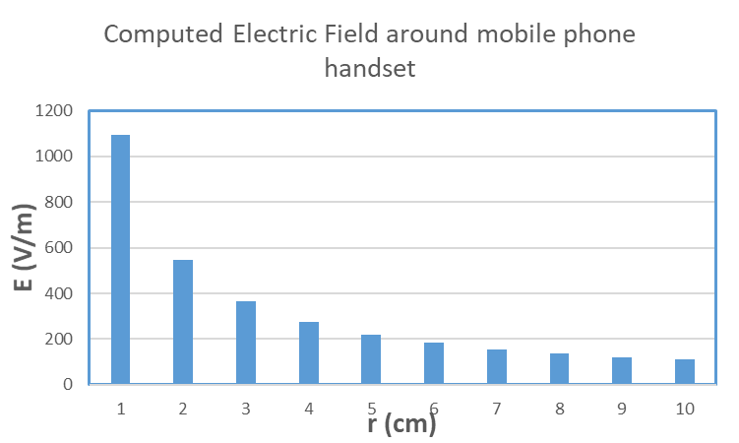
Calculation of Penetrating Electric Field of Various Tissues of Human Body
8
DISTANCE FROM MOBILE PHONE HAND SET ( CM ) | INCIDENT ELECTRIC FIELD ( E ₒ)
1 | 1094.6
2 | 547.3
3 | 364.8666667
4 | 273.65
5 | 218.92
6 | 182.4333333
7 | 156.3714286
8 | 136.825
9 | 121.6222222
10 | 109.46

Slide 9
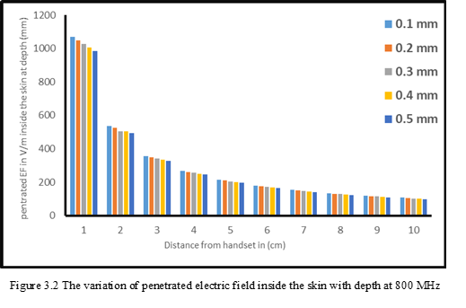
9

Slide 10
10

Slide 11
11

Slide 12
12

Slide 13
Conclusion
13
After comparing the theoretical calculations of the electric field strength, we came to the conclusion that frequencies of mobile phone radiation are harmful for general public exposure at various distances, which we observed in this research. As well as we observed that, the penetrated electric field for various frequencies of mobile phone towers may be harmful for the human body tissues.
Recommendation and future works
1. Manage experiments to prove the effects of mobile phone radiation on human body.
2. Filter the harmful radiations automatically. By discovering mechanisms inside the mobile phone.

Slide 14
References
14
[1] https://www.statista.com/statistics/498374/number-of-mobile-cellular-subscriptions-in-iraq/
[2] L. Stefan, Ahlbom, A. Hall and F. Maria, "Long-Term Mobile Phone Use and Brain Tumor Risk", American Journal of Epidemiology, vol. 161, no. 6pp.526–35, 2005.
[3]https://ec.europa.eu/health/scientific_committees/emerging/docs/scenihr_o_041.pdf
[4] Federal Communications Commission Office of Engineering & Technology. Questions and answers about biological effects and potential hazards of radiofrequency electromagnetic fields,” OET BULLETIN 56, Fourth Edition, 1999.
[5] P. Vecchia, R. Matthes , G. Ziegelberger , J. Lin ,R.Saunders , and A. Swerdlow , “Exposure to High Frequency Electromagnetic Fields, Biological Effects and Health Consequences (100 kHz-300 GHz),” Oberschleisheim ICNIRP , 2009.
[6] M.H. Repacholi, “An overview of WHO’s EMF project and the health effects of EMF Exposure,” Proceedings of the International Conference on Non-Ionizing Radiation at UNITEN. Electromagnetic Fields and Our Health, 2003.
[7] L.J. Challis, “Mechanisms for interaction between RF fields and biological tissue,” Bioelectromagnetics Supplement, vol. 7, pp. 98-106, 2005.

Slide 15
References
15
[8] V.N. Bingy and A.V.Savin , “ Physical Challenges of Weak Magnetic Fields Effect on Biological Systems,” Physical Sciences Successes, vol..173, no.3,pp. .265 – 300, 2006.
[9] N. N. Nikolaenko, L.A Rybina. and I.N. Serov, “Changes in Electric Activity and Behavior When Using Optical Filters with Matrix Fractal Topology,” Reports of the Academy of Scienc, vol. 383, no1, pp. 132-133, 2002.
[10] O. Gerd, A. Navarro, Enrique, P. Manual, M. Ceferine and P.Gomez, “The Meicroware Syndrome: Further aspect of Spanish Study,” 2004 .
[11] R.Wolf and D. Wolf , “Increased incidence of cancer near a cell phone transmitter Station,” Int J Cancer Prev. vol.1, pp. 123-128, 2004.
[12] L.Hardell., K. H.Mild, A.Pahlson and A.Hallquist, “Ionizing radiation, cellular
telephones and the risk for brain tumours,” Journal Eur J Cancer Prev. vol. 10, no. 6, pp. 523-529. 2001.
[13] https://www.fcc.gov/general/body-tissue-dielectric-parameters
[14] ICNIRP www. icnirp. Org / documents / emfgdl.pdf,(2010).

