Slide 1
Carolus Linnaeus (1707-1778 A.D.)

Slide 2
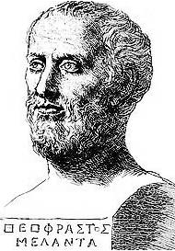
Theophrastus (372 BC to 287 BC) the father of botany

Slide 3
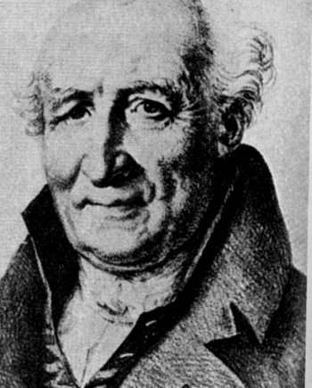
Antoine Laurent de Jussieu (1748-1836)

Slide 4
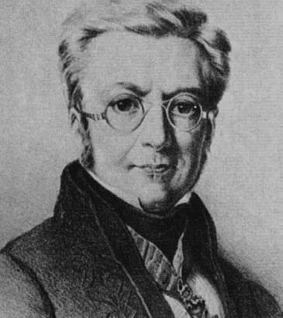
Augustin Pyramus de Candolle (1778-1841)

Slide 5
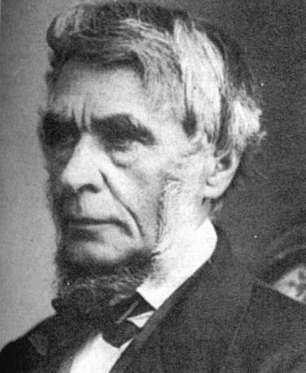
George Bentham (1800-1884

Slide 6
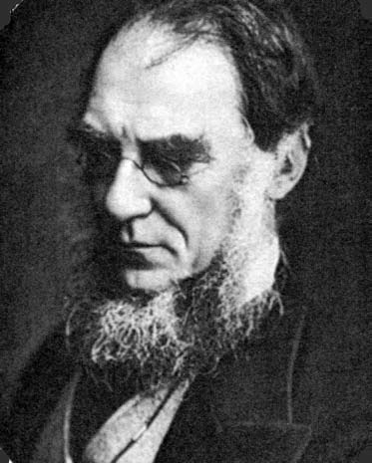
Sir Joseph Dalton Hooker (1817-1911)

Slide 7
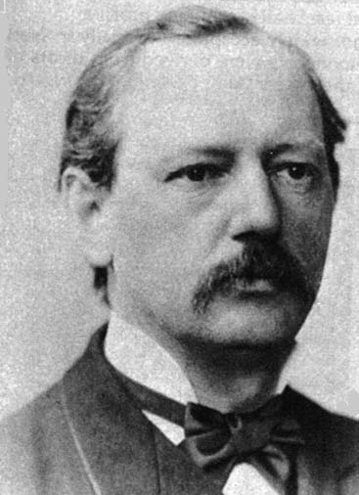
Adolph Engler (1844-1930)

Slide 8
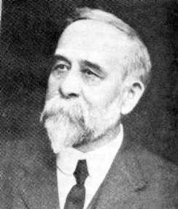
Charles Bessey (1845-1915)

Slide 9
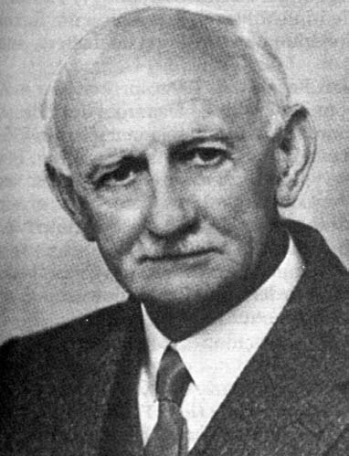
John Hutchinson (1884-1972)

Slide 10
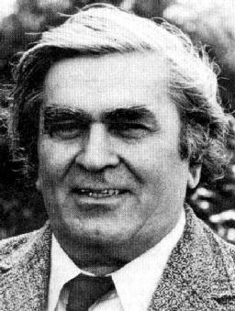
Armen Takhtajan (1910-2009)

Slide 11
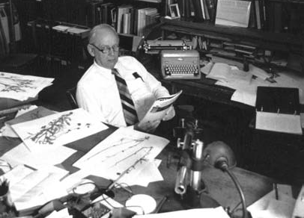
Arthur Cronquist (1919-1992)

