Slide 1
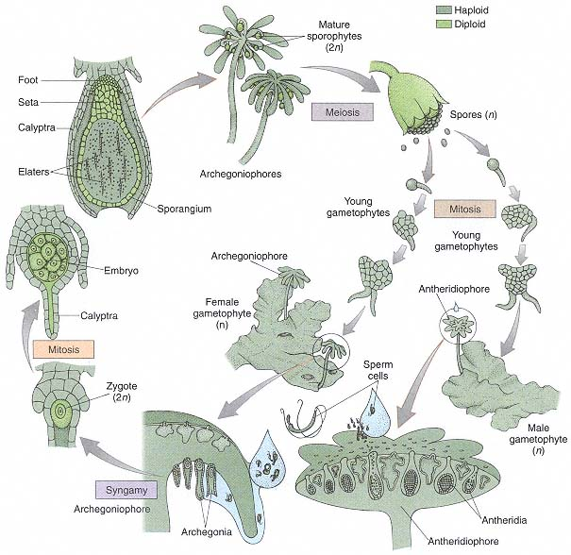
Life Cycle of Bryophyta

Slide 2
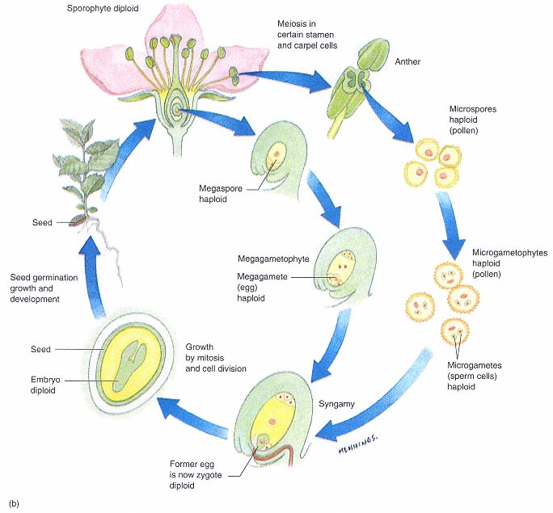
Life Cycle of Phanerophyta

Slide 3
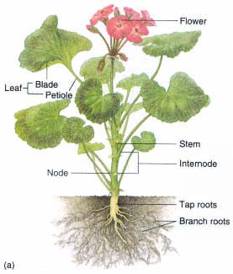
Flowering Plant Parts

Slide 4
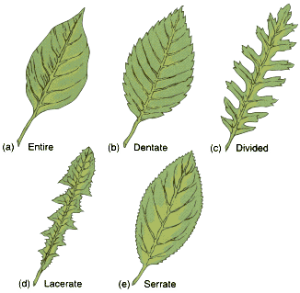
Leaves

Slide 5
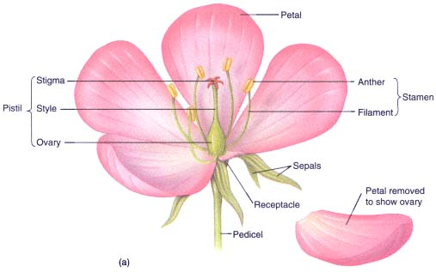
Flower (L.S.)

Slide 6
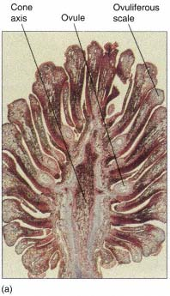
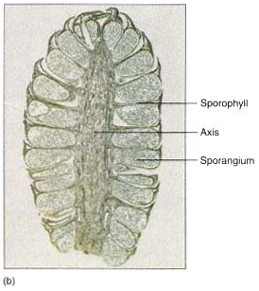
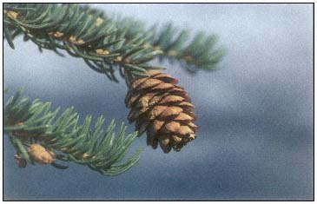
Cone of Coniferophyta
Female cone (L.S.)
Male cone (L.S.)

Slide 7
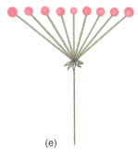
Inflorescences
Simple Dichasium
Simple Umble

