Slide 1
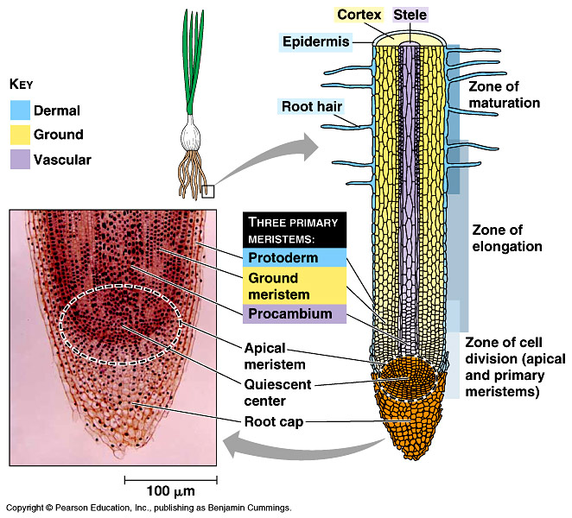

Slide 2
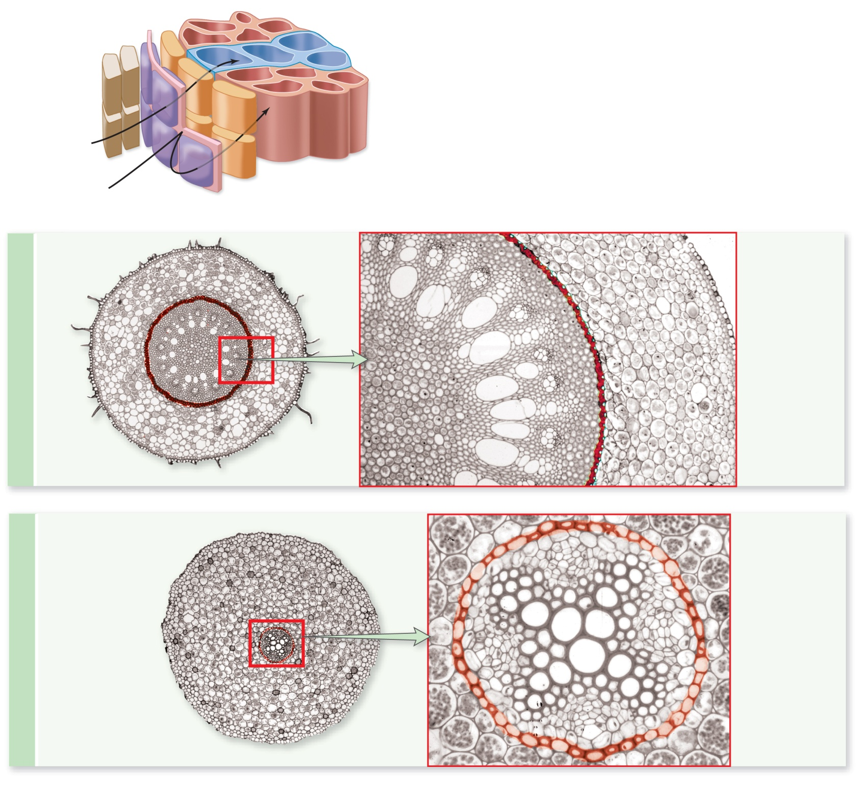
Epidermis
Cortex
Endodermis
Location of
Casparian strip
Monocot
Primary phloem
Pericycle
Primary xylem
1250 µm
Pith
385 µm
Endodermis
Location of
Casparian strip
Endodermis
Primary xylem
Eudicot
Cortex
Primary phloem
Epidermis
Pericycle
48 µm
8 µm

Slide 3
Root types. A. Tap root. B. Fibrous root system. C. Prop roots. D. Haustorial roots

Slide 4
Storage roots; Raphanus sativus, radish

Slide 5
Buttress roots, Ficus rubiginosa

Slide 6
Pneumatophores; Avicennia germinans, black mangrove

Slide 7
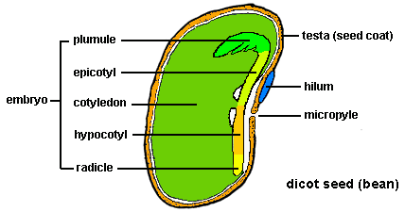
SEED STRUCTURE

