Slide 1
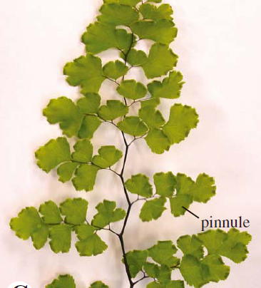
Polypodiales: Adiantum, with bipinnate leaf, having ultimate pinnules

Slide 2
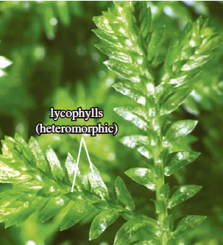
Lycopodiophyta: Selaginella apoda, with dimorphic leaves

Slide 3
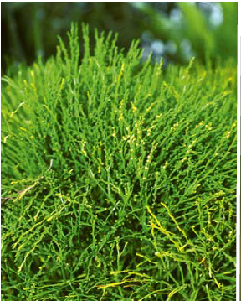
Psilotophyta. Psilotum nudum

Slide 4
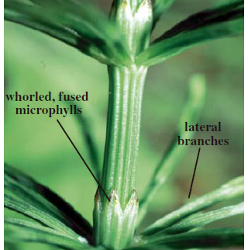
Equisetales. Equisetum arvense, , the only extant genus of the equisetophytes

Slide 5
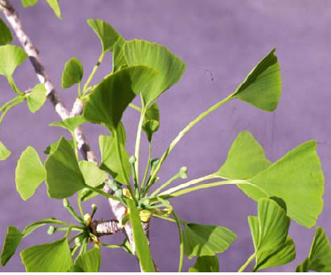
Ginkgo biloba

Slide 6
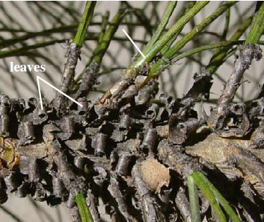
Conifers: Pinus, Branch, showing scale leaves and fascicles

Slide 7
