Slide 1
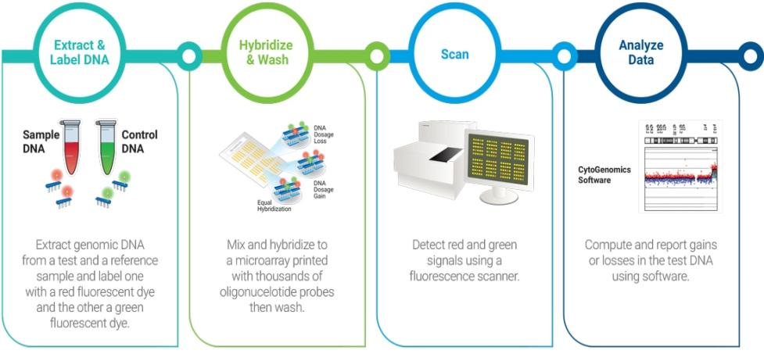
Comparative genomic hybridization (CGH)

Slide 2
What is Comparative genomic hybridization (CGH) ?
Is a technique that permits the detection of chromosomal copy number changes without the need for cell culturing.
Kallioniemi et al at the University of California, San Francisco were the first to report CGH as a new chromosome analysis technique in 1992,1 shortly followed by du Manoir et al.

Slide 3
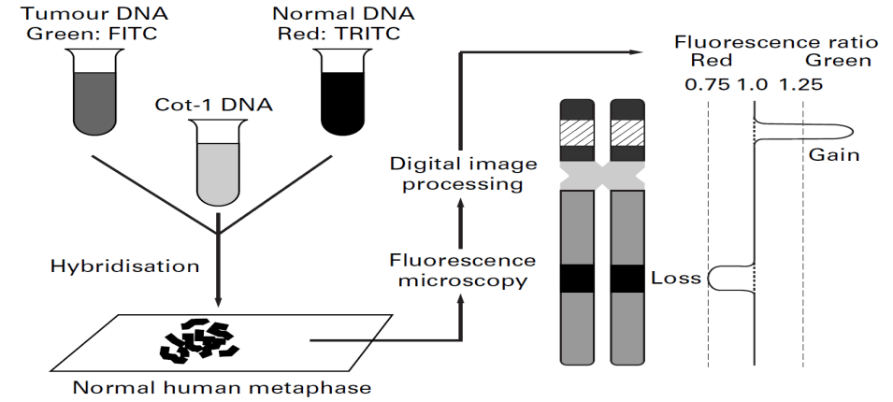
Principle of CGH
The principle of CGH is that, the tumour DNA is labelled with a green fluorochrome, mixed (1:1) with red labelled normal DNA, and hybridised to normal human metaphase preparations. The normal reference DNA and the metaphases are obtained from a healthy volunteer and do not need to be from the patient. The green and red labelled DNA fragments compete for hybridisation to their locus of origin on the chromosomes. The green to red fluorescence ratio measured along the chromosomal axis represents loss (ratio < 1) or gain (ratio > 1) of genetic material in the tumour at that specific locus.

Slide 4
Applications of CGH?
Because no cell culturing is required for CGH, this technique has enabled tremendous progress in the analysis of chromosomal changes in solid tumours.
Applied in cancer research include screening of tumours for genetic aberrations, searching for genes involved in the carcinogenesis of particular subsets of cancers, analyzing tumours in experimental models to obtain an insight into tumour progression, diagnostic classification, and prognosis assessment.
Apart from these oncological applications, CGH analysis has also been used to study chromosomal aberrations in fetal and neonatal genomes.

Slide 5
Disadvantages of CGH
CGH is a relatively time consuming and difficult technique with a number of limitations.
It cannot detect structural chromosomal aberrations without copy number changes, such as balanced chromosomal translocations, inversions, or ring chromosomes
It also has the disadvantage of being less sensitive than PCR based methods in detecting deletions.
Theoretically, the loss or gain of one copy of a certain chromosome in a diploid genome should result in a fluorescence ratio of 0.5 or 1.5. However, in experiments comparing male and female DNA, where the fluorescence ratio for the X chromosome should be 0.5 or 2.0, these ratios are never found in practice.

Slide 6
Steps for preforming CGH
METAPHASE SLIDE PREPARATION
Metaphase chromosomes are prepared according to standard protocols using phytohaemagglutinin stimulated peripheral blood lymphocytes from a karyotypically normal man or woman. Because women have two X chromosomes and the Y chromosome does not contain much genetic information, it is preferable to use metaphase spreads from women.

Slide 7
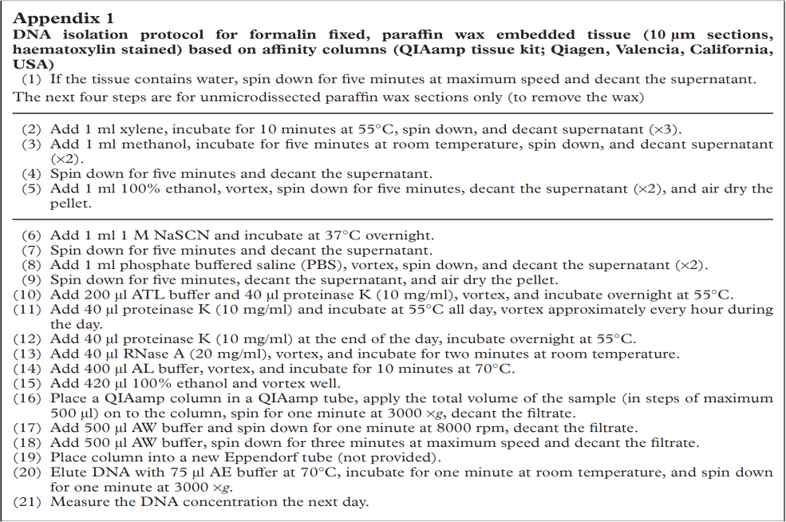
DNA ISOLATION FROM TUMOUR TISSUE

Slide 8
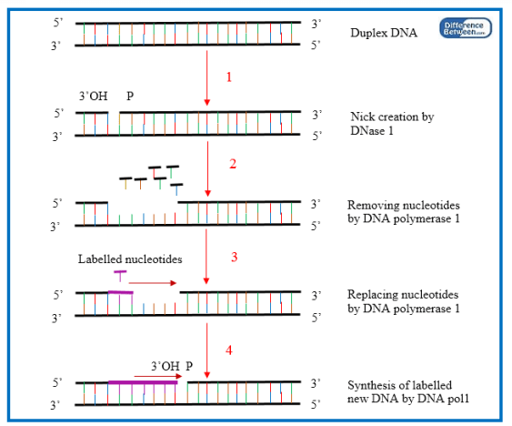
DNA LABELLING (NICK TRANSLATION)
Is the, cutting DNA and substituting unlabelled nucleotides with digoxigenin, biotin, or fluorochrome labelled nucleotides)

Slide 9
DNA LABELLING (NICK TRANSLATION)

Slide 10
BLOCKING
Chromosomal regions with short repetitive DNA sequences occur throughout the whole genome, but in a high number at all centromeres, telomeres, and some specific regions (chromosome arms 1p and 16p, and chromosomes 19 and 22). The lengths of these regions are highly variable between individuals (and thus between tumour and reference DNA), and this can interfere with CGH analysis. Therefore, repetitive DNA regions are blocked with unlabelled Cot-1 DNA (placental DNA from 50 to 100 bp, which is enriched for repetitive DNA sequences). Suboptimal blocking, seen as non-black centromeres, can lead to a reduced amplitude of the green to red ratio and gains and losses may go undetected. As an alternative to blocking, removal of repetitive sequences from the probe may be another solution to this problem.

Slide 11
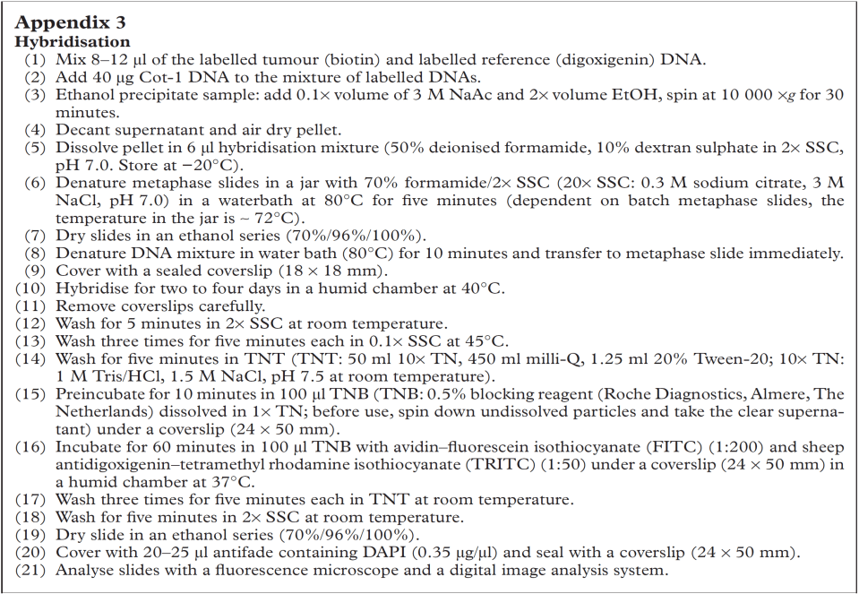
HYBRIDISATION

Slide 12
