Slide 1
Lab2
Cell dimension
Msc.Awat.Y.Hasan
Msc.Mustafa.F.Rajab

Slide 2
Learning objectives
Cell dimension.
Ocular and stage micrometer.
Methods of determination cell dimension.
Materials
Microscope, stage micrometer, ocular micrometer, specimen, ruler and electron micrograph.

Slide 3
Cell dimension
To measure the length or diameter of cell or component of the cell such as organelles we need, an ocular micrometer which has a scale. This is simply a disc of glass upon which equally spaced divisions are etched. The scale may be divided into 50 subdivisions, or 100 subdivisions. If we want to use the ocular micrometer, we have to calibrate it against a fixed and known ruler, the stage micrometer.

Slide 4
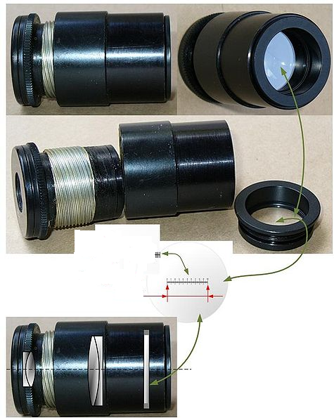
Ocular micrometer

Slide 5
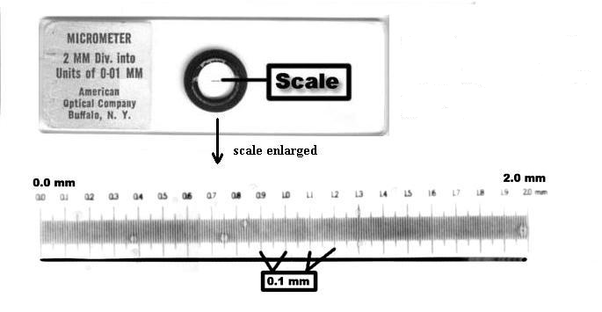
Stage micrometer

Slide 6
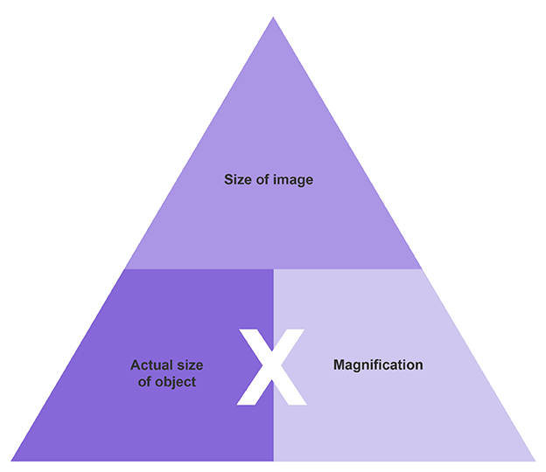
How can you determine the diameter of the structures of the electron micrograph ?
Equation
Magnification can be worked out from a photograph or drawing using the equation below:
The same unit of measurement should be used when making the calculation - metre (m), millimetre (mm) or micrometre (µm).

Slide 7
-To convert millimetres into micrometres, multiply by 1000. Actual Length = length of the Image divided by the Magnification. Magnification = length of the Image divided by the Actual Length. Scale bar Working out magnification: -Measure the scale bar image (beside drawing) in mm. -Convert to µm (multiply by 1000). -Magnification = scale bar image divided by actual scale bar length (written on the scale bar).

