Slide 1
EXTENDED RESPONSE
Plants have been cultivated for at least 11,000 years
Part A identify 5 plants people use for food and 5 plants people use for other purposes
Part B How has human cultivation changed some plants

Slide 2
Botany
Plants are essential to our survival because they produce virtually or almost al our food We eat plants either directly, in the form of fruits, vegetables, and grains, or indirectly, by eating animals that consume plants
Plants also provide medicines, clothing, paper, cosmetics, and many other products.
Plants play a major role in the continuous cycling of the Earth s water, Oxygen, carbon dioxide, and mineral nutrients The study of plants is called botany.

Slide 3
Of the more than 350,000 plant species, people use at least 10,000 species for food. incredibly, fewer than 20 plant species provide more than 90 percent of our food supply. The Cultivation of plants for food probably began about 11,000 years ago in the Middle East. Wheat, barley, lentils, and peas were the first domesticated food crops.
Growing plants and raising animals for human use is called agriculture

Slide 4
People propagated, or reproduced, individual plants that had valuable characteristics, such as plants that produced the largest or tastiest fruits.
In the 11,000 years that humans have been cultivating plants, we have changed many of the plants so much that they could not grow and survive without Us.
Food crops can be classified in many ways, including by their use and by their ta taxonomic classification.

Slide 5
Several factors have increased food production ,including the use of fertilizers and pesticides. As land is cultivated to produce an adequate food supply, the health of the environment is compromised by soil erosion depleted water supplies, and pollution.

Slide 6
Plants Provide thousands of nonfood products, including clothing fabric dye, Iumber, paper, cosmetics, fuel, cork, rubber, turpentine, and pesticides,
Ornamental plants improve the human environment in many important ways they provide shade, minimize soil erosion, reduce noise, and lower home energy costs.

Slide 7
Everyday definitions of fruits and vegetables are different from botanical definitions. Many common vegetables, such as green beans, tomatoes, squash and pumpkins, are actually fruits. Botanically speaking. A fruit is the part of a flowering plant that usually contains seeds.
Plants provide many important medicines, such as
quinine, morphine, and anti-cancer drugs.

Slide 8
Example about Medicine plants
Garlic | Allium sativum | heart health, dental health, sickle cell anemia, diabetes
Lemon Balm | Melissa officinalis | anxiety, stress, memory improvement
Mullein | Verbascum | ear inflammation
Passionflower | Passiflora incarnata | anxiety, stress, sleep disorders, insomnia, mental health
Cape Aloe | Aloe ferox | anti-bacterial, anti-fungal
Aloe | Aloe vera / Aloe barbadensis | anti-bacterial, moisturizer, dry skin
Hintonia | Hintonia latiflora | diabetes

Slide 9
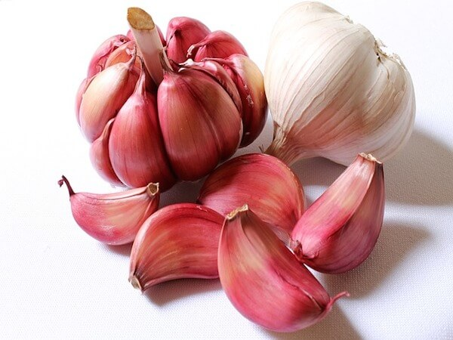
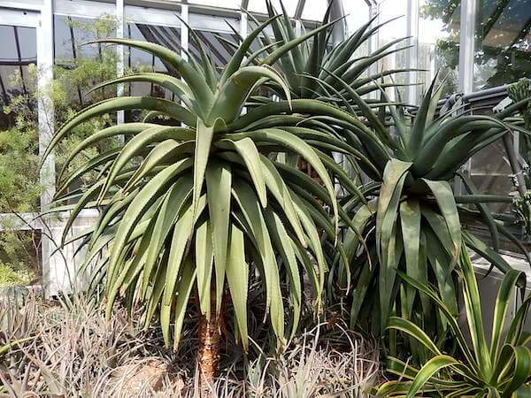
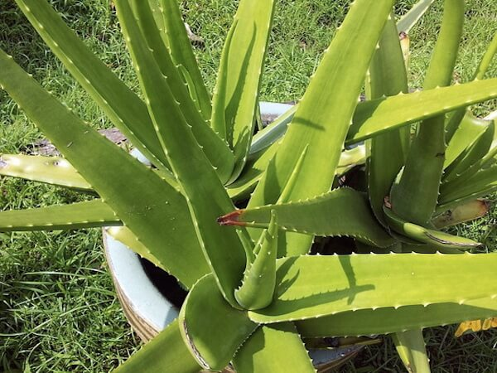
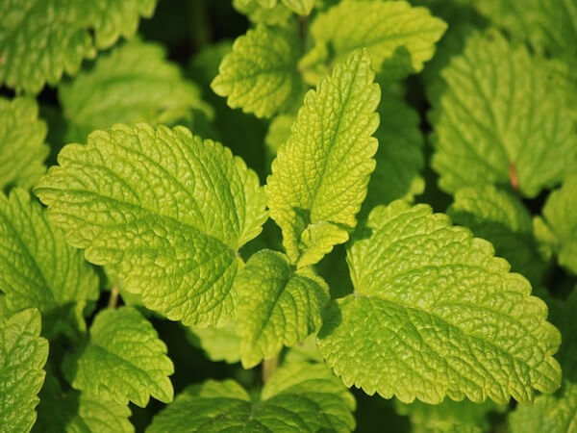
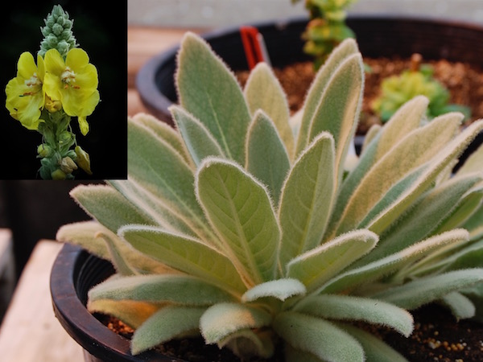
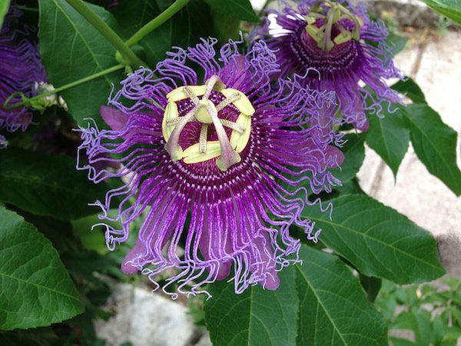
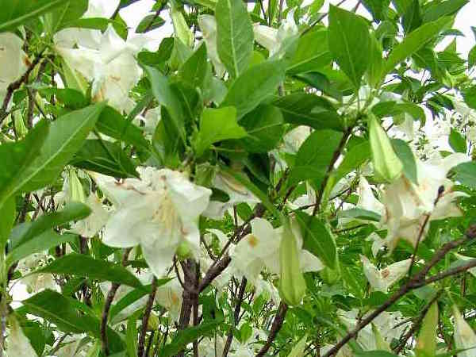
Cape Aloe
Garlic
Aloe
Lemon Balm
Mullein
Passionflower
Hintonia

Slide 10
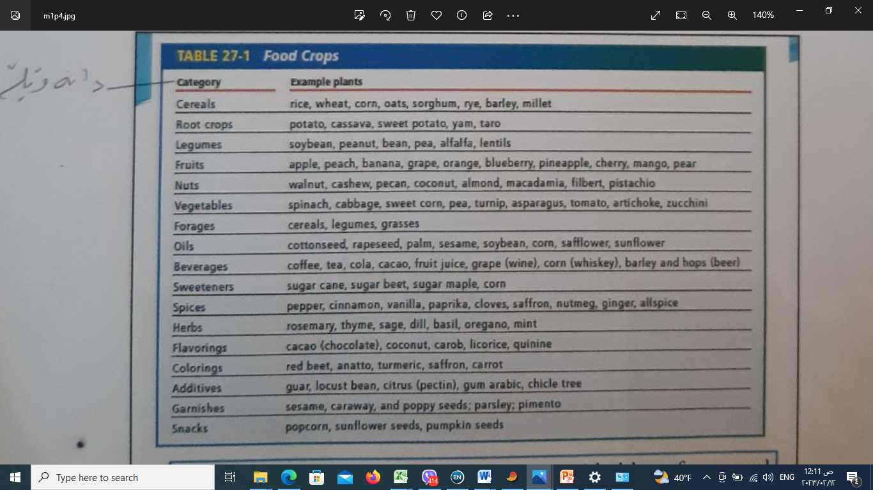

Slide 11
DIRECTIONS: Choose the letter of the answer choice
that best answers the question.
1. Early farmers selected wheat plants that had which of the following
characteristics?
A. fewest grains
B. largest seed pods
C. easily dispersed seeds
D. stalks not easily broken in the wind
2. Which plants are the major source of food for the world today?
a. spices
b.cereals
c. Iegumes
d. root crops
3 Which of the following is an inorganic nutrient recycled by plants?
A. sugar
B. starch
C.cellulose
D Phosphorus
4 Plants classified as root crops have edible underground structures. Which of
the food plantsshown above is a rootcrop?
a.rice
b.pecan
c. protien
d. oregano.

