Slide 1
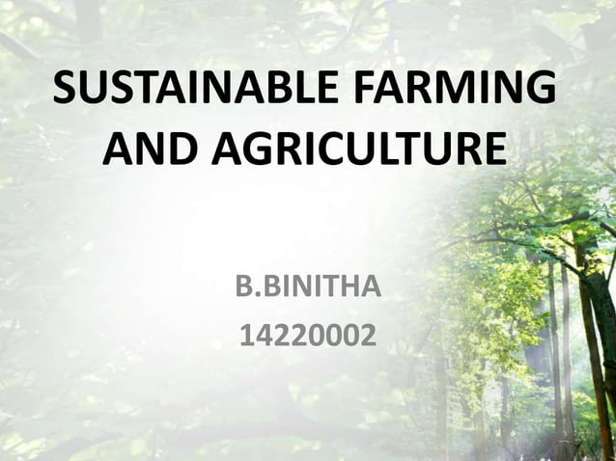
Abdulqader M Youns
PhD. In Environmental Pollution

