Slide 1
Public Health
Set by: : Dr. Abdulqader Musheer
Lecture: 2
24/10/2023. Tuesday.

Slide 2
Epidemiology: introduction and basic concepts
Definition.
Epidemiologists’ definition.
Epidemiology examples.
Uses of epidemiology.
Types of epidemiology.
Characteristics of disease that we look for in descriptive studies.
Measures of morbidity and mortality.
Epidemiological investigation.

Slide 3
Definition
Epidemiology is a branch of medicine, which deals with the incidence, distribution, and possible control of diseases and other factors relating to health.

Slide 4
It is the study of the determinants, distribution, and frequency of disease and the application of this study to control of health problems.
Epidemiology is a cornerstone of public health, and shapes policy decisions and evidence-based practice by identifying risk factors for disease and targets for preventive healthcare.

Slide 5
Epidemiology, literally meaning, "the study of what is upon the people",
is derived from Greek
epi 'upon, among',
demos 'people, district', and
logos 'study, word, discourse', suggesting that it applies only to human populations.

Slide 6
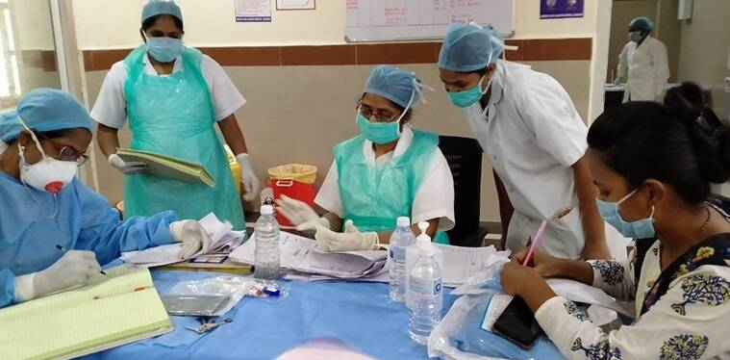
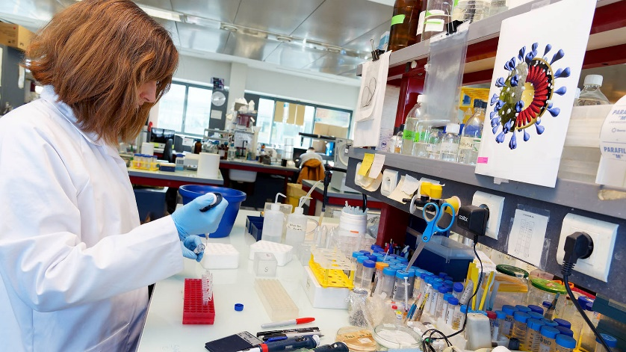
Epidemiologists’ definition
Epidemiologists are public health workers who investigate patterns and causes of disease and injury.
They seek to reduce the risk and occurrence of negative health outcomes through research, community education and health policy.

Slide 7
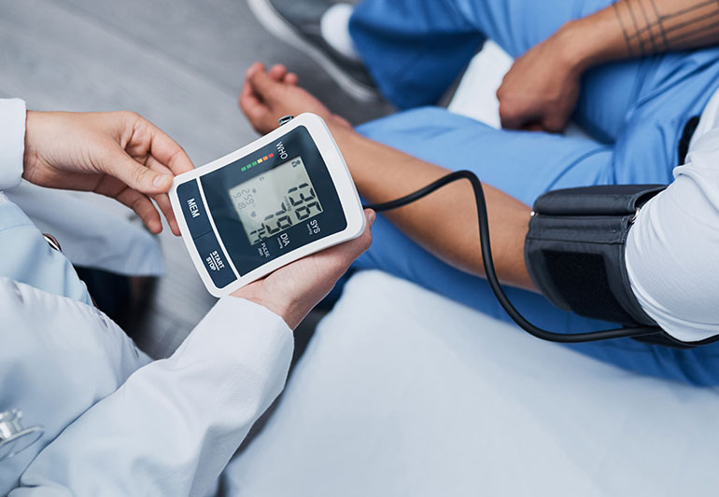
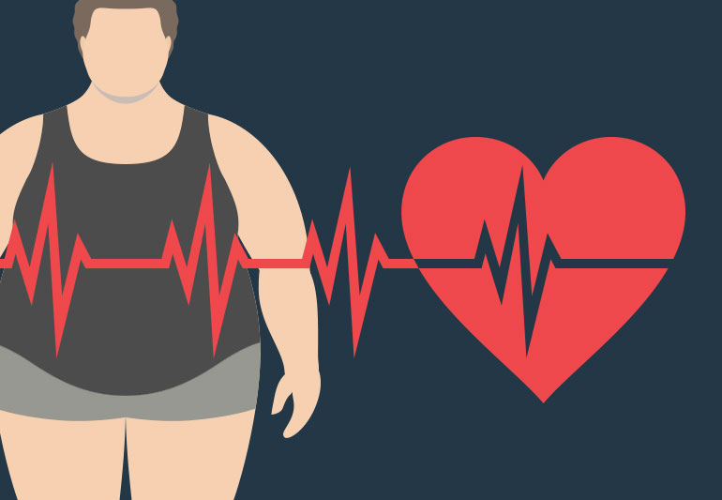
Epidemiology examples
The term epidemiology is now widely applied to cover the description and causation of not only epidemic, infectious disease, but of disease in general, including related conditions.
Some examples of topics examined through epidemiology include as high blood pressure, mental illness and obesity.

Slide 8
Uses of epidemiology
To determine, describe, and report on the natural course of disease, disability, injury, and death.
To aid in the planning and development of health services and programs.

Slide 9
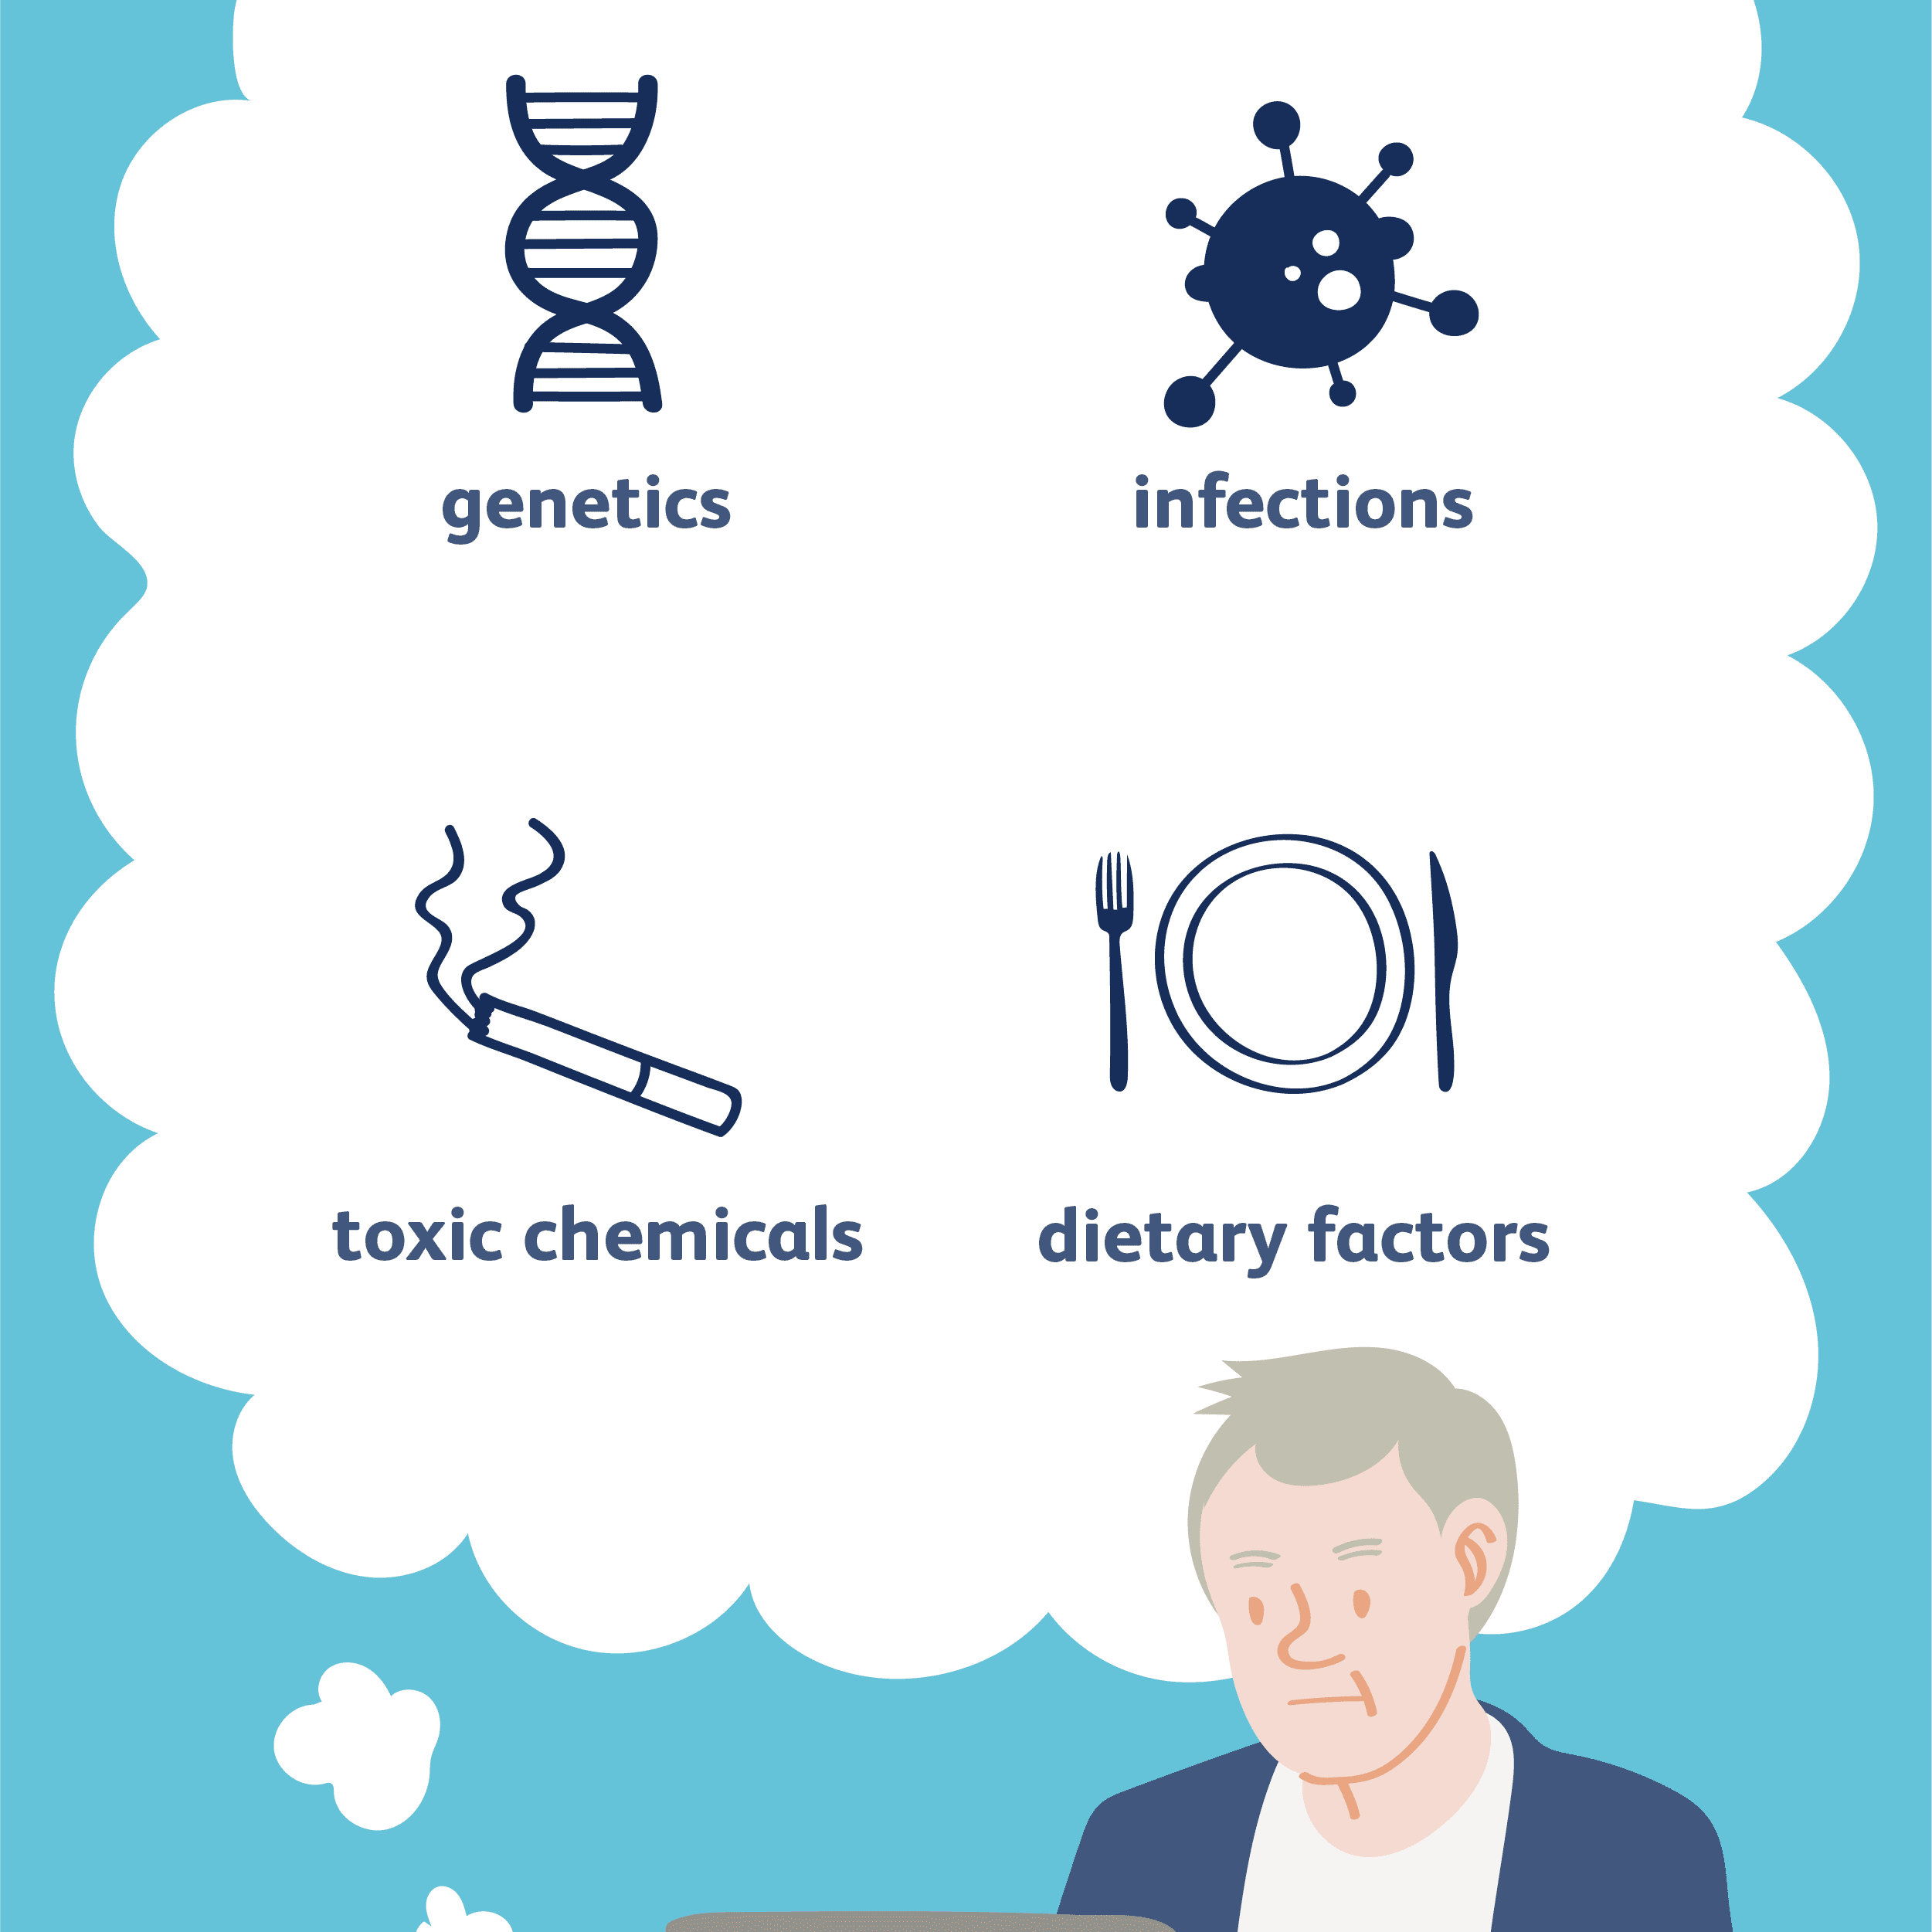
To provide administrative and planning data.
To study the cause of diseases, or conditions, disorders, disabilities, etc.
To determine the primary agent responsible or ascertain causative factors.

Slide 10
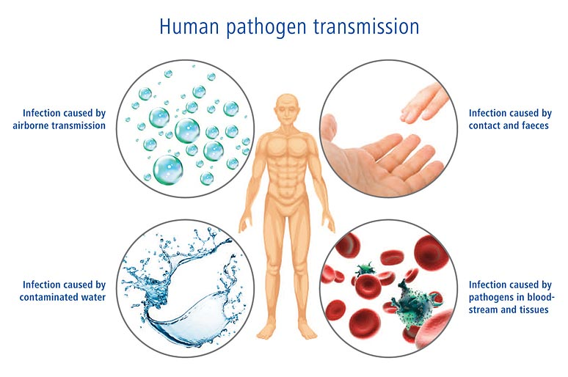
To determine the characteristics of the agent or causative factors.
To determine the mode of transmission.

Slide 11
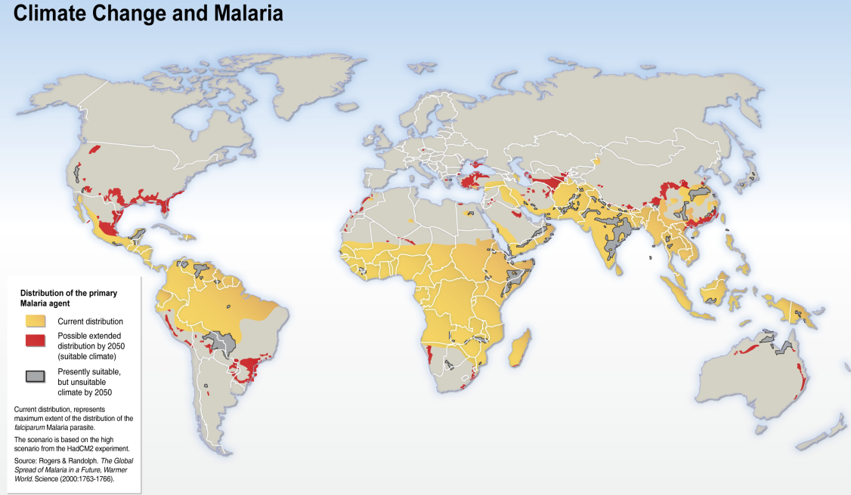
To determine contributing factors.
To identify and determine geographic patterns.

Slide 12
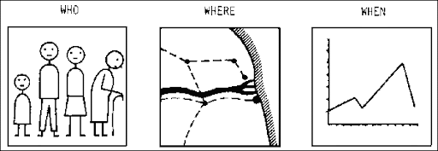
Types of epidemiology
Descriptive epidemiology: examining the distribution of disease in a population, and observing the basic features of its distribution.

Slide 13
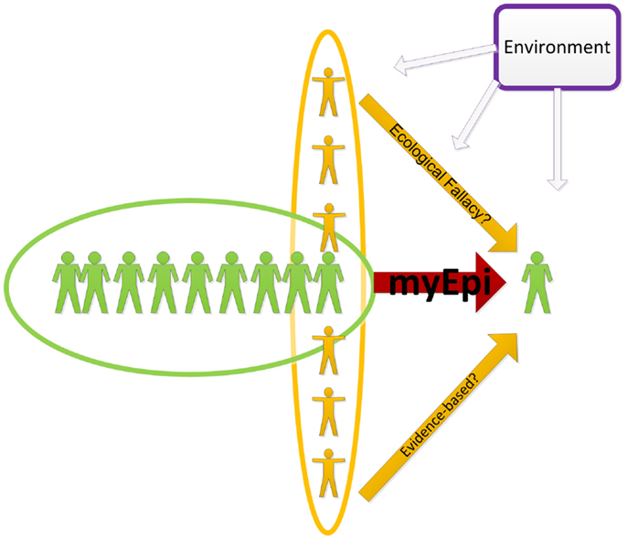
Types of epidemiology
Analytic epidemiology: investigating a hypothesis about the cause of disease by studying how exposures relate to disease.

Slide 14
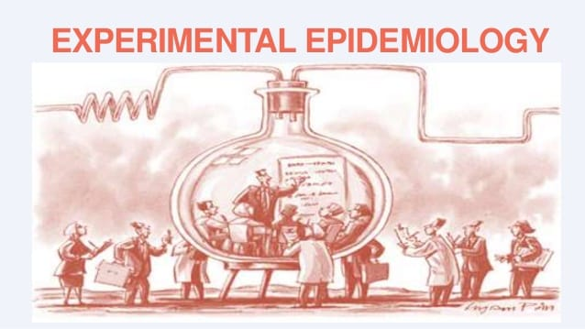
Types of epidemiology
Experimental epidemiology: is the study of the relationships of various factors determining the frequency and distribution of diseases in a community.

Slide 15
Characteristics of disease that we look for in descriptive studies
Person
Age, gender, ethnic group.
Genetic predisposition.
Concurrent disease.
Diet, physical activity, smoking.
Risk taking behavior.
Socioeconomic status, education, occupation.

Slide 16
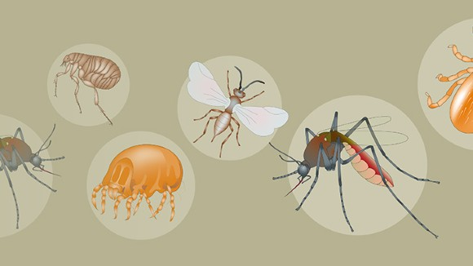
Geographic place
Presence of agents or vectors.
Climate.
Geology.
Population density.
Economic development.
Nutritional practices.
Medical practices.

Slide 17
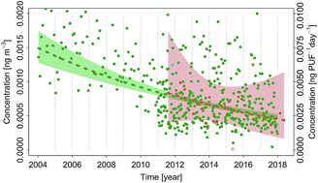
Time
Calendar time.
Time since an event.
Physiologic cycles.
Age (time since birth).
Seasonality.
Temporal trends.

Slide 18
Measures of morbidity and mortality
Examine host – disease relationships and disease transmission modes.
Systematically investigate an epidemic outbreak.
Define and differentiate incidence and prevalence.
Measure key indices of morbidity and mortality.

Slide 19
Morbidity:
It the condition of suffering from a disease or medical condition.
Morbidity is when you have a specific illness or condition.
Some examples of common morbidities are heart disease, diabetes, and obesity.
You can have more than one morbidity at a time.

Slide 20
Mortality:
The state of being subject to death.
Mortality is the condition of one day having to die or the rate of failure or loss.
An example of mortality is that all animals eventually will die.

Slide 21
Epidemiological investigation
The purpose of the epidemiologic investigation is to identify a problem, collect data, formulate and test hypotheses.
It involves the collection and analysis of more facts or data to determine the cause of illness and to implement control measures to prevent additional illness.

