Slide 1
Soil Quality Index SQI

Slide 2
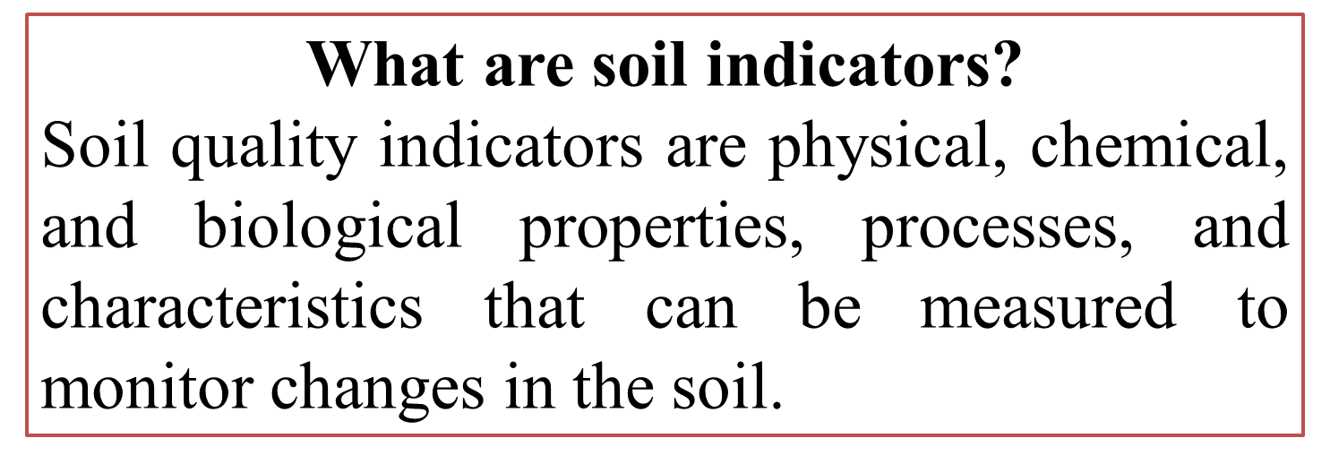

Slide 3
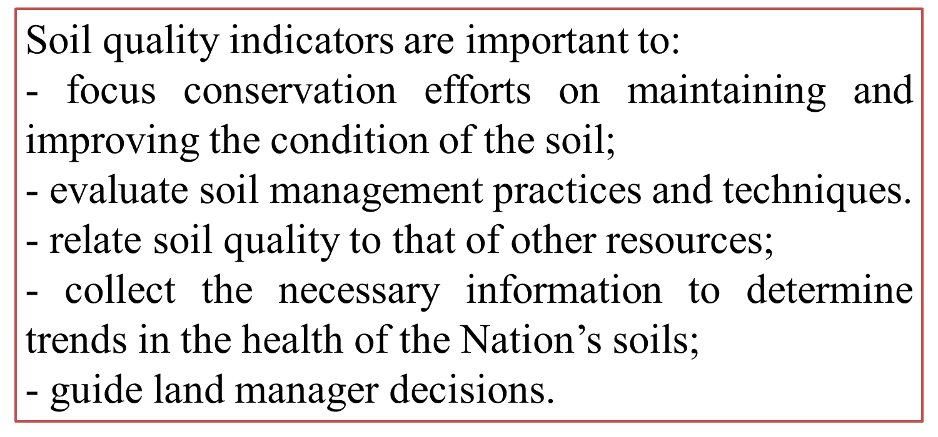
Why are indicators important?

Slide 7
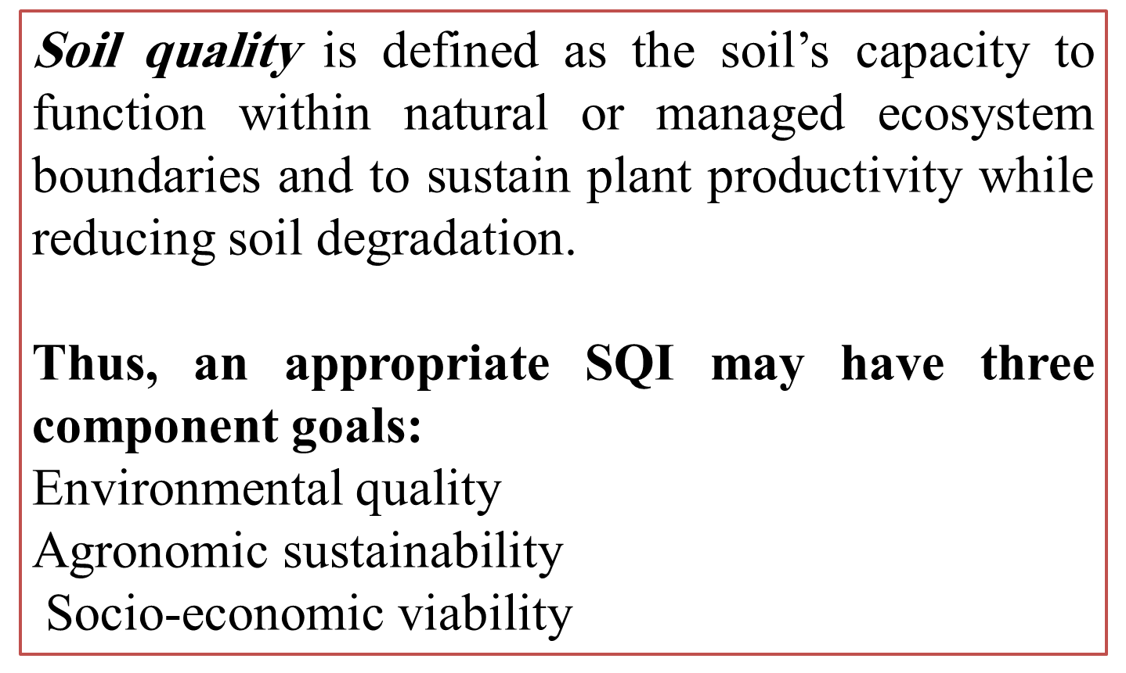

Slide 8
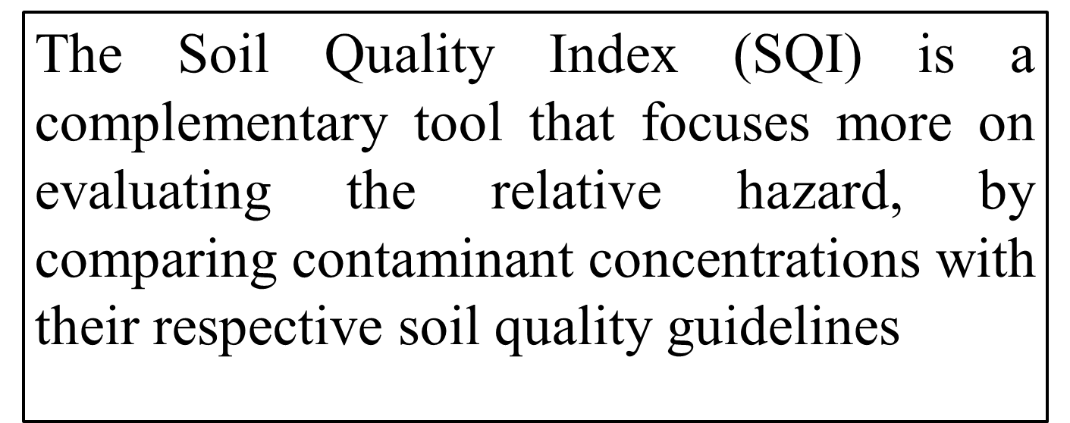

Slide 11
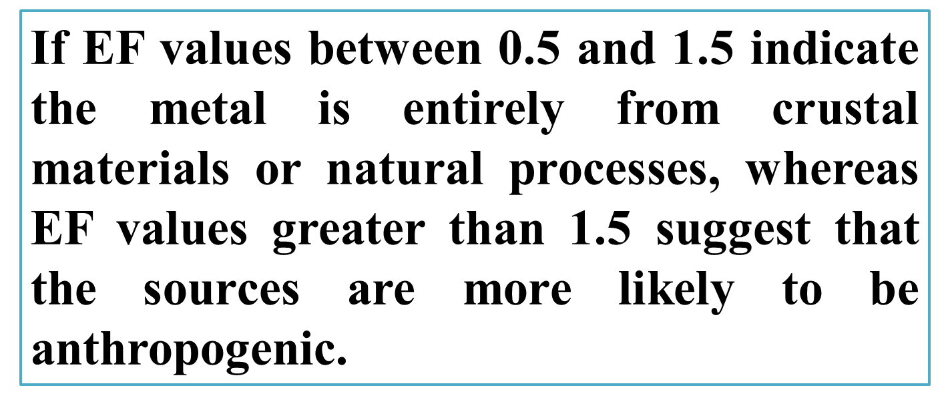

Slide 13
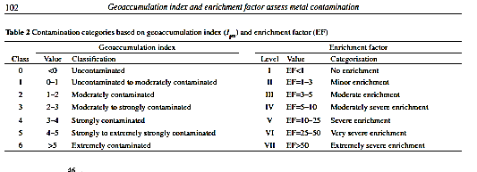

Slide 14
Example1 :From following table calculate the EF and I geo index ?
Metals | As | Cd | Cr | Hg | Ni | Zn | Pb | Fe
Concentration (mg/Kg) | 4.8 | 0.32 | 51.6 | 0.15 | 60.98 | 89.1 | 6.58 | 77.6
Back ground | 8.5 | 0.44 | 77 | 0.1 | 25 | 65 | 23 | 200
$EF of As=\frac{\frac{4.8}{77.6}}{\frac{8.5}{200}}$ =$\frac{0.016}{0.0425}$=0.3765
Igeo of As=log₂ [4.8/1.5*8.5]=-1.41

Slide 15
Example1 :From following table calculate the EF and I geo index ?
Metals | As | Cd | Cr | Hg | Ni | Zn | Pb | Fe
Concentration (mg/Kg) | 4.8 | 0.32 | 51.6 | 0.15 | 60.98 | 89.1 | 6.58 | 77.6
Back ground | 8.5 | 0.44 | 77 | 0.1 | 25 | 65 | 23 | 200
Example 2 :From following table calculate the EF and I geo index for soil S₂ and S₅ ?

Slide 16
Why use iron
Abundance: Iron is one of the most abundant elements in the Earth's crust, and its concentration is relatively stable in various environmental samples. Therefore, using iron as a reference element ensures consistency and comparability across different samples.
Homogeneity: Iron is often uniformly distributed in environmental matrices, making it a suitable reference element for normalizing metal concentrations. This homogeneity reduces variability and uncertainty in the enrichment ratio calculations.
Inertness: Iron is relatively inert and less susceptible to chemical changes or interactions in environmental samples compared to other metals. Its stability makes it an ideal choice for normalization, minimizing potential biases introduced by sample handling or analytical procedures.
Availability: Iron concentration data are readily available for many environmental samples due to its widespread occurrence and importance in various natural processes. This accessibility facilitates the calculation of enrichment ratios without the need for additional analytical measurements or complex data processing.

