Slide 1
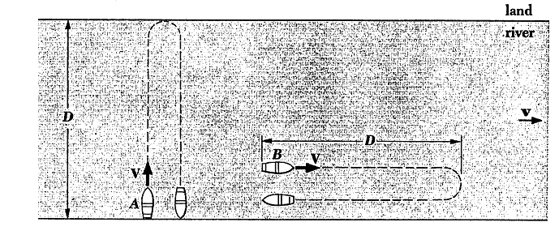
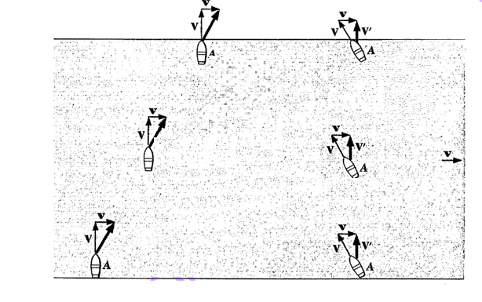
THE SPECIAL THEORY OF RELATIVITY
A. The Michelson-Morley experiment
Boat A
$$V^{2}=V^{′2}+ʋ^{2} (1−1)$$
$$V^{′}=\sqrt{V^{2}−v^{2}}=V\sqrt{1−\frac{v^{2}}{V^{2}}} (1−2)$$
Boat B
$$\frac{D}{V+v} (1−4)$$
$$\frac{D}{V−ʋ} (1−5)$$
The total round-trip time t_{B} is the sum of these times, namely,
$$\frac{t_{A}}{t_{B}}=\sqrt{1−\frac{v^{2}}{V^{2}}} (1−7)$$
The ratio between the times t_{A} and t_{B} is

Slide 2
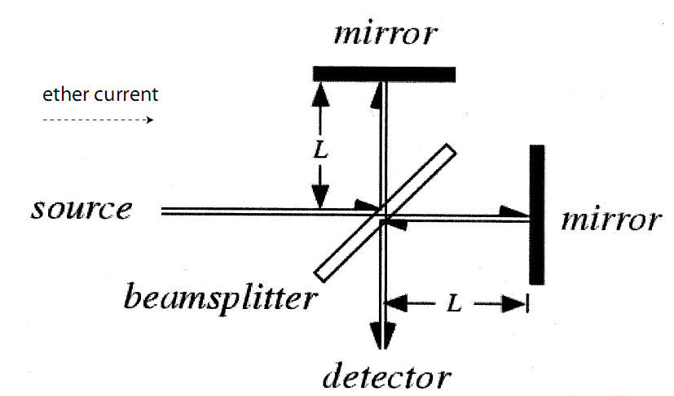
FIG.3: The Michelson- Morley experiment.
The negative result of the Michelson-Morley experiment had two consequences. First, it said that the hypothesis of the ether is wrong. Second, it suggested that the speed of light in free space is the same everywhere, regardless of any motion of the source or the observer.

Slide 4
The special theory of relativity
Inertial frame of reference: An inertial frame of reference is one in which Newton’s first law of motion holds. In such a frame, an object at rest remains at rest and an object in motion continues to move at constant velocity (constant speed and direction) if no force acts on it. Any frame of reference that moves at constant velocity relative to an inertial frame is itself an inertial frame.
The special theory of relativity, developed by Einstein in1905, treats problems involving the motion of inertial frames of references at constant velocity with respect to one another. It has a profound influence on all of physics.
The special theory of relativity is based up on two postulates:
The first postulate: The laws of physics may be expressed in equations having the same form in all inertial frames of reference moving at constant velocity with respect to one another. This postulate expresses the absence of a universal frame of reference.
The second postulate: The speed of light in free space has the same value in all inertial frames of reference. This postulate follows directly from the result of the Michelson-Morley experiment.

Slide 6
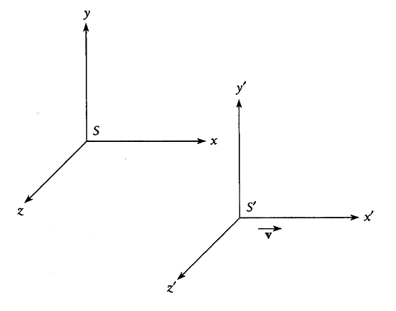
C. The Galilean transformation
Suppose that we are in a frame of reference S and find that an event occurs at the time t and has the coordinates x; y; z. Consider a different frame of reference S' moving with respect to S at the constant velocity ʋ, see Fig.
For simplicity, we assume that ʋ is in the +x direction and that time in both systems is measured from the instant when the origins of S and S' coincide.
We also intuitively expect that times are the same in both frames of reference:
The set of Eqs. (1-8) and (1-9) is known as the Galilean transformation.

Slide 7
To convert velocity components measured in the S frame to their equivalents in the frame S', we simply differentiate Eqs.(8) with respect to time. The results are
The Galilean transformation are violate both of the postulates of special relativity. The first postulate calls for identical equations of physics in both the S and S' frames of reference, but the fundamental equations of electricity and magnetism assume very different forms when Eqs.(1-8) and (1-9) are used. The second postulate calls for the same value of the speed of light whether determined in S or S'. If the speed of light in the direction x in the S system is c, then in the system S' we have c' = c - ʋ, not correct. Clearly, a different transformation is required if the postulates of special relativity are to be satisfied.

Slide 8
D. The Lorentz transformation
where κ is a factor of proportionality that does not depend on x and t but may be a function of ʋ. The choice of Eq.(1-11) follows from several considerations:
1- it is linear in x and x' ,so that a single event in the frame S corresponds to a single event in the frame S'
2-it is simple; and it has the possibility of reducing to the equation x'=x-ʋt ,which is valid in ordinary mechanics.
Because the equations of physics must have the same form in both S and S', we need only change the sign of ʋ to write the corresponding equation for x in terms of x' and t':

Slide 9
To get the time transformation, we substitute Eq.(11) into Eq.(12).The result is
from which we find that
To find κ, we use the second postulate.
the light propagation in the frames S and S' is governed by the equations

Slide 10
Substituting Eqs.(11)and(15) into Eq.(17) yields
Solving for x, we find
The use of eq.(17) gives
$$\frac{1+v/c}{1−(\frac{1}{k^{2}}−1)(c/v)}=1 (1−20)$$
Hence, we obtain
$$k=\frac{1}{\sqrt{1−{v^{2}}/{c^{2}}}} (1−21)$$

Slide 11
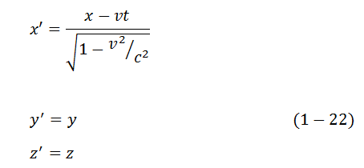
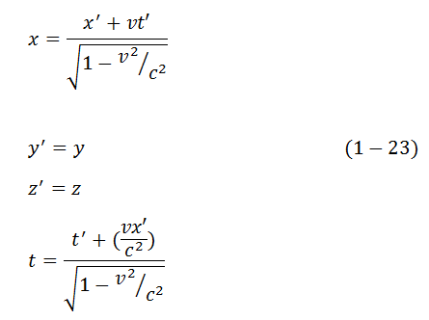
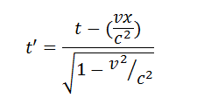
Thus, the transformation equations are
The inverse Lorentz transformation is
The above transformation is called the
Lorentz transformation.

Slide 12
Simultaneity
The relative character of time as well as space has many implications. Notable, events that seem to take place simultaneously to one observer may not be simultaneous to another observer in relative motion, and vice versa.
Consider two events –the setting off of a pair of flares-that occur at the same time t₀ to some body at two different locations x₁ and x₂.What does the pilot of a spacecraft in flight see? To him, the flare at x₁ and t₀ appears at the time
While the flare at x₂ and t₀ appears at the time
Since x₁ ≠ x₂, we have t₁'≠ t₂'. Hence two events that occur simultaneously to one observer are separated by a time interval

Slide 14
E. Length contraction
Derive the relativistic length construction using the Lorentz transformation
A rod is lying at rest along the x' axis of a frame of reference S' .The coordinates of its ends are x₁' and x₂'.The length L₀ of the rod is
$$L_{0}=x_{2}′−x_{1}′ (1−27)$$
Suppose that we measure the length of the rod from a frame of reference S, parallel to which the rod is moving with the velocity ʋ. Will the length L measured in S be the same as the length L₀ measured in S'?
The length L of the rod in the frame S is determined as
$$L=x_{2}−x_{1} (1−28)$$
where x₁ and x₂ are the coordinates of the rod ends measured at the same time t. According to the Lorentz transformation, we have

Slide 15
Hence, we obtain
The use of the definitions (27) and (28) yields
or
According to the above equation, the length of an object in motion with respect to an observer appears to be shorter than when it is at rest with respect to him. This phenomenon is called the Lorentz - FitzGerald contraction or the length contraction.

Slide 16
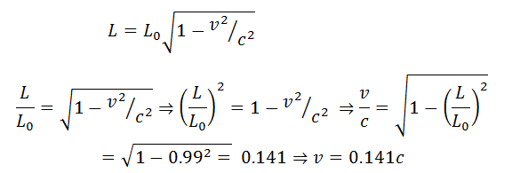
Ex. How fast should a rocket ship move for its length to be contracted to 99% of its rest length?
Sol.

Slide 18
E. Time dilation
Derive the formula for time dilation using the inverse Lorentz transformation
Time intervals, too, are affected by relative motion. Clocks moving with respect to an observer appear to tick less rapidly than they do when at rest with respect to him. This effect is called time dilation.
Let's consider an event happening at a point x´ in the frame S´ .An observer in S' measures the time. He finds that the event happens from the time t₁' to the time t₂'. The duration of the event is
$$t_{0}=t_{2}^{′}−t_{1}^{′} (1−33)$$

Slide 19
To the observer in S, the duration of the event is
Hence, we obtain
$$t=\frac{t_{0}}{\sqrt{1−{v^{2}}/{c^{2}}}} (1−37)$$
Clearly, t > t₀. Thus, a clock moving with respect to an observer appears to tick less rapidly than it does when at rest with respect to him. In other words, a moving clock runs more slowly than a stationary clock.

Slide 20
Example
A spacecraft is moving relative to the earth. An observer on the earth finds that, between 1 P.M. and 2 P.M. according to her clock, 3601 s elapse on the spacecraft’s clock. What is the spacecraft’s speed relative to the earth?
Solution
Here t₀ = 3600 s is the proper time interval on the earth and t = 3601 s is the time interval in the moving frame as measured from the earth. We proceed as follows:
$$t=\frac{t_{0}}{\sqrt{1−{v^{2}}/{c^{2}}}} ⥤1−\frac{v^{2}}{c^{2}}=({\frac{t_{0}}{t})}^{2}$$
$$v=c\sqrt{1−{( \frac{t_{0}}{t})}^{2}}=2.998×{10}^{8}\frac{m}{s} \sqrt{1−{\left( \frac{3600}{3601}\right)}^{2}}= 7.1×{10}^{6}m/s$$

Slide 22
EXPERIMENTAL VERIFICATION OF LENGTH CONTRACTION AND TIME DILATION
The conclusions of the special theory of relativity find direct experimental verification in many of the phenomena of particle physics. We shall illustrate this by an example. Muons are unstable sub- atomic particles, which decay into electron and neutrino. Their mean lifetime in a frame in which they are at rest is 2 µs. They are created in the upper atmosphere at a height 5 to 6 kms during the interaction of primary cosmic rays with the atmosphere. They are also found in considerable number at the sea level. The speed of muons is ʋ = 0.998 c
$$L=vt_{0}=\left(2.994×{10}^{8}m/s\right)×\left(2×{10}^{−6}s\right)=600 m$$
This distance is much smaller than the height where the muons are born. Let us explain this paradox by relativistic calculation. The lifetime of muons is their proper life measured in their own frame. In laboratory frame their life is
$$t=\frac{t_{0}}{\sqrt{1−{v^{2}}/{c^{2}}}}= t=\frac{2×{10}^{−6}s}{\sqrt{1−{0.998}^{2}}}=\frac{2×{10}^{−6} m}{0.063}=32×{10}^{−6}s$$
In this time muons can travel a distance

Slide 23
L$=vt=\left(2.994×{10}^{8}m/s\right)×32×{10}^{−6}s =9600 m.$
Thus muons can reach the sea level in their lifetime.
We can arrive at the same conclusion by considering the length contraction formula. In muons frame the distance between the birthplace of muons and the sea level appears to be contracted to
$$L=L_{0}\sqrt{1−{v^{2}}/{c^{2}}} =9600m \sqrt{1−{0.998}^{2}} m=9600×0.063m=600m$$
The time required to traverse this distance t= L/ʋ = (600m)/(2.994 × 10⁸m/s)=2×10⁻⁶s.
This time is the same as the lifetime of the meson. Thus, the two points of view give identical results.

Slide 24
Example2: Twin paradox
Consider the famous relativistic effect known as the twin paradox. This paradox involves two identical clocks, one remains on earth and the other one is taken on a trip in to space at the speed ʋ and eventually is brought back. It is customary to replace the clocks with the pair of twins Dick and Jane. Dick is 20 years old when he takes off a space trip at a speed of 0.8c to a star 20 light-years away. His trip takes 50 years. To Jane, who stays behind, the pace of Dick's life is slower than her pace by a factor of
$$\sqrt{1−{v^{2}}/{c^{2}}}=\sqrt{1−{0.8}^{2}}=0.6=60\%$$
To Jane, Dick's heart beats only 3 times for every 5 beats of her heart; Dick thinks only 3 thoughts for every 5 thoughts of hers. Finally, Dick returns after 50 years according to Jane's calendar, but to Dick the trip has taken only 30 years. Dick is therefore 50 years old whereas Jane is 70 years old.
Where is the paradox? If we consider the situation from the point of view of Dick in the space craft, Jane on the earth is in motion relative to him at a speed of 0.8c. Should not Jane then be 50 years old when the space craft returns, while Dick is then be 70- the precise opposite of what was conducted above?

Slide 25
But the two situations are not equivalent. Dick changed from one inertial frame to a different one when he started out, when he reversed direction to head home, and when he landed on the earth. Jane, however, remained in the same inertial frame during Dick's trip. Therefore, the time dilation formula applies to Jane's observations of Dick, but not to Dick's observations of Jane.
To look at Dick's trip from his perspective, we must take in to account that the distance L he covers is shortened to
$$L=L_{0}\sqrt{1−{v^{2}}/{c^{2}}}=20 light−year×0.6=12 light−years$$
Hence, to Dick, his trip took
2L/ʋ = 2×12 light-years/0.8c = 30 years
Thus, the aging of the twins is no symmetric. This effect has been verified experimentally.

Slide 26
G. Doppler Effect
1. Doppler Effect in sound
We are familiar with the increase in frequency of a sound when its source approaches us (or we approach the source) and the decrease in frequency when the source recedes from us (or we recede from the source). These changes in frequency constitute the Doppler Effect. The origin of this effect is straight forward. Indeed, successive waves emitted by a source moving toward an observer are closer together than normal because of the advance of the source. Consequently, the separation between the waves, i.e. the wavelength, is shorter, and hence the corresponding frequency is higher.
The relation between the source frequency ν₀ and the observed frequency ν is
$$ν=ν_{0}\frac{1+v/c}{1−V/c} (1−38)$$
where c is the speed of sound, ʋ is the speed of the observer, and V is the speed of the source. The signs of ʋ and V are plus for approaching and minus receding. Transverse motion does not cause a Doppler shift in sound.

Slide 27
2. Doppler Effect in light
We consider a light source as a clock that ticks ν₀ times per second and emits a wave of light with each tick. we will examine the three situations shown in Fig.(5)
A-Transverse Doppler effect in light
Assume that the observer is moving perpendicular to a line between him and the light source. In the reference frame of the source, the proper time between two adjacent ticks is t₀ = 1/ν₀ . In the reference frame of the observer, the time between two adjacent ticks is $t=t_{0}/\sqrt{1−{v^{2}}/{c^{2}}}$ .The frequency measured in the reference frame of the observer is
$$ν= \frac{1}{t}=\frac{1}{t_{0}}\sqrt{1−{v^{2}}/{c^{2}}} (1−39)$$

Slide 28
$ν=ν_{0}\sqrt{1−{v^{2}}/{c^{2}}}$ (1-40)
The observed frequency ν is always lower than the source frequency ν₀.The same formula is true when the source is moving perpendicular to the line between the source and the observer. Thus, transverse motion does cause a Doppler shift in light, unlike in the case of sound.
B-Longitudinal Doppler effect in light
Assume that the observer is receding from the source. We call S the reference frame of the source, and call S' the reference frame of the observer.
Now the observer travels the distance ʋt away from the source between ticks, which mean that the light wave from a given tick takes ʋt/c longer to reach him than the previous one. Hence the total time between the arrival of successive waves is
$$T=t+\frac{vt}{c} (1−41)$$
$$T=\frac{t_{0}}{\sqrt{1−{v^{2}}/{c^{2}}}} + \frac{(v/c)t_{0}}{\sqrt{1−{v^{2}}/{c^{2}}}}=t_{0}\frac{1+v/c}{\sqrt{1−{v^{2}}/{c^{2}}}}=t_{0}\sqrt{\frac{1+v/c}{1−v/c}} (1−42)$$

Slide 29
Hence, the observed frequency ν=1/T is
$$ν (receding)=ν_{0}\sqrt{\frac{1−v/c}{1+v/c}} (1−43)$$
The observed frequency ν is lower than the source frequency. The same formula is true for the motion of the source away from the observer.
In the case where the observer is approaching the source, we have
$$ν(approching)=ν_{0}\sqrt{\frac{1+v/c}{1−v/c}} (1−44)$$
In this case, the observed frequency ν is higher than the source frequency. The same formula is true for the motion of the source toward the observer.
Equation (1-43) and (1-44) can be combined in the single formula
$$ν=ν_{0}\sqrt{\frac{1+v/c}{1−v/c}} (1−45)$$
by adopting the convention that ʋ is + for source and observer approaching each other and - for source and observer receding from each other

Slide 30
The Expanding Universe
The Doppler Effect in light is an important tool in astronomy. Stars emit light of certain characteristic frequencies called spectral lines, and motion of a star toward or away from the earth shows up as a Doppler shift in these frequencies. The spectral lines of distant galaxies of stars are all shifted toward the low-frequency (red) end of the spectrum and hence are called “red shifts.” Such shifts indicate that the galaxies are receding from us and from one another, that is, the universe is expanding.

Slide 31
Example
A distant galaxy in the constellation Hydra is receding from the earth at 6.12 × 10⁷m/s. By how much is a green spectral line of wavelength 500 nm (1 nm × 10⁻⁹ m) emitted by this galaxy shifted toward the red end of the spectrum?
solution
$$λ=λ_{0}\sqrt{\frac{1+v/c}{1−v/c}}$$
Here ʋ = 0.204c and λ₀ = 500 nm, so
$$λ=500nm\sqrt{\frac{1+0.204}{1−0.204}}=615nm$$
which is in the orange part of the spectrum. The shift is λ - λ₀ = 615nm-500 nm= 115 nm.

Slide 32
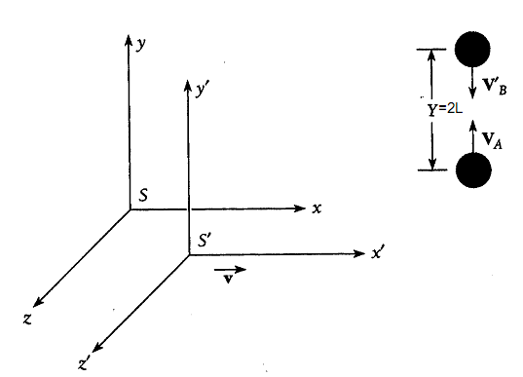
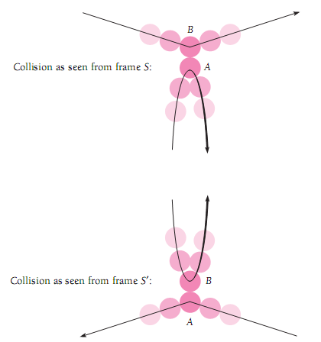
The relativity of mass
$$V_{A}=V_{B}′=V (1−46)$$
$$t_{0}=\frac{2l}{V_{A}}=\frac{2l}{V_{B}′} (1−47)$$
the round-trip time t for B as measured in S is longer than t₀
$$t=\frac{t_{0}}{\sqrt{1−{v^{2}}/{c^{2}}}}$$
Hence, the speed V_{B} of B as measured in S is

Slide 33
$$V_{B}=\frac{2L}{t}=\frac{2L\sqrt{1−{v^{2}}/{c^{2}}}}{t_{0}}=V_{A}\sqrt{1−{v^{2}}/{c^{2}}} (1−48)$$
Since the collision is elastic, the total momentum is conserved, that is,
$$m_{A}V_{A}−m_{B}V_{B}=−m_{A}V_{A}+m_{B}V_{B} (1−49)$$
where m_{A} and m_{B} are the masses of A and B as measured in S. This leads to
$$m_{A}V_{A}=m_{B}V_{B} (1−50)$$
Inserting Eq.(48) into Eq.(50),we find
$$m_{A}=m_{B}\sqrt{1−{v^{2}}/{c^{2}}} \left(1−51\right)$$
$$or m=m_{0}/\sqrt{1−{v^{2}}/{c^{2}}} (1−52$$
We call m₀ the rest mass or the proper mass. Thus, the mass m of a moving body is larger than its rest mass m₀ by the factor $1 /\sqrt{1−{v^{2}}/{c^{2}}}$.The increase of the mass due to motion is a relativistic effect. We call m the relativistic mass of the body.

Slide 34
The relativistic momentum is defined as
$$p=mv=\frac{m_{0}v}{\sqrt{1−{v^{2}}/{c^{2}}}} (1−53)$$
In the theory of special relativity, the Newton's second law of motion is expressed by the formula
$$F=\frac{dp}{dt}=\frac{d}{dt}(mv)=m_{0}\frac{d}{dt}[\frac{v}{\sqrt{1−{v^{2}}/{c^{2}}}} ] (1−54)$$
According to the above formula, we have
$$F=\frac{d}{dt}\left(mv\right)=m\frac{d}{dt}v+v\frac{d}{dt}m=ma +v\frac{d}{dt} m (1−55)$$
Here a = dv/dt is the acceleration. If ʋ varies with time, m also varies with time. In this case, we have F ≠ ma.

Slide 35
Example 1.5
Find the acceleration of a particle of mass m and velocity v when it is acted upon by the constant force F, where F is parallel to ʋ.
solution
$$F=\frac{d}{dt}(mv)=m_{0}\frac{d}{dt}[\frac{v}{\sqrt{1−{v^{2}}/{c^{2}}}} ]$$
$$F=m_{0}[\frac{1}{\sqrt{1−{v^{2}}/{c^{2}}}}+\frac{{v^{2}}/{c^{2}}}{{(1−{v^{2}}/{c^{2}})}^{3/2}} ]\frac{dv}{dt}$$
$$=\frac{m_{0}a}{{(1−{v^{2}}/{c^{2}})}^{3/2}}$$
The acceleration of the particles is
$$a=\frac{F}{m_{0}} {(1−{v^{2}}/{c^{2}})}^{3/2}$$

Slide 36
I.Mass and energy
$$K=\int_{0}^{s}{Fds } (1−56)$$
Using the relativistic form of the second law of motion
$$F= \frac{d}{dt}\left(mv\right) (1−57)$$
Eq.(1-56) becomes
$$K=\int_{0}^{s}{\frac{d}{dt}\left(mv\right)ds}=\int_{0}^{v}{vd(mv)}=\int_{0}^{v}{vd }(\frac{m_{0}v}{\sqrt{1−{v^{2}}/{c^{2}}}} )$$
Integrating by parts $\int{udV=uV−\int{Vdu}}$

Slide 37
$$=\frac{m_{0}v^{2}}{\sqrt{1−{v^{2}}/{c^{2}}}}−m_{0}\int_{0}^{v}{\frac{v}{\sqrt{1−{v^{2}}/{c^{2}}}}}dv (1−58)$$
$$=\frac{m_{0}v^{2}}{\sqrt{1−{v^{2}}/{c^{2}}}}+m_{0}c^{2}\sqrt{1−{v^{2}}/{c^{2}}} \begin{matrix}v \\ ⃒ \\ 0\end{matrix}$$
$$=\frac{m_{0}c^{2}}{\sqrt{1−{v^{2}}/{c^{2}}}}−m_{0}c^{2}$$
The above equation may be rewritten as
$mc^{2}=K+{m_{0 }c}^{2} (1−59)$
We interpret mc² as the total energy of the body. It follows from Eq.(1-59) that, when the body is at rest, that is, when K =0,the body never the less possesses the energy m₀c².The energy

Slide 38
$$E_{0}=m_{0}c^{2} (1−60)$$
is called the rest energy. The total energy can be written as
$$E=mc^{2}=\frac{m_{0}c^{2}}{\sqrt{1−{v^{2}}/{c^{2}}}} (1−61)$$
In terms of E and E₀ , Eq.(1-59) becomes
$$E=+E_{0}+K (1−62)$$
Equation (1-61) says that mass and energy are not independent.
Mass and energy are different aspects of the same thing.

Slide 40
Example
A stationary body explodes into two fragments each of mass 1.0 kg that move apart at speeds of 0.6c relative to the original body. Find the mass of the original body.
solution
$$E_{0}=mc^{2}=m_{1}c^{2}+m_{2}c^{2}=\frac{m_{01}c^{2}}{\sqrt{1−{v^{2}}/{c^{2}}}}+\frac{m_{02}c^{2}}{\sqrt{1−{v^{2}}/{c^{2}}}}$$
$$m=\frac{E_{0}}{c^{2}}= \frac{2(1kg)}{\sqrt{1−{0.6}^{2}}}=2.5 kg$$

Slide 41
Kinetic energy at low speeds
The relativistic formula for the kinetic energy is
$$K=mc^{2}−m_{0}c^{2}=\frac{m_{0}c^{2}}{\sqrt{1−{v^{2}}/{c^{2}}}} − m_{0}c^{2} (1−63)$$
Consider the case where v ˂˂ c. We use the approximation (1+ x)^{n} ≈1+ nx for small x to expand the first term in the above formula. Then we obtain the expression
$\frac{1}{\sqrt{1−{v^{2}}/{c^{2}}}}=1+\frac{1}{2}\frac{v^{2}}{c^{2}}$ when v ˂˂ c
$$K=\left(1+\frac{1}{2}\frac{v^{2}}{c^{2}}\right)m_{0}c^{2}−m_{0}c^{2 }≈\frac{1}{2}m_{0}v^{2}(1−64)$$
In agreement with classical mechanics.

Slide 43
Energy and momentum
the total energy, rest energy, and momentum of a particle are related
$$E=\frac{m_{0}c^{2}}{\sqrt{1−{v^{2}}/{c^{2}}}} (1−65)$$
Square of E is
$$E^{2}=\frac{{m_{0}}^{2}c^{4}}{1−{v^{2}}/{c^{2}}} (1−66)$$
Momentum is
$$p= \frac{m_{0}v}{\sqrt{1−{v^{2}}/{c^{2}}}} (1−67)$$
We have

Slide 44
$$p^{2}c^{2}=\frac{{m_{0}}^{2}v^{2}c^{2}}{1−{v^{2}}/{c^{2}}} (1−68)$$
When we subtract p²c² from E² we obtain
$$E^{2}−p^{2}c^{2}=\frac{{m_{0}}^{2}c^{4}−{m_{0}}^{2}v^{2}c^{2}}{1−{v^{2}}/{c^{2}}} = {m_{0}}^{2}c^{4} (1−69)$$
Hence, we have
$$E^{2}={m_{0}}^{2}c^{4}+p^{2}c^{2} (1−70)$$

Slide 45
Massless particles
In classical mechanics, a particle must have rest mass in order to have energy and momentum. However, this requirement does not hold true in relativistic mechanics. When m₀ =0and ʋ <c, we find from Eqs.(1-65) and (1-67) that E = p = 0. Such a particle is meaningless. However, when m₀ = 0 and ʋ = c, we have E = 0/0 and p = 0/0, indicating that E and p can have any values. Thus, massless particles may exist if they travel with the speed of light. The relation between the total energy E and the momentum p of a massless particle is
$$E=pc (1−71)$$
An example of massless particles is the photon.

Slide 46
Example 1.8
An electron (m = 0.511 MeV/c²) and a photon (m = 0) both have momenta of 2.000 MeV/c. Find the total energy of each.
Solution
The total energy of the electron is
$$E^{2}={m_{0}}^{2}c^{4}+p^{2}c^{2}$$
$$E=\sqrt{{m_{0}}^{2}c^{4}+p^{2}c^{2} }=\sqrt{{(\frac{0.511MeV}{c^{2}})}^{2}c^{4}+{(\frac{2MeV}{c})}^{2}c^{2}}$$
$$=\sqrt{{(0.511MeV)}^{2}+{(2MeV)}^{2}}=2.064 MeV.$$
The photon total energy is
$$E=pc=\left(2\frac{MeV}{c}\right)C=2 MeV.$$

Slide 47
Velocity Addition
Suppose something is moving relative to both S and S´. An observer in S measures its three velocity components to be
$$V_{x}=\frac{dx}{dt}, V_{y}=\frac{dy}{dt} , V_{z}=\frac{dz}{dt} (1−72)$$
Meanwhile, to an observer is S' they are
$$V_{x}′=\frac{dx^{′}}{dt}, V_{y}′=\frac{dy^{′}}{dt} , V_{z}′=\frac{dz^{′}}{dt} (1−73)$$
By differentiating the inverse Lorentz transformation equations for x, y, z, and t, we obtain
$$dx=\frac{dx^{′}+vdt′}{\sqrt{1−{v^{2}}/{c^{2}}}} (1−74)$$
$$dy=dy′$$
$$dz=dz′$$

Slide 48
$$dt=\frac{dt^{′}+\left(\frac{v}{c^{2}}\right)dx′}{\sqrt{1−{v^{2}}/{c^{2}}}}$$
Thus, the formulae for the velocity addition are
$$V_{x}=\frac{V_{x}^{′}+ʋ}{1+(\frac{ʋV_{x}′}{c^{2}})} (1−75)$$
$$V_{y}=\frac{V_{y}′\sqrt{1−{v^{2}}/{c^{2}}}}{1+(\frac{ʋV_{x}′}{c^{2}})} (1−76)$$
$$V_{z}=\frac{V_{z′}\sqrt{1−{v^{2}}/{c^{2}}}}{1+(\frac{ʋV_{x}′}{c^{2}})} (1−77)$$

Slide 49
Consider a ray of light emitted in the moving frame S' in its direction of motion relative to S. In this case, we have V_{x}' = c. An observer in S will measure the speed
$$V_{x}=\frac{V_{x}^{′}+ʋ}{1+(\frac{ʋV_{x}′}{c^{2}})}=\frac{c+ʋ}{1+(\frac{ʋc}{c^{2}})}=c$$
Thus both observers in S and S' find the same value for the speed of light.

Slide 50
Example
Spacecraft Alpha A is moving at 0.90c with respect to the earth. If spacecraft B is to pass Alpha at a relative speed of 0.50c in the same direction, what speed must B have with respect to the earth?
solution
$$V_{x}=\frac{V_{x}^{′}+ʋ}{1+(\frac{ʋV_{x}′}{c^{2}})}=\frac{0.5c+0.9c}{1+(0.5c)(0.9c)/c^{2}}=0.97c$$
This speed is less than c.

