Slide 1
Electromotive Force
Adil Hamid
Third stage Physical Chemistry

Slide 2
Half Reactions
what are half reactions ? Let us consider the reaction:
Such a reaction which is brought about by loss of electrons (oxidation) and gain of electrons (reduction) is called an Oxidation-Reduction reaction or Redox reaction.
This reaction can be considered as made up of two half-reactions:
The first half-reaction that proceeds by oxidation is often referred to as the Oxidation half-reaction.
The second half-reaction that occurs by reduction, is referred to as the Reduction half-reaction.

Slide 3
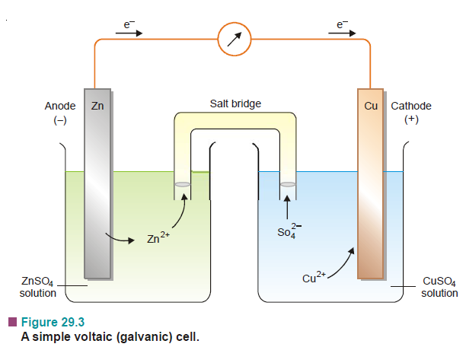
Electrochemical Cells
A device for producing an electrical current from a chemical reaction (redox reaction) is called an electrochemical cell.

Slide 4
Voltaic Cells
A Voltaic cell, also known as a galvanic cell is one in which electrical current is generated by a spontaneous redox reaction.
A simple voltaic cell is shown by the spontaneous reaction of zinc metal with an aqueous solution of copper sulphate.
The solutions in the two compartments may be connected by a salt bridge.
The salt bridge is a U-tube filled with an electrolyte such as NaCl, KCl, or K₂SO₄.
It provides a passage to ions from one compartment to the other compartment without extensive mixing of the two solutions.

Slide 5
Cell Terminology
Current is the flow of electrons through a wire or any conductor.
Electrode is the material: a metallic rod/bar/strip which conducts electrons into and out of a solution.
Anode is the electrode at which oxidation occurs. It sends electrons into the outer circuit. It has negative charge and is shown as (–) in cell diagrams.
Cathode is the electrode at which electrons are received from the outer circuit. It has a positive charge and is shown as (+) in cell diagrams.
Electrolyte is the salt solutions in a cell.
Anode compartment is the compartment of the cell in which oxidation half-reaction occurs.
Cathode compartment is the compartment of the cell in which reduction half-reaction occurs.
Half-cell. Each half of an electrochemical cell, where oxidation occurs and the half where reduction occurs, is called the half cell.

Slide 6
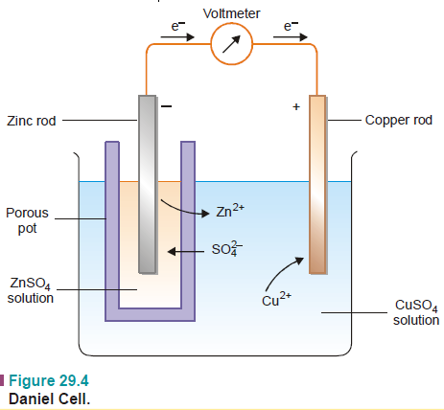
Daniel Cell
It is a typical voltaic cell. It was named after the British chemist John Daniel. It is a simple zinc copper cell like the one described above.
In this cell the salt-bridge
has been replaced by a
porous pot.

Slide 7
Cell reaction
The flow of electrons from one electrode to the other in an electrochemical cell is caused by the half-reactions.
The net chemical change obtained by adding the two half-reactions is called the cell reaction.

Slide 8
Cell potential or emf
The flow of current through the circuit is determined by the ‘push’, of electrons at the anode and ‘attraction’ of electrons at the cathode.
These two forces constitute the ‘driving force’ or ‘electrical pressure’ that sends electrons through the circuit.
This driving force is called the electromotive force (abbreviated emf) or cell potential.
The emf of cell potential is measured in units of volts (V) and is also referred to as cell voltage.

Slide 9
Cell diagram or Representation of a Cell
A single vertical line (|) represents a phase boundary between metal electrode and ion solution (electrolyte).
A double vertical line (||) represents the salt bridge, porous partition or any other means of permitting ion flow while preventing the electrolyte from mixing.
Anode half-cell is written on the left and cathode half-cell on the right.
In the complete cell diagram, the two half-cells are separated by a double vertical line (salt bridge) in between.
The zinc-copper cell can now be written as

Slide 10
The symbol for an inert electrode, like the platinum electrode is often enclosed in a bracket.
The value of emf of a cell is written on the right of the cell diagram. Thus a zinc-copper cell has emf 1.1V and is represented as:

Slide 11
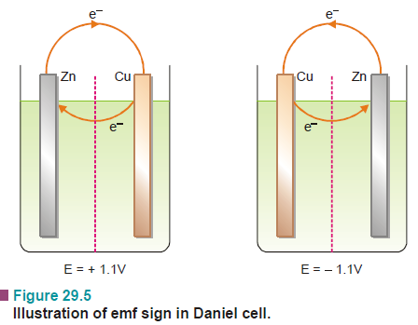
Convention regarding sign of emf value
The emf of a cell reflects the tendency of electrons to flow externally from one electrode to another.
This corresponds to a clockwise flow of electrons through the external circuit. Thus the emf of the cell is given the +ve sign.
If the emf acts in the opposite direction through the cell circuit, it is quoted as –ve value.
The negative sign indicates that
the cell is not feasible in the
given direction.

Slide 12
Calculating the emf of a cell
The emf of a cell can be calculated from the half-cell potentials of the two cells (anode and cathode) by using the following formula
E_{cell} = E_{cathode} – E_{anode} = E_{R} – E_{L}
where E_{R} and E_{L} are the reduction potentials of the right-hand and left-hand electrodes respectively.
It may be noted that absolute values of these reduction potentials cannot be determined.
These are found by connecting the half-cell with a standard hydrogen electrode whose reduction potential has been arbitrarily fixed as zero.

Slide 13
Weston Standard Cell
A standard cell is one which provides a constant and accurately known emf.
The Weston cadmium cell is constructed in a H-shaped glass tube
The positive electrode consists of mercury covered with a paste of solid mercurous sulphate (Hg₂SO₄) over which is placed a layer of cadmium sulphate crystals.
The negative electrode is 12.5% cadmium amalgam, Cd(Hg), covered with cadmium sulphate crystals.
The entire cell is filled with saturated cadmium sulphate solutions and sealed.

Slide 14
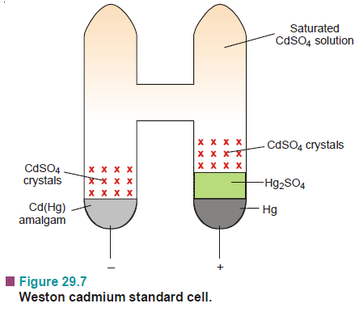
The emf of a cadmium standard cell is 1.0183 (V) at 20°C.

Slide 15
Relation Between emf And Free Energy
The maximum amount of work, W_{max}’ obtainable from the cell is the product of charge flowing per mole and maximum potential difference, E, through which the charge is transferred.
where n is the number of moles of electrons transferred and is equal to the valence of the ion participating in the cell reaction. F stands for Faraday and is equal to 96,500 coulombs and E is the emf to the cell.
According to Gibbs-Helmholtz equation, the decrease in free energy of a system at constant pressure is given by the expression

Slide 16
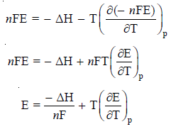
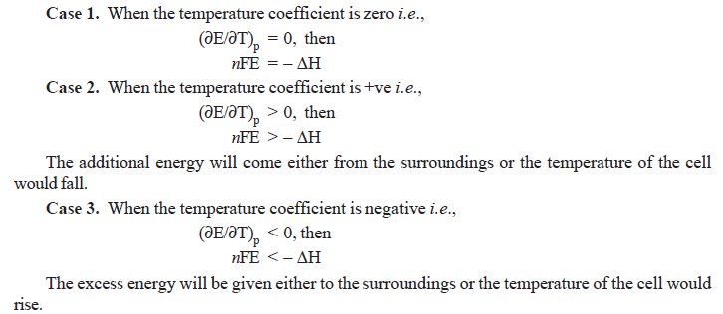

Slide 17
Standard emf of a cell
The value of emf varies with the concentration of the reactants and products in the cell solutions and the temperature of the cell.
When the emf of a cell is determined under standard conditions, it is called the standard emf. The standard conditions are (a) 1 M solutions of reactants and products; and (b) temperature of 25°C.
Thus standard emf may be defined as : the emf of a cell with 1 M solutions of reactants and products in solution measured at 25°C.
Standard emf of a cell is represented by the symbol E°.
With gases 1 atm pressure is a standard condition instead of concentration.
For a simple Zn-Cu voltaic cell, the standard emf, E°, is 1.10 V. This means that the emf of the cell operated with [Cu²⁺] and [Zn²⁺] both at 1 M and 25°C is 1.10 V. That is,

Slide 18
Determination of emf of a half-cell
By a single electrode potential, we also mean the emf of an isolated half-cell or its half-reaction.
The emf of a cell that is made of two half-cells can be determined by connecting them to a voltmeter.
However, there is no way of measuring the emf of a single half-cell directly.
A convenient procedure to do so is to combine the given half-cell with another standard half-cell.
The emf of the newly constructed cell, E, is determined with a voltmeter.
The emf of the unknown half-cell, E°, can then be calculated from the expression

Slide 19
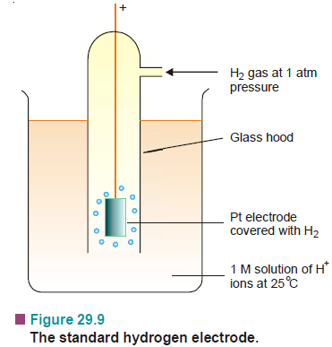
The standard hydrogen half-cell or Standard Hydrogen Electrode (SHE), is selected for coupling with the unknown half-cell.
It consists of a platinum electrode immersed in a 1 M solution of H⁺ ions maintained at 25°C.
Hydrogen gas at one atmosphere enters the glass hood and bubbles over the platinum electrode. The hydrogen gas at the platinum electrode passes into solution, forming H⁺ ions and electrons.
The emf of the standard hydrogen electrode is arbitrarily assigned the value of zero volts. So, SHE can be used as a standard for other electrodes.

Slide 20
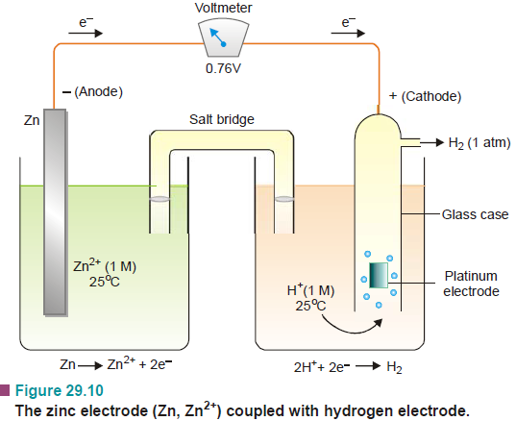
The half-cell whose potential is desired, is combined with the hydrogen electrode and the emf of the complete cell determined with a voltmeter. The emf of the cell is the emf of the half-cell.
For example, it is desired to determine the emf of the zinc electrode,
Zn | Zn²⁺ as :

Slide 21
IUPAC convention places the SHE on the left-hand side
In the convention adopted by the IUPAC, the SHE is always placed on the left-hand side of the half-cell under study.
The electrons flow from left-to-right and the given half-cell electrode gains electrons (reduction).
The observed emf of the combined electrochemical cell is then the emf of the half-cell on the right-hand.
Such emf values of half-cells, or half reactions, are known as the Standard reduction potentials or Standard potentials.
However, if the SHE be placed on the right hand side of the given half-cell, the potential so obtained is called as the Standard oxidation potential.
According to IUPAC convention, the standard reduction potentials alone are the standard potentials.

Slide 22
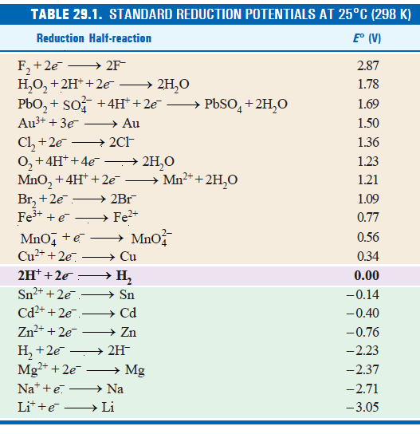

Slide 23
Using Standard Potentials
In Table 29.1 the standard reduction potentials (E°) are arranged in the order of increasing potentials.
The relative position of electrodes (M/M⁺) in the table can be used to predict the reducing or oxidising ability of an electrode.
The electrodes that are relatively positive indicate that reduction reaction involving addition of electrons, is possible.
M⁺ + e– → M
In case of relatively negative potential involving loss of electrons, is indicated.
M → M⁺ + e–
It also follows that the system with higher electrode potential will be reduced by the system with lower electrode potential.

Slide 24
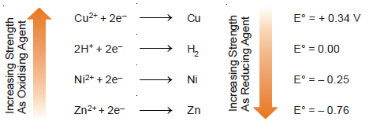
Predicting the Oxidising or Reducing Ability
Let us consider a series of elements Cu, H₂,Ni, Zn and their ions. These four elements could act as reducing agents.
On the other hand, their ions Cu²⁺, H⁺, Ni²⁺ and Zn²⁺ can act as electron acceptors or oxidising agents.
The value of E° becomes more negative down the series. This means that Cu²⁺ is the best oxidising agent (most electron-attracting ion) of those in the list. That is, Cu²⁺ shows the greatest tendency to be reduced.
Conversely, Zn²⁺ is the worst oxidising agent, being the least electron-attracting ion.

Slide 25
Some important points concerning the Table of Standard Reduction Potentials (Table 29.1) are:
The more positive the value of E°, the better the oxidising ability (the greater the tendency to be reduced) of the ion or compound, on moving upward in the Table.
The more negative the value of E° the better the reducing ability of the ions, elements or compounds on moving downward in the Table.
Under standard conditions, any substance in this Table will spontaneously oxidise any other substance lower than it in the Table.

