Slide 1
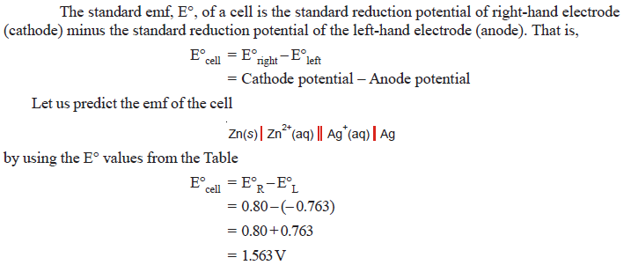
Predicting cell emf

Slide 2
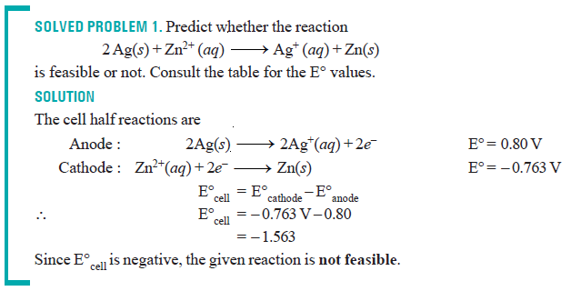
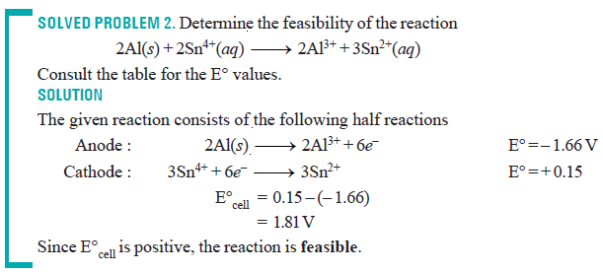

Slide 3
The Nernst Equation
Nernst equation enable us to calculate the half-cell potential, E, from the standard electrode potential, E°, and the temperature of the cell.
This relation known as the Nernst equation can be stated as

Slide 4
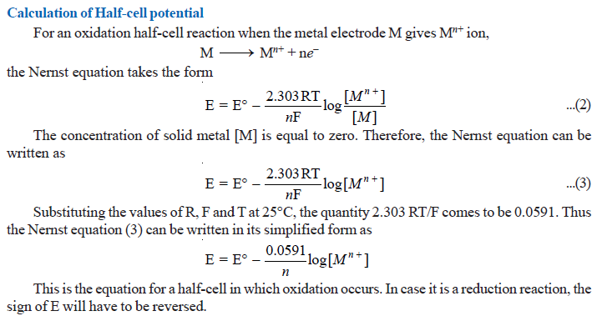

Slide 5
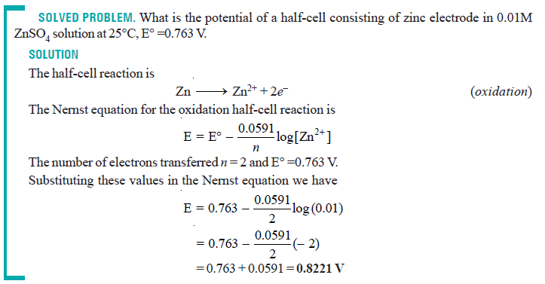

Slide 6
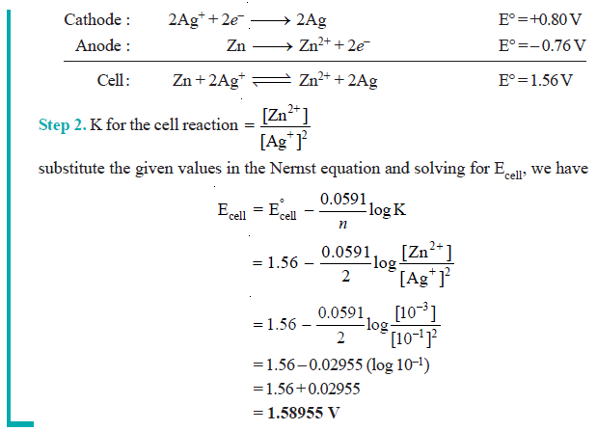

Slide 7
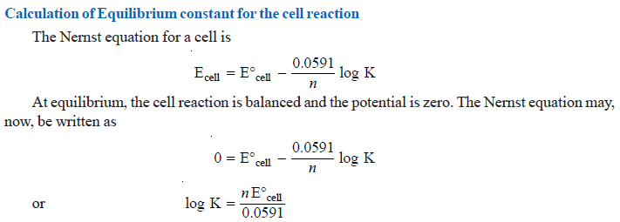

Slide 8
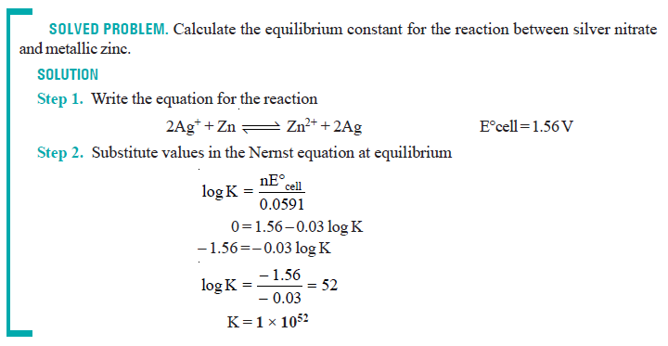

Slide 9
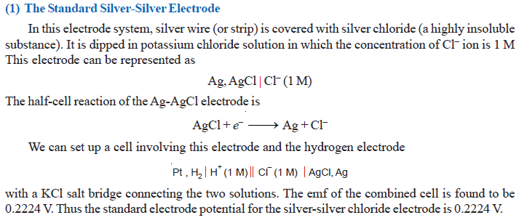
Other Reference Electrodes

Slide 10
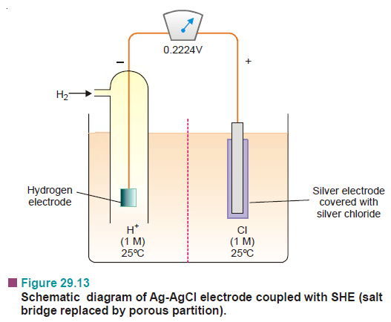

Slide 11
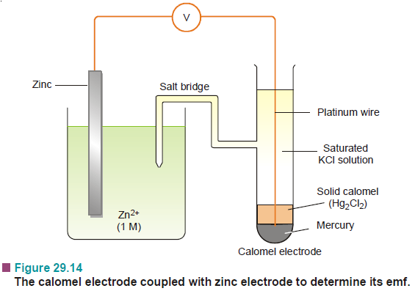
(2) The Calomel Electrode

Slide 12
It is the most commonly used secondary standard reference electrode. SCE, consists of a wide glass-tube with a narrow side-tube. A platinum wire is dipping into liquid mercury covered with solid mercurous chloride (Hg₂Cl₂,calomel).
The tube is filled with a 1 M solution of KCl (or saturated KCl solution).
The side-tube containing KCl solution provides the salt bridge which connects the electrode to any other electrode.

Slide 13
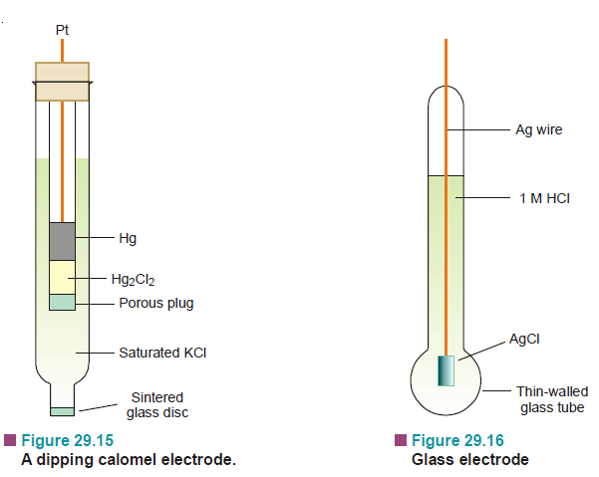

Slide 14
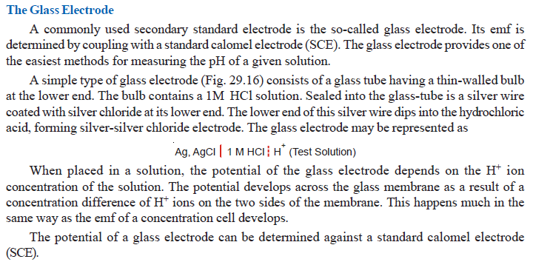

Slide 15
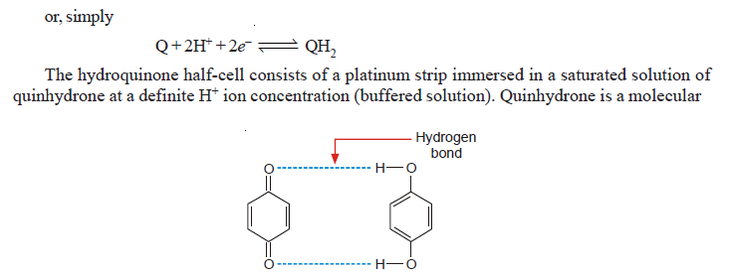

Slide 16
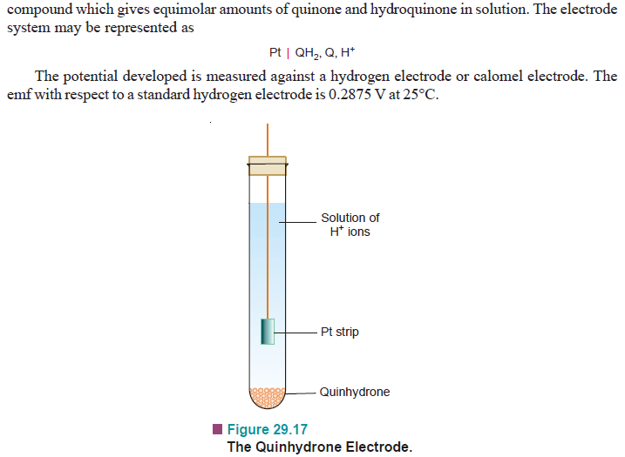

Slide 18
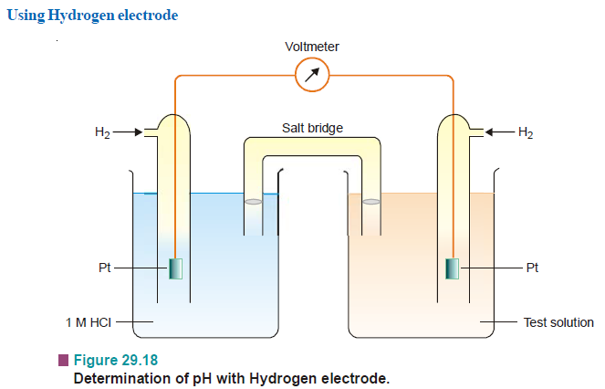

Slide 19
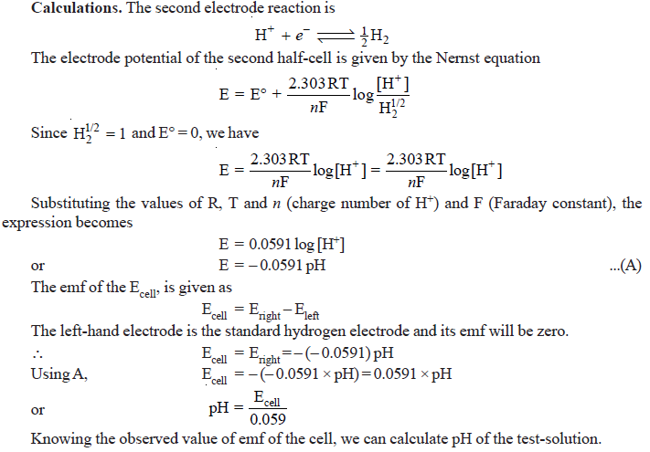

Slide 21
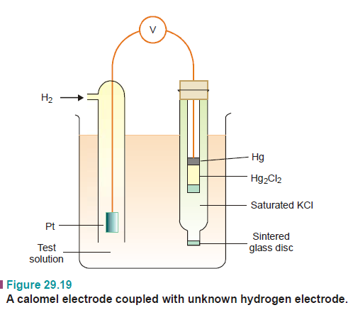

Slide 22
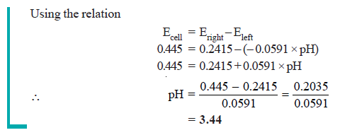

Slide 23
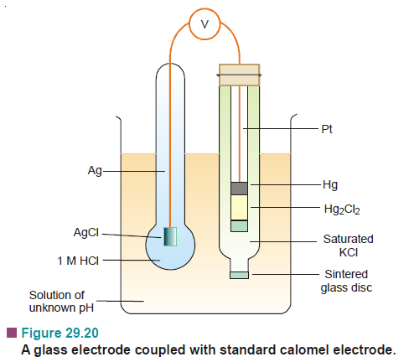

Slide 24
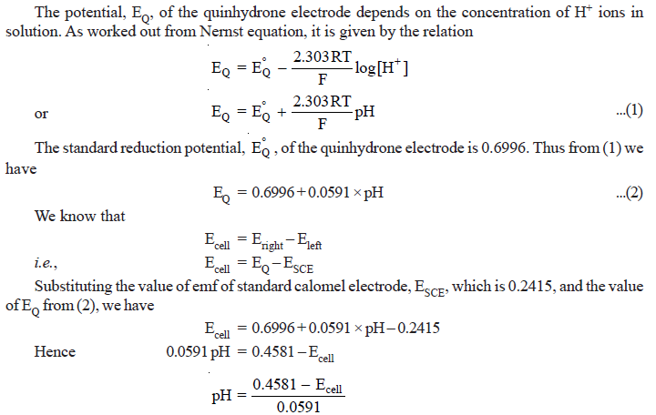

Slide 25
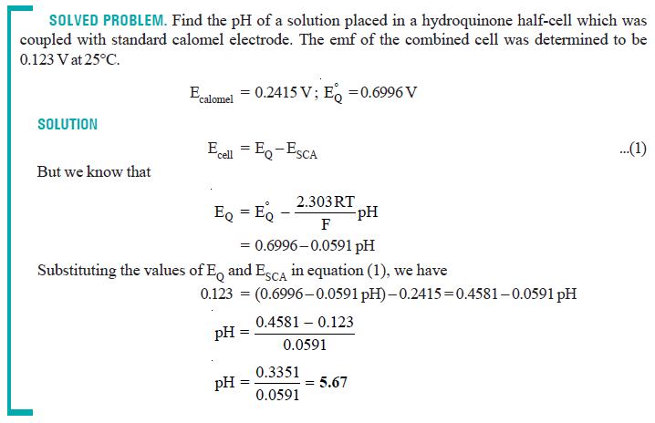

Slide 26
Potentiometric Titrations
Acid-base Titrations
A hydrogen electrode or a glass electrode is immersed in solution of the acid whose strength is to be determined.
The glass electrode is coupled with a standard calomel electrode.
The cell thus formed is connected to the potentiometer or electronic voltmeter.
When alkali is added, pH of the solution changes.
The emf of the cell also changes with pH of the solution in accordance with the relation.

Slide 27
Concentration Cells
Cell potentials depend on concentration of the electrolyte. Thus a cell can be constructed by pairing two half-cells in which identical electrodes are dipping in solution of different concentrations of the same electrolyte. Such a cell called concentration cell.
It may be described as : a cell in which emf arises as a result of different concentrations of the same electrolyte in the component half-cells.
A concentration cell consists of two silver electrodes, one immersed in 0.1 M silver nitrate solution and the other in 1 M solution of the same electrolyte.
The two solutions are in contact through a membrane (or a salt bridge).

Slide 28
When the electrodes are connected by a wire, it is found experimentally that electrons flow from the electrode in more dilute (0.1M) solution to that in the more concentrated (1 M) solution.
Explanation. The concentration of Ag⁺ ions in the left compartment is lower (0.1M) and in the right compartment it is higher (1M).
There is a natural tendency to equalise the concentration of Ag⁺ ions in the two compartments.
This can be done if the electrons are transferred from the left compartment to the right compartment. This electron transfer will produce Ag+ ions in the right compartment by the half-cell reactions :

Slide 29
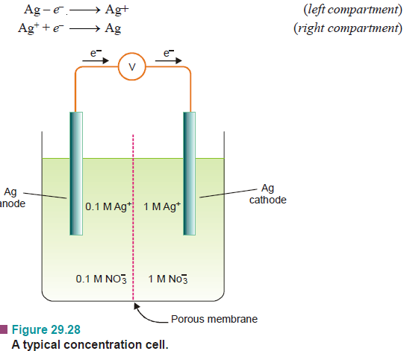

Slide 31
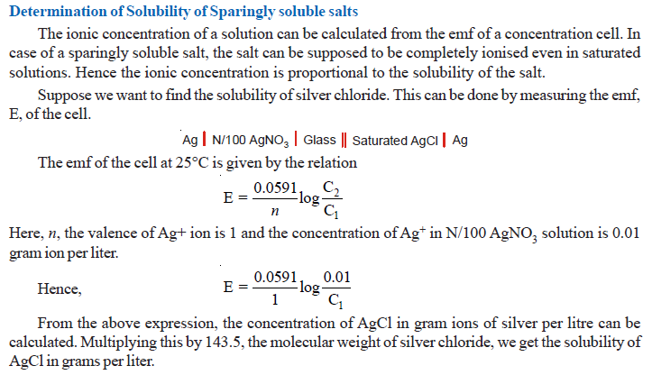

Slide 33
