Slide 1
Partial differential Equations
Ministry of Higher Education Mathematics Department
College of Education 3rd Stage
Academic Year
2021-2022
Lecturer
Dr. Adnan A. Jalal

Slide 2
Lecture Outlines
Introduction To Partial D.E.
Order and degree of a partial D.E.
Linear and non-linear partial D.E.
Classification of first order partial D.E.
Origin of partial differential equations.
Rule I. Derivation of a partial differential equation by the elimination of arbitrary constants.

Slide 3
Introduction To Partial D.E.
Definition. An equation containing one or more partial derivatives of an unknown function of two or more independent variables is known as a partial differential equation.
$\begin{matrix}∂z/∂x+∂z/∂y=z+xy & …(1) & \\ (∂z/∂x)^{2}+∂^{3}z/∂y^{3}=2x\left(\frac{∂z}{∂x}\right) & …(2) & \\ z(∂z/∂x)+∂z/∂y=x & …(3) & \end{matrix}$

Slide 4
2. Order and degree of a partial D.E.
The order of a partial differential equation is defined as the order of the highest partial derivative occurring in the partial differential equation.
The degree of a partial differential equation is the degree of the highest order derivative which occurs in it after the equation has been rationalized, i.e., made free from radicals and fractions so far as derivatives are concerned.

Slide 5
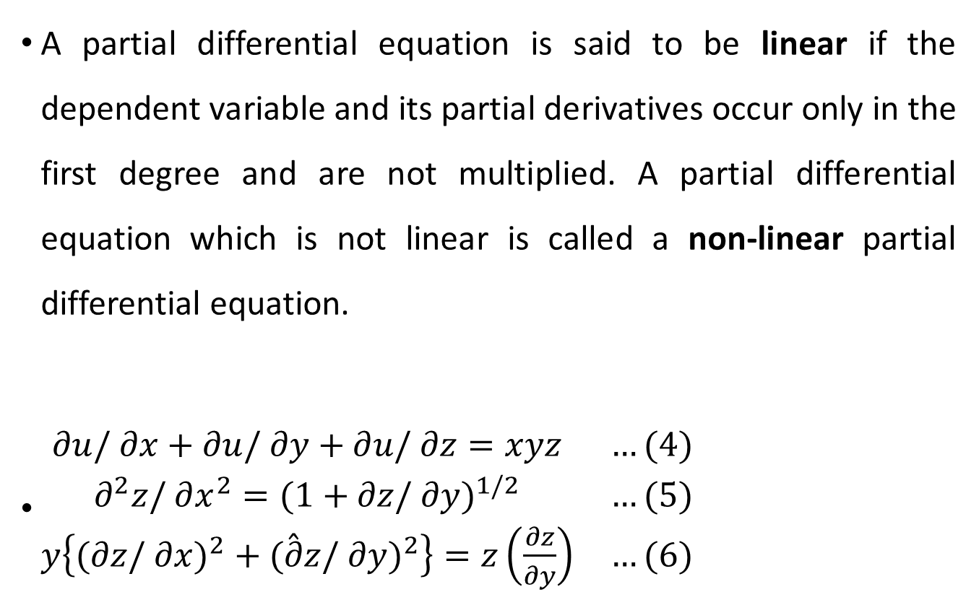
3. Linear and non-linear partial D.E.
A partial differential equation is said to be linear if the dependent variable and its partial derivatives occur only in the first degree and are not multiplied. A partial differential equation which is not linear is called a non-linear partial differential equation.
$\begin{matrix}∂u/∂x+∂u/∂y+∂u/∂z=xyz & …(4) & \\ ∂^{2}z/∂x^{2}=(1+∂z/∂y)^{1/2} & …(5) & \\ y\left\{(∂z/∂x)^{2}+(\overset{ˆ}{∂}z/∂y)^{2}\right\}=z\left(\frac{∂z}{∂y}\right) & …(6) & \end{matrix}$

Slide 6
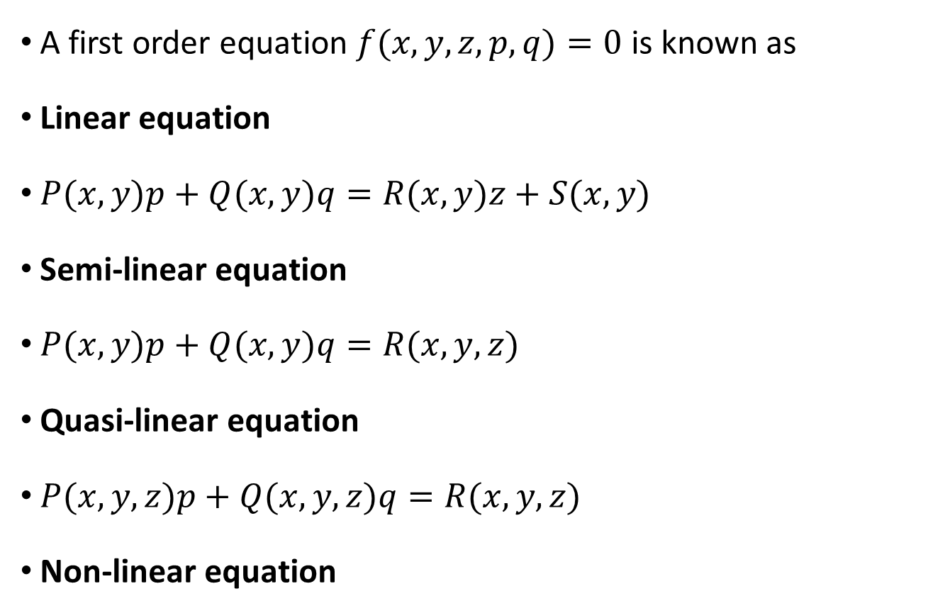
4. Classification of first order partial D.E.
A first order equation $f(x,y,z,p,q)=0$ is known as
Linear equation
$P(x,y)p+Q(x,y)q=R(x,y)z+S(x,y)$
Semi-linear equation
$P(x,y)p+Q(x,y)q=R(x,y,z)$
Quasi-linear equation
$P(x,y,z)p+Q(x,y,z)q=R(x,y,z)$
Non-linear equation

Slide 7
5. Origin of partial differential equations.
Consider an equation $F\left(x,y,z,a,b\right)=0 …(1)$
Differentiating (1) with respect to $x$ and $y$ partially in turn, we get
$\begin{matrix}∂F/∂x+p(∂F/∂z)=0 & \text{and} & ∂F/∂y+q(∂F/∂z)=0\end{matrix} …(2)$
Eliminating two constants $a$ and $b$ from three equations of (1) and (2)
$f\left(x,y,z,p,q\right)=0, …(3)$
which is partial differential equation of the first order.

Slide 8
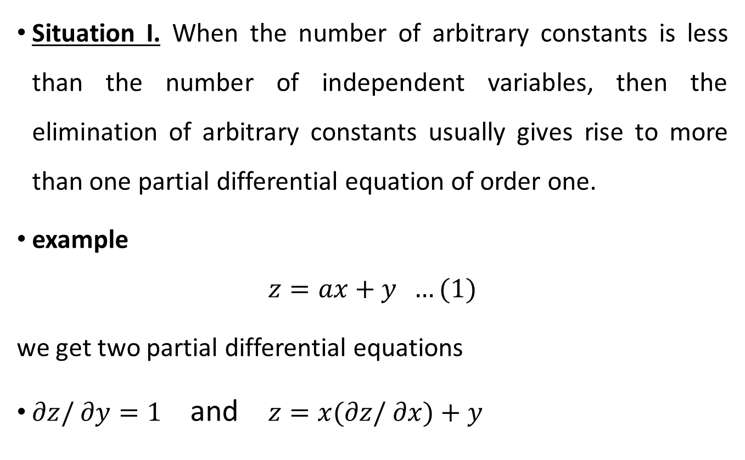
6. Rule I. Derivation of a partial differential equation by the elimination of arbitrary constants.
Situation I. When the number of arbitrary constants is less than the number of independent variables, then the elimination of arbitrary constants usually gives rise to more than one partial differential equation of order one.
example
$$z=ax+y …(1)$$
we get two partial differential equations
$∂z/∂y=1$ and $z=x(∂z/∂x)+y$

Slide 9
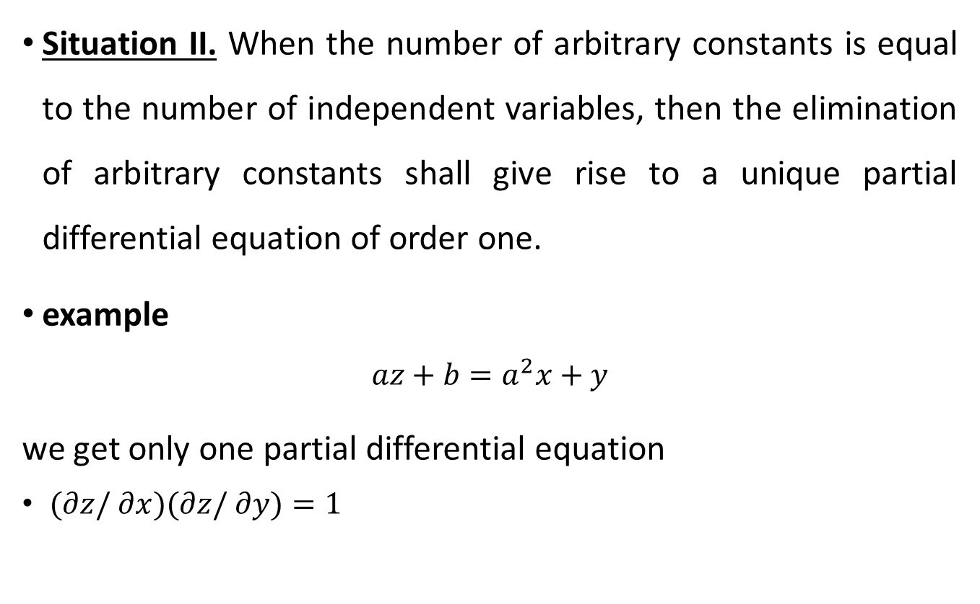
6. Rule I. Derivation of a partial differential equation by the elimination of arbitrary constants.
Situation II. When the number of arbitrary constants is equal to the number of independent variables, then the elimination of arbitrary constants shall give rise to a unique partial differential equation of order one.
example
$$az+b=a^{2}x+y$$
we get only one partial differential equation
$(∂z/∂x)(∂z/∂y)=1$

Slide 10
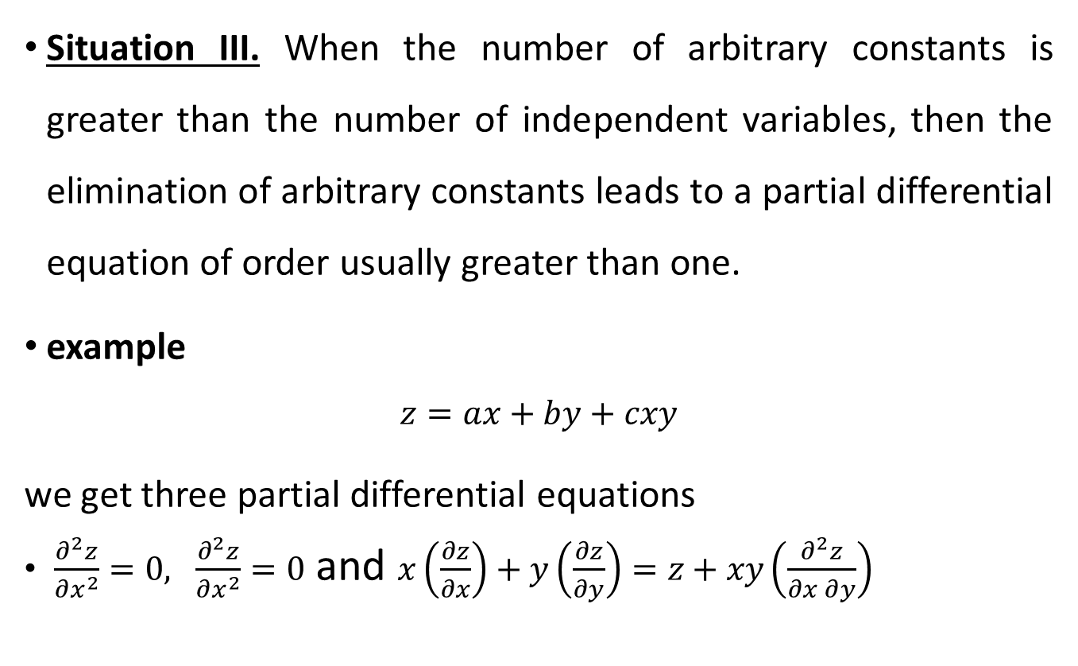
6. Rule I. Derivation of a partial differential equation by the elimination of arbitrary constants.
Situation III. When the number of arbitrary constants is greater than the number of independent variables, then the elimination of arbitrary constants leads to a partial differential equation of order usually greater than one.
example
$$z=ax+by+cxy$$
we get three partial differential equations
$\frac{∂^{2}z}{∂x^{2}}=0, \frac{∂^{2}z}{∂x^{2}}=0$ and $x\left(\frac{∂z}{∂x}\right)+y\left(\frac{∂z}{∂y}\right)=z+xy\left(\frac{∂^{2}z}{∂x∂y}\right)$

Slide 11
Thank you

