Slide 1
Analyzing Similar projects
Chapter Three
Writing Thesis

Slide 2
why do we need similar projects
The project that you are starting to design it is an unknown project ,may be you not design it through out the Architectural stages.
This is mean you don’t have enough information about the project.
To create good design you have to know what are the previous similar projects, and how were designed.

Slide 3
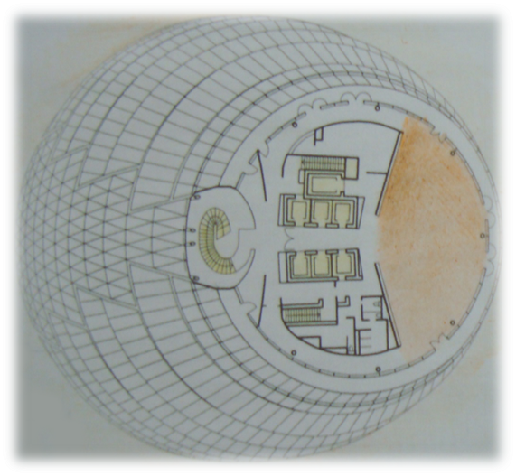
You should review general description about your selected project
Name of project: London city hall
Location : England, London
Architect : Norman Foster
Style : High-Tech Modern,
Date : 1998 to 2003.
Construction : System glass cladding.
Building Type : government offices.
High : 45 m
Number of floors : 10 floors above the ground floor.
• gross floor area : 18,000 m 2.
• ground net area :12,000 m 2.

