Slide 1
Building Construction
University of Salahaddin
Department of Architecture
2n d Stage
²⁰²²
Floor Slab Systems
BY:
AUSAMA MAGID

Slide 2
From Previous Lecture:
Arches Syasytems and Materials:
Definitions
Material
Terminology
Advantage & Disadvantage
Proportion
Types & Geometry
Notes:
Computer is an advanced electronic device that takes raw data as input from the user and processes these data under the control of set of instructions (called program) and gives the result (output) and saves output for the future use. It can process both numerical and non- numerical (arithmetic and logical) calculations.

Slide 3
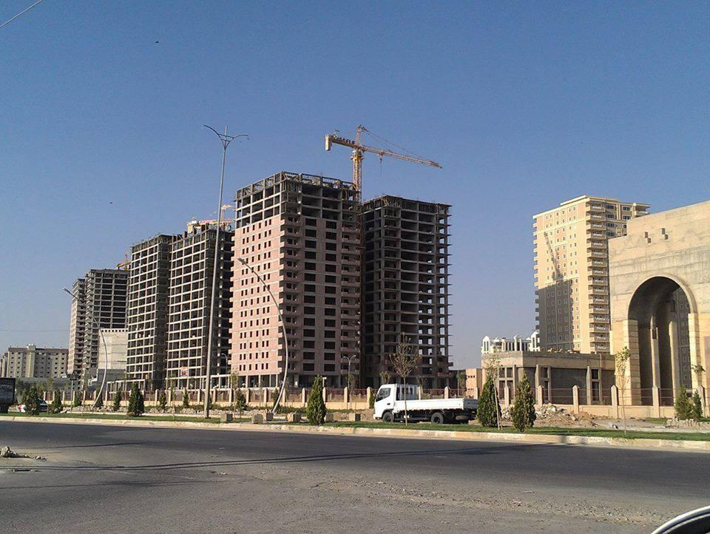
The Contents of This Class Lecture
Definitions:
Factors effecting in
Architecture
Factors effecting in
Structure
Types of roof slab system
Class work
Homework

Slide 4
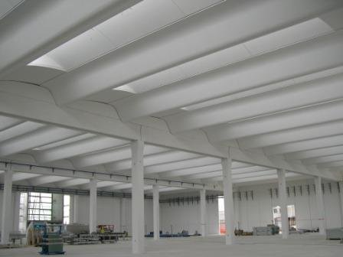
Definition of Floor and Slab System :
A roof is part of a building envelope. It is the covering on the uppermost part of a building or shelter which provides protection from animals and weather, notably rain or snow, but also heat, wind and sunlight. The word also denotes the framing or structure which supports that covering.

Slide 5
Definition of Floor and Slab System :
In Architecture Design: the characteristics of a roof are dependent upon the purpose of the building that it covers, the available roofing materials and the local traditions of construction and wider concepts of architectural design and practice and may also be governed by local or national legislation. In most countries a roof protects primarily against rain. A verandah may be roofed with material that protects against sunlight but admits the other elements. The roof of a garden conservatory protects plants from cold, wind, and rain, but admits light.
In Structure Design: A Horizontal building system birding spaces between supports

Slide 6
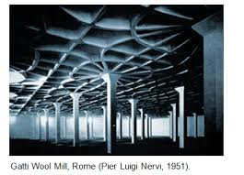
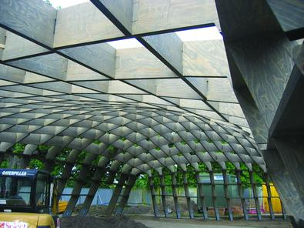
Factors effecting the Architectural design of floors:
1-Function 2- Aesthetics
3-Span 4-Internal&External Environment

Slide 7
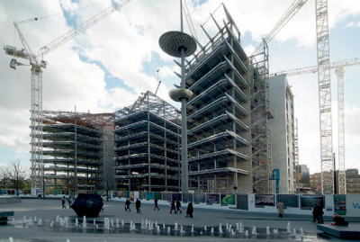
Factors effecting the Architectural design of floors:
5-Economy& Sustainability
6- Speed of Erection

Slide 8
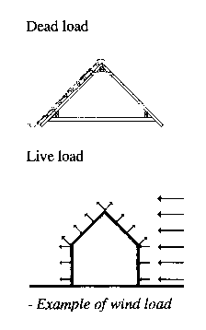
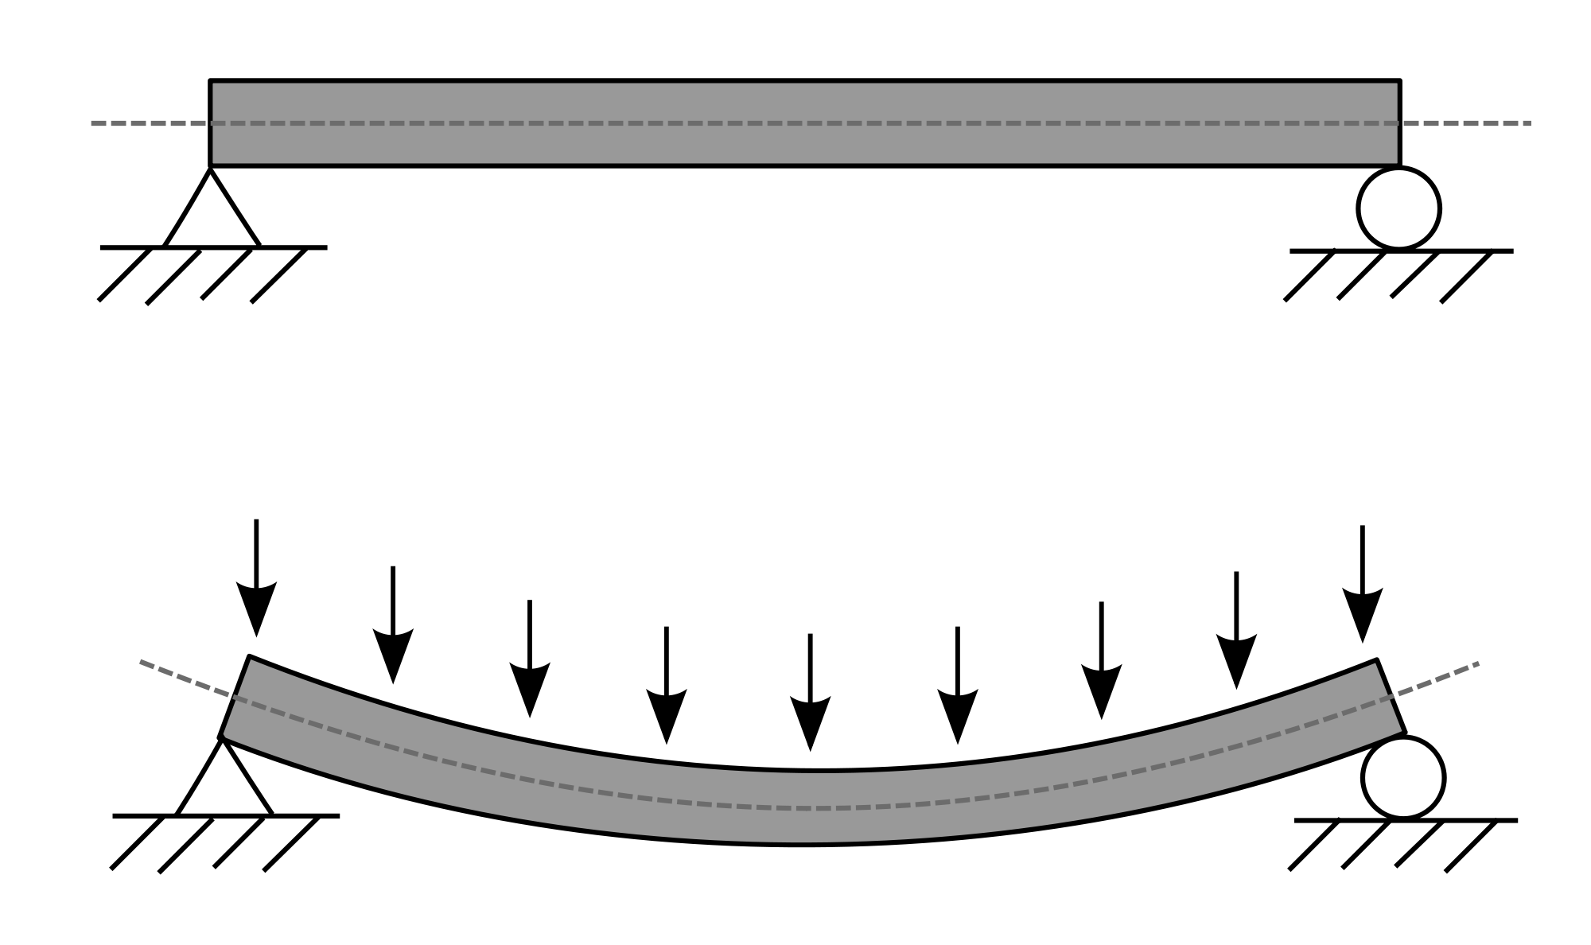
Factors effecting the Structural design of floors:
2- Dead ,Live, Wind ,Vibration and seismic Loads
1- Span

Slide 9
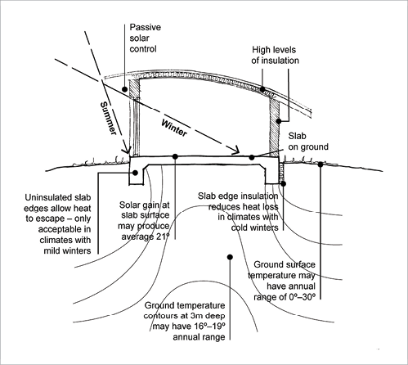
Benefits of concrete slabs:
Concrete slab, a very common and important structural element, are constructed to provide flat, useful surfaces. It is a horizontal structural component, with top and bottom surfaces parallel or near so.
Thermal comfort
‘Thermal mass’ describes the potential of a material to store and re-release thermal energy. It is sometimes referred to as ‘building conditioning’, which is much more effective than air conditioning. Materials with high thermal mass, such as concrete slabs

Slide 10
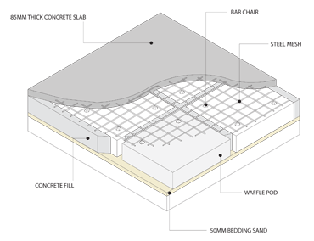
Benefits of concrete slabs:
‘Durability
Long life — Concrete’s high embodied energy can be offset by its permanence. If reinforcement is correctly designed and placed, and if the concrete is placed and compacted well so there are no voids or porous areas, concrete slabs can have an almost unlimited life span.

Slide 11
Benefits of concrete slabs:
Design issues
Passive solar design principles and high mass construction work well together, and concrete slabs are generally the easiest way to add thermal mass to a house. Living rooms should face north in all but hot humid climates, to enable winter sun to invest warmth into the slab. Concrete slabs perform better as the diurnal temperature range increases.
Natural ventilation must be provided for in the design, to allow heat stored in the slab to dissipate on summer evenings, particularly for slabs on upper storey's, where warm air accumulates. Zone off the upper space from lower living areas where possible and ensure the space can be naturally ventilated. This is particularly important if bedrooms are located upstairs, to maintain night-time sleeping comfort.
Insulation of the slab edge in cooler climates prevents warmth escaping through the edges of the slab. This insulation needs to be designed to complement the footing design

Slide 12
Benefits of concrete slabs:
Finishing
For the thermal mass of a concrete slab to work effectively, it must be able to interact with the house interior. Covering the slab with finishes that insulate, such as carpet, reduces the effectiveness of the thermal mass. However, the wide variety of finishes available does allow thermal mass to be utilized.
For the thermal mass of a concrete slab to work effectively, it must be able to interact with the house interior.
Tiles fixed by cement or cement-based adhesives are commonly available in many colors, sizes and patterns, but avoid rubber-based adhesives which have an insulating effect
Polished concrete includes two distinct types of finishes: trowel finished floors (with or without post-applied finishes), and ground and polished or abrasive blasted floors

Slide 13
Concrete Slab Roof Types :
Concrete slab, a very common and important structural element, are constructed to provide flat, useful surfaces. It is a horizontal structural component, with top and bottom surfaces parallel or near so.
Deck System
1-Cast –in Place reinforced concrete slab
2-Precast reinforced concrete slab
4- Steel corrugated sheet with Cast –in Place reinforced concrete slab
3-Cast –in Place reinforced concrete slab with masonry filler
5- Jack Arching

