Slide 1
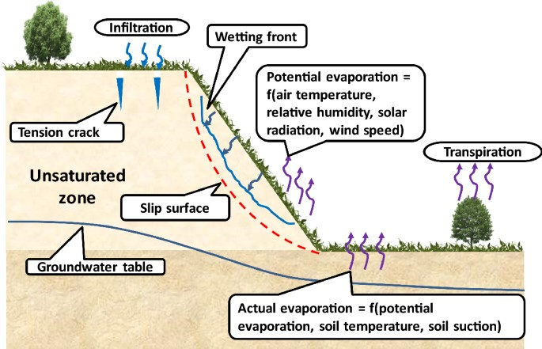
Salahaddin University – Erbil College of Engineering
Civil Engineering Department
Soil Mechanics
Ahmed Mohammed Hasan
B.Sc. in Civil Engineering
M.Sc. & Ph.D. in Geotechnical Engineering
ahmed.hasan@su.edu.krd
Theoretical part (4 hrs)
Spring semester
2022 - 2023
Ahmed M. Hasan, PhD, Geotechnical Specialist, College of Engineering – Salahaddin University-Erbil
1

Slide 2
Objectives of the course
To familiar undergraduate students with core principles of soil Mechanics including origin of soil, clay minerals, soil classification, permeability, shear strength, consolidation etc….
To show and teach undergraduate students how to perform various tests on soils in the laboratory.
How to apply these above knowledge in Geotechnical Engineering projects.
A-Theoretical part:
Chapter 1: Basic characteristics of soils Chapter 2: Soil description and classification. Chapter 3: Soil phase relationships.
Chapter 4: Compaction of soils Chapter 5: Permeability and seepage. Chapter 6: Stress within a soil mass. Chapter 7: Shear strength of soil.
Chapter 8: Compressibility and consolidation of soil. Chapter 9: Slope stability
Chapter 10: Lateral earth pressure Chapter 11: Soil Investigations
References:
1.
2.
3.
Principals of Geotechnical Engineering, 2002. Braja M. Das, 5th edition.
Soil Mechanics, 1995. G. E. Barens.
Soil Mechanics, 1979. T. W. Lambe and Robert V. Whitman.
Soil Mechanics and Foundation Engineering, 2002. DR. K. R. Arora
Physical and Geotechnical Properties of Soils, 1984. Joseph E. Bowles.
An Introduction of Geotechnical Engineering, 1982. R. D. Holtz and W. D. Kovacs.
Craig s Soil Mechanics, 2014. R.F. Craig, 8 Edition
Core Principles of Soil Mechanics, ICE textbooks, 2014. Sanjay K. Shukla. Soil Mechanics: Concepts and Applications, 2014. William Powrie, 3rd edition.
Problem Solving in Soil Mechanics, 2003. A. Aysen.
Solving problems in Soil Mechanics, 1986. B. H. C. Sutton.

Slide 3
Chapter one
1. Basic characteristics of soils
Contents of chapter 1
  Definitions 4
  Uniqueness of soils 6
  Examples of Soil Mechanics problems 6
    Leaning Tower of Pisa 6
    Liquefaction : Sand becomes liquid during Earthquake 6
    Quick clay 6
  Origin of Soil 8
    Physical factors 8
    Chemical factors 9
  Clay water 13
  Swelling and shrinkage of clays 14
  Activity of soils 15

Slide 4
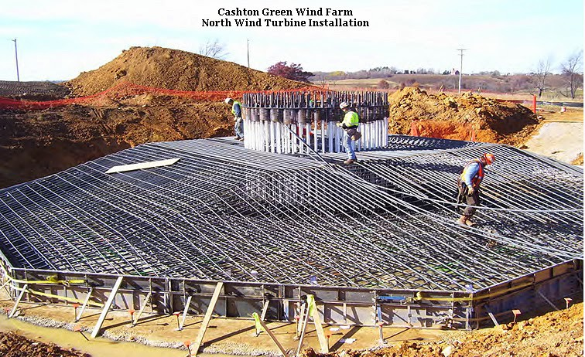
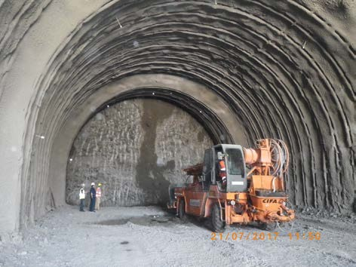
  Definitions
Soil:
soil to the Civil Engineer is any un-cemented or weakly cemented accumulation of
mineral particles formed by weathering of rocks that can be:
    built on: foundations to buildings, bridges, wind farms. (see Figure 1.1 )
    built in: tunnels. (see Figure 1.2 and 1.3)
    built with: roads, embankments, dams. (see Figure 1.4 and 1.5)
    supported by: retaining walls, sheet piles . (see Figure 1.6)
Soil Mechanics:
soil mechanics is studying the behaviour of soil such as strength, elasticity, permeability, volume
change. These properties basically depend on the nature of the soil grains, the current stress, water content and unit weight.
Soil mechanics differs from other branches of engineering in that generally there is little control over the material properties. We have to deal with the soil at the site and this is often highly variable. By taking samples at a few scattered locations we have to determine the soil properties and heir variability.
Soil mechanics is a relatively new branch of engineering science, the first major conference occurred
in 1936 and the mechanical properties of soils are still incompletely understood. The first complete mechanical model for soil was published as recently as 1968 (Modified Cam Clay MCC model). Over the last 40 years there has been rapid development in our understanding of soil behaviour and the application of this knowledge in engineering practice (Bubble model, Brcelona Basic Model BBM).
Geotechnical Engineering:
Geotechnical Engineering is studying the behaviour of soil and rock including landfills, Soil- Structure Interaction, Advances in Offshore Geotechnics, Transportation Geotechnics, environmental geotechnics (see Figure 1.7)
Figure 1.1 Built on Soil
Figure 1.2 Built in Soil

Slide 5
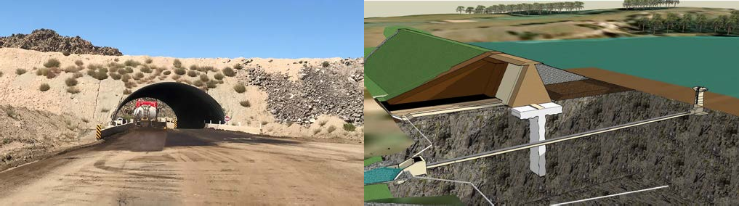
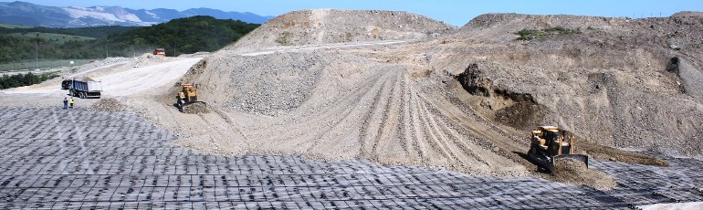
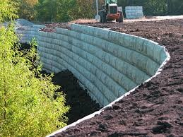
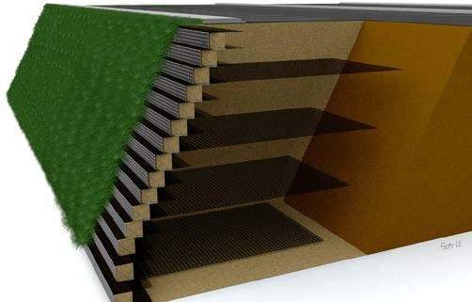
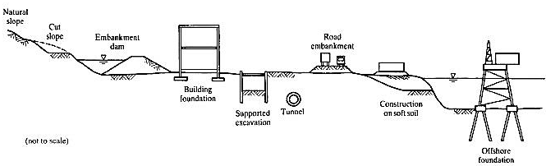
Figure 1.3
Built in Soil
Figure 1.4 built with soil
Figure 1.5 built with soil
Figure 1.6 supported by: retaining walls,
Figure 1.7 Examples of geotechnical Engineering construction

Slide 6
1.2 Uniqueness of soils
Soil is a very unique material and complex in nature. The unique characteristics of soils are as follows:
It is not a solid, continuous material, but rather is composed of three different constituents: solid
(grain), water, and air, and is thus an aggregated material.
Particle sizes have significant influence on soil behavior from granular soil to clay.
The amount of water also plays a very important role in soil behavior.
Its stress–strain relation is not linear from the small strain levels.
Its pore spaces possess the capability of water flow.
It has time-dependent characteristics; that is, it is susceptible to creep.
It swells when wetted or shrinks when dried.
It is an anisotropic material due to the particle shapes and the depositional direction under gravity.
It is also spatially nonhomogeneous
  Examples of Soil Mechanics problems
Engineers have to deal with many challenging soil mechanics problems even at present, as well as in the past. A few historical and interesting cases are presented in the following subsections.
    Leaning Tower of Pisa
This famous building illustrates historical soil mechanics problems. The 56 m high bell tower at Pisa, Italy (see Figure 1.8), leans about 3.97° or 3.9 m at top toward the south. The construction of the
tower started in 1173 and was completed in 1372. It was reported that the tower started to sink unevenly after the construction progressed to the third floor in 1178 and more floors were built up to accommodate for the tilt. The lean is obviously due to uneven settlement of the foundation soil. This time dependent settlement phenomenon is called consolidation settlement of clay and is discussed
later in chapter 8.
    Liquefaction : Sand becomes liquid during Earthquake
Can you believe that soil transforms into liquid? Yes, it does. During Japan’s 1964 Niigata earthquake, apartment buildings lost their foundation support and sank and tilted (Figure 1.9). Foundation soil was transformed into viscous liquid due to earthquake vibration. A similar phenomenon was also observed in the Alaska earthquake that occurred in March 1964. This phenomenon is called soil liquefaction.
Liquefaction is one of the major geotechnical engineering problems during earthquakes. It causes the settlement and tilting of buildings, catastrophic slope failures, and massive lateral movement of the ground. Although this topic is not covered in this course, it is one of the major topics in the advanced soil mechanics field, soil dynamics, or earthquake engineering.
    Quick clay
A very unique type of clay called quick clay is commonly abundant in Scandinavian countries (i.e., Norway and Sweden). It has very high value of degree of sensitivity (S_{t}) (see Chapter 7) . Figure 1.10
demonstrates a dramatic change of its strength from a solid undisturbed specimen (left) to liquid stage of remolded specimen (right).

Slide 7
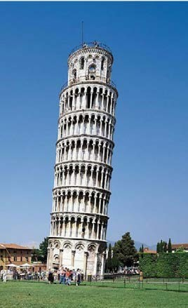
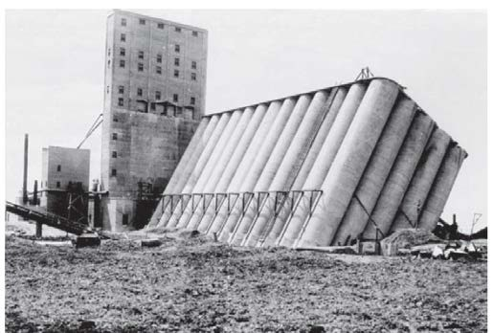
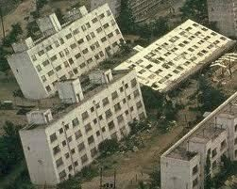
Figure 1.8 Leaning tower of Pisa.
Figure 1.9 Building tilt and settlement due to a) low Bearing Capacity b) liquefaction (earthquake, Japan).

Slide 8
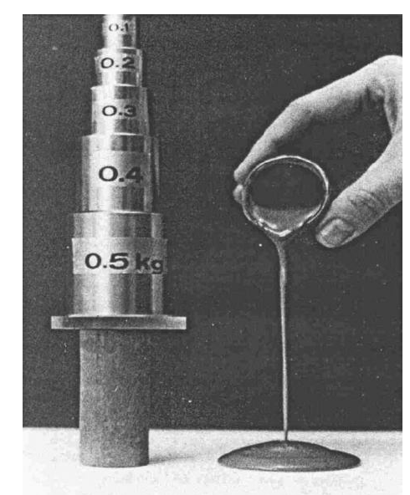
Figure 1.10 Quick clay before and after remolding
Vedio\1 Concrete Retaining Wall failure.mp4
Vedio\2 Building Hanging After Landslide Collapses in Istanbul.mp4 Vedio\3 Retaining wall collapse moment _ Failed civil engineering.mp4
Vedio\4 Slope or retaining wall failure geohazard tank model.mp4 Vedio\ 5 lequifaction
Vedio\ 6 dam failure
1.4 Origin of Soil
Soil is the result of weathering process on rock formations. If the product of weathering remain at their original place is called residual soil, while if the product of weathering is transported and deposited in different places then is called transported soil. Weathering process may be by
1.4.1 Physical factors (wind, water, glaciers, freezing and thawing): resulting practices materials carrying same properties of parent rock. Grain soils like boulders, cobbles, gravels, sand, silt are examples of physical weathering products. These soil exist in nature in grain structure as seen in Figure 1.11 and Figure 1.12. These particles may be angular, sub-angular, or rounded, are contacted together with bond (structure) or without (fabric) bond between them ,and the structure or the fabric ( may be very loose, loose, medium dense, dense (see, Figure 1.13 ), very dense depending on way of packing of the particles together .

Slide 9
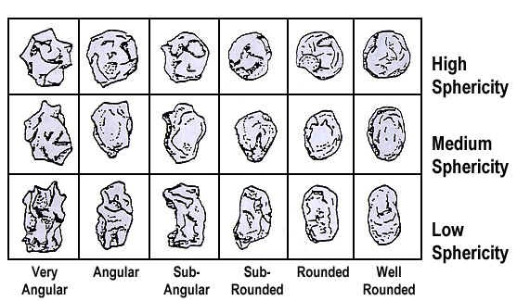
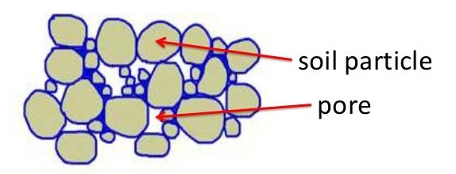
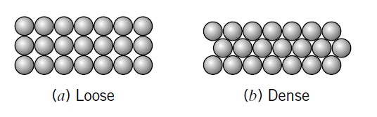
Figure 1.11 Soil’s angularity.
Figure 1.12 product of physical weathering and shape of coarse grains
Figure 1.13 (a) Loose and (b) dense packing of spheres.
1.4.2 Chemical factors: results in change in mineral from parent rock due to action of water, oxygen and carbon dioxide. Clay minerals (less than 0.002mm) which are the major components of clay soils are example of chemical weathering production (see Figure 1.14). They are very flaky and therefore have very large surface areas.

