Slide 1
Chapter 2
2. Description and classification of soils
Contents of chapter 2
Introduction 16
Particle Size Analysis 17
2.2.1 Procedure for grain size determination 17
2.2.1.1 Coarse grained soils: 17
2.2.2.2 Fine grained soil 19
2.2.2 Atterberg Limits 20
Classification of soil 22
Unified Soil Classification system (USCS) 22
1.3.1.1 Coarse-grained Materials 22
2.3.1.2 Fine grained materials (finer no.200 > 50%) 23
AASHTO Classification System 30
Additional Problems 34
2.1 Introduction
Soils are all different, depending on their origins, compositions, locations, geological histories, and many other factors. Two soils may be quite different, even though they were obtained from nearby boreholes on the same construction site. And thus, in-situ and laboratory tests on soil specimens are critically important to obtain their index parameters and engineering characteristics. However, it is more convenient for engineers when soils are categorized into several groups with similar engineering behaviors. Engineers can understand approximate engineering characteristics of those grouped soils without actual laboratory or field tests. This process is called soil classification, and it helps engineers in the preliminary design stage of geotechnical engineering problems. Most soil classification standards use soil indices such as Atterberg limits (liquid limit, plastic limit), soil gradation information (D₁₀, D₅₀, C_{u}, C_{c}), etc. In current geotechnical engineering practice, three standards are widely used in the United States and UK which are the Unified Soil Classification System (USCS), AASHTO (American Association of State Highway and Transportation Officials) methods and British Standard (BS), respectively, as shown in Table 2.1.

Slide 2
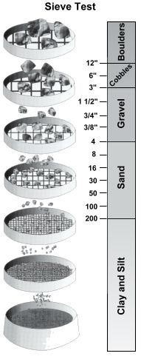
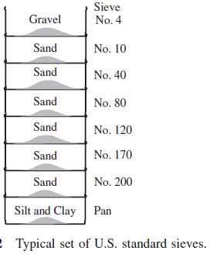
Table 2.1 Unified soil classification System (USCS) [American Society for Testing and Materials [ASTM] and British Standard (BS) as two examples.
 |  | USCS | British standard (BS)
Very coarse soils | Boulders | >200 mm | >200 mm
 | Cobble | 200 - 76 mm | 200 - 60 mm
Coarse soils | Gravels G | 76 – 4.75 mm | 60 – 2.0 mm
 | Sands S | 4.75 – 0.075 mm | 2 – 0.06 mm
Fine soils | Silts M | 0.075 – 0.002 mm | 0.06 – 0.002 mm
 | Clay C | < 0.002 mm | < 0.002 mm
colloidal
USCS and ASSHTO for classification are selected in this course.
Particle Size Analysis
Commonly the soils for civil engineering are defined according their particle size; there are various Systems for classification the size of particles as shown in Table 2.1
Procedure for grain size determination
Different procedures are required for grain size analysis of fine and coarse-grained material.
Detailed procedures are described in the ASTM includes methods of testing soil for engineering purposes.
2.2.1.1 Coarse grained soils:
Sieve analysis is used to determine the distribution of the very coarse and coarse grain sizes. The soil is passed through a series of sieves (Table 2.2) with the mesh size reducing progressively (see Figure 2.1), and the proportions by weight of the soil retained on each sieve are measured. Sieving can be performed either wet or dry. Because of the tendency for fine particles to clump together, wet sieving is often required with fine-grained soils. If the percent finer on sieve No.200>5% the test must be completed by hydrometer and then the analysis is called combined sieve analysis.
Table 2.2 : U.S. standard sieves
Sieve no. Opening size (mm)
3 6.35
4 4.75
10 2.00
20 0.84
40 0.425
60 0.25
80 0.18
100 0.15
120 0.125
170 0.09
200 0.075

Slide 3
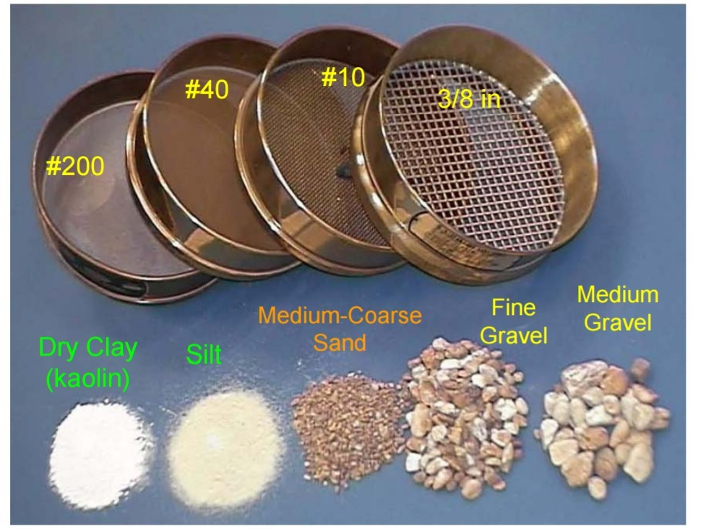
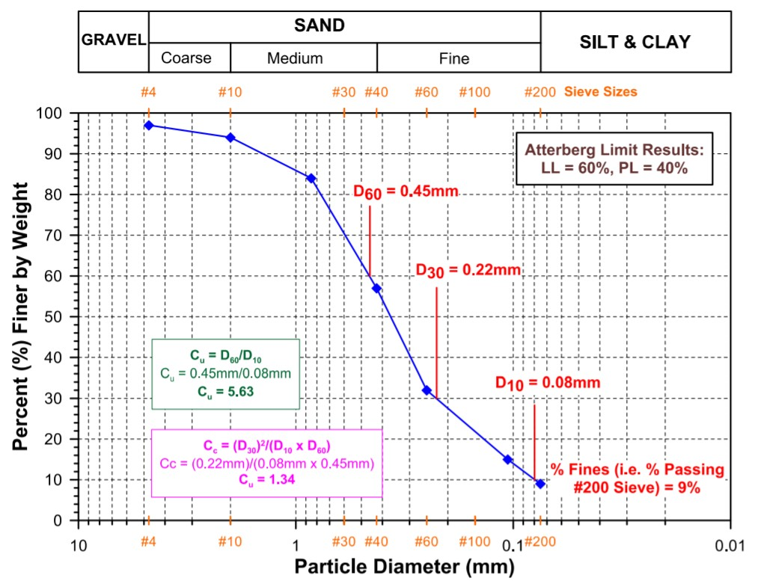
Figure 2.1 A typical soil sample including coarse and fine grained particles
Note:
the above sieves no. are suggested, but it is necessary to involve sieve No.4, No.10, No.40, No.200 in set of sieves.
The particle size(mm) vs. % finer(%passing) is plotted on a semi-log paper to find percentage of each G,S,M, and C in total soil to be used for classification of soil .Typical results of sieve analysis test are shown in Figure. 2.2.

Slide 4
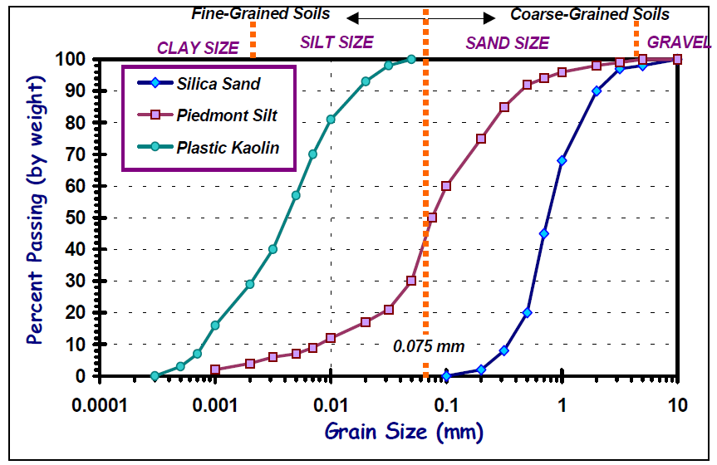
Figure 2.2 : Typical sieve analyses and boundaries of USCS
2.2.2.2 Fine grained soil:
To determine the grain size distribution of material passing the sieve No. 200(0.075 mm) the hydrometer method is commonly used (due to unavailability of sieves smaller than no. 200). The soil is mixed with water and a dispersing agent, stirred vigorously, and allowed to settle to the bottom of a measuring cylinder. As the soil particles settle out of suspension the specific gravity of the mixture reduces. As in Figure. 2.3 a hydrometer is used to record the variation of specific gravity with time. By making use of Stoke’s Law, which relates the velocity of a free falling sphere to its diameter, the test data is reduced to provide particle diameters and the % by weight of the sample finer than a particular particle size by:
where , = soil particle velocity( L/t) , γ_{s} = unit weight of soil,
γ_{w} = unit weight of water, µ= viscosity of water, D = diameter of soil particles
Soil particles
Hydrometer
Cylinder (1000 ml)
Figure 2.3 Hydrometer test

