Slide 1
Chapter Four
4. Compaction of soils
Contents of chapter 4
Introduction 47
Relative density (D_{r}%) 48
Laboratory compaction test 49
Standard Proctor Test Procedure 49
Compaction curve 50
Zero Air Void Curve 51
Compaction Energy 52
Structure of Compacted Clay Soil 53
Specification of compaction in the field 54
Hand test 55
Field compaction methods 57
Compaction Equipment 57
Dynamic Compaction 60
Field density determinations 60
Core cutter method 61
Sand cone method 61
4.8 Additional Problems 63
4.1 Introduction
The soil’s footing supporting capacity (bearing capacity), settlement, shear strength, etc. all depend on how well the soil is compacted. Compaction increases the soil’s strength and decreases compressibility
and permeability. It may also control characteristics of swelling and shrinkage and frost susceptibility. Compaction is a physical process to decrease the voids of soil by static or dynamic loading. For example, granular soils are easily compacted by vibration, while saturated cohesive soils cannot be well compacted by dynamic loads because of viscous resistance of pore water pressure to transient loadings. Compaction characteristics are first discussed based on the laboratory compaction test. Then compaction specification in the field, field compaction techniques, and field inspection methods are discussed. Related subjects, such as relative density is presented in this chapter.

Slide 2
4.2 Relative density (Dr%)
It is important to know the level of compaction that has been achieved on earth works or on existing earth. In order to indicate the level of compaction relative to the densest and the loosest compaction level for a given specific soil, mostly for granular soils, relative density (Dr) is introduced and is defined in the following equation:
where e_{max}, e_{min}, and e are the maximum, minimum, and in-situ soil’s void ratios, respectively. When the in-situ soil’s void ratio is in its loosest (e = e_{max}) state, then, Dr = 0%. If it is in its densest (e = e_{min}) state, Dr = 100%. Dr values of most in-situ soils are between 0% and 100%. Table 4.1 shows some
guidelines of relationships among the relative densities, level of denseness, SPT (standard penetration test) N₆₀ value, and the soil’s effective angle of internal friction ϕ′ (Chapter 7). As will be discussed in Chapter 11, the N60 value is the modified SPT blow count adjusted to 60% hammer drop energy and is related to many practical design values in foundation engineering practice.
Table 4.1 Relative Density with Soil Parameters
e_{min} and e_{max} are determined in the laboratory as follows (ASTM D 4253) for dry granular soils. As shown in Figure 4.1,
By substituting above two Equations into Equation (4.1), the relative density D_{r} can also be defined as

Slide 3
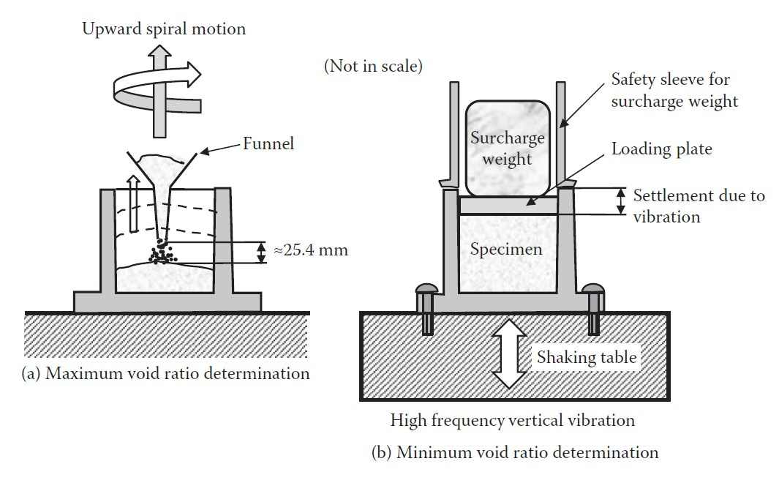
Figure 4.1 Maximum and minimum void ratio determination.
4.3 Laboratory compaction test
In the laboratory, specimens with different water contents are compacted with the same level of compaction energy. Water contents versus compacted soil’s dry densities are then plotted to determine the optimum compaction effort. In the early 1930s, Proctor (1933) developed a standard compaction procedure during earth dam construction projects. This method is called the Proctor method, and its original version and some modified versions are currently used in ASTM (D 698 and D 1557) and AASHTO (T 99 and T 180).
4.3.1 Standard Proctor Test Procedure
The standard Proctor method follows the following steps:
Mix dry soil thoroughly with water to prepare a uniform specimen with designed water content.
Pour the loose specimen at a little over one-third depth into a standard-size mold 101.6 mm (4 in.) in diameter and 116.43 mm (4.584 in.) high without an extension collar, with 944 cm3 (1/30 ft3) volume as seen in Figure 4.2(a).
Compact the specimen by 25 free drops of a rammer (W = 24.5 N (2.5 kilogram force [kgf] or 5.5 pound force [lbf]) from 304.8 mm (12 in.) high as seen in Figure 4.2(b). The mold should be placed on hard ground to avoid possible compaction energy loss.
Repeat steps 1 to 3 for the second and third layers to fill the mold with soil slightly above the top level of the mold. For the third-layer compaction, an extension collar is attached.
Remove the extension collar and trim the specimen surface by a straight edge to get exactly 944 cm3 (1/30 ft3) volume of the specimen.
Weigh the whole mold with soil in it to obtain the wet weight of the specimen.
Extrude the specimen from the mold and obtain a representative soil specimen in a container for water content determination.

Slide 4
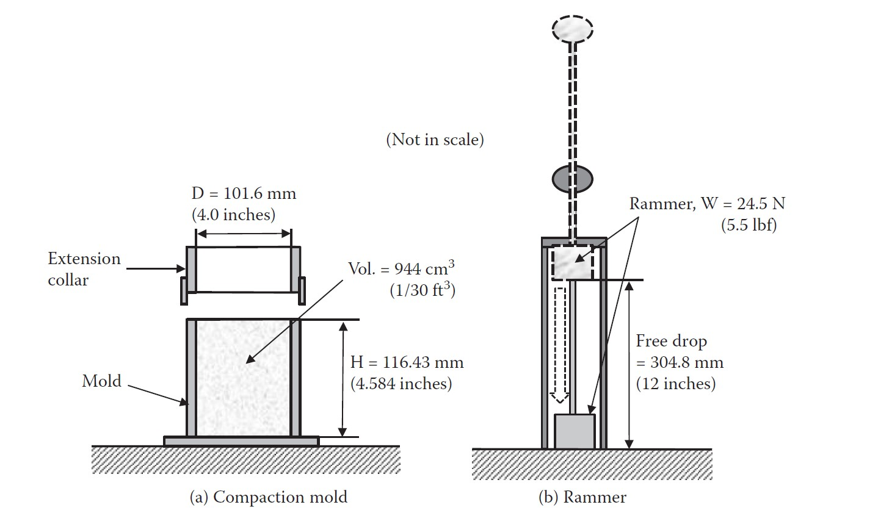
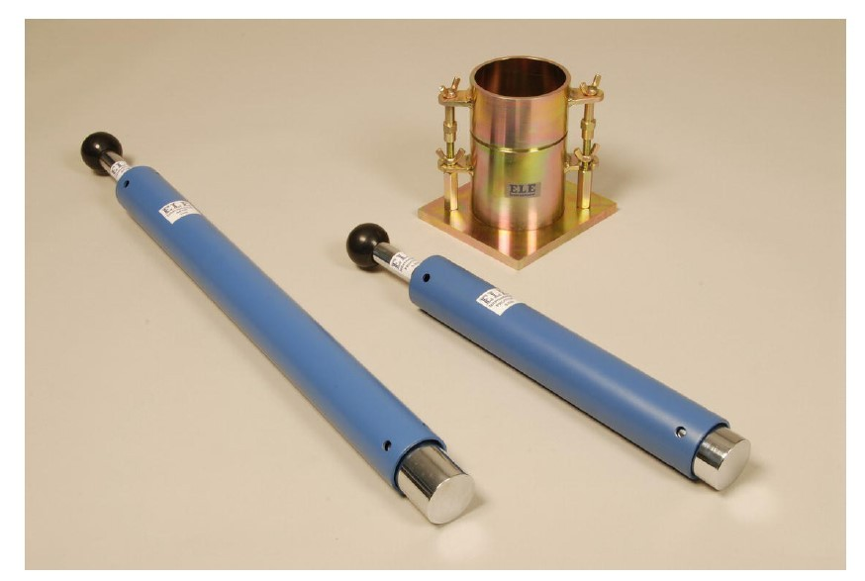
8. Repeat steps 1 to 7 for several different water contents. In general, soils from the previous experiment could be reused for the next test by breaking them down to particles and remixing with additional water.
Figure 4.2 Standard Proctor compaction device.
4.3.2 Compaction curve
After the experiment, a set of total (moist) unit weight (γt) and water content (w) are measured. The compaction effectiveness, however, is compared in terms of increased dry unit weight (γd) of the specimen, instead of total unit weight (γt). Equation (3.16) in Chapter 3 (reappearing as Equation 4.4 in this chapter) is used to explain this:
As seen in the first term of the γ_{t} expression, increasing w increases γ_{t} for a same value of void ratio e, which is a measure of compaction effectiveness. Thus, γ_{t} cannot be used to evaluate the effectiveness

Slide 5
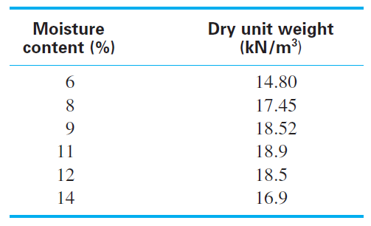
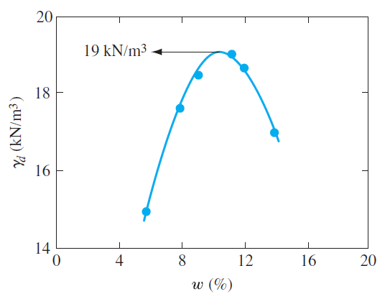
of compaction. The γ_{d} expression in Equation (4.4) shows a direct relationship between “e” and “γ_{d}.” Accordingly, γ_{d} = γ_{t} /(1 + w) in Equation (4.4) is used in the compaction analysis.
Table 4.2 Example computation of compaction test data
Figure 4.3 Example compaction curve.
In Figure 4.3, γd increases with increase of w in the beginning, reaches the peak value (γd,max = 19kN/m³) at w ≈ 10.2%, and drops thereafter. The peak γ_{d} is defined as the maximum dry unit weight, γ_{d},max, and the corresponding water content is called the optimum water content, w_{opt}. In the beginning, the addition of water works as a lubricant between particles to reduce the void and then to increase the dry unit weight. However, when the void is highly saturated with water, water starts to work as a cushion against compaction energy and does not work anymore to increase the soil’s dry unit weight, but rather to decrease it with increased water content due to reduced actual compaction energy to the soil’s skeleton. Thus, there is an optimum amount of water to transmit the most compaction energy to soil grain structures.
4.3.3 Zero Air Void Curve
From Equation (4.4) and using S_{r}e = G_{s}w relation in Equation (3.11) in Chapter 3, γ_{d} can be rewritten as

Slide 6
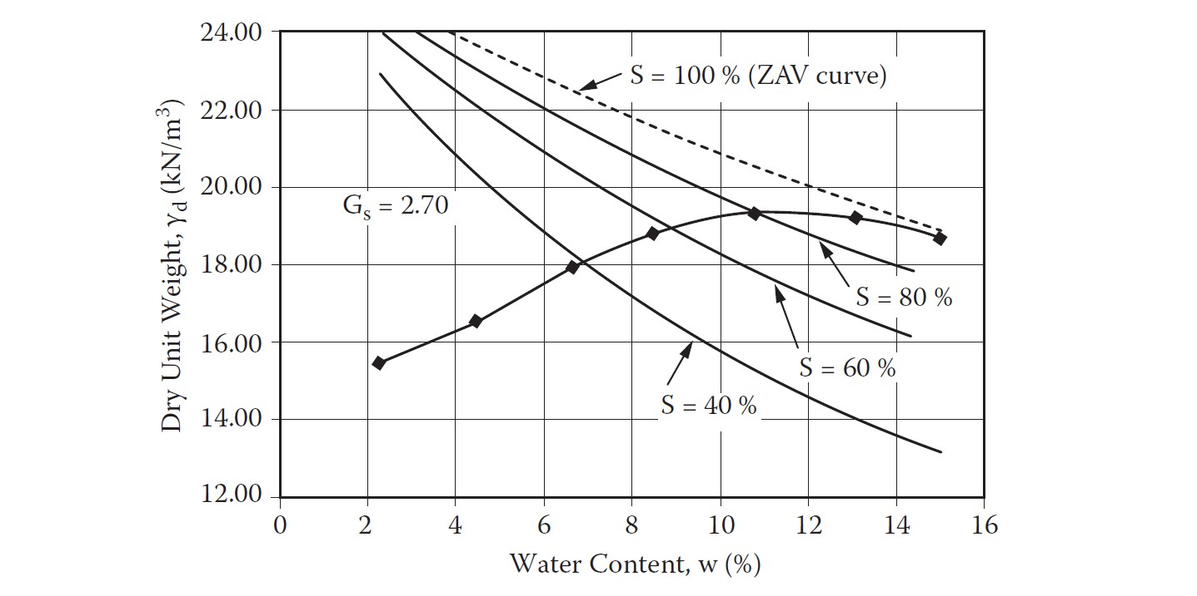
Equation (4.5) shows a unique relationship between γ_{d} and w for a fixed S_{r} (degree of saturation) value and for a given G_{s} value. Figure 4.4 plots a group of curves from Equation (4.5) for various S_{r} values (40%, 60%, 80%, and 100%) with Gs = 2.7.
It can be seen that, when w increases, Sr increases. At γ_{d,max}, Sr reaches more than 90%, and Sr approaches nearly 100% (full saturation) when the water content passes OMC. The Sr = 100% curve is called the zero air void (ZAV) curve, and compaction curves approach the ZAV curve at high water
content as seen. Therefore, this curve is often used as a guideline to construct a proper compaction curve for a high water content zone.
Figure 4.4 Compaction curve with various S (degree of saturation) values.
4.3.4 Compaction Energy
The Proctor test is a standard test with compaction energy of
E = Σ[W (weight of rammer) × h (height of drop)/volume of specimen] = 24.5N × 0.3048m × 3(layers) × 25(drops)/944 × 10⁻⁶ m³ (5.7) = 594 kN−m/m³ → 600 kN−m/m³
Several other modified versions of compaction energy are obtained by changing the mold size, the weight of the rammer, the drop height, the number of drops, and the number of layers. Table 4.3 summarizes some of these modified versions.
When the compaction energy is increased, γ_{d,max}, increases. Since the ZAV curve confines the upper limit of the compaction curve, the corresponding OMC decreases slightly as seen in an example in Figure 4.5. This observation suggests that, when a higher dry unit weight is required in the field, the field compaction energy shall be increased and, at the same time, water content shall be adjusted to have a slightly lower value to obtain the maximum effect of the increased compaction energy.

Slide 7
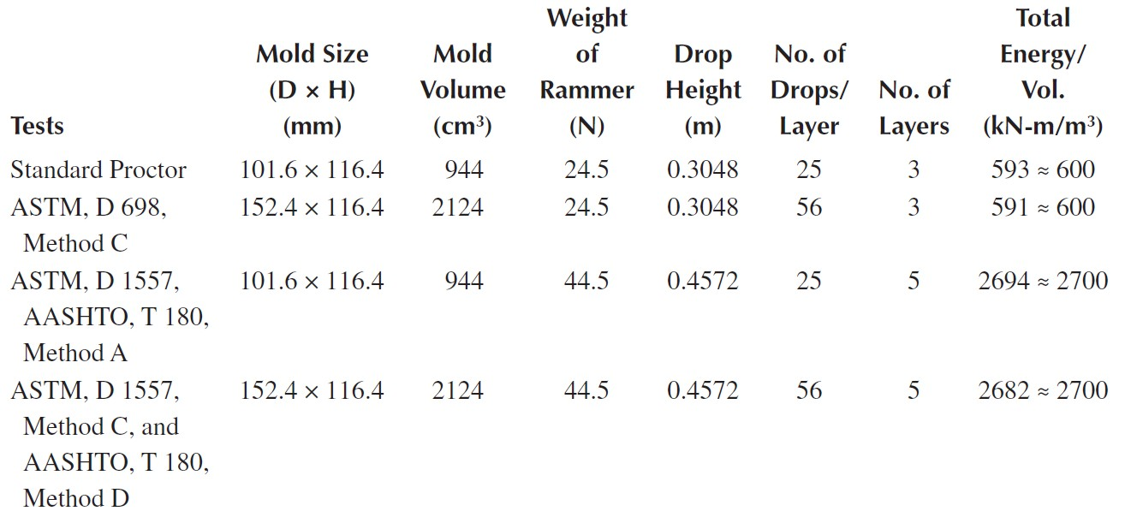
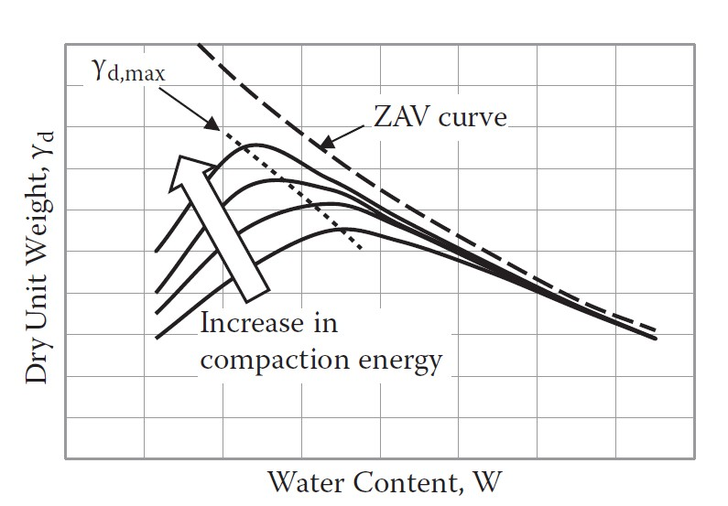
Table 4.3 Various compaction energies in laboratory tests
Figure 4.5 Compaction curves with various compaction energies.
4.3.5 Structure of Compacted Clay Soil
Lambe (1958a) studied the effect of compaction on the structure of clay soils, and the results of his study are illustrated in Figure 4.6. If clay is compacted with a moisture content on the dry side of the optimum, as represented by point A, it will possess a flocculent structure. This type of structure results because, at low moisture content, the diffuse double layers of ions surrounding the clay particles cannot be fully developed; hence, the interparticle repulsion is reduced. This reduced repulsion results in a more random particle orientation and a lower dry unit weight. When the moisture content of compaction is increased, as shown by point B, the diffuse double layers around the particles expand, which increases the repulsion between the clay particles and gives a lower degree of flocculation and a higher dry unit weight. A continued increase in moisture content from B to C expands the double layers more. This expansion results in a continued increase of repulsion between the particles and thus a still greater degree of particle orientation and a more or less dispersed structure. However, the dry unit weight decreases because the added water dilutes the concentration of soil solids per unit volume.

Slide 8
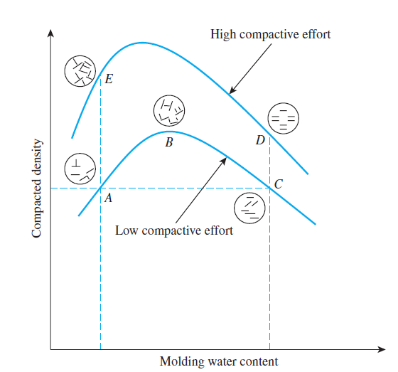
At a given moisture content, higher compactive effort yields a more parallel orientation to the clay particles, which gives a more dispersed structure. The particles are closer and the soil has a higher unit weight of compaction. This phenomenon can be seen by comparing point A with point E in Figure 4.6.
Figure 4.6 Effect of compaction on structure of clay soils
4.4 Specification of compaction in the field
After the compaction curve for a given soil is obtained from laboratory tests, the specification of compaction in the field is made. Relative Compaction (R.C.) is defined as
where γd,field is the specified dry unit weight, that shall be achieved in the field, and γd,max is the maximum dry unit weight obtained from the laboratory compaction test. Since γd,max varies depending on the compaction energy level or test method such as standard Proctor, etc., it shall be noted that R.C. could be more than 100% if the compaction energy in the laboratory was low. This implies that if a higher R.C. value (>100%) is required in the field, higher field compaction energy
than the laboratory energy level is required to achieve the specified requirement. Table 4.4 provides a guide for tentative R.C. requirements for various types of soils in USCS and the importance of earthworks.
As can be seen in Table 4.4, the poorer the type of soil or the higher the importance of the earthwork
is, the higher are the required R.C. values. It is noted again that those R.C. values are based on the standard Proctor test, so, if other standards with different energy levels are used, the required R.C. values may change. It is cautioned that the relative compaction R.C. in Equation (4.6) and the relative density Dr in Equation (4.1) shall not be mixed up since γ_{max} in Equation (4.6) is obtained from the compaction test at its optimum water content, while γ_{max} in Equation (4.1) for Dr is obtained from a standard maximum unit weight test for a dry granular specimen. These values are not necessarily the same.

Slide 9
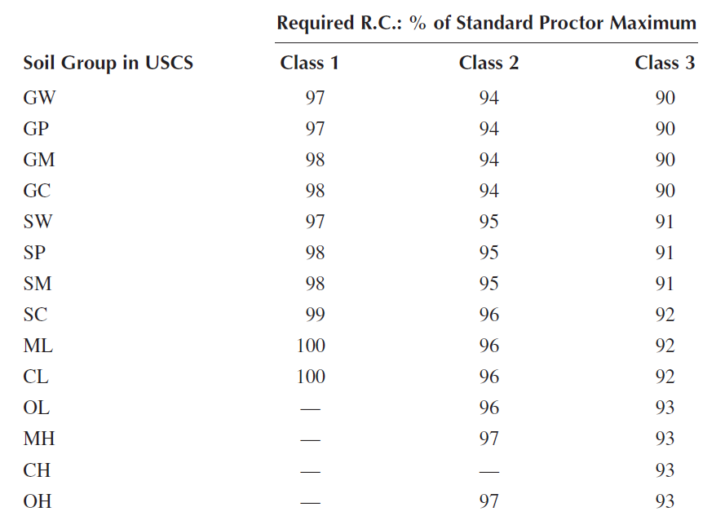
Table 4.4 Tentative requirements for compaction based on USCS
Class 1: Upper 3 m of fills supporting one- or two-story buildings. Upper 1 m of subgrade under pavement.
Upper 0.3 m of subgrade under floors.
Class 2: Deeper parts of fills under buildings.
Deeper parts (to 10 m) of fills under pavements, floors. Earth dams.
Class 3: All other fills requiring some degree of strength or incompressibility.
4.5 Hand test
A quick method of determining moisture density is known as the “Hand Test.”
Pick up a handful of soil. Squeeze it in your hand. Open your hand.
If the soil is powdery and will not retain the shape made by your hand, it is too dry. If it shatters when dropped, it is too dry.
If the soil is mouldable and breaks into only a couple of pieces when dropped, it has the right amount of moisture for proper compaction.
If the soil is plastic in your hand, leaves small traces of moisture on your fingers and stays in one piece when dropped, it has too much moisture for compaction.

