Slide 1
Chapter Five
5. Permeability and Seepage
Contents of chapter 5
Introduction 65
Hydraulic heads 66
Seepage velocity v_{s} 67
Indirect methods to determine k 68
Determination of coefficient of permeability k in the laboratory 69
Constant head permeability test 69
Falling head permeability test 69
Determination of coefficient of permeability k in the field 69
Coefficient of permeability (hydraulic conductivity) k in layered soil 70
Flow parallel to soil layers 70
Flow normal to soil layers 70
Flow net 71
One-Dimensional Flow Net 71
Flow Net for Two-Dimensional Problems with Isotropic Soils 72
Design of filters 76
Applications of filters 78
Clay core 78
Retaining wall 78
Additional Problems 79
Introduction
Permeability is the property of soil which permits flow of water from points of high energy to points of low energy, due to existence of interconnected voids. It can be measured by coefficient of permeability k (cm/s or m/s).
It is possible to measure k in the laboratory (by constant head method and falling head method, see laboratory hand-outs) and in the field (well pumping test, see Craig’s Soil Mechanics)
The importance of permeability
Settlement prediction (preloading).
Seepage through and beneath earth structures such as earth dams and retaining walls. 3- In designing of filters in which protect hydraulic structure from piping.

Slide 2
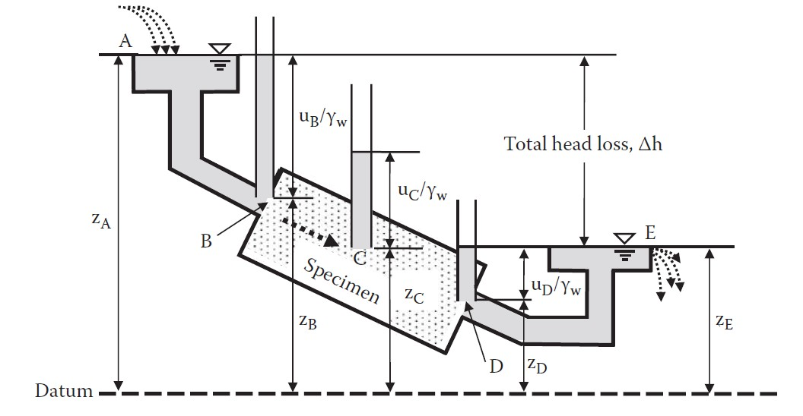
Discharge of wells.
To determine the amount of water that return into shallow and deep excavations during construction of a project.
5.2 Hydraulic heads:
The total head (h_{t}) at a point in a submerged soil mass (see Figure 5.1) is expressed by Bernoulli Equation as shown below:
(Total head) = (pore water head)] + (elevation head) + (velocity head)
The velocity of water in the soil is very small, therefore it is possible to ignore the last part of the above equation resulting in Equation 5.1:
According to the position of datum, the values of and could be positive or negative.
Figure 5.1 Hydraulic heads (Water flow through a pipe)
Heads h_{z}, h_{p} and h_{t} at various points in Figure 5.1
hz:elevation head is a distance from a point to datum
(+) if the point up the datum, (-) if the point down the datum
h_{p}: pressure head is a distance from a point to Water Level
(+) if the point down the W.L (-) if the point up the W. L
h_{t}: total head ht may be + or -.
Head loss is an energy loss. When water flows in soils, it must flow through many small passages in

Slide 3
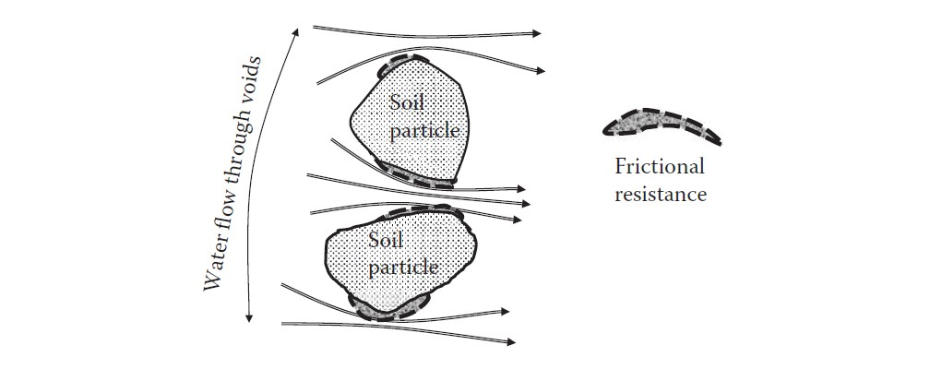
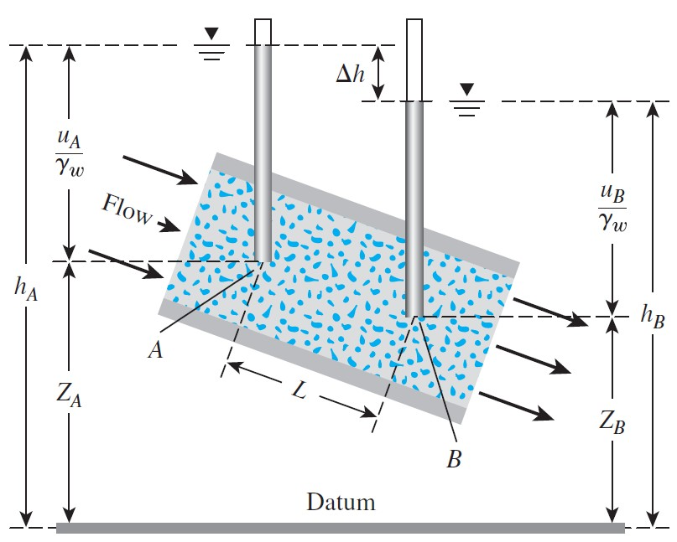
void sections of soils, as illustrated in Figure 5.2. This creates frictional resistance on the surfaces of particles. Flow energy is transmitted to frictional resistance on particle surfaces and then may be lost in heat generation, although it may not be easy to measure the temperature rise due to this energy transfer.
Figure 5.2 Frictional energy loss around particles due to water flow.
Darcy’s law: the velocity of flow of water through a soil is proportional to the hydraulic gradient (i).
where q is the rate of flow of water (i.e. discharge of water in, for example, volume/time),
k is coefficient of permeability of a soil,
i is hydraulic gradient = Δh/L,
Δh is loss in total head (h_{t}) (difference in total head (i.e. h_{A} – h_{B} , see Figure 5.3)) ,
L= length between points A and B of the soil mass (see Figure 5.3).
Figure 5.3 Pressure, elevation and total heads for flow of water through a soil
5.3 Seepage velocity vs
The seepage velocity v_{s} is the average velocity of water flowing through pores. It can be estimated by dividing the flow rate q by the average area of voids A_{v} on a cross section normal to the
direction of flow (see Figure 5.4):

