Slide 1
Chapter Six
6 Stress within a soil mass
Contents of chapter 6
Introduction 87
Total stress and effective stress 88
Total stress (σ) 88
Effective stress (σ’) 88
Effective stress computations in soil mass 88
Dry Soil Layers 88
Soil Layers with Steady Water Table 89
Totally Submerged Soil Layers 91
Effective stress change due to water table change 92
Capillary rise and effective stress 93
Effective stress with water flow 95
Quicksand (Sand boiling or liquefaction) 96
Heave of clay due to excavation 98
Dry Excavation 98
Wet Excavation 99
Summary 100
Stresses due to surface loading 101
Vertical stress due to a point load (concentrated load) 101
Vertical stress due to a vertical line load 102
10.4.3 Vertical stress due to a vertical strip load (Finite width and infinitelength) 104
6.10.4 Vertical stress below a centre of a uniform loaded circular area 107
10.4.5 Vertical stress caused by rectangular load (under corner of the loading area) 107
Newmark’s influence chart for vertical pressure 112
1:2 approximate slope method (Trapezoidal) method 113
Additional problems 119
6.1 Introduction
Terzaghi (1925) developed the effective stress concept, which became a key concept in modern
soil mechanics. Effective stress in soil contributes to its strength and volume change. It also influences the capillary rise, seepage force due to water flow, quicksand (sand boiling), and heaving at the bottom of the excavation. These are discussed in this chapter.
Soil is an assemblage of particles so that the soil’s skeleton (particle connected structure) is a major body to resist against external forces. This is seen in Figure 6.1, in which two-headed arrow vectors indicate inter-particle forces at contact points, including normal contact forces as well as shear contact forces. In a dry situation, inter-particle forces are in equilibrium with the external forces as seen. However, if the soil is saturated or partially saturated, pore water pressure develops, and it also resists against some part of the external forces.

Slide 2
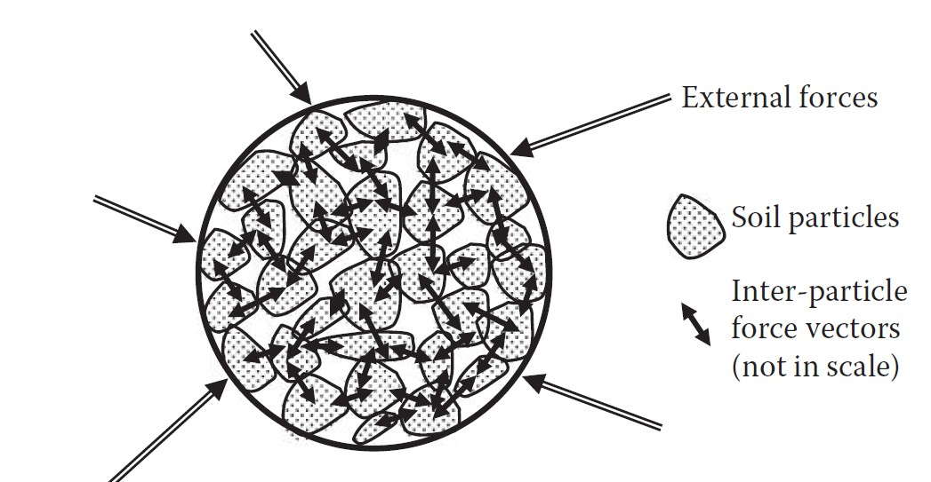
Figure 6.1 Inter-particle stresses in particle assemblage.
6.2 Total stress and effective stress
6.2.1 Total stress (σ)
Generated by the mass in the soil body, calculated by sum up the unit weight of all the material (soil solids + water) multiplied by soil thickness or depth. Denoted as σ, σ_{v}, P_{o .}The unit weight of soil is in natural condition and the water influence is ignored.
σ = γ. h
(6.1)
where h is the depth of a point within a soil mass.
6.2.2 Effective stress (σ’)
Defined as soil stress which influenced by water pressure in soil body. Proposed by Terzaghi at 1923 base on the experimental result. Applied to saturated soil and has a relationship with two types of stresses (i.e.):
Total Stress (σ) , Pore Water Pressure (u)
σ’ = σ − u
(6.2)
Note: Geostatic stresses increased linearly with depth.
6.3 Effective stress computations in soil mass
6.3.1 Dry Soil Layers
Figure 6.2 shows several layers of dry soil deposit. The total vertical (overburden) stress at Point A is the weight of a soil column of 1 × 1 area above Point A, and thus,
(6.3)
The vertical stress distribution σ with the depth is plotted alongside. In this case, u = 0, and thus σ′ = σ throughout the depth.

Slide 3
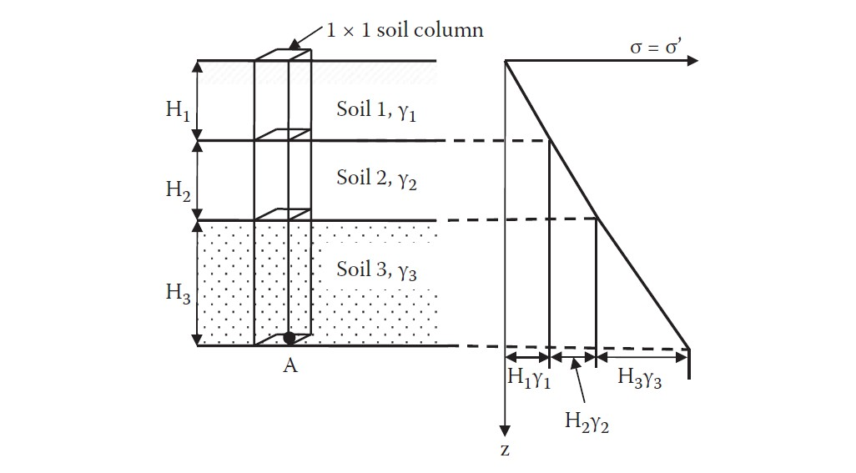
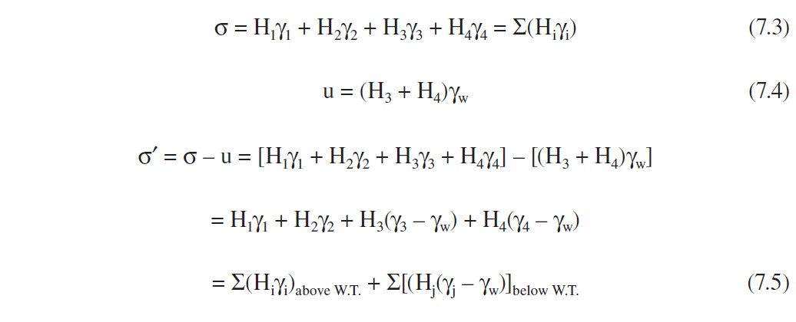
Figure 6.2 Effective stress computation for dry soil layers.
6.3.2 Soil Layers with Steady Water Table
Figure 6.3 plots a situation with a steady groundwater table. The water table is midway of soil layer
2. In this case, the total vertical stress σ at Point A is calculated first as the weight of a 1 × 1 soil column as before, and then the hydrostatic water pressure u is computed. Finally, the effective vertical stress σ′ is computed as follows:
(6.4)
(6.5)
(6.6)
where i and j denote the values for above the water table and below the water table, respectively. These individual distribution curves are also plotted in Figure 6.3. The effective stress distribution curve and Equation (6.6) suggest that σ′ can be directly calculated by a summation of soil layer thickness multiplied by the unit weight for all layers by assigning the total unit weight γ_{t} for soils above the water table and submerged unit weight( γ′ = γ_{t} – γ_{w}) for soils below the water table.

Slide 4
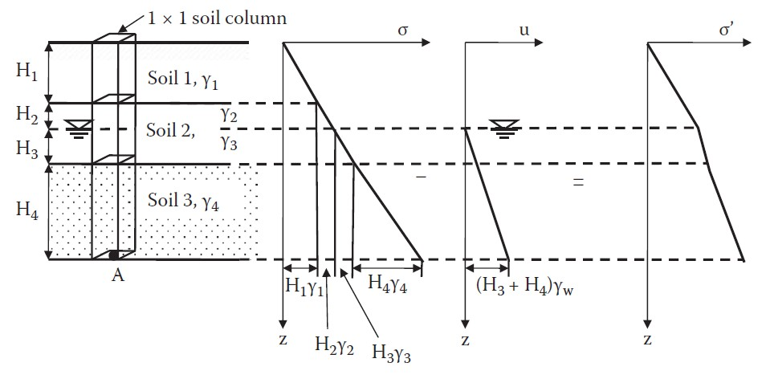
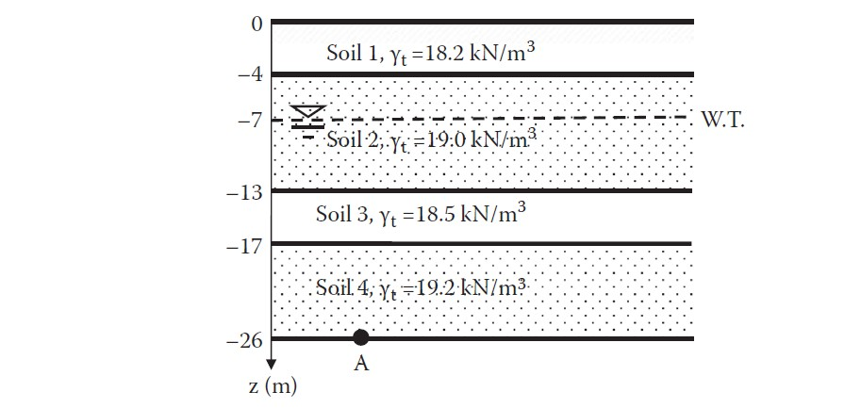
Figure 6.3 Effective stress computation for dry and wet soil layers.
Example 6.1:
Figure below shows soil conditions and water table elevation. Calculate the effective overburden stress at Point A, (a) by computing σ and u individually, and (b) by directly using γ_{t} above the water table and γ′ below the water table.
Solution:
Assume that for Soil 2, γ_{t} values above and below the water table are the same.
Method (a): individual computations of σ and u, then σ′:
Method (b): direct computation of σ′:
Both solutions yielded the same results.
90

Slide 5
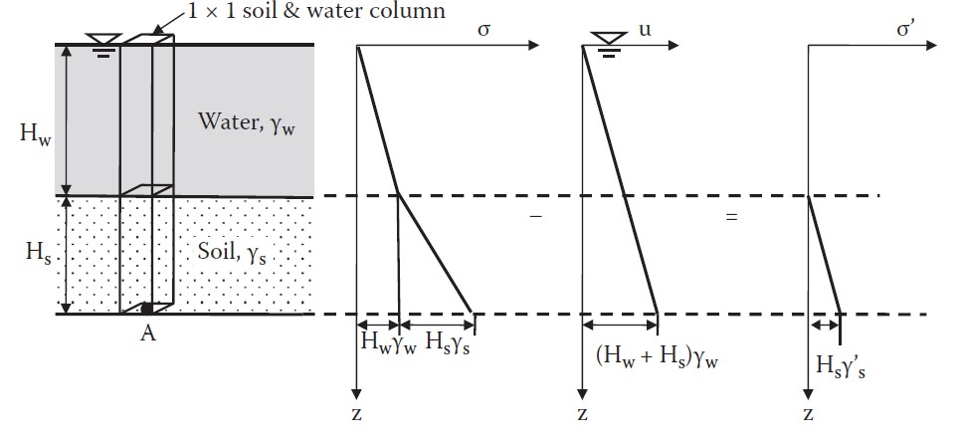
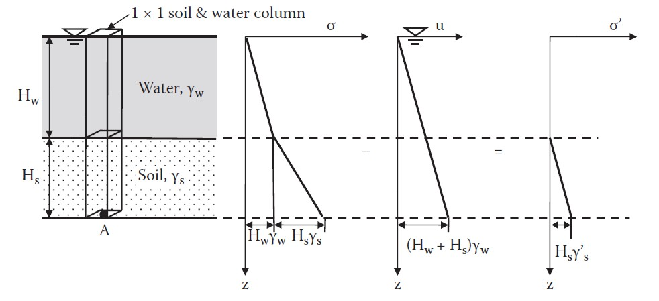
6.3.3 Totally Submerged Soil Layers
To calculate the effective stress σ′for soils under lakes or at ocean bottom, the same principles as before are used that is, use of γ′for soils under the water table. Since all soils are under the water table, it is simply
Figure 6.4 shows the distributions of σ, u, and σ′for this case. It can be seen that σ′is not affected by the depth of water H_{w}.
Figure 6.4 Effective stress computation for underwater soil layers.
Example 6.2:
Calculate σ, u, and σ′ on a soil element at 2 m depth from an ocean-bottom surface under 300 m
deep water. The soil’s unit weight is 17.5 kN/m³. Does this high water pressure compress soil?
Solution:
Total stress and pore water pressure are very high, but the effective stress is very low. Since the formation of the soil’s skeleton is controlled by inter-particle stress (effective stress), soils at the

Slide 6
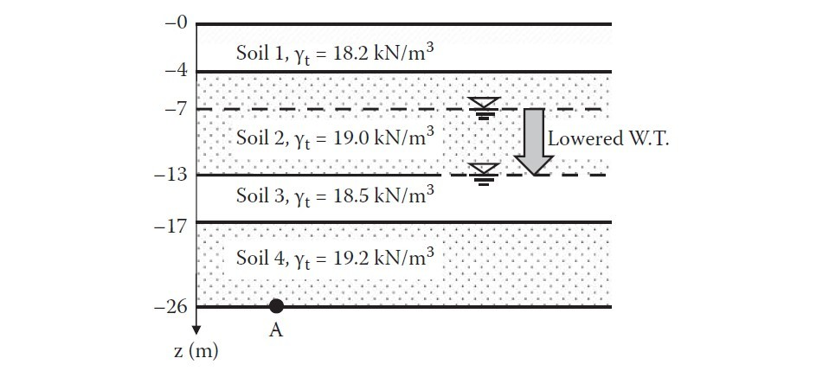
near surface of the ocean bottom are not compressed much because of the rather small effective overburden stress.
The foregoing Example demonstrates that very soft soils exist at deep ocean bottoms even though those soils are subjected to extremely high water pressures. High water pressure acts
hydrostatically all around the surface of grain particles, and thus it does not contribute to increase in inter-particle stresses.
6.4 Effective stress change due to water table change
When the water table changes, the effective overburden stress changes since the effective stress
computation uses either γ_{t} or γ′ depending on the water table elevation, as seen in the previous section. In particular, when the water table drops, the effective stress increases. The effective stress increase implies higher grain skeleton stress, and thus it causes volume decrease or settlement. In modern history, many urban industrial cities pumped up underground water for industrial uses and lowered the water table elevation permanently. The consequence was ground surface settlement in
many cities around the world.
Example 6.3:
For the site shown in the Figure below (the same site as in Example 6.1), water table elevation was
at −7 m originally, and lowered 6 m to −13 m due to heavy industrial water use. Calculate the change of the effective overburden stress at Point A. What is a consequence of the lowering water table elevation?
Solution:
Assume that, for Soil 2, γt values above and below the water table are the same. Before lowering
the water table using the result in Example 6.1:
After lowering the water table to − 13 m:
Thus, the change in σ′, Δσ′ = 363.1 – 304.2 = 58.9 kPa increase This increase in effective stress would cause ground settlement in the near future.
In contrast to cases with lowering water table elevation, its rise causes a reduction in effective stress. In such cases, some swell is possible, but it may not be as severe as in the case of settlement. One potential problem of this case is that underground structures, including buried pipes as well as

Slide 7
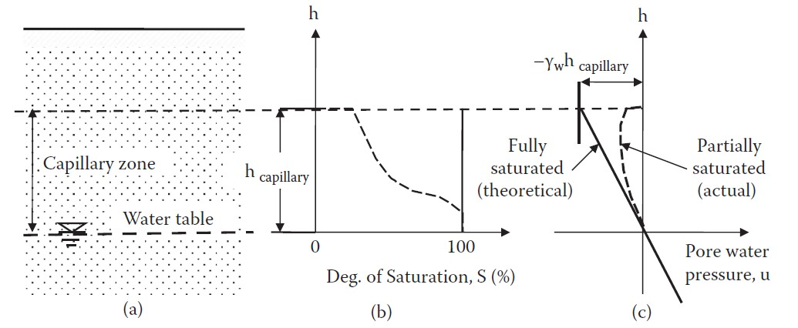
massive underground structures, may be pushed upward due to increased buoyancy forces applied to such structures.
6.5 Capillary rise and effective stress
Soils above the water table are, in general, not completely dry due to capillary rise, as seen in
Figure 6.5. The capillary zone affected by the rise depends on the size of the void opening of the soils. The smaller the void spacing is, the higher the rise is. Small void spaces in soil assemblages work as capillary tubes. Hazen (1930) empirically gave an approximate maximum height of
capillary rise, h capillary, as a function of soil properties D10 and e as
(6.7)
where e is the void ratio, D10 is the effective grain size in millimeters, and C is a constant with a range of 10 to 50. Table 6.1 shows general values of these for different soils. As can be seen in the table, capillary rise is quite high for finer soils.
Figure 6.5 Capillary rise.
Table 6.1 Approximate capillary rise in different soils
Capillary rise is due to suction created by the surface tension of water films around particles, as seen in Figure 6.6. This suction works as attractive particle-to-particle stress and creates negative pore water pressure. Thus, it increases the effective stress, according to Equation (6.2). Theoretically, the pore water pressure u in the capillary zone is −γ_{w}h for fully saturated soils, as

Slide 8
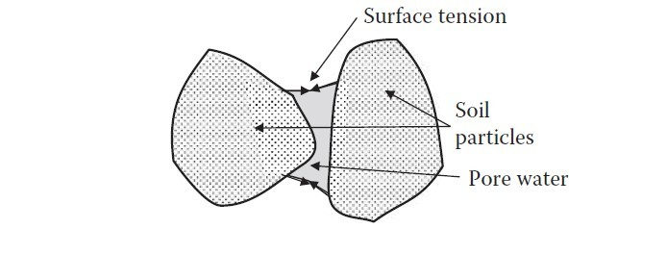
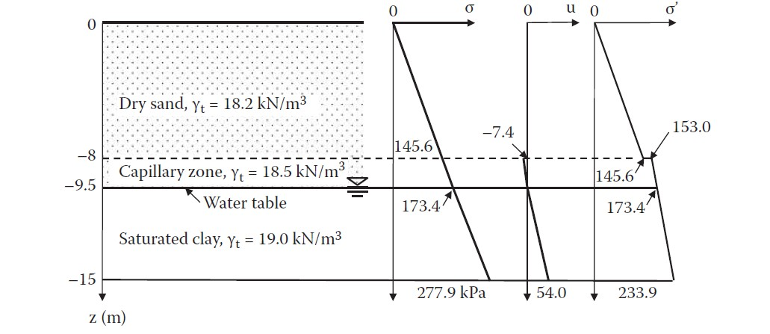
seen in Figure 6.5(c). However, the degree of saturation S in the capillary zone changes from nearly fully saturated condition (100%) at the water table level to very low at the highest rise, as shown in Figure 6.5(b). Therefore, the actual u is smaller than the theoretical one. It is approximated by
(6.8)
Figure 6.6 Surface tension between particles.
where S is expressed in percentage and h_{capillary} is the height from the water table level. Actual pore water pressure u in the capillary rise zone is also shown in Figure 6.5(c) with a dotted line. Because of negative pore water pressure in the capillary zone, the effective stress in that zone needs to be modified from the one without capillary rise consideration, as demonstrated in Example 6.4.
Example 6.4:
For the soil condition given in the Figure below, calculate and plot σ, u, and σ′ distributions
with the depth considering the capillary rise. Assume that the average degree of saturation S in the capillary zone is 50%.
223.9

Slide 9
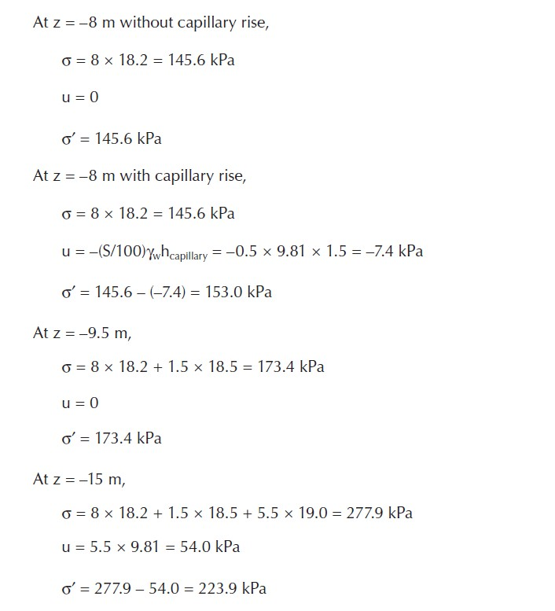
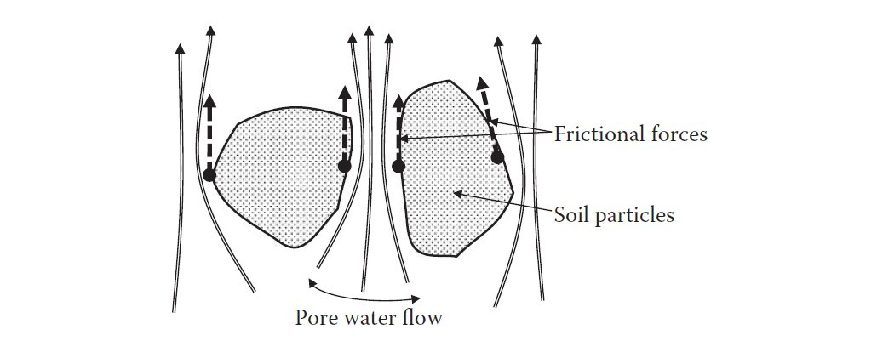
Solution:
Note that, in Example 6.4, there is a discontinuity in the effective stress distribution curve at the top of capillary zone. This occurred due to using an average S value for the capillary zone in the Example. In reality, that portion of the curve should change smoothly when the variation of S is properly accounted, though the precise estimation of S is not an easy task.
6.6 Effective stress with water flow
When water flows through pores of soil mass, it drags the particles. The dragging action creates
frictional force on the particle surface toward the direction of water flow, as seen in Figure 6.7.
These frictional forces act on particles’ surface work as seepage force and change the effective stress.
Figure 6.7 Upward seepage force.

Slide 10
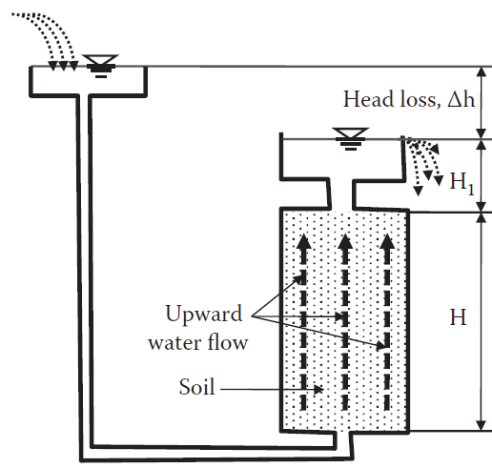
In Figure 6.8, a cylinder filled with soil is subjected to upward water flow due to the head difference at both ends of the soil column.
≤ h/L
(6.9)
where i_{c} is called critical hydraulic gradient. Equation (6.9) implies that, when the h/L ratio is equal to or higher than the ic value (γ ′/γ_{w}), the effective stress is zero or negative. The effective stress is the inter-particle stress, and thus zero or negative inter-particle stress implies separation of the particles. This condition causes quicksand (or sand boiling) of granular soils and heave of cohesive soils.
The i_{c} value is approximately 1.0 since γ ′ (= γ_{t} − γ_{w}) is nearly equal to γw for many soils (e.g., γ_{t} = 18 ~ 20 kN/m³, and γ_{w} = 9.81 kN/m³). Thus, when the total head loss h exceeds approximately the length of the specimen L, these critical conditions would prevail.
h
h_{w}
L
Figure 6.8 Water pressure with upward seepage flow.
6.7 Quicksand (Sand boiling or liquefaction)
Quicksand or sand boiling is best demonstrated in the case of the cut-off sheet pile situation as shown in Figure 6.9. In the figure, water flows from left to right due to the total head difference. Soils near the BC section of the sheet pile are subjected to upward seepage pressure and potentially possess the quicksand condition. The factor of safety for the quicksand condition can be measured by
(6.10)
where ic is the critical hydraulic gradient defined in Equation (6.9), and iB→C is the hydraulic gradient from Point B to Point C computed by

