Slide 1
Gas constant (R)
The empirical observations summarized by Boyle’s and Charles’s laws and Avogadro’s principle can be combined into a single expression:
pV = constant x nT
The constant of proportionality was found experimentally to be the same for all gases, is denoted R and called gas constant.
R =$\frac{PV}{nT}$
R = 8.31451 K⁻¹ mol⁻¹
8.31451 kPa L K⁻¹ mol⁻¹
8.20578 $×$ 10² L atm K⁻¹ mol⁻¹
62.364 L Torr K⁻¹ mol⁻¹
1.98722 cal K⁻¹ mol⁻¹

Slide 2
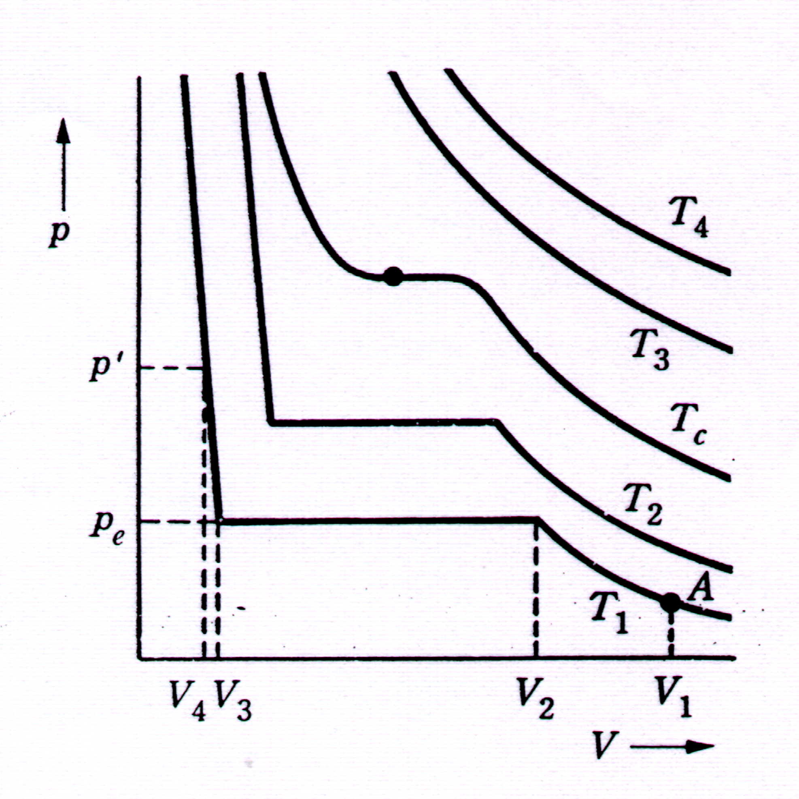
Critical temperature?
Given a p-V plot of a real gas…
At higher temperatures T₃ and T₄, isotherm resembles that of an ideal gas

Slide 3
Critical temperature?
At T₁ and V₁, when gas volume decreased, pressure increases
From V₂ to V₃, no change in pressure even though volume decreases
Condensation taking place and pressure = vapor pressure at T₁
Pressure rises steeply after V₃ because liquid compression is difficult

Slide 4
Critical temperature
At T > T_{c}, gas can’t be compressed into liquid
At T_{c}, isotherm in a p-V graph will have a point of inflection
1st and 2nd derivative of isotherm = 0
We shall look at a gas obeying the Van der Waals equation

Slide 5
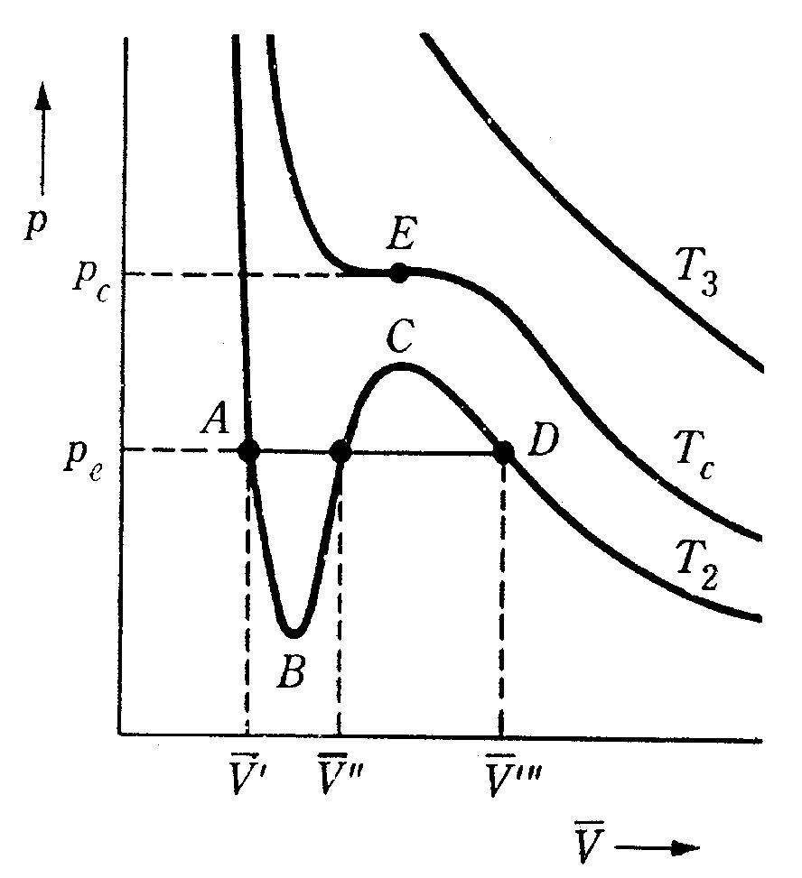
VDW equation and critical constants
Using VDW equation,
we can derive the following

Slide 6
VDW equation and critical constants
At T_{c}, V_{c} and P_{c}, it’s a point of inflexion on p-V_{m} graph

Slide 7
VDW equation and critical constants
As seen from formula, bigger molecules decrease critical temperature
Stronger IMF increase critical temperature
for all gases: the critical compression factor

Slide 8
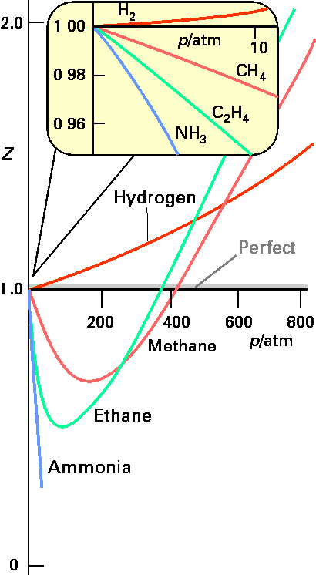
Compressibility Factor The most useful way of displaying this new law for real molecules is to plot the compressibility factor, Z :
For n = 1
Z = PV / RT
Ideal Gases have Z = 1
Deviations from ideality can be described by the COMPRESSION
FACTOR, Z (sometimes called the compressibility).

Slide 9
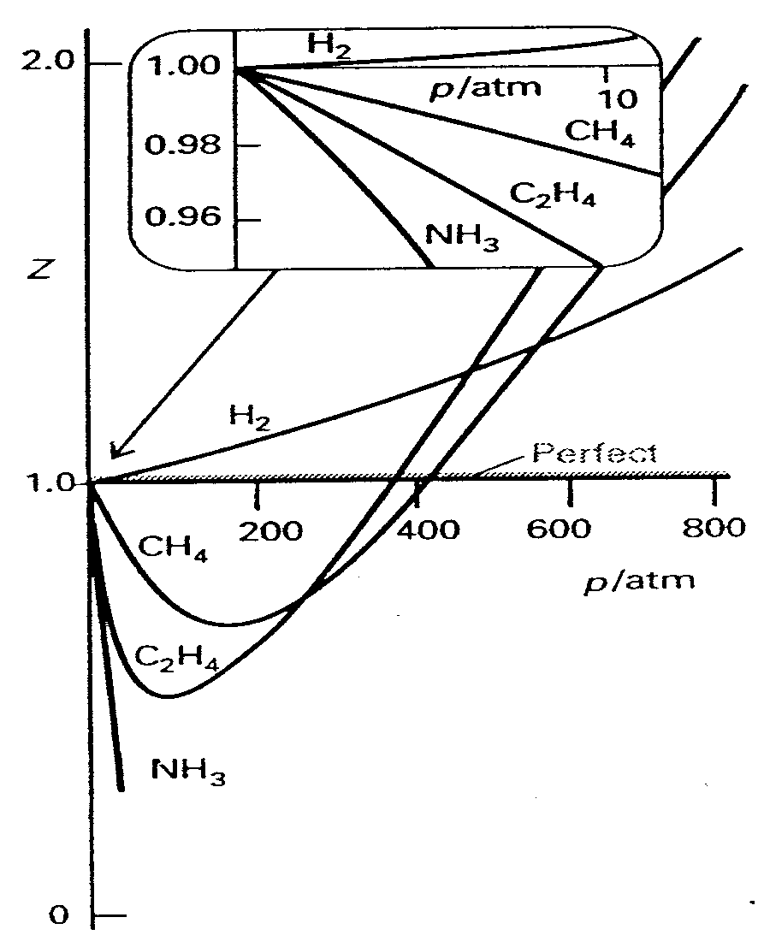
Compressibility Factor(Z)
Compressibility factor measures the deviation of a real gas' behavior from that of an ideal gas
Recall Z plot?
Z = pV_{m} / RT; also called the compressibility factor
Z should be 1 at all conditions for an ideal gas

Slide 10
Compressibility Factor(Z)
For real gases, Z not equals to 1
Z = V_{m} / V_{m,id}
Implications:
At high p, V_{m} > V_{m,id}, Z > 1
Repulsive forces dominant

Slide 11
Compressibility Factor
At intermediate p, Z < 1
Attractive forces dominant
More significant for gases with significant IMF

Slide 12
Boyle Temperature
Boyle Temperature is the temperature where Z=1 over a wide range of pressures.
Z also varies with temperature
At a particular temperature
Z = 1 over a wide range of pressures
That means gas behaves ideally
Obeys Boyle’s Law (recall V ∝ 1/p)
This temperature is called Boyle Temperature

Slide 13
Boyle Temperature
Boyle Temperature can be found from Z-p graph where dZ/dp=0
Mathematical implication
Initial gradient of Z-p plot = 0 at T
dZ/dp = 0
For a gas obeying VDW equation
T_{B} = a / Rb
Low Boyle Temperature favoured by weaker IMF and bigger gas molecules.

Slide 14
Virial Equations
Recall compressibility factor Z?
Z = pV_{m}/RT
Z = 1 for ideal gases
What about real gases?
Obviously Z ≠ 1
So how do virial equations address this problem?

Slide 15
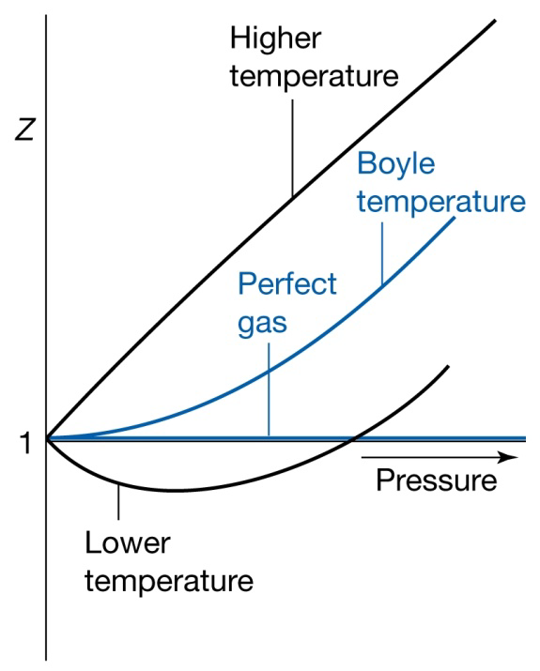
Virial Equations
Form
pV_{m}/RT = 1 + B/V_{m} + C/V_{m}² + D/V_{m}³ + …
pV_{m}/RT = 1 + B’p + C’p² + D’p³ + …
B,B’,C,C’,D & D’ are virial coefficients
Temperature dependent
Can be derived theoretically or experimentally
B and C are themselves functions of
temperature, B(T) and C(T).
B = 0 at Boyle temperature

Slide 16
Virial Equations
Most flexible form of state equation
Terms can be added when necessary
Accuracy can be increase by adding infinite terms
For same gas at same temperature
Coefficients B and B’ are proportionate but not equal to each other

Slide 17
Kinetic Theory of gases
The kinetic theory of gases is the study of the microscopic behavior of molecules and the interactions which lead to macroscopic relationships like the ideal gas law.

Slide 18
The study of the molecules of a gas is a good example of a physical situation where statistical methods give precise and dependable results for macroscopic manifestations of microscopic phenomena.
For example, the pressure, volume and temperature calculations from the ideal gas law are very precise. The average energy associated with the molecular motion has its foundation in the Boltzmann distribution, a statistical distribution function. Yet the temperature and energy of a gas can be measured precisely.

Slide 19
Kinetic Temperature
The expression for gas pressure developed from kinetic theory relates pressure and volume to the average molecular kinetic energy. Comparison with the ideal gas law leads to an expression for temperature sometimes referred to as the kinetic temperature.
This leads to the expression
where N is the number of molecules, n the number of moles, R the gas constant, and k the Boltzmann constant. The more familiar form expresses the average molecular kinetic energy:

Slide 20
Molecular Speeds
From the expression for kinetic temperature
substitution gives the root mean square (rms) molecular velocity:
From the Maxwell speed distribution this speed as well as the average and most probable speeds can be calculated.

Slide 21
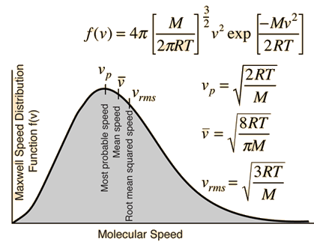
Maxwell Speed Distribution
The speed distribution for the molecules of an ideal gas is given by
From this function can be calculated several characteristic molecular speeds and such things as what fraction of the molecules have speeds over a certain value at a given temperature. It is involved in many rates of phenomena.
Note that M is the molar mass and that the gas constant R is used in the expression. If the mass m of an individual molecule were used instead, the expression would be the same except that Boltzmann's constant k would be used instead of the molar gas constant R.

Slide 22
Example 3:Fifteen students took a 25-point quiz. Their scores are 25, 22, 22, 20, 20, 20, 18, 18, 18, 18, 18,15, 15, 15, and 10. Find the average score and the rms score.
Solution:

Slide 23
Mean Free Path
The mean free path or average distance between collisions for a gas molecule may be estimated from kinetic theory.
The mean free path could then be taken as the length of the path divided by the number of collisions.
The number of molecules per unit volume can be determined from Avogadro's number and the ideal gas law, leading to

Slide 24
collision time & collision frequency
The average time between collisions is called the collision time $τ$ The reciprocal of the collision time 1/ $τ$ , is equal to the average number of collisions per second,or the collision frequency f.
If v_{av} is the average speed, then the average distance traveled between collisions is:
λ=v_{av}$.$ $τ$

Slide 25
Example 1: Oxygen gas O₂ has a molar mass of about 32 gm/mol and hydrogen gas H₂ has a molar mass of about 2 gm/mol Calculate (a) the rms speed of an oxygen molecule when the temperature is 300 K, and (b) the rms speed of a hydrogen molecule at the same temperature. (R = 8.314 J/(mol . K).
Solution:

Slide 26
EXAMPLE2: The local poison control centre wants to know more about carbon monoxide and how it spreads through a room. You are asked (a) to calculate the mean free path of a carbon monoxide molecule, and (b) to estimate the mean time between collisions. The molar mass of carbon monoxide 28.0 gm/mol is Assume that the CO molecule is traveling in air at 300 K and 1.00 atm, and that the diameters of both CO molecules and air molecules are 3.7$×10_10$ m.
Solution:

