Slide 1
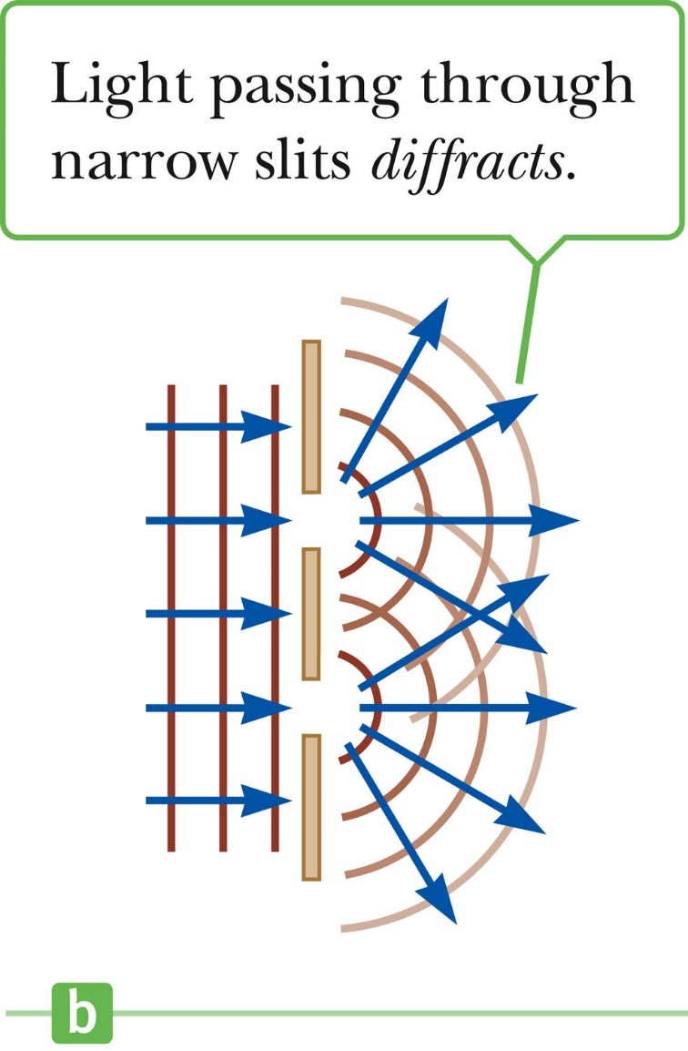
Chapter three
Diffraction
Huygen’s principle: the waves spread out after they pass through slits
This spreading out of light from its initial line of travel is called diffraction
In general, diffraction occurs when waves pass through small openings, around obstacles or by sharp edges

Slide 2
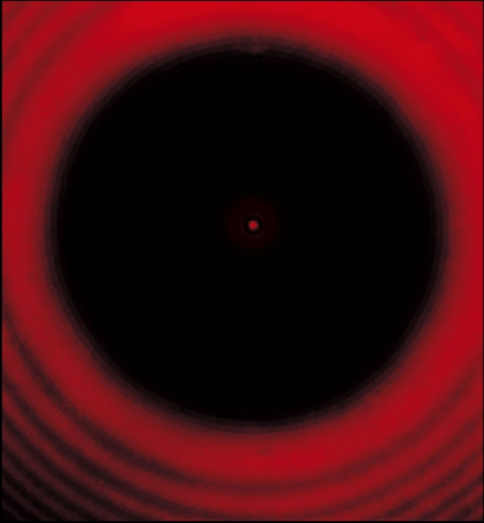
These results cannot be explained by geometric optics
Geometric optics would say that light rays traveling in straight lines should cast a sharp image on the screen
The diffraction pattern of a penny placed midway between the screen and the source
Notice the bright spot at the center!

Slide 3
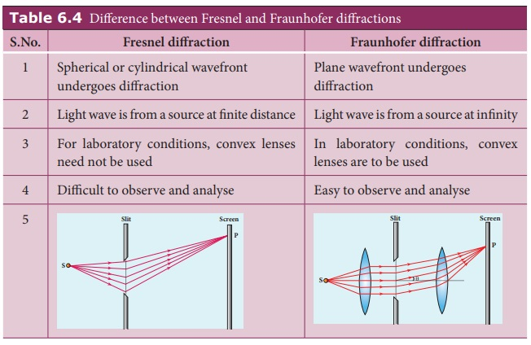
Types of Diffraction:
1- Fresnel diffraction
2- Fraunhofer diffraction

Slide 4
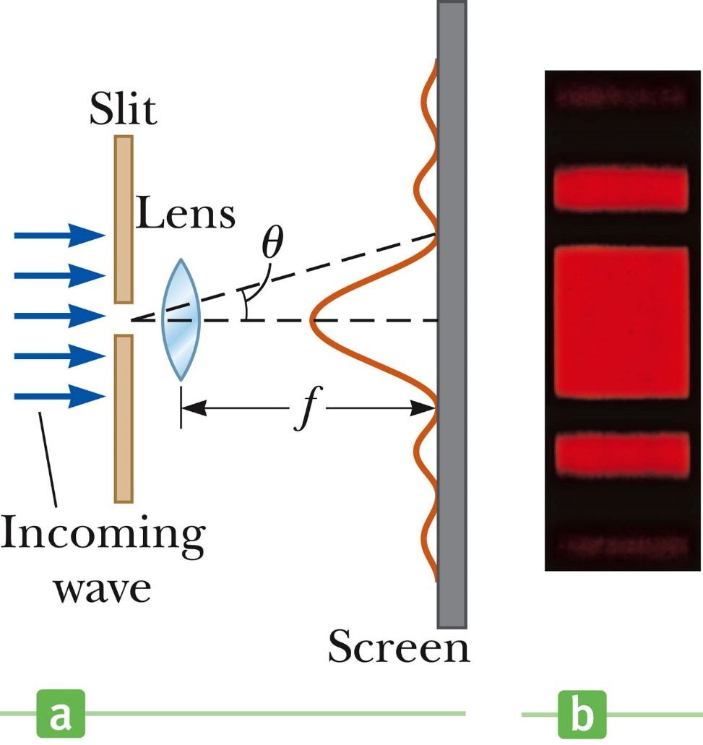
Fraunhofer Diffraction occurs when the rays leave the diffracting object in parallel directions
Screen very far from the slit
Converging lens (shown)
A bright fringe is seen along the axis (θ = 0) with alternating bright and dark fringes on each side

Slide 5
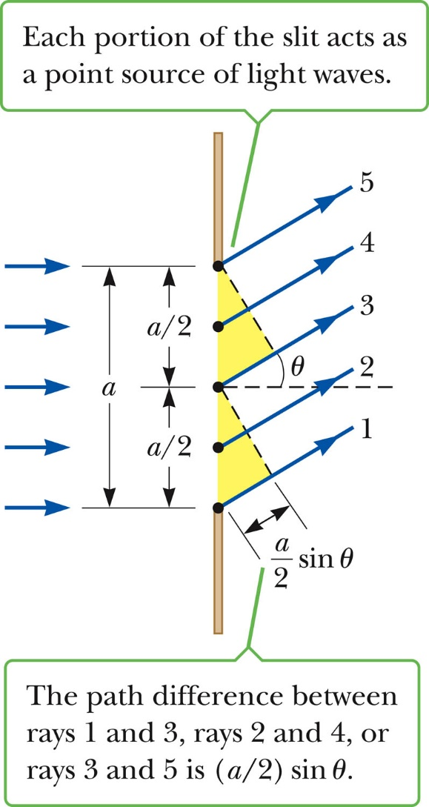
According to Huygen’s principle, each portion of the slit acts as a source of an individual wave
The light from one portion of the slit interferes with light from other portions
The resultant intensity on the screen depends on the direction θ
= δ
path difference

Slide 6
All the waves that originate at the slit are in phase
Wave 1 travels farther than wave 3 by an amount equal to the path difference
where a is the width of the slit
If this path difference is exactly half of a wavelength, the two waves cancel each other and destructive interference results:
In general, destructive interference occurs for a single slit of width a when sin θ_{dark} = mλ / a m = ±1, ±2, ±3, …
Does not give any information about the variations in intensity along the screen

Slide 7
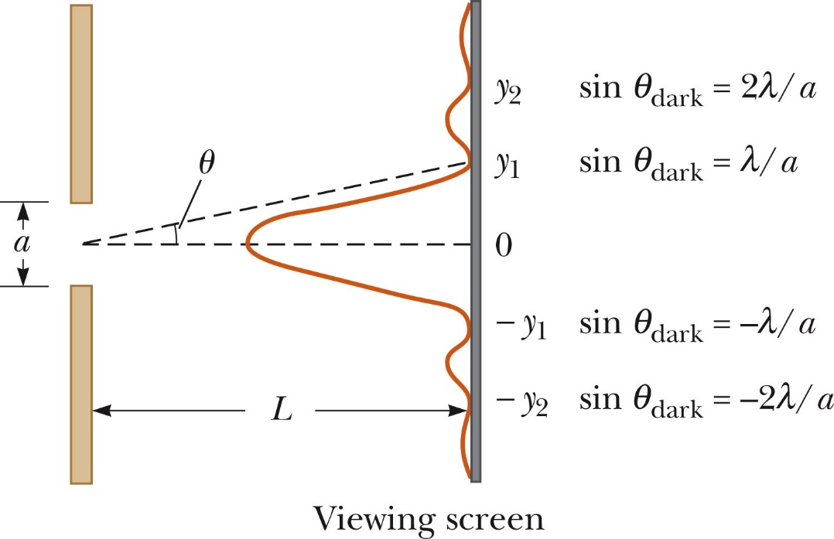
The general features of the intensity distribution are shown
A broad central bright fringe is flanked by much weaker bright fringes alternating with dark fringes
The points of constructive interference lie approximately halfway between the dark fringes

Slide 8
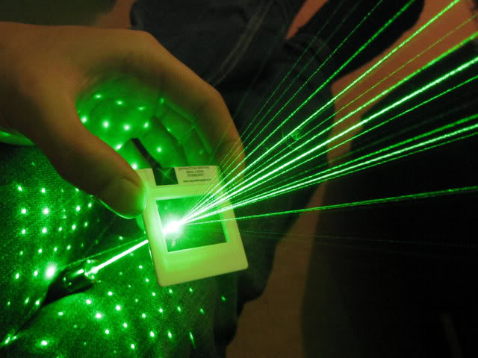
Diffraction grating
A diffraction grating is a periodic multiple-slits device that is designed to take advantage of the sensitivity of its diffraction pattern to the wavelength of the incident light.
invented by Fraunhofer
Slits are called lines or rulings , Grating spacing is the distance between Rulings
The diffracting grating consists of many equally spaced parallel slits
A typical grating contains several thousand lines per centimeter
The intensity of the pattern is the result of the combined effects of interference and diffraction

Slide 9
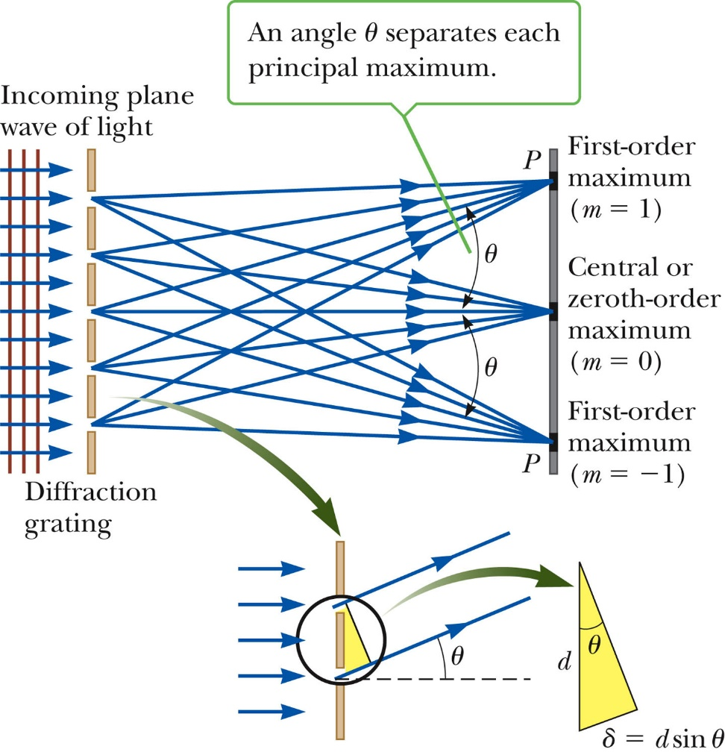
The condition for maxima is
d sin θ_{bright} = m λ
m = 0, ±1, ±2, …
The integer m is the order number of the diffraction pattern
If the incident radiation contains several wavelengths, each wavelength deviates through a specific angle
d, distance between slits

Slide 10
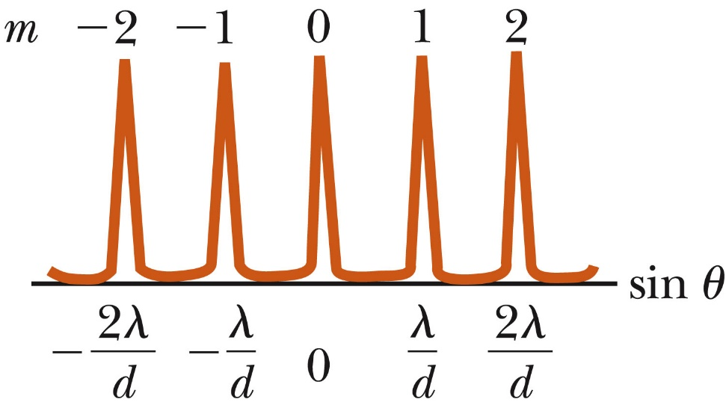
All the wavelengths are focused at m = 0
This is called the zeroth order maximum
The first order maximum corresponds to m = 1
Note the sharpness of the principle maxima and the broad range of the dark area
This is in contrast to the broad, bright fringes characteristic of the two-slit interference pattern

Slide 11
The difference between diffraction and interference
Parameter | Diffraction | Interference
Occurrence | It occurs because of the secondary wavelengths superposition | It occurs due to the light waves superposition that is from two sources
Width of fringes | Unequal | Equal
Intensity of fringe | Not same, in case of diffraction, for all fringes | Same fringe intensity for all the fringes
Obstacle or slit | There is a requirement for it | There is not a requirement for it
Fringe spacing | Non-uniform in the case of diffraction | Uniform in the case of interference
Contrast between maxima and minima | The contrast between maxima and minima is poor | The contrast between maxima and minima is certainly good
Wave propagation direction | It changes after diffraction | It does not change after superposition

Slide 12
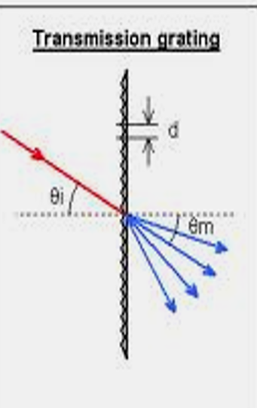
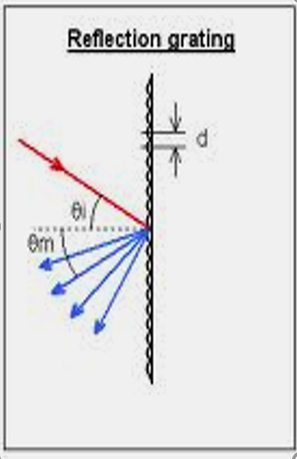
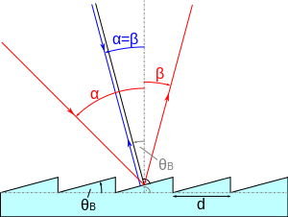
Types of grating:
1- transmission grating can be made by cutting parallel grooves on a glass plate
The spaces between the grooves are transparent to the light and so act as separate slits
2- reflection grating can be made by cutting parallel grooves on the surface of a reflective material, The reflection from the spaces between the grooves is specular, The reflection from the grooves is diffuse , The spaces between the grooves act as parallel sources of reflected light, like the slits in a transmission grating
3- Blazed Gratings A blazed grating is used in spectroscopy , with grooves shaped into right triangles to concentrate light at a specific wavelength. Light can be transmitted or reflected at a high efficiency, at the exact wavelength needed for an application. The blaze angle controls which wavelength is diffracted from the overall beam of light.

Slide 13
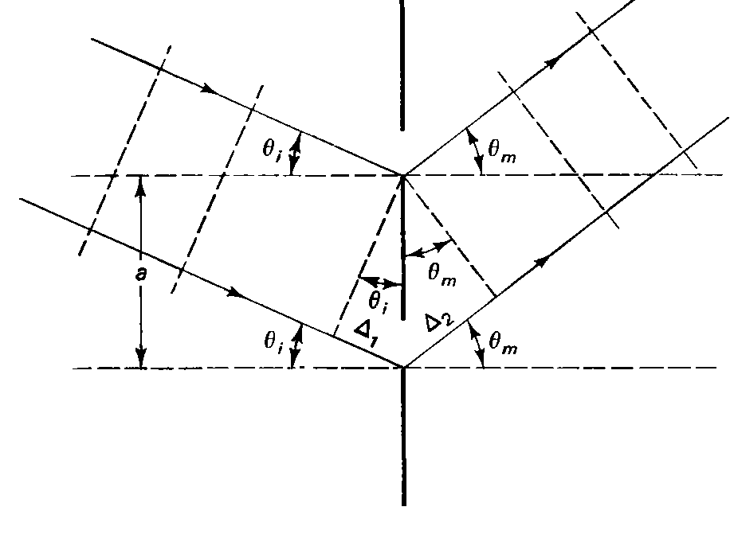
Grating equation
Here assume plane of the incident wavefront makes an angle θ_{i} with the plane of the grating.
The net path difference between the successive slits is
The grating equation is then become :
The zeroth order of interference occurs when m= 0 that or θ_{m} = - θ _{i}

Slide 14
Dispersion of a grating
Higher diffraction orders become less intense under the envelope of the single slit diffraction.
Within an order the wavelengths separated better for higher orders.
The angular dispersion defined as:
The grating equation
For normal incidence

Slide 15
span

Slide 16
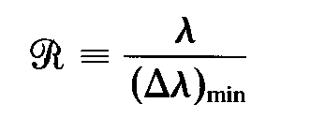
Resolution of a grating
Resolving power is defined in general by:
Δλ _{min} is the minimum wavelength interval of two spectral components that just are resolvable by Rayleigh criterion.
For normal incidence light of wavelength (λ + Δλ) ,and principal maximum of order m the grating equation will be
a sin θ _{m}= m ( λ + Δλ)
To satisfy Rayleigh's criterion this peak must coincide(same θ) with the first minimum of the neighbouring wavelengths peak in the same order or
Equating the right hand sides of the equations above we obtain
the resolving power of the grating is

Slide 17
Notice that the resolving power like the dispersion is independent of groove spacing for a given diffraction angle
If we write:
for a grating width W and incorporates the grating equation for normal incidence then
This mean resolution of a grating at diffracting angle θ_{m} depends on the width of the grating rather than the number of grooves

Slide 18
Q1/ What is the angular separation in second order between light of wavelengths 400 nm and 600 nm when diffracted by a grating of 5000 grooves/cm?
Q2 / (a) Describe the dispersion in the red wavelength region around 650 nm (both in °/nm and in nm/mm) for a transmission grating 6 cm wide, containing 3500 grooves/cm, when it is focused in the third-order spectrum on a screen by a lens of focal length 150 cm. (b) Find the resolving power of the grating under these conditions
Q3/ How many lines must be ruled on a transmission grating so that it is just capable of resolving the sodium doublet (589.592 nm and 588.995 nm) in the first- and second-order spectra

