Slide 1
Salahadin University
Electrical & Electronic Dep.
﻿Free Space Laser Communication
DR. Ahmed Mammon

Slide 2
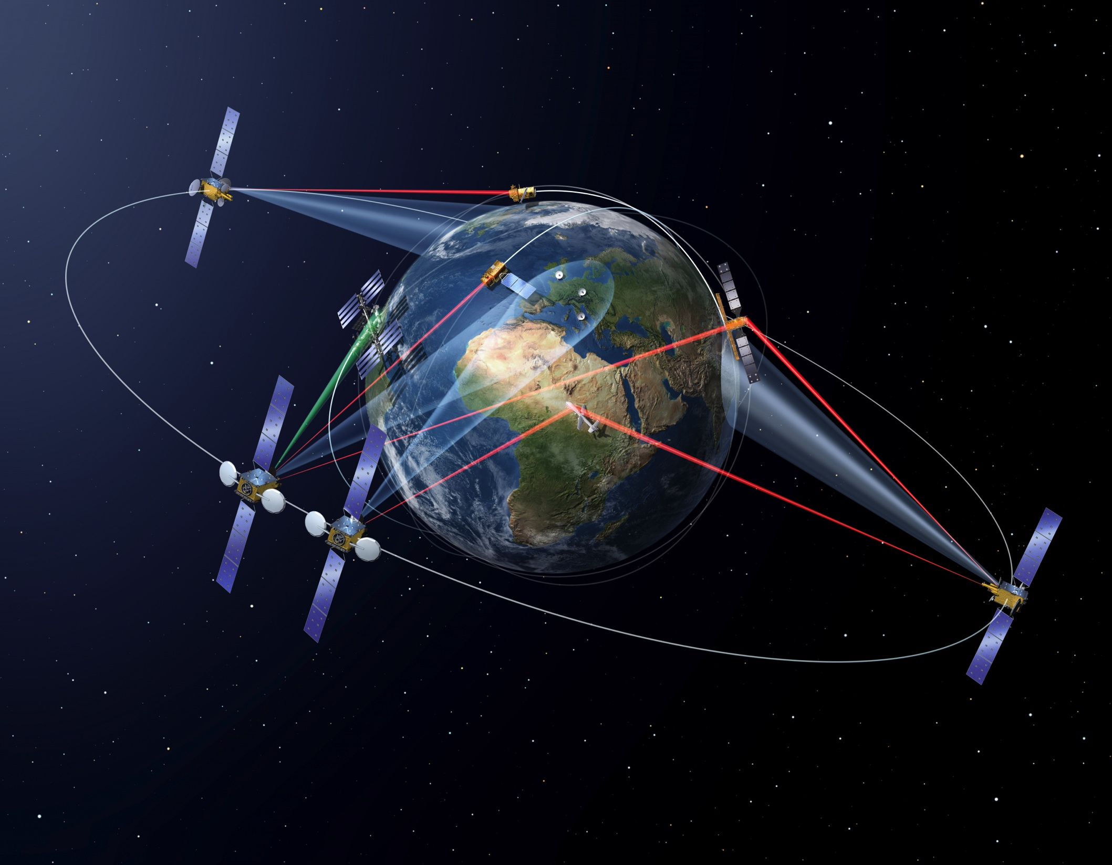
Why Use Laser Communications in
Space?
Laser communication (LC) can pack data onto:
Tighter waves, higher bandwidth, allowing more data to be transmitted over a single link.
While the achieved data rates depend on the signal-encoding scheme.
In general, they could be 100 to 1000 times higher than rates in RF communication.
A challenge for laser satellite communications is ensuring the optimum operation of equipment in harsh environments.
Effects from radiation,
Shock,
Vibration,
And temperature

Slide 3
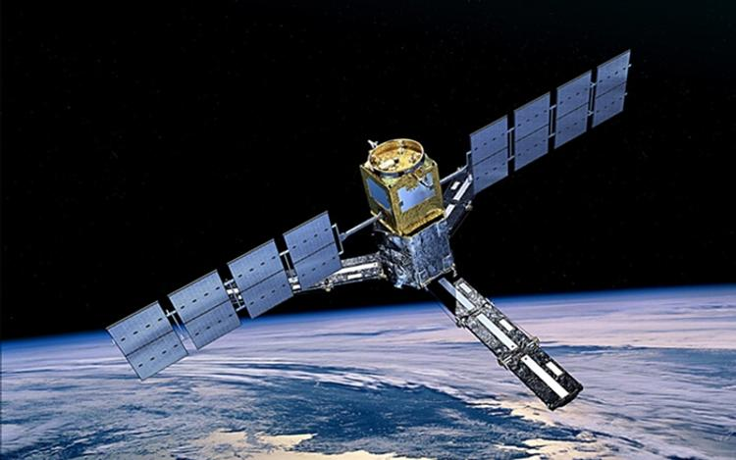
In order to effectively transmit over such long distances, the source laser
requires high optical power to overcome scattering and enable
communication between a transmitter and receiver.
In space, these payloads must have low power consumption,
be small and lightweight with a high capacity of
information transfer.

Slide 4
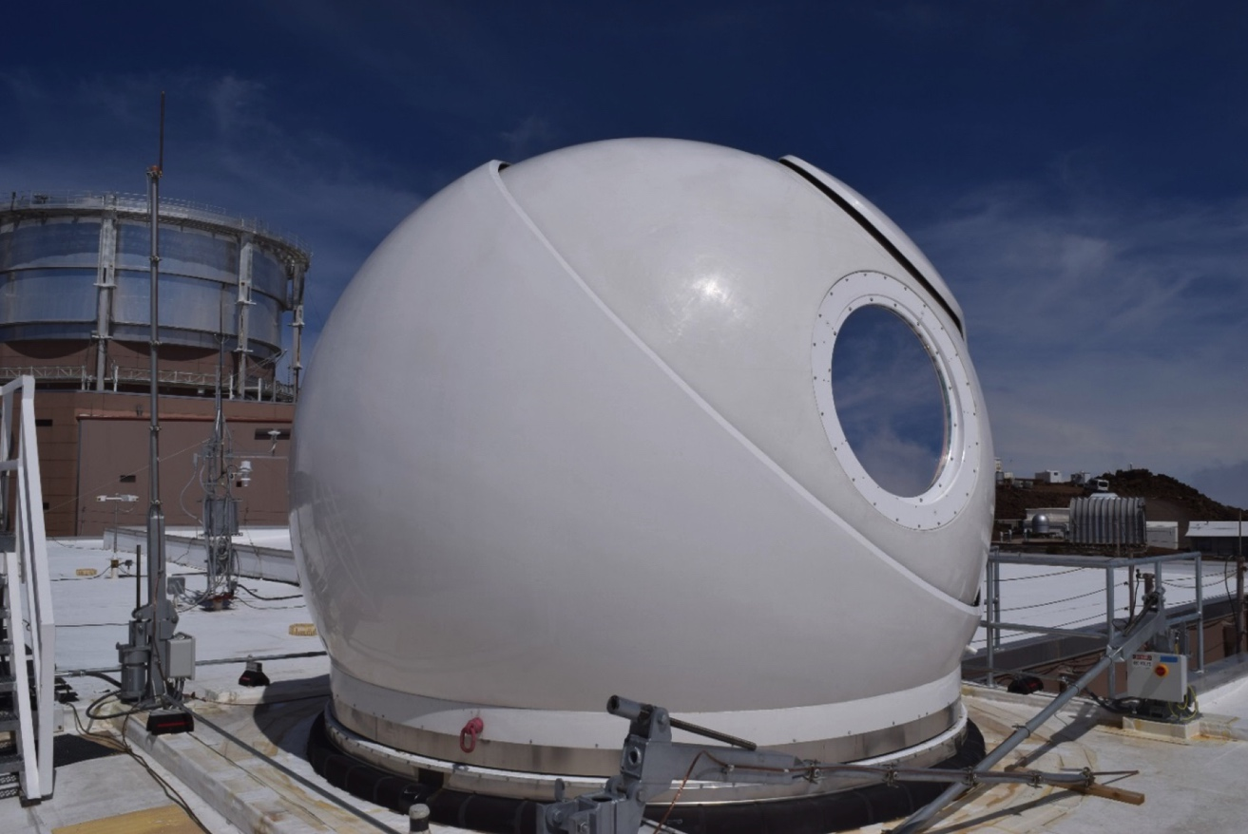
The Optical Chain of Ground Stations
Is Laser Communication a substitute for RF Communication?
Although LC has a lot of potentials. it will never fully replace radio frequency communication in the ground segment, as they are two very different things
While two-way laser communication between vehicles in space is already a well-tested
solution over millions of kilometres, LC high-throughput links through Earth’s
atmosphere can quickly become problematic at distances of even a few kilometres.

Slide 5
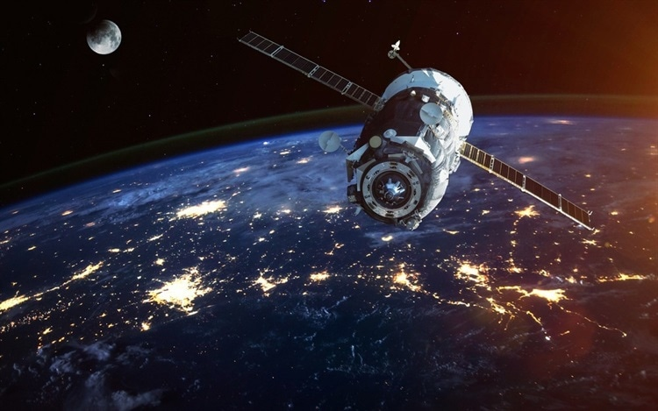
Mitsubishi Electric Corporation has developed an optical receiver
prototype to circumvent the challenges in beam alignment.
The new optical receiver integrates a function to detect the
direction of the incident laser beam with space optical
communication components. These prototypes can be installed
on any laser communication terminals (LCTs).

Slide 6
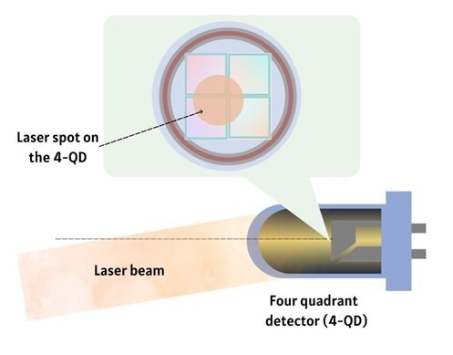
In general, a photoelectric detector converts the laser light it receives into electric signals.
These electric signals are read out on an oscilloscope and proportional values are assigned to the strength of the signals.
Mitsubishi Electric uses a four-quadrant detector (4-QD) in their new prototype to enhance spatial acquisition. 4-QD detectors are constructed with advanced photolithography technology.

Slide 7
Advantages
Free space laser communications links eliminate the need for securing right of ways, and buried cable installations.
As the equipments operate within the near infrared spectrum, they are not subject to government licensing and no spectrum fees have to be paid Additionally,
since no radio interference studies are necessary.
Security Aspects
Free space laser communications systems have narrow optical beam paths,
which are not accessible unless viewing directly into the transmitter path.
Safety Aspects
Although the emitted laser beam is invisible to the unaided eye, it can cause
eye damage if viewed directly at close range for extended periods of time

Slide 8
Thank you

