Slide 1
Holograms
Edited by
Dr. Ahmed Mahmood,

Slide 2
What’s holography?
Holography is the process or technique of making three-dimensional image of the object. A hologram is produced by the interaction of two beams of laser light , one is the object beam coming through the object and another is the reference beam coming directly from the source.

Slide 3
Construction of Hologram
Notes:
The laser points at the beam splitter, which divides the beam of light into two parts.
Mirrors direct the paths of these two beams so that they hit their intended targets.
Each of the two beams passes through a diverging lens and becomes a wide swath of light rather than a narrow beam.
One beam, the object beam, reflects off of the object and onto the photographic emulsion.
The other beam, the reference beam, hits the emulsion without reflecting off of anything other than a mirror.

Slide 4
Construction of Holograms
Need a laser (highly coherent and monochromatic light), lenses, mirror, photographic film, and an object
A beam splitter: This is a device that uses mirrors and prisms to split one beam of light into two beams
Reference beam aimed at a piece of holographic film by mirrors.
Object beam directed at object to be recorded to illuminate object and then meets reference beam at film.
Produces interference pattern of object beam and reference beam which is recorded.
Film is developed. This is called as hologram.
This hologram contains all the informations about the intensity and phases of the scattered waves from the object.

Slide 5
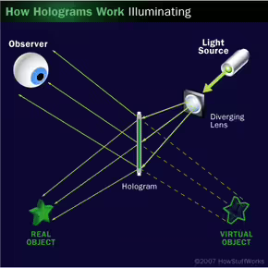
Reconstruction of an image from Hologram

Slide 6
Reconstruction of an image from Hologram
To view the image, the hologram is again illuminated with another laser beam called the reconstruction beam which is at same angle as reference beam.
Hologram acts as a diffraction grating.
This form a real image in front of the hologram and a virtual image behind the hologram.
The virtual image has all the characteristic of the object. The real image can be photographed directly without using a lens.

Slide 7
Hololography vs. Photography
Photography is 2D record of a 3D object whereas holography gives a three dimensional form of original object..
Hologram is the positive pattern where as in conventional photography negative pattern is produced.
In ordinary photography each region contains separate and individual part of the original object.
On the other hand, each part of a hologram contains
information about the entire object.
Notes:
Destruction of a portion of a negative leads to an irrepairable
loss of information corresponding to the destroyed part.
Destruction of a part of hologram does not cause a loss of information about the object, each separate fragment is capable of producing image with a reduced clarity.

Slide 8
Applications of Holography
Holographic interferometry
Holographic microscopes and radars
Supermarket scanners
Optical Computers , holographic television
Improve design of aircraft wings and turbine blades, holographic lens in aircraft head-up display
Data storage
Art
Medical applications or biomedicine

Slide 9
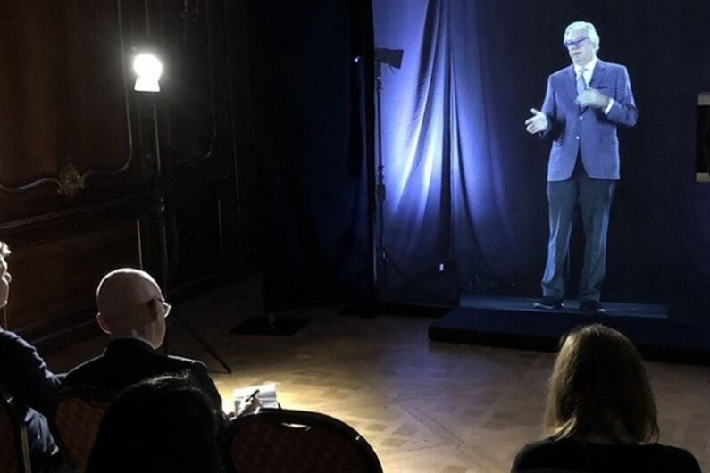
Distance learning & Communication

Slide 10
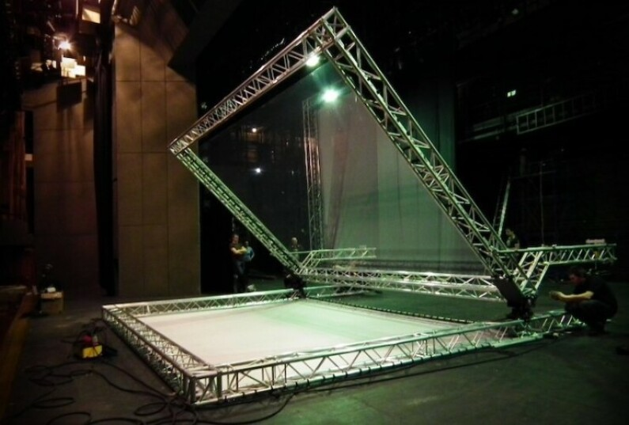
In Art Entertainment

Slide 11
Medicine
Notes:
University staff managed to create an interactive model

Slide 12
THANK YOU

