Slide 1
Salahaddin University Engineering College Electrical Engineering Department
Microprocessor
& Microcontroller
3rd C/C
Lect.12
Lecturer :
Dr. Ahmed Mamoon Mahmood

Slide 2
Microprocessor vs. Microcontroller
Basically a features issue.
Microprocessor – (the physical processor chip)
Composed of control unit, register, arithmetic and logic units
NO Memory, May be timers, No direct external I/O ports
Does have pins for a data bus and an address bus
When implemented in a PC, add a keyboard for input, a monitor, a mouse, a printer, etc.
Microcontroller
Central core of microprocessor but limited capabilities in regards to registers, memory size, and speed.
On board memory
Several Timers
I/O configurable ports
In implementation, may or may not have a keyboard, rather a keypad/switches for input or other types of control, often does not have monitor

Slide 3
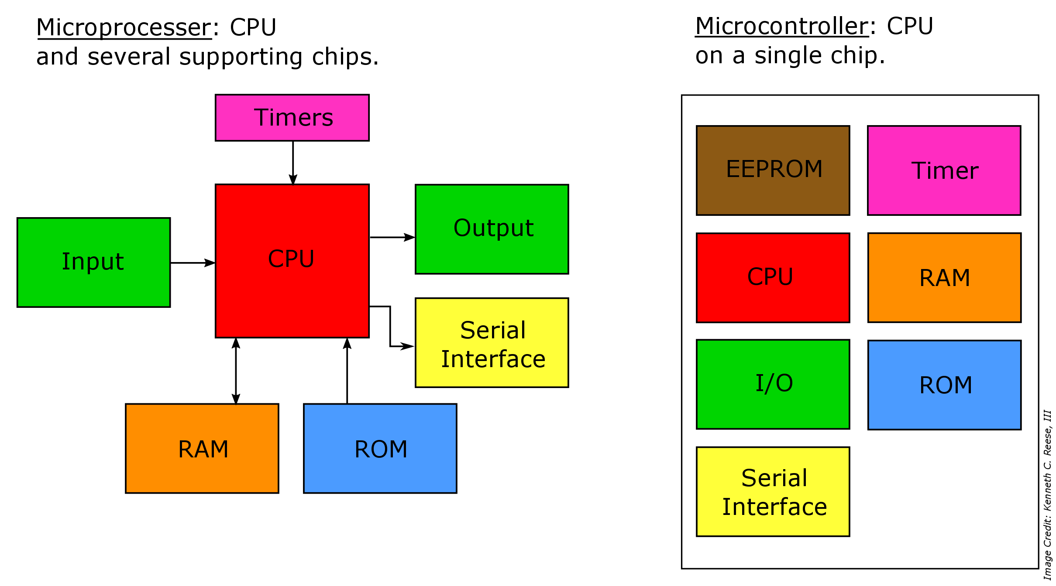

Slide 4
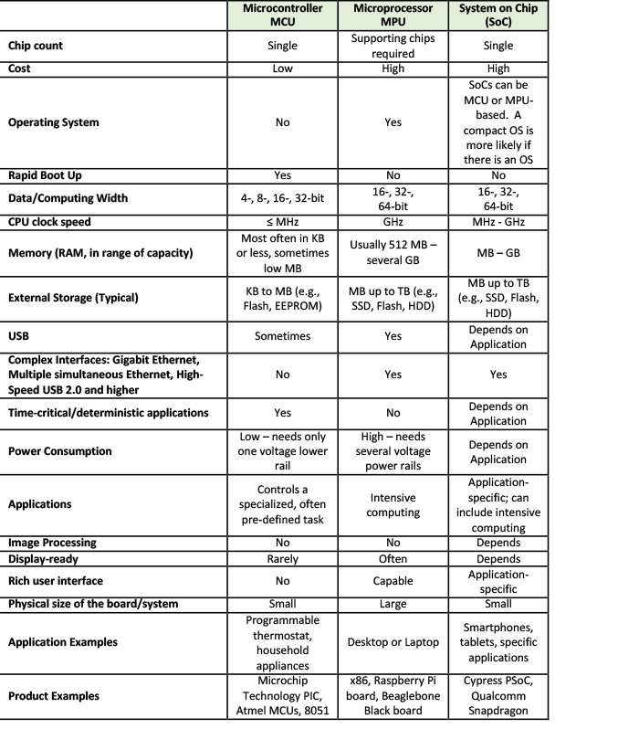
4

Slide 5
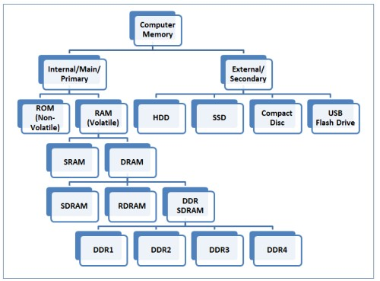
5

Slide 6
What are the types of internal memory?
There are basically two kinds of internal memory: ROM and RAM.
ROM stands for read-only memory. It is non-volatile, which means it can retain data even without power. It is used mainly to start or boot up a computer.
Once the operating system is loaded, the computer uses RAM, which stands for random-access memory, which temporarily stores data while the central processing unit (CPU) is executing other tasks. With more RAM on the computer, the less the CPU has to read data from the external or secondary memory (storage device), allowing the computer to run faster. RAM is fast but it is volatile, which means it will not retain data if there is no power. It is therefore important to save data to the storage device before the system is turned off.

Slide 7
What are the types of RAM?
There are two main types of RAM: Dynamic RAM (DRAM) and Static RAM (SRAM).
DRAM (pronounced DEE-RAM), is widely used as a computer’s main memory. Each DRAM memory cell is made up of a transistor and a capacitor within an integrated circuit, and a data bit is stored in the capacitor. Since transistors always leak a small amount, the capacitors will slowly discharge, causing information stored in it to drain; hence, DRAM has to be refreshed (given a new electronic charge) every few milliseconds to retain data.
SRAM (pronounced ES-RAM) is made up of four to six transistors. It keeps data in the memory as long as power is supplied to the system unlike DRAM, which has to be refreshed periodically. As such, SRAM is faster but also more expensive, making DRAM the more prevalent memory in computer systems.

Slide 8
What are the common types of DRAM?
Synchronous DRAM (SDRAM) “synchronizes” the memory speed with CPU clock speed so that the memory controller knows the exact clock cycle when the requested data will be ready. This allows the CPU to perform more instructions at a given time. Typical SDRAM transfers data at speeds up to 133 MHz.
Rambus DRAM (RDRAM) takes its name after the company that made it, Rambus. It was popular in the early 2000s and was mainly used for video game devices and graphics cards, with transfer speeds up to 1 GHz.
Double Data Rate SDRAM (DDR SDRAM) is a type of synchronous memory that nearly doubles the bandwidth of a single data rate (SDR) SDRAM running at the same clock frequency by employing a method called "double pumping," which allows transfer of data on both the rising and falling edges of the clock signal without any increase in clock frequency.

Slide 9
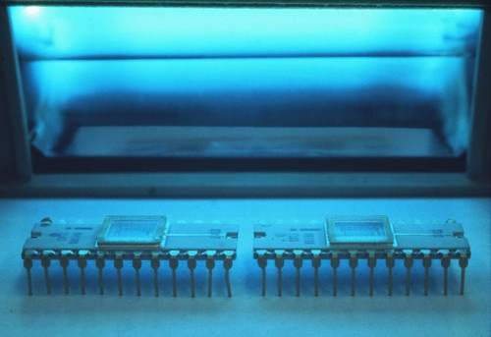
An EPROM (Erasable PROM) had a little window on the top, which allowed it to be erased using a UV light. The first EPROM, introduced in 1971, was the 1702. It had 256 bytes of memory.

Slide 10
So this way you didn’t waste chips every time you had to fix a bug. But it took around 20 minutes to erase one of these, so one usually had a couple of dozen chips and you would erase a bunch at a time.
EEPROM (Electrically-erasable PROM) made it possible to both program and erase the chip electrically.
Flash memory (which is used to store the code in today’s microcontrollers) is just a variation of EEPROM. They differ in the way they are erased — EEPROMs can be erased in single bytes, whereas flash memory is erased in larger blocks (e.g. 4K bytes). EEPROM requires two transistors structure per bit to erase a dedicated byte in the memory, while flash memory has one transistor per bit to erase a region of the memory.
EEPROM usually can permit more erase/write cycles than flash memory.

Slide 11
Introduction to Microcontroller:
A microcontroller (μC or uC) is a solitary chip microcomputer fabricated from VLSI fabrication. A micro controller is also known as embedded controller. Today various types of microcontrollers are available in market with different word lengths such as 4bit, 8bit, 64bit and 128bit microcontrollers. Microcontroller is a compressed micro computer manufactured to control the functions of embedded systems in office machines, robots, home appliances, motor vehicles, and a number of other gadgets. A microcontroller is comprises components like – memory, peripherals and most importantly a processor. Microcontrollers are basically employed in devices that need a degree of control to be applied by the user of the device.
Notes:
Vary large scale integrated ccts

Slide 12
Microcontroller Basics:
Any electric appliance that stores, measures, displays information or calculates comprise of a microcontroller chip inside it. The basic structure of a microcontroller comprise of:-
CPU – Microcontrollers brain is named as CPU. CPU is the device which is employed to fetch data, decode it and at the end complete the assigned task successfully. With the help of CPU all the components of microcontroller is connected into a single system. Instruction fetched by the programmable memory is decoded by the CPU.
Memory – In a microcontroller memory chip works same as microprocessor. Memory chip stores all programs & data. Microcontrollers are built with certain amount of ROM or RAM (EPROM, EEPROM, etc) or flash memory for the storage of program source codes.

Slide 13
3.Input/output ports – I/O ports are basically employed to interface or drive different appliances such as- printers, LCD’s, LED’s, etc.
4.Serial Ports – These ports give serial interfaces amid microcontroller & various other peripherals such as parallel port.
5.Timers – A microcontroller may be in-built with one or more timer or counters. The timers & counters control all counting & timing operations within a microcontroller. Timers are employed to count external pulses. The main operations performed by timers’ are- pulse generations, clock functions, frequency measuring, modulations, making oscillations, etc.
6. ADC (Analog to digital converter) – ADC is employed to convert analog signals to digital ones. The input signals need to be analog for ADC. The digital signal production can be employed for different digital applications (such as- measurement gadgets).

Slide 14
8.DAC (digital to analog converter) – this converter executes opposite functions that ADC perform. This device is generally employed to supervise analog appliances like- DC motors, etc.
9.Interpret Control- This controller is employed for giving delayed control for a working program. The interpret can be internal or external.
10.Special Functioning Block – Some special microcontrollers manufactured for special appliances like- space systems, robots, etc, comprise of this special function block. This special block has additional ports so as to carry out some special operations.

Slide 15
Types of Microcontroller:
Microcontrollers are divided into categories according to their memory, architecture, bits and instruction sets. So let’s discuss types of microcontrollers:-
Bits:
8 bits microcontroller executes logic & arithmetic operations. Examples of 8 bits micro controller is Intel 8031/8051.
16 bits microcontroller executes with greater accuracy and performance in contrast to 8-bit. Example of 16 bit microcontroller is Intel 8096.
32 bits microcontroller is employed mainly in automatically controlled appliances such as office machines, implantable medical appliances, etc. It requires 32-bit instructions to carry out any logical or arithmetic function.

Slide 16
Memory:
External Memory Microcontroller – When an embedded structure is built with a microcontroller which does not comprise of all the functioning blocks existing on a chip it is named as external memory microcontroller. For illustration- 8031 microcontroller does not have program memory on the chip.
Embedded Memory Microcontroller – When an embedded structure is built with a microcontroller which comprise of all the functioning blocks existing on a chip it is named as embedded memory microcontroller. For illustration- 8051 microcontroller has all program & data memory, counters & timers, interrupts, I/O ports and therefore its embedded memory microcontroller.

Slide 17
Instruction Set:
CISC- CISC means complex instruction set computer, it allows the user to apply 1 instruction as an alternative to many simple instructions.
RISC- RISC means Reduced Instruction Set Computers. RISC reduces the operation time by shortening the clock cycle per instruction.
Memory Architecture:
Harvard Memory Architecture Microcontroller
Princeton Memory Architecture Microcontroller

Slide 18
8051 Microcontroller:
The most universally employed set of microcontrollers come from the 8051 family. 8051 Microcontrollers persist to be an ideal choice for a huge group of hobbyists and experts. In the course of 8051, the humankind became eyewitness to the most ground-breaking set of microcontrollers. The original 8051 microcontroller was initially invented by Intel. The two other members of this 8051 family are-
8052 – This microcontroller has 3 timers & 256 bytes of RAM. Additionally it has all the features of the traditional 8051 microcontroller. 8051 microcontroller is a subset of 8052 microcontroller.
8031 – This microcontroller is ROM less, other than that it has all the features of a traditional 8051 microcontroller. For execution an external ROM of size 64K bytes can be added to its chip.
8051 microcontroller brings into play 2 different sorts of memory such as- NV-RAM, UV-EPROM and Flash.

