Slide 1
Design of RC Beams For Flexure
Chapter Three

Slide 2
Design and Analysis of Rectangular Beams
Whitney Block`s:
Whitney replaced the curved stress block with an equivalent rectangular block of intensity 0.85f `c and depth α = β1c, as shown in Figure.
Fig. 5 Stress-strain curve for concrete in bending
Equating the horizontal forces C and T and solving for a, we obtain:
0.85f `c ab = As fy

Slide 3
Where ρ = As/ b d
Before the design of any beams is attempted, several miscellaneous topics need to be discussed. These include the following:
1. Structural Safety
The working loads are multiplied by certain load factors that are larger than 1.
Multiplying the theoretical ultimate strength by the strength reduction factor, Ø, which is less than 1. These values generally vary from 0.90 for bending down to 0.65 for some columns.

Slide 4
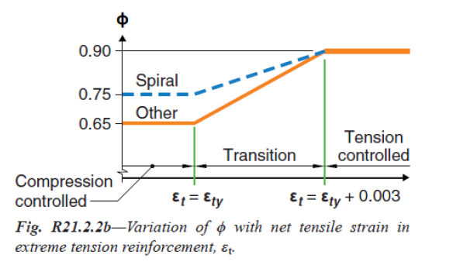
- Ductility Adoption: The ductility gain by an ample warning for the user of the building when overloaded. The warning happened with deflection and cracks. The final failure of the beam can be controlled by designing the beam to contain an amount of steel equal to or less than maximum steel area (As,max. )or maximum steel ratio.(ρmax.). For ductile or tension-controlled beams and slabs where Єt ≥ (Єy +0.003), the value of Ø for bending is 0.90. This situation is shown in Fig.6.
Fig. 6 Variation of Ø with tensile strain Єt

Slide 5
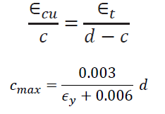
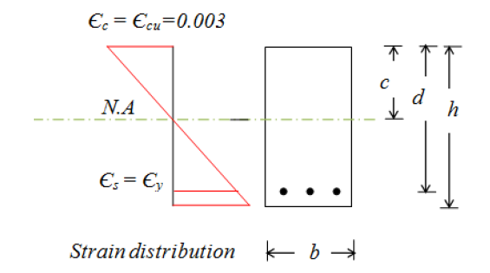
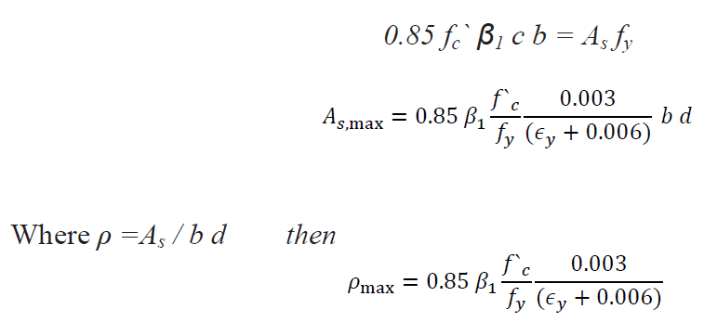
In this section, an expression is derived for As,max and ρmax, the percentage of steel to be considered ductile section.
C = T, Example for rectangular section
0.85 fc` β1 c b = As fy
Fig. 7 Strain distributions
maximum acceptable percentage of steel to be in tension control where steel stain at Єt= Єy +0.003 and reduction factor Ø=0.9. The value of ρmax can be easily determine for different f`c and fy.

Slide 6
2. Minimum Percentage of Steel
If the ultimate resisting moment of the section is less than its cracking moment, the section will fail immediately when a crack occurs. This type of failure may occur without warning. To prevent such a possibility, the ACI (9.6.1.2) specifies a certain minimum amount of reinforcing that must be used at every section of flexural members where tensile reinforcing is required by analysis, whether for positive or negative moments. In the following equations, bw represents the web width of beams.
3. Balanced Sections:
A beam that has a balanced steel ratio is one for which the tensile steel will theoretically just reach its yield point at the same time the extreme compression concrete fibers attain a strain equal to 0.003.

Slide 7
4. Beam proportions: Unless architectural or other requirements dictate the proportions of reinforced concrete beams, the most economical beam sections are usually obtained for shorter beams (up to 8m length), when the ratio of d to b is in the range of 1.5 to 2. For longer spans, better economy is usually obtained if deep, narrow sections are used. The depths may be as large as 3 or 4 times the widths.
5. Deflections: The ACI Code in its Table 9.3.1.1 provides minimum thicknesses of beams and one-way slabs for which such deflection calculations are not required. If deflections are computed for members of lesser thicknesses than those listed in the table and are found to be satisfactory, it is not necessary to abide by the thickness rules.
6. Estimated beam weight: The weight of the beam to be selected must be included in the calculation of the bending moment to be resisted, because the beam must support itself as well as the external loads.

Slide 8
7. Selection of bars: After the required reinforcing area is calculated. For the usual situations, bars of sizes Ø35mm and smaller are practical to be used.
8. Cover: The reinforcing for concrete members must be protected from the surrounding environment; that is, fire and corrosion protection need to be provided. In addition, the cover improves the bond between the concrete and the steel. In Section 20.6.1.3 of the ACI Code, specified cover is given for reinforcing bars under different conditions.
9. Minimum spacing of bars: The code (25.2.1) states that the clear distance between parallel bars cannot be less than 25mm, d_{b} or 4/3 d_{agg}.. If the bars are placed in more than one layer, those in the upper layers are required to be placed directly over the ones in the lower layers, and the clear distance between the layers must be not less than 25mm.

Slide 9
10.Lateral Support
It is unlikely that laterally unbraced reinforced concrete beams of any normal proportions will buckle laterally, even if they are deep and narrow, unless they are subject to appreciable lateral torsion. As a result, the ACI Code (10.4.1) states that lateral bracing for a beam is not required closer than 50 times the least width, b, of the compression flange or face.
11.Skin Reinforcement for Deep Beams
Beams with web depths that exceed 1m have a tendency to develop excessively wide cracks in the upper parts of their tension zones. For a beam designed with an effective depth > 0.9 m, additional skin reinforcement must be determined with the following expression, in which A_{sk} is the area of skin reinforcement per meter of height on each side of the beam: ACI 9.7.2.3 Longitudinal skin reinforcements shall be uniformly distributed at both sides of the beam for a distance h / 2 from the tension face or s from section 24.3.2.

Slide 10
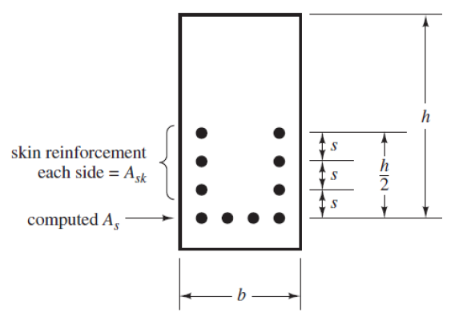
Fig. 10 Skin reinforcements
12.Bundled Bars
Sometimes when large amounts of steel reinforcing are required in a beam or column. For such situations, groups of parallel bars may be bundled together. Up to four bars can be bundled, provided they are enclosed by stirrups or ties.
Fig. 11 Bundle bars

Slide 11
13. Continuous Beams
The very common situation, however, is for beams and slabs to be continuous over several supports, as shown in Fig.12. Because reinforcing is needed on the tensile sides of the beams, we will place it in the bottoms when we have positive moments and in the tops when we have negative moments.
Fig. 12 Continues beam.

Slide 12
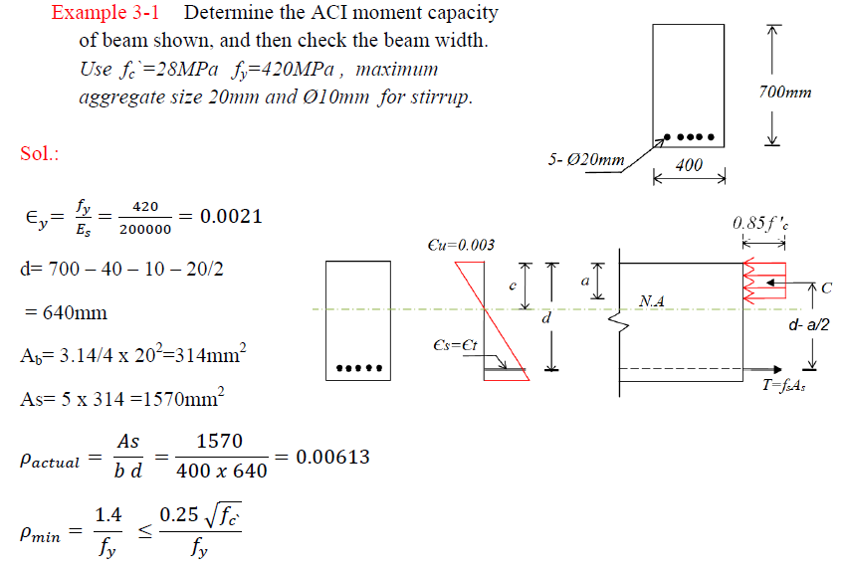

Slide 13
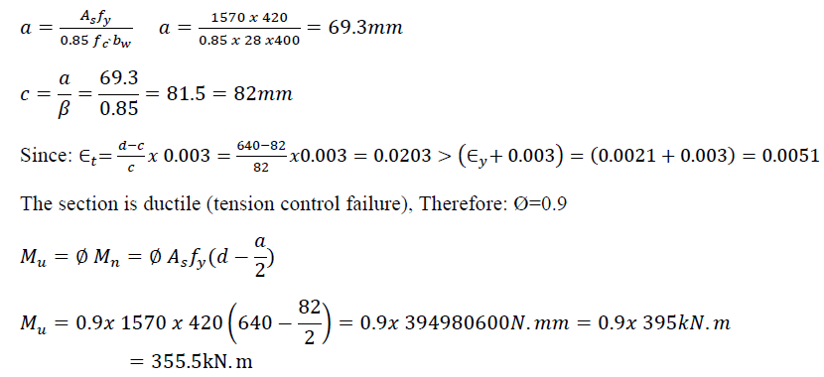

Slide 14
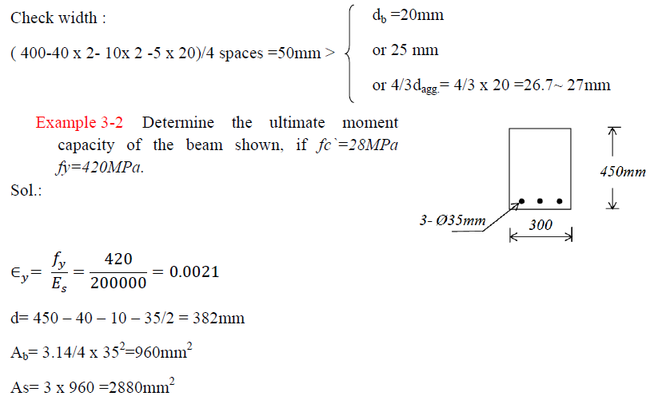

Slide 15
