Slide 1
Properties of cation exchange :
1-Reversibility : cation exchange reaction are reversible reaction
Or near it, but there are some exceptions such as:
A-Poly valent cations except (Fe) or trace elements.
B- Some cations.
C-Adsorption of some large organic molecules such as pesticides.
2- Stoichiometry :
CaX + 2NH₄⁺ Soluble = 2NH₄ X + Soluble Ca
But some times there are hysterias phenomenon.
3-Speed: Exchange reactions are rapid.
4-Mass action: Due to their reversibility the CER can be driven in either forward or reverse direction by multipilatry the concentration of reactants or and products for example:
CaX + 2Na (high concentration) = Na2 X + Ca( low concertation)
CaX + Na₂CO₃ = Na₂X + CaCO₃ (precipitation).
NH₄⁺X + NaOH =NaX +NH₄OH =NaX +H₂0 + NH₃

Slide 2
5- Valence dilution effect : For example
$$\frac{\left(NH4\right)2 X}{CaX}=K\frac{\left(NH4\right)2}{(Ca)}$$
If concentration of NH₄⁺ =1 mmole /L and Ca²⁺ = 1 mmole /L
The ratio = $\frac{1}{1}$ =1
But if the solution diluted 10 times the ratio will change to
$The ratio=$ $\frac{\left(NH4\right)2}{Ca2+}$= $\frac{\left(0.1\right)2}{0.1}$ = 0.1
What is the application of this law in water classification?
6-Complementary cations:
a: Ca-Al + NH₄⁺ = Replace is easier.
b: Ca-Na + NH₄⁺
Why replacing of Ca by Nh4 in a is easier than b?

Slide 3
7- Anion effect: The anion associated with replacing cation can affect by cation exchange (CE) depending on types of anions and products for example:
A- More weakly dissociated :
HX + Na⁺ + OH⁻ NaX + H₂O
HX + Na⁺ + Cl⁻ NaX + H⁺ + Cl⁻
Why the behavior of the second reaction is differing from the first one as shown by red arrow? Explain it.
^{B- Less soluble:}
AlX + 3Na + 3OH 3NaX + Al(OH)₃
_{AlX + 3Na + 3Cl}⁻ _{3NaX + Al}³⁺ _{+ 3Cl}⁻

Slide 4
C –More volatile and non volatile :
2HX + CaCO₃ CaX + H₂CO₃ CaX + H₂O +CO₂
2HX + CaSO₄ CaX + H₂SO₄ (Non volatile)

Slide 5
Langmuir equation or model :
Suppose that the covered soil surface at any time = ϴ and non covered portion = 1- ϴ depending on above :
Rate of adsorption $∝$ c(1- ϴ)
Rate of adsorption = K₁ C₁ (1- ϴ)
C = concentration of equilibrium
Rate of desorption $∝$ ϴ
Rate of desorption = K₂ ϴ

Slide 6
At equilibrium point :
Rate of adsorption = rate of desorption
.’. K₁ C (1- ϴ) = K₂ ϴ
.’. K₁ C = K₂ ϴ+ K₁ C ϴ
.’. K₁ C = ϴ ( K₂ +K₁ C )
ϴ = $\frac{\text{K}\text{1} \text{C}}{\text{K}\text{2} \text{+}\text{K}\text{1} \text{C}}$
If $\frac{\text{K}\text{1} }{\text{K}\text{2} }=$K or = a
$\frac{1}{\text{ϴ}}$ = $\frac{\text{K}\text{2} \text{+}\text{K}\text{1} \text{C}}{\text{K}\text{1} \text{C}}$

Slide 7
$\frac{1}{\text{ϴ}}$ = $\frac{\text{K}\text{2} }{\text{K}\text{1} \text{C}}$ + $\frac{1}{\text{ϴ}}$ = $\frac{\text{K}\text{1} \text{C}}{\text{K}\text{1} \text{C}}$
$\frac{1}{\text{ϴ}}$ = 1+ $\frac{\text{K}\text{2} }{\text{K}\text{1} \text{C}}$
$\frac{1}{\text{ϴ}}$ = 1+ $\frac{\text{1} }{\text{a} \text{C}}$ ( because $\frac{\text{K}\text{1} }{\text{K}\text{2} }=$K or = a
$\frac{1}{\text{ϴ}}$ = $\frac{\text{ac}\text{+}\text{1} }{\text{a} \text{c}}$
$\frac{x}{m}$ $∝$ ϴ ……
.’. $\frac{x}{m}=$b ϴ b=k and ϴ= $\frac{\text{ac} }{\text{a} c+1}$
.’. [ $\frac{x}{m}=$ $\frac{\text{a}\text{b}\text{c} }{\text{a} c+1}$ ] Dividing both sides by c .

Slide 8
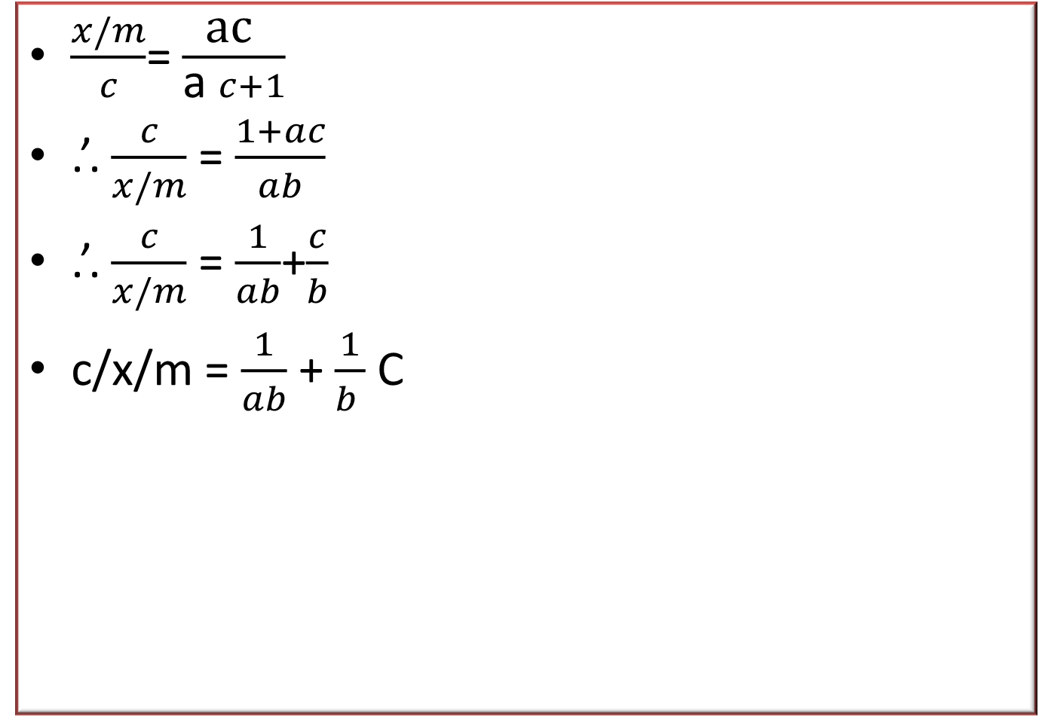
$\frac{x/m}{c}$= $\frac{\text{ac} }{\text{a} c+1}$
.’. $\frac{c}{x/m}$ = $\frac{1+ac}{ab}$
.’. $\frac{c}{x/m}$ = $\frac{1}{ab}$+$\frac{c}{b}$
c/x/m = $\frac{1}{ab}$ + $\frac{1}{b }$ C

Slide 9
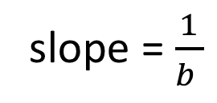
$\frac{c}{x/m}$
A=K= affinity constant
B=maximum adsorption
$\frac{slope }{intercept }$ = $\frac{\frac{1}{b }}{\frac{1}{ab }}$
= $\frac{1}{b }$* $\frac{ab}{1 }$= a or K
slope = $\frac{1}{b }$
}
$\frac{1}{ab}$ = intercept
C at equilibrium

Slide 10
Freandlich equation:
It used successfully gas adsorption and it can be use in adsorption of Mo and boron.
$\frac{x}{m}=$ K${C.}^{\frac{1}{n}}$
$\frac{x}{m}=$
K= Empirical constant
C_{o} = concentration at equilibrium
N= Empirical constant
$$\frac{x}{m}$$
C_{o}

Slide 11
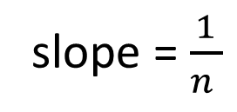

But logarithmic form in as follow
Log $\frac{x}{m}$ = $\log^{k}$+ $\frac{1}{n}$ $\log^{\text{C}\text{o}}$
slope = $\frac{1}{n }$
Log x/m
}
$$\log^{k}$$
$$\log^{\text{C}\text{o}}$$

Slide 12
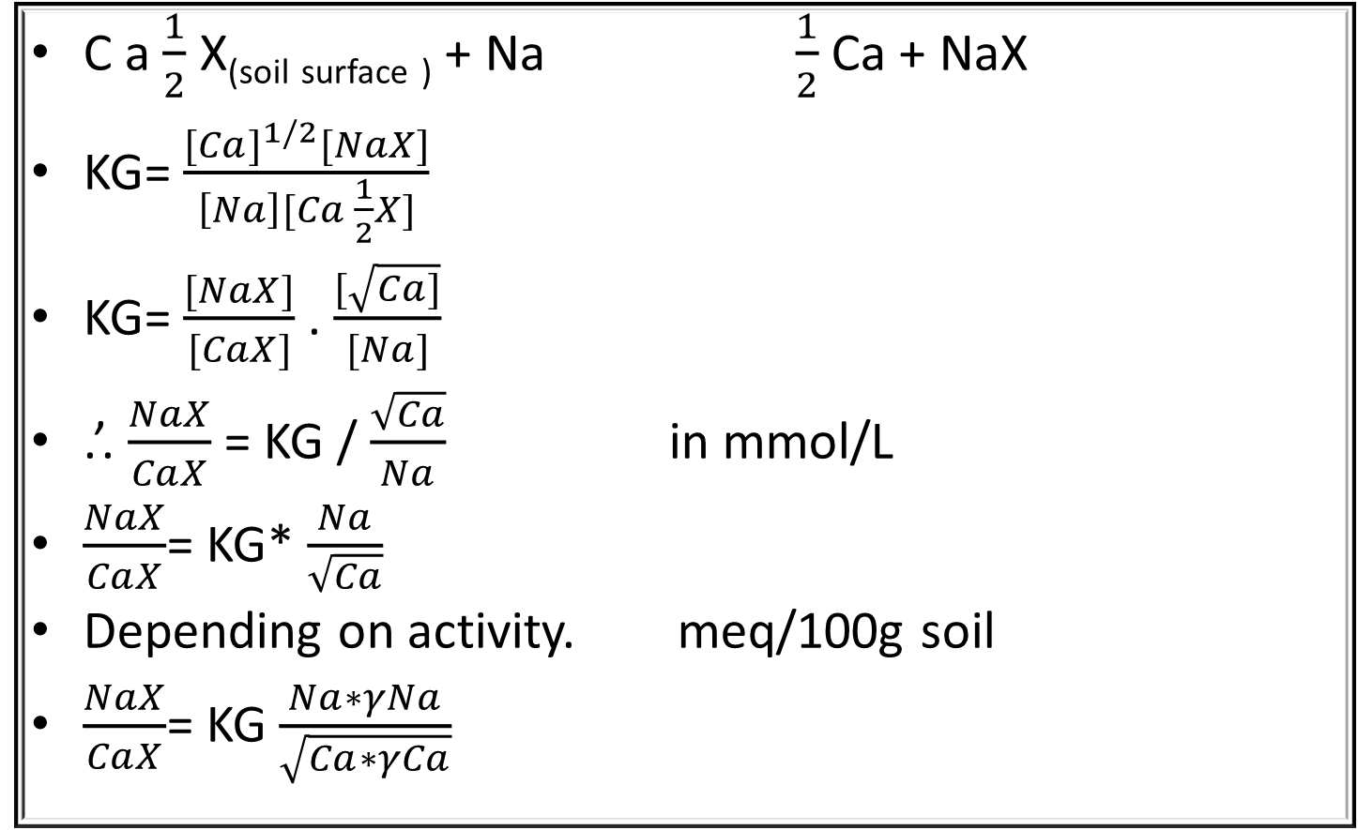
Gapon model :
C a $\frac{1}{2}$ X_{(soil} _{surface} ₎ + Na $\frac{1}{2}$ Ca + NaX
KG= $\frac{{[Ca]}^{1/2}[NaX]}{\left[Na\right][Ca \frac{1}{2}X]}$
KG= $\frac{[NaX]}{[CaX]}$ . $\frac{[\sqrt{Ca]}}{[Na]}$
.’. $\frac{NaX}{CaX}$ = KG / $\frac{\sqrt{Ca}}{Na}$ in mmol/L
$\frac{NaX}{CaX}$= KG* $\frac{Na}{\sqrt{Ca}}$
Depending on activity. meq/100g soil
$\frac{NaX}{CaX}$= KG $\frac{Na∗γNa}{\sqrt{Ca∗γCa}}$

Slide 13
While $\frac{γNa}{\sqrt{γCa}}$ = constant
.’. $\frac{NaX}{CaX}$= KG $\frac{Na}{\sqrt{Ca}}$ ( depending on activity )
ESR = KG SAR
After that Mg was added to the Gapon model as follow
$\frac{NaX}{CaX+MgX}$ = KG $\frac{Na}{\sqrt{Ca+Mg}}$ mmol/L
Meq/100g soil
$\frac{NaX}{CaX+MgX }$ = KG $\frac{Na}{\sqrt{\frac{Ca+Mg}{2}}}$ meq/L

Slide 14
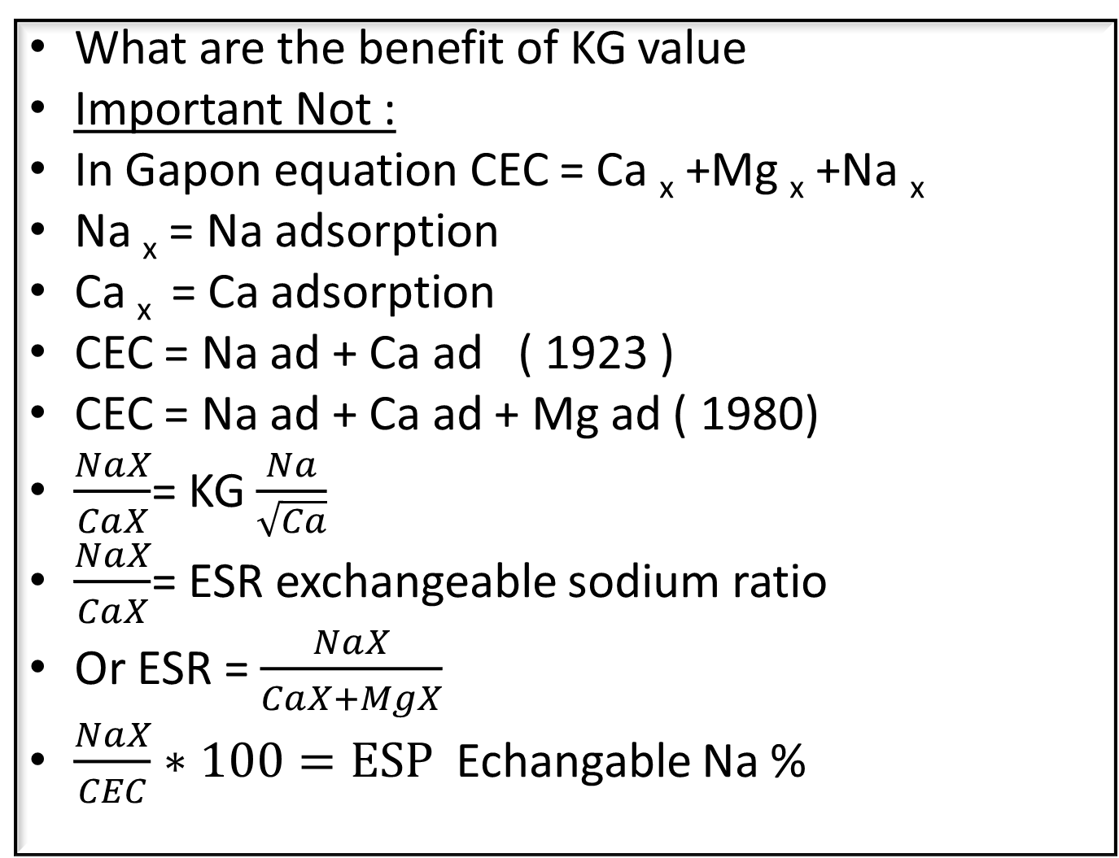
What are the benefit of KG value
Important Not :
In Gapon equation CEC = Ca _{x} +Mg _{x} +Na _{x}
Na _{x} = Na adsorption
Ca _{x} = Ca adsorption
CEC = Na ad + Ca ad ( 1923 )
CEC = Na ad + Ca ad + Mg ad ( 1980)
$\frac{NaX}{CaX}$= KG $\frac{Na}{\sqrt{Ca}}$
$\frac{NaX}{CaX}$= ESR exchangeable sodium ratio
Or ESR = $\frac{NaX}{CaX+MgX}$
$\frac{NaX}{CEC}∗100=ESP$ Echangable Na %

Slide 15
For example : calculate KG if you are given the following information :
1- Na x = 10 meq/100g soil
CEC= 20 meq/100g soil
Soluble Na = 8 mmole/L
Soluble Ca = 9 mmole/L
$\frac{NaX}{CaX}$= KG $\frac{Na}{\sqrt{Ca}}$
$\frac{NaX}{CEC−NaX}$= KG $\frac{Na}{\sqrt{Ca}}$
$\frac{10}{20−10}$= KG $\frac{8}{\sqrt{9}}$ 10/10=KG*8/3
1= KG*8/3 3=KG*8
KG= 3/8

