Slide 1
4thstage Biology Department Practical Medical Bacteriology 2nd semester
Gram Negative Bacilli Oxidase Positive
(Lab 3)
MSc. Ala J Ahmad

Slide 2
Genus: Pseudomonas sp
Gram-negative, rod-shaped bacterium.
Aerobic
Non-lactose fermenter. Motile with the polar-flagellum Simple growth requirement.
Widely distributed in water, soil, and human-animal intestine.

Slide 3
Pseudomonas aeruginosa
Biofilm producer.
Multidrug resistant pathogen.
The organism is considered opportunistic causing nosocomial infections such as:
Ventilator-associated pneumonia.
Eye infection secondary to trauma or surgery.
Otitis externa.
Cystic fibrosis
Urinary tract infection and various sepsis syndromes.

Slide 4
Lab diagnosis of Pseudomonas aeruginosa
Specimen: pus, urine, sputum, blood, eye swabs.
Smear: Gram-negative rods.
Culture:
Obligate aerobe, grows on all routine media over wide range of temperature (5-42 ˚C).
Bluish-green pigmented large colonies with characteristic “fruity” odor on culture media such as Nutrient agar and Cetrimide agar which is a selective medium for this bacterium.

Slide 5
Lab diagnosis of Pseudomonas aeruginosa
Biochemical reaction:
Oxidase and catalase positive. IMVIC test: ---+
Sugar fermentation and H₂S production: red slant/red butt with no H₂S and gas.
Identification of this bacterium is based on oxidase positivity, colony morphology, non-lactose fermenter on MacConkey, characteristic of pigment production and growth at 42˚C.

Slide 6
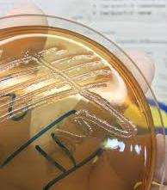
Pseudomonas aeruginosa
NA or Cetrimide agar
Catalase
MA
TSIA
IMViC ---+

Slide 7
Genus: Vibrio sp.
Species of medical importance: Vibrio cholerae
Gram-negative, curved rods. Facultative anaerobes.
Actively motile.
Typically found in salt water.
Cause foodborne infection, eating undercooked seafood.

Slide 8
Lab diagnosis of Vibrio sp.
Specimen: mucus flecks from stools.
Smear: Although observed as a gram-negative organism, it is easily seen and recognized on direct dark-field microscopy examination of the stool showing the rapidly motile vibrios.

Slide 9
Lab diagnosis of Vibrio sp.
Culture
For enrichment, a few drops of stool can be incubated for 6–8 hours in alkaline peptone water at room temperature as well as 37 ˚C.
Growth is rapid in peptone agar; on blood agar with a pH near 9.0(rapidly killed by acid).
Thiosulphate citrate bile salt sucrose agar (TCBS) media is selective media for primary isolation of V.cholerae, on which it produces convex, smooth, round yellow colonies that are readily visible against the dark-green background of the agar.

Slide 10
TCBS

Slide 11
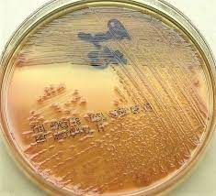
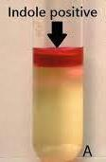
MA
TCBS
Catalase
Vibrio cholerae
TSIA
IMViC +-++

Slide 12
An adult cholera victim. The hands show wrinkled skin

Slide 13
Genus: Helicobacter sp
Helicobacter pylori
Spiral-rod shaped gram negative bacterium. Microaerophilic.
Actively motile with multiple flagella at one pole.
Causing gastritis and gastric ulcer.

