Slide 1
Practical Medical Bacteriology
4thstage Biology Department
General Urine Examination
(Urine Analysis)
(Lab 5)
Ala J.Ahmad
MSc in Microbiology@su.edu.krd

Slide 2
What is General Urine Examination?
General Urine Examination (GUE) also called urine analysis (Urinalysis).
A urinalysis is an array of tests performed on urine.
It's used to detect and manage a wide range of disorders, such as urinary tract infections, kidney disease and diabetes.

Slide 3
Collection of Urine Specimens
The first voided morning urine (the most common)
Random urine (for emergency)
Clean-catch, midstream urine (for urine culture)
Attention:
Urine need to be examined within 1-2 hour, else
requires refrigeration.

Slide 4
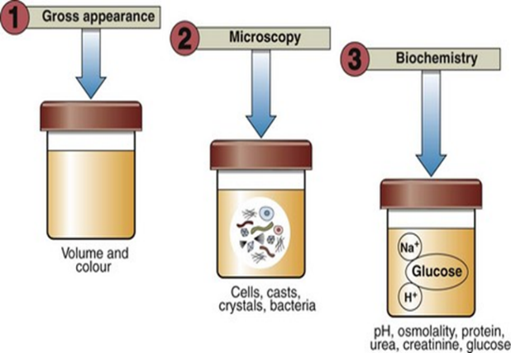
GUE: What to Look for?
Urinalysis consists of the following measurements:
Physical examination
Chemical examination
Microscopic examination
3
2

Slide 5
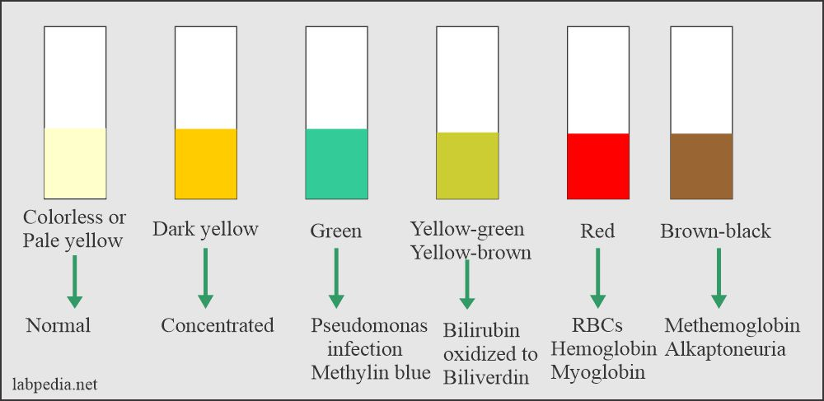
Physical Examination
Appearance
Urine volume:1-2,5 L/d
Specific gravity (SG)
Appearance:
Including color and clarity
urochrome

Slide 6
Chemical Examination
Urine dipsticks:
The entire strip is dipped in the urine sample and color changes in each square are noted.
The color change takes place after several seconds to a few minutes from dipping the strip.
If read too early or too long after the strip is dipped, the results may not be accurate.

Slide 7
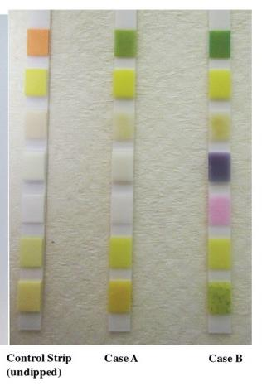
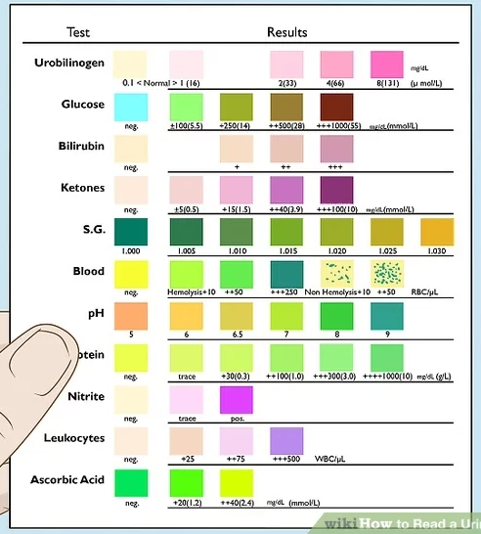
What is Evaluated on Chemical Examination

Slide 8
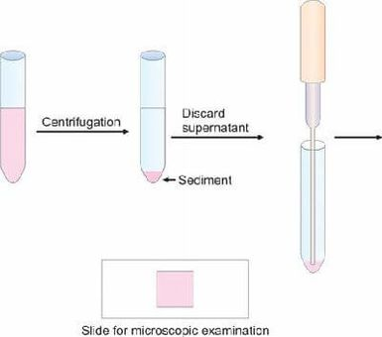
Microscopic Examination
Microscopic urinalysis is done simply by pouring the urine sample into a test tube and centrifuging it for a few minutes. The top liquid part (the supernatant) is discarded.
The solid part left in the bottom of the test tube (the urine sediment) is mixed with the remaining drop of urine in the test tube and one drop is analyzed under a microscope.

