Slide 1
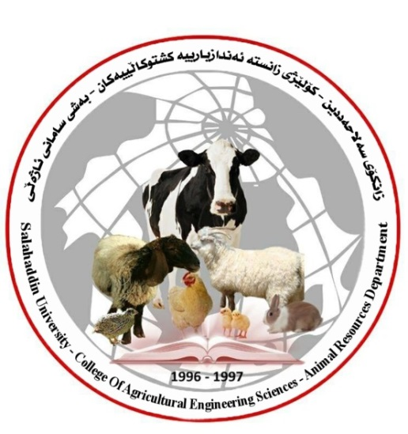
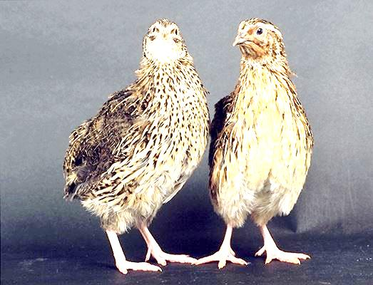
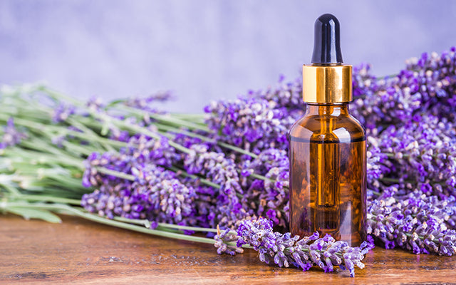
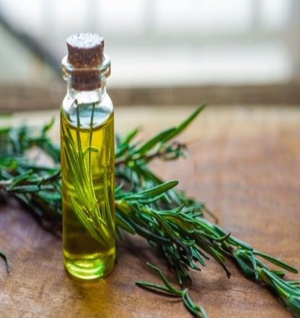
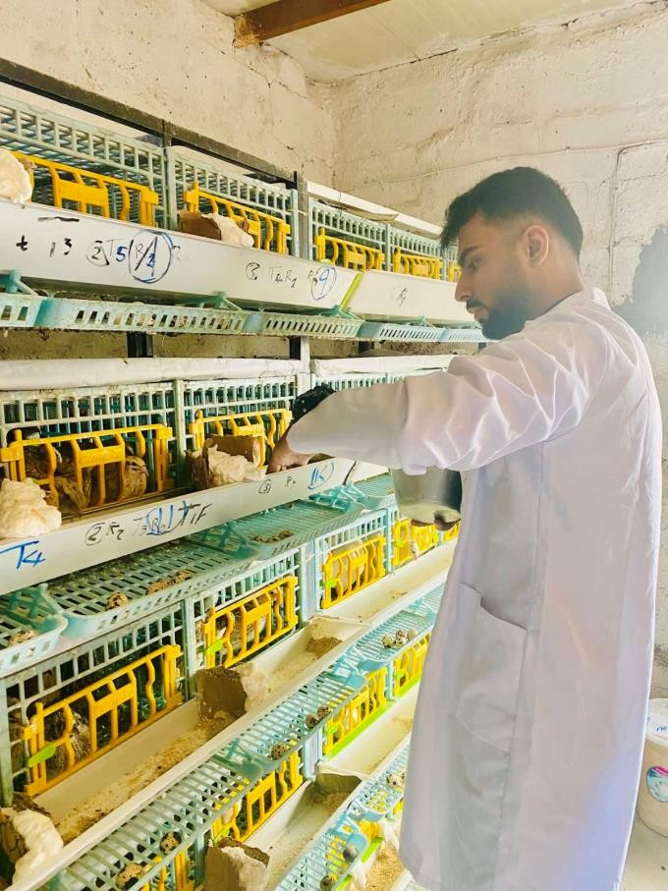
Effect of Dietary Supplement of Lavender and Rosemary Essential Oil on Quails Productive Performance, Egg Quality and Physiological Parameters
Prepared by: Farman Faisal Muhammed
Salahaddin University–Erbil,College
Of Agricultural Engineering Sciences Animal Recourse Department
Supervised by : Assist Prof. Dr. Alaa Abdulmejeed Mustafa
April 2024
Introduction and the Objective
Results and Discussion
Quail (Coturnix Japonica) production is one of the best sector of commercial poultry production. Lavender (Lavandula angustifolia) and Rosemary (Rosmarinus officinalis) are belonging to the Labiatae (Lamiaceae) family (Laghouati et al., 2020). These compounds of vegetable origin are called essential oils (EOs). Lavender and Rosemary EOs are plants rich in active ingredients (Mahgoub et al., 2019). These two EOs stimulate the appetite and digestive system, exhibiting antioxidant and antimicrobial activities (Sevim and Yusuf, 2017). Recently, they are also reported to stimulate the release of digestive enzymes promote the absorption and synergies of vitamins and minerals in the body
1- Effect of LEO and REO on quails productive performance
The influence of adding lavender and rosemary essential oil and the their combine on quail performance shows in figure 1 . the effect of supplementing lavender and rosemary essential oil significantly (p<0.01) increased of feed intake (FI) T4 and other treatments compared to control group. Hen day (HD%) significantly (p<0.01) recorded the highest egg production T4, T3 and T2 90.95, 86.35 and 85.4% respectively compared to quails in control which recorded the lowest 69.21% of egg production. However , did not effect on feed conversion ratio (FCR).
The objective of this study;
The objective of the current study was to investigate the influence of dietary Lavender and Rosemary essential oils and their combination on laying Japanese quail performance, egg quality and physiological parameters.
Figure 1.effect of lavender and rosemary
Methodology
Experimental Design
72 Quails with 42 days age
2- Effect of LEO and REO on quails physiological parameters
Influence of supplementing lavender and rosemary essential oil and the their combine on serum biochemical shows in table 4. However, adding two essential oils significantly (p<0.01) raised serum HDL ratio particularly in T3 rosemary essential oil recorded the highest level 72.23 mg/dl compared to control group recorded the lowest level 18.93 mg/dl of HDL. While other parameters did not significantly changed.
T1
Control group (standard feed)
T2
adding 0.6% Lavender Essential oil to standard feed
T3
adding 0.3% Rosemary Essential oil to standard feed
T4
adding 0.6% Lavender + Rosemary Essential oil to standard feed
Table 2. Effect of adding lavender and rosemary essential oil and the their combine on physiological parameters
Items | Glucose mg/ml | Total cholesterol mg/dl | Triglyceride (TG) mg/dl | HDL mg/dl | LDL mg/dl | S. Ca mg/dl
P. value | NS | NS | NS | ** | NS | NS
T1 | 334.23 ± 8.66 | 190.63 ± 30.31 | 1178.63 ± 19.08 | 18.93 ± 6.09 c | 118 ± 28.59 | 23.58 ± 1.55
T2 | 308 ± 5.93 | 254.93 ± 51.97 | 1178.77 ± 25.03 | 36.77 ± 21.29 b | 164.33 ± 34.65 | 27.69 ± 1.45
T3 | 315.8 ± 8.2 | 288.17 ± 52.99 | 1117.2 ± 47.62 | 72.23 ± 41.97 a | 165.33 ± 12.84 | 28.04 ± 1.64
T4 | 314.7 ± 5.55 | 230.03 ± 72.22 | 1133 ± 110.6 | 35.77 ± 12.3 b | 143 ± 59.28 | 24.91 ± 0.48
18 quails for each treatment with 3 replicates 5 female, 1 male for each.
-The feed is provide by weighting daily 35 g feed/ quail
2- Studied traits:
a- Hen day egg production (HD%)
b- Feed intake (FI)
c- Feed conversion ratio (FCR)
2- Physiological parameters: The blood will collect to the tube without anticoagulants to serum biochemical tests, Glucose, Calcium (Ca), Cholesterol, high density lipo-protein (HDL), Low density lipo-protein LDL.
Rosemary EO.
Lavender EO.
Conclusions and Recommendations
References
In conclusion, the incorporation of lavender and rosemary essential oils into rations was determined not to show any adverse effect on the performance parameters. Increased feed intake and hen day egg production particularly when mixed. Furthermore. Concerning the serum biochemical essential oils increased level of HDL.
- AL-zubaidi, S. S. A.(1986). Poultry management. Basra university press and the ministry of higher education and Scientific research. Iraq (Arabic).
- Amer, Sh. A., Shimaa I. Shalaby, Ahmed G., Ahmed A. A. A., Gehan K. S., Wafaa R. I. A. Sherief, Sarah A. and Mosleh M. A. , Aaser M. A. , Arwa H. N. (2022). Impact of Dietary Lavender Essential Oil on the Growth and Fatty Acid Proﬁle of Breast Muscles, Antioxidant Activity, and Inﬂammatory Responses in Broiler Chickens. Antioxidants, 11, 1798.
- Arunrao, K. V. , Duraisamy K. , Ramasamy A. , Aranganoor K. T. and Abdulmojeed Y. (2023). Production performance of four lines of Japanese quail reared under tropical climatic conditions of Tamil Nadu, India. Front. Genet. 14: 1128944. \
We recommend : 1- According to the conclusion dietary essential oils have many benefits to poultry production increasing of egg production in laying quails.
2- Herb essential oils feeding (a confined percentage) with optimal management and it will be a key for further research in the future to achieve economic goal and regarding bird’s health.

