Slide 1
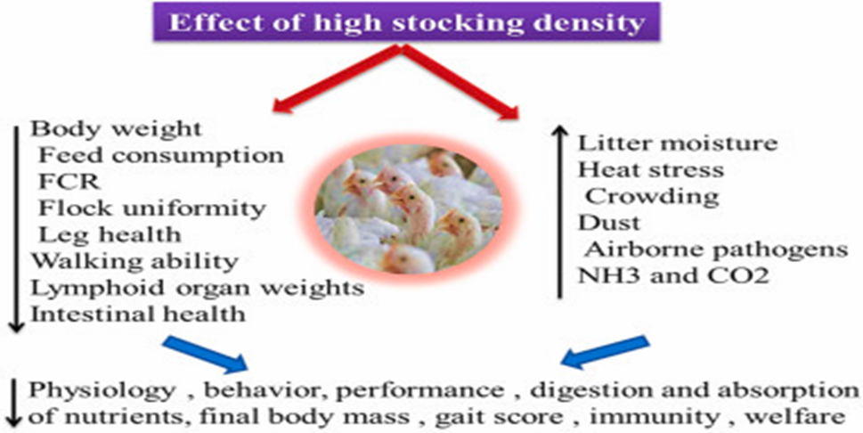
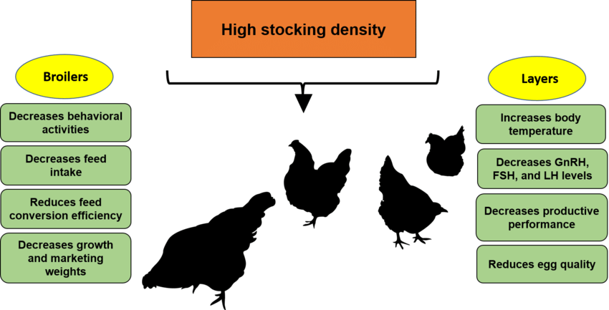
Effect of Different Stocking Densities as Environmental Stress Factor on Broilers Performance and Behavior
By: Zahra Taha Assad
4th stage Animal Resource Department- Collage of Agriculture Engineering Science-
Salahhadin university
Supervised by: Assist. Prof. Dr. Alaa Ab. Mustafa
The ultimate goal of poultry producers worldwide is to maximize kg of chicken produced per square meter of space while preventing production losses due to overcrowdings to achieve a satisfactory economic return. According to the industry, stocking density is currently expressed as a mass per unit of space rather than numbers of birds being reared in a given area (Abudabos et al., 2013).
Stocking density has become a major issue in the debate on broiler welfare. Very high densities may impair the bird’s welfare directly through physical restriction of the movement and indirectly effects through poor litter quality, high ammonia level and heat are also suggested to affect welfare (Abo. Alqassem et al., 2018).
Poultry producers all around the world attempt to maximize the production of meat and egg as much as possible per square meter of the area while minimizing production losses due to overcrowding, to produce an economic return (Mustafa and Tayeb, 2022).
1-Effect of high stocking density on productive performance
As shown in Table 1. The results for the feed intake were not signiﬁcantly different between the groups, although feed intake showed a linear increase as the stocking density decreased (p < 0.05). There was no signiﬁcant difference in FCR among the groups. No mortality were observed .
The feed intake of chickens reportedly decreases because of the alleviation of additional metabolic heat responses under heat stress .
2- Effect of high stocking density on broilers behavior
1- Effect of stocking density on broilers behavior is indicated in table 3. All behavior traits were recorded by camera CCTV. In this study, broilers raised at HSD were significantly lower in laying, walking, feeding, and comfort behavior (preening). On the other hand, there was no significant difference in standing, drinking, stretching, and pecking between all treatments Behavior often shows animals' contentment with their surroundings density had an adverse effect on BWG, compared with low stocking.
.
In conclusion, in this review the results demonstrated that increasing stocking density affected production performance (feed intake, body weight gain) and behavior parameters (feeding, standing, walking, pecking, preening, stress, and aggressive behaviors). It means increased of growth and meat production in HSD about 15-20% as LSD. Moreover, antioxidant systems and induced more oxidative stress under high-temperature conditions. HSD induces a physiological oxidative stress response and compared to low stocking density.
Introduction
Results and Discussion
Conclusion
The Objective
Table 1. Effect of stocking density on performance of broiler chickens
Due to this reasons, the aim of this study is to investigate the effect of different stocking densities as environmental stress factor on broilers behavior and performance.
 | Stocking Density (Birds/m 2)
Parameters | 16 | 18 | 21 | 23 | 26 | SEM | P- Value
Initial BW(g/bird) | 1345.5 | 1347.3 | 1353.3 | 1351.7 | 1356.8 | 7.322 | NS
Final BW (g/bird) | 1988.6 ab | 2013.7a | 1945.3b | 1844.0 | 1816.0 c | 8.361 | **
BWG (g/bird) | 643.1ab | 666.4a | 592.0abc | 492.3bc | 459.4c | 26.017 | **
Feed intake (g/bird) | 1052.3 | 1067.3 | 1064.5 | 991.0 | 898.4 | 26.806 | NS
FCR | 1.66 | 1.60 | 1.80 | 2.09 | 2.06 | 0.105 | NS
Abudabos,A.M., Samara, E.M., Hussein, E.O., Al-Ghadi, M.A.Q. and Al-Atiyat, R.M., (2013). Impacts of stocking density on the performance and welfare of broiler chickens. Italian Journal of Animal Science, 12(1), p.e11.
Ahmed, S.A., Ahmed, E.A. and El Iraqi, K.G., 2018. Effect of different stocking densities as an environmental stressing factor on broiler behavior and performance. Benha Veterinary Medical Journal, 34(2), pp.51-65.
Mustafa, A.A. and Tayeb, I.T., 2022. The influence of dietary salvia and lavender powders on productive performance, some physiological parameters, and immunity of broiler under stocking density stress. Iraqi Journal of Agricultural Sciences, 53(6), pp.1280-1288.
References
Table 3. Effect of stocking density on behaviors of broiler chickens
P. value | HSD | MSD | LSD
* | 61.65b | 63.29ab | 64.56a | Lying | Behavioral activities%
NS | 2.64 | 2.12 | 1.73 | Standing
* | 1.92b | 2.19ab | 2.75a | Walking
** | 5.82b | 6.37ab | 7.77a | Feeding
NS | 8.91 | 8.15 | 5.95 | Drinking
NS | 5.75b | 5.82ab | 6.65a | Preening
NS | 5.8 | 5.67 | 4.07 | pecking

