Slide 1
Animal resource Dept. 4th stage Ornamental birds Dr. Alaa 2023

Slide 2
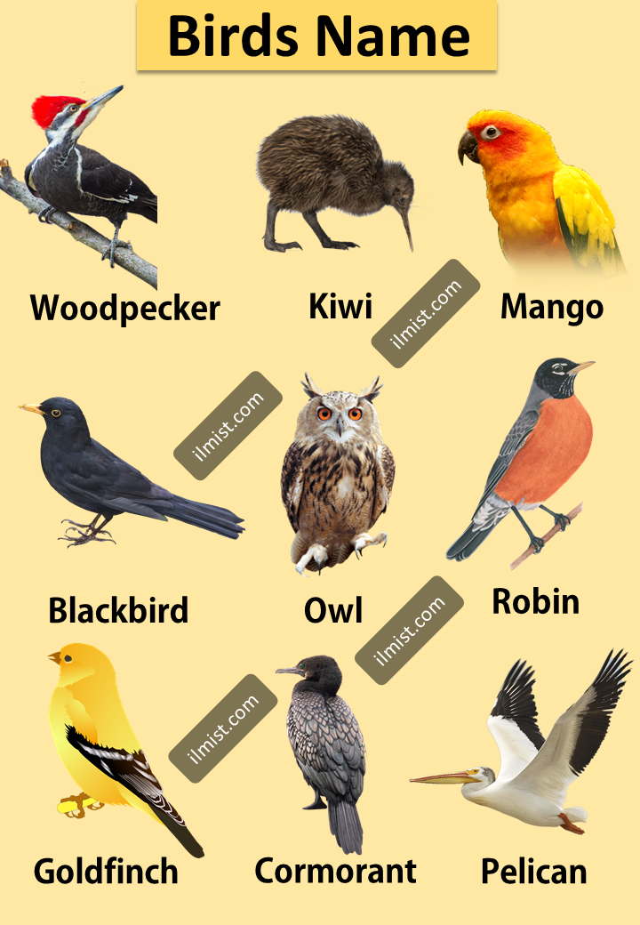

Slide 3
1st Lecture
An overview of bird (Aves)

Slide 4
Bird, members of the class Aves, unique in having wings and feathers, include more than 10,400 living bird species – more than half being perching birds. Their feathers distinguish them from all other classes of animal; no other animals on earth have them. Since earliest times birds have been cultural resource.

Slide 5
What is the study of animals and birds called?
The branch of science that deals with the study of animals is called zoology.
Ornithology; a branch of zoology dealing with the scientific study of birds. Including study several aspects: bird ecology, taxonomy, evolution, physiology, and habitat.
The word "ornithology" comes from the late 16th-century Latin ornithologia meaning "bird science" from the Greek ὄρνις ornis ("bird") and λόγος logos ("theory, science, thought").

Slide 6
Classifications of birds; The general scientific classification of birds is as follows:
Kingdom: Animalia Phylum: Chordata Subphylum: Vertebrata Class: Aves
Order (27):
Galliformes (Chicken, Quails, Turkey and Pheasants)
Anseriformes (Geese, Ducks and Swan)
Columbiformes (Pigeons, Doves)
Pssitaciformes (Parrot, Parakeets and Macaw)
Passeriformes (song birds)
Falconiformes (Eagle, Hawk and Vulture)

Slide 7
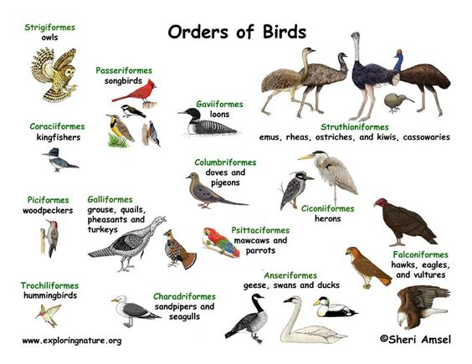

Slide 8
Bird Facts;
1- Birds are warm-blooded, have feathers, wings, Bipedal (two legs) and lay eggs.
2- Birds can fly with the help of their hollow bone.
3- Embryo eat and grow inside the egg outside of mothers body.
4- Chicken is the most common species of bird all over the world.
5- Most of birds can fly e.g. swan, pigeon, eagle …etc. others cannot e.g. chicken and penguins.

Slide 9
Bird facts
6- Ostrich is the largest bird in the world. Bee humming bird is the smallest living bird. And all birds are adapted according to the environment that living in.
7- In most birds, beauty give males than females.
8- Humming birds can fly backwards.
9- Wild birds naturally migrate as group from one place to another for breeding.

Slide 10
General characteristic of the birds are as follows:
Birds are endothermic vertebrates.
The body of the birds are covered with feathers (help in preventing heat loss and reduce air friction by providing passage to the air).
Their forelimbs are modified into wings. And Their hind limbs are adapted for walking, hopping, perching, grasping, wading and swimming.
High metabolism rate. Birds have a high metabolic activities than any other animals in the world. Some birds will consume food that is equal to their body weight each day.

Slide 11
Birds have no teeth, have horny beaks (the lower and upper jaws are modified into a beak) and scaly feet.
There is no skin gland except the oil gland.
They are oviparous which means they lay eggs to develop their young ones.
The shape of the body is streamlined which helps them to fly high in the sky.
Birds have a very strong vision.
Most birds have lightweight skeletons with hollow bones and strong muscles. This keeps them light enough to fly in the sky called pneumatic bone.

Slide 12
The excretory, respiratory and the digestive system of the birds is very efficient, in order to minimize its body weight thus helping it to fly.
Birds have some exchanging inside the body have some unique organs like; crop, gizzard and air sacs while have not gall bladder that different with animals.
Depending on the species the birds can be said to be carnivores or herbivores creature.
Based on the ability to fly birds are categorized into carinates and ratites. Birds that have the ability to fly are called as carinates and birds that cannot fly are called as ratites.

