Slide 1
Ventilation system
Assist.Prof.Dr.Tahsin Alla .M
Poultry Nutrition and metabolism
Animal Resource Department
College of Agriculture
University of Salahuddin

Slide 2
3. Ventilation
To ensure that good welfare and reproductive performance are achieved by maintaining birds under appropriate, and optimal environmental conditions.
Ventilation is used to achieve an in-house environment that will optimize bird comfort, achieve the best biological performance, and maintain bird health and welfare. The ventilation system supplies adequate fresh air and also removes excess moisture, gases, and airborne by-products. It also contributes to temperature and humidity control in all ambient conditions, and provides a uniform draft-free environment at bird level.

Slide 3
Air
The main contaminants of air within the house environment are dust, ammonia, carbon dioxide, carbon monoxide, and excess water vapor. Levels of these contaminants must be kept within legal limits at all times. Continued and excessive exposure to these contaminants can:
Damage the respiratory tract.
Decrease the efficiency of respiration.
Trigger disease (e.g. ascites or chronic respiratory disease).
Affect temperature regulation.
Contribute to poor litter quality.
Reduce bird performance.

Slide 4
Effects of common parent stock house air contaminants.
Ammonia | Ideal level <10 ppm. Can be detected by smell at 20 ppm or above. >10 ppm will damage lung surface. >20 ppm will increase susceptibility to respiratory diseases. >25 ppm may reduce growth rate depending upon temperature and age.
Carbon Dioxide | Ideal level <3,000 ppm. >3,500 ppm causes ascites. Carbon dioxide is fatal at high levels.
Carbon Monoxide | Ideal level <10 ppm. >50 ppm affects bird health. Carbon monoxide is fatal at high levels.
Dust | Damage to respiratory tract lining and increased susceptibility to disease. Dust levels within the house should be kept to a minimum.
Humidity | Ideal level 50-70% after brooding. Effects vary with temperature. At >29°C (84.2°F) and >70% relative humidity, growth will be affected. Relative humidity <50% particularly during brooding will affect growth.

Slide 5
Housing and Ventilation Systems
There are two basic types of ventilation systems:
Natural Ventilation
Also known as open-sided, curtain-sided, or natural houses.
Fans may be used inside the house to circulate and move air.
Power Ventilation (controlled/closed environment housing)
These houses usually have either solid sidewalls or curtains that are kept closed during house operation.
Fans and inlets are used to ventilate the house.

Slide 6
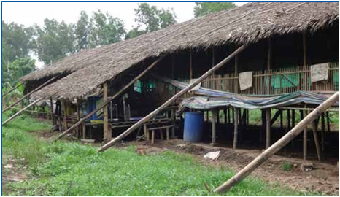
Open-Sided/Natural Ventilation
Open-sided (or naturally ventilated) houses rely on the free flow of air through the house for ventilation. Achieving adequate control of the in-house environment can be difficult in open-sided houses, and as a result, consistency and level of performance tends to be lower than in controlled-environment houses.

Slide 7
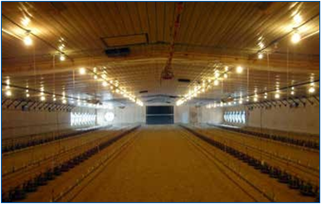
Controlled Environment Housing
Power ventilation in controlled or closed environment houses is the most popular form of ventilation system for parent stock due to the ability to provide better control of the internal environment under a range of ambient conditions. The most common form of controlled environment housing is that which operates under a negative pressure. These houses usually have solid sidewalls and exhaust fans that draw air out of the house and automated inlets through which fresh air is drawn into the house.

Slide 8
In order to provide the best environment for the bird throughout the production cycle and at any time of the year, every closed-environment house should be equipped to cater for the three stages of ventilation. These are:
Minimum ventilation.
Transitional ventilation.
Tunnel ventilation.
In some regions of the world where ambient temperatures do not get hot enough to warrant the need for tunnel ventilation, this stage may be omitted from the design of the house.
Because closed-environment houses usually have solid sidewalls, it is strongly advised to link these houses to standby generators in case of loss of power. In power-ventilated, curtain-sided houses, automatic curtain- opening devices should be in place.
Most modern controlled-environment housing uses negative-pressure ventilation. This means that fans exhaust air out of the house and fresh air is drawn into the house through air inlets. This is called negative- pressure ventilation because it works by creating a partial vacuum inside the house.

Slide 9
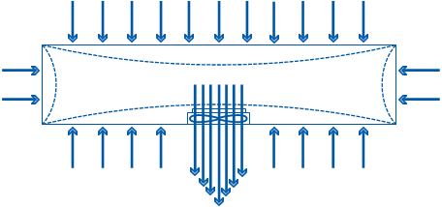
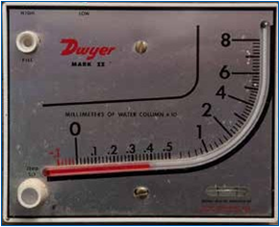
Negative pressure only works efficiently if the house is effectively sealed. In a house that is effectively sealed against air leaks, all the air entering the house comes in through the desired air inlets and uncontrolled air leakage will be minimized.
Air pressure within the house should be monitored regularly. Monitoring pressure over time is a useful means of identifying air leakage and there are easy-to-use pressure gauges (manometers) available. If the air pressure falls below the suggested levels (0.15 inches of water column), an investigation should be carried out and appropriate action taken (e.g. repair broken inlets or ripped curtains).

Slide 10
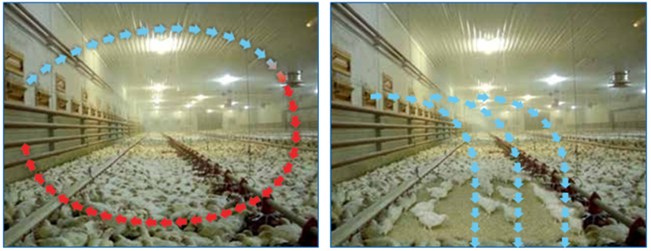
Minimum Ventilation
Minimum ventilation brings fresh air into the house and exhausts any stale in-house air (to remove excess moisture and prevent the build-up of harmful gases), while maintaining the required in-house air temperature.
Some minimum amount of ventilation must be given at all times when there are birds present in the house– no matter what the outside temperature is. Minimum ventilation can be used during winter and summer and at any stage of the production cycle but is most commonly used during brooding and cool weather (i.e. whenever it is colder outside than the desired in-house set-point temperature and the actual house temperature is at or below the required set point temperature). Minimum ventilation is not adequate for cooling birds during high temperatures and should create very little air movement at bird level. Good ventilation is particularly important for young birds under 10 days of age.

Slide 11
It is essential to provide some ventilation to the house regardless of the outside conditions.
Minimum ventilation is used for young chicks, night time, or cold weather ventilation.
Minimum ventilation should be timer driven.
Achieving the correct operating negative pressure to ensure incoming air is drawn at high speed towards the apex of the roof is critical.
Air inlet number and size of opening should achieve high air velocity to prevent cold air dropping to the floor.
Not all air inlets may need to be opened but those that are opened should be evenly spaced and open the same amount.
When setting up the minimum ventilation inlets, the minimum air inlet opening size should be around 5 cm.
Monitor air flow and bird behavior to determine if settings are correct.

Slide 12
Transitional Ventilation
Transitional ventilation is used when the house temperature is above the desired (or set-point) temperature, but it is not yet warm enough (or the birds are still not old enough) to use tunnel ventilation. Transitional ventilation is a temperature driven process. As the house temperature increases above the required set point, the ventilation system should be set to stop operating minimum ventilation, and start to ventilate continuously for temperature control. During transitional ventilation, a large volume of air can be introduced into the house, but unlike tunnel ventilation, this air is not blown directly onto the birds.

Slide 13
Transitional ventilation works in a similar way to minimum ventilation. Air inlets operating on the basis of negative pressure direct the incoming air, at speed, away from the birds up to the apex of the house where it mixes with warm in-house air before falling back to floor level.
The number of sidewall inlets in use is increased to allow a higher volume of air to be brought into the house. As a general guideline for transitional ventilation, enough air inlets should be open so that approximately 40-50% of the tunnel fan capacity is being used.

Slide 14
Transitional ventilation is used when a higher than minimum air exchange is required.
Transitional ventilation is a temperature-driven process that removes heat when house temperature increases above the desired set point.
Evaluating bird behavior is the only real way to determine if transitional ventilation settings are correct.

Slide 15
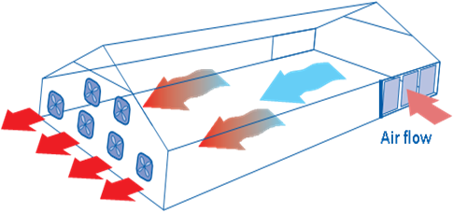
Tunnel Ventilation
Tunnel ventilation is used to keep the birds feeling cool. The system uses fans at one end of the house and air inlets at the other end. High volumes of air are drawn down the length of the house, exchanging the air in the house in a short time.
The switch from transitional ventilation to tunnel ventilation should occur when the birds need the cooling effect of wind chill. The heat generated by the birds is removed and a wind-chill effect is created that allows the birds to feel a temperature that is lower than that shown on the thermometer.

Slide 16
Tunnel ventilation cools birds through high-velocity air flow.
Tunnel ventilation controls the effective temperature felt by the bird which can only be estimated by bird behavior.
If the house design permits tunnel ventilation only, then considerable caution should be practiced with young birds that are not fully feathered.
Younger birds feel a greater wind chill than older birds for a given air speed, and thus are prone to wind-chill effects.
Observations of bird behavior are critical.

Slide 17
Bird Behavior in Tunnel Ventilation
Monitoring and evaluating bird behavior are the only real ways to determine if tunnel ventilation settings are correct for the age, stocking density, biomass and feather cover of the flock. The effects of wind chill on a flock cannot be clearly defined by using temperature and humidity meters only. During tunnel ventilation, regardless of what the house thermometer is showing, birds could be feeling much cooler or hotter than house sensors indicate they should.
If birds are sitting down, they may be feeling cold. If birds are spread out, but with wings held slightly away from their bodies, or if they are lying on one side with one wing open, they may be too warm. If more than 10% of birds are panting slightly or heavily, the flock may be too warm.
If birds are too cool for example, energy will be used to keep warm rather than for egg production. If birds are too warm, feed intake will reduce and more energy will be expended for increased respiration and egg production will drop. Floor eggs may increase if air speed is too high causing drafts in nest boxes, as birds will prefer to lay eggs on the floor where the air speed is usually slower.

Slide 18
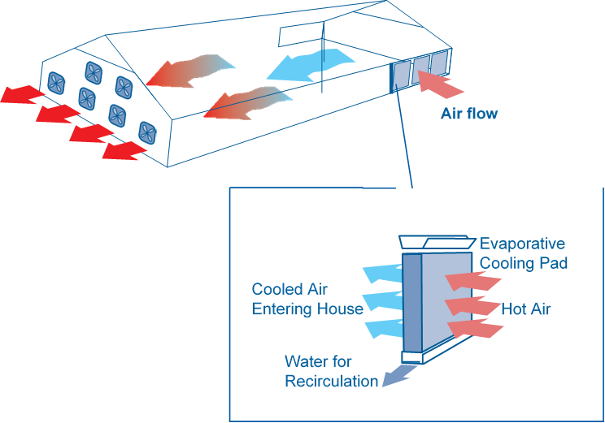
Tunnel ventilation settings should be checked and adjusted by:
Reducing or increasing the number of fans in use.
Turning on or off evaporative cooling systems (fogging or pads).
Increasing air speed by the use of in-house baffles to increase wind-chill effect.
Increasing or reducing the amount of time that evaporative cooling pad pumps are running.

