Slide 1
Poultry management / Theory 3rd lect. Poultry management requirements; (3- Ventilation) Animal Resource Dept. 3rd stage Dr. Alaa 2022

Slide 2
Ventilation is one of the most important principles of raising poultry farms, particularly broiler chicken to reach the highest productivity and the highest conversion rate. Poor ventilation leads to low weight and food conversion rate.

Slide 3
Ventilation is the only key to reduce the respiratory problems of the bird respiratory diseases that increase the mortality rate, reduce the immunity of birds and make them susceptible to bacterial and viral diseases and eventually develop respiratory disease Chronic Respiratory Disease (CRD), which is difficult to treat and causes significant economic losses, and poor ventilation leads to increased incidence of Hock Burn.

Slide 4
Ventilation in a poultry house supplies fresh air that is essential to sustain life. It also helps reduce the extremes of temperature, humidity and air contamination to tolerable limits for confined chickens.

Slide 5
What is the importance of ventilation in poultry house?
Because birds cannot sweat, they eliminate the excess of heat through breathing, vigorous flapping, and panting. Ventilation helps to eliminate excess of heat and humidity from the sheds where the birds are housed, generating comfort and welfare.

Slide 6
The role of ventilation
In poultry farming (eggs and especially meat producers) birds need to consume a large amount of good quality feed to develop the metabolic processes. The metabolic processes increase humidity levels. Birds eliminate water through respiration and feces and the moisture is accumulated in the environment and needs to be removed through ventilation. Also, humidity increases the thermal sensation of the birds, they eliminate the excess of heat through breathing, vigorous flapping, and panting.

Slide 7
Table.1 Air quality parameters in chicken house and hazard levels
Ammonia | Ideal level <10 ppm. Can be detected by smell at 20 ppm or above. >10 ppm will damage lung surface. >20 ppm will increase susceptibility to respiratory diseases. >25 ppm may reduce growth rate depending upon temperature and age.
Carbon Dioxide | Ideal level < 0.3% or 3000 ppm. >3,500 ppm causes ascites. Carbon dioxide is fatal at high levels.
Carbon Monoxide | Ideal level <10 ppm. >50 ppm affects bird health. Carbon monoxide is fatal at high levels.
Oxygen | Ideal level >16% Below > 6% is lethal.
Dust | < 3.4 mg/m³ Damage to respiratory tract lining and increased susceptibility to disease. Dust levels within the house should be kept to a minimum.
Humidity | Ideal level 50-70% after brooding. Effects vary with temperature. At >29°C (84.2°F) and >70% relative humidity, growth will be affected. Relative humidity <50% particularly during brooding will affect growth.

Slide 8
What are the main importance's of ventilation in poultry houses?
1- Elimination of many harmful gases in the respiratory system of the bird, such as ammonia (feces and litter) and gases resulting from the operation of heaters and replace the proportion of carbon dioxide gas by oxygen to breathe birds well.
2- Heat and moisture distribution inside the poultry houses from equipment's, walls and ceiling and get rid of excess heat (summer) and moisture (winter).
3- Have a role of cooling body especially in summer.
4- Get rid of bad dust and odors from the building.

Slide 9
Poor ventilation lead to:
Damage the respiratory tract.
Decrease the efficiency of respiration.
Trigger disease (e.g. ascites or chronic respiratory disease).
Affect temperature regulation.
Contribute to poor litter quality.
Reduce bird performance and productivity.

Slide 10
There are several factors that control the amount of air inside the poultry houses which must be considered:
Building type (insulation grade) and geographic location.
Temperature and relative humidity inside and outside the house particularly, during summer and winter.
The type and age of birds.
Intensity of birds inside the house.

Slide 11
Ventilation in hot and cold region.
Ventilation varies more effective in the summer than in the winter season. Ventilation in the summer season is the highest rate in order to rid the birds of excess heat resulting from birds inside the house.
While ventilation in the winter (less ventilation rate) due to raising moisture outside the house, is intended to renew the house air to prevent the increase of moisture inside the house while at the same time maintain the temperature of birds and heating system and control moisture of the litter. For this reason ventilation in the summer is much easier than ventilation in the winter.

Slide 12
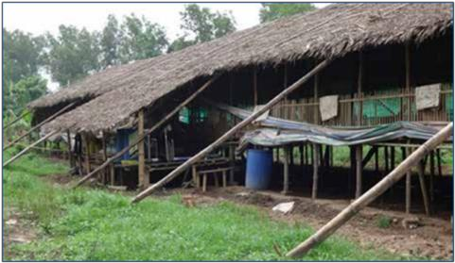
Housing and Ventilation Systems
There are two basic types of ventilation systems
1- Natural Ventilation or Open-sided
Natural air curtains are allowed to enter the house.-
Fit for areas where outside temperature does not exceed 33 C.-
-It’s a conventional system.
Not best fit for our condition. -
Fans may be used inside the house to circulate and move air.

Slide 13
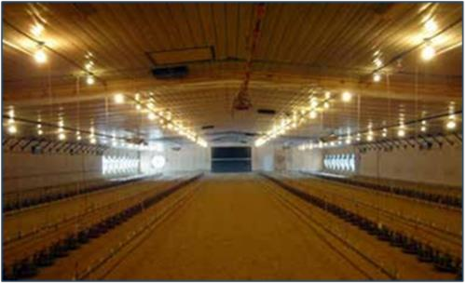
2- Mechanical air movement ventilation (controlled/closed environment housing)
- Mechanical air movement ventilation is required
to ventilate a house in all climate conditions.
- This system suit our climate condition.
- This system use electric fans and inlets are used as principal to exchange in in the house. Its divided in to two distinct types positive and negative pressure.

Slide 14
1- Positive pressure system
-Fans are arranged to push fresh air in to the building.
-Create air velocity which produce wind chill effect.
-For high density and extreme climate conditions this system is not very much effective especially for our condition.

Slide 15
2- Negative pressure system
-Most modern controlled-environment housing uses negative-pressure ventilation.
-The most common in poultry houses.
-When using negative pressure ventilation, the pressure differences pulls fresh air through inlets and fans in to the house by creating a partial vacuum inside the house.
-Because there is negative pressure relative to the air pressure outside, fresh air flows into the house through air intakes.
- This system is best fit for our climate condition.

Slide 16
Negative pressure only works efficiently all the air entering the house comes in through the desired air inlets and uncontrolled air leakage will be minimized. Negative pressure system in different weathers is divided in to three stages of ventilation. These are:
Minimum ventilation (Cold weather ventilation).
Tunnel ventilation (Hot weather ventilation).
Transitional ventilation (Optimal weather ventilation).

Slide 17
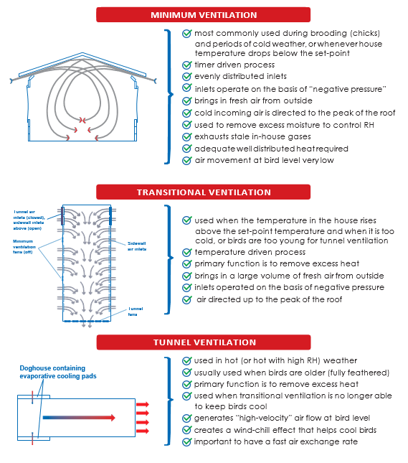

Slide 18
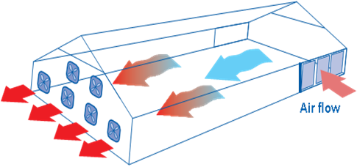
In some regions of the world where ambient temperatures do not get hot enough to warrant the need for tunnel ventilation, this stage may be ignored from the design of the house.
Tunnel ventilation

Slide 19
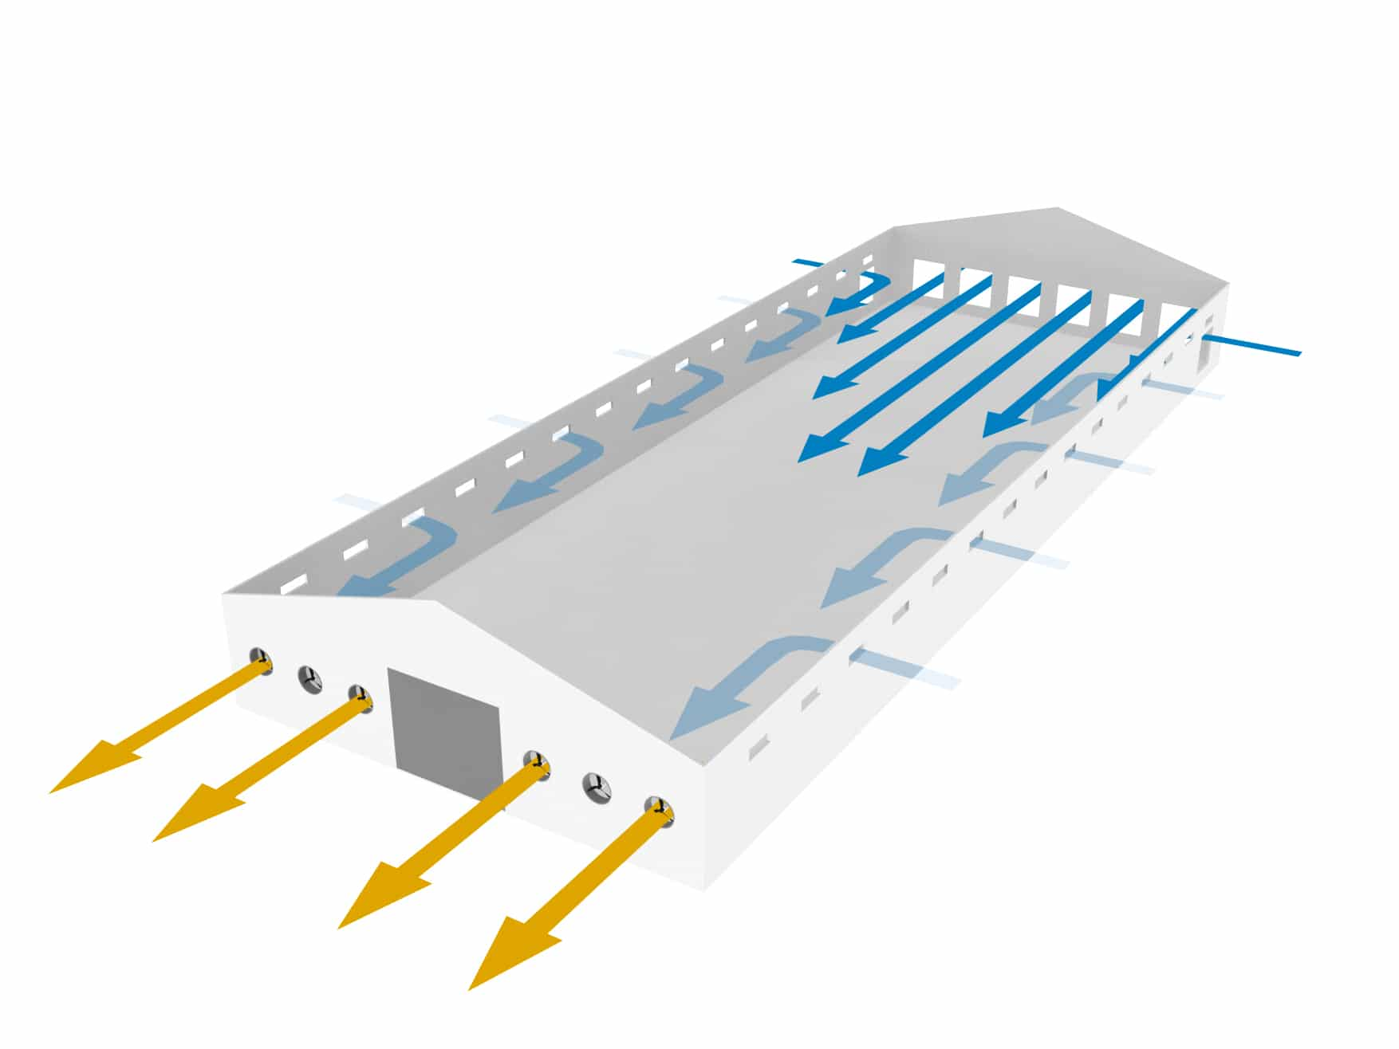
Tunnel ventilation

Slide 20
During winter, it is particularly challenging to meet these parameters due to the dilemma between maintaining temperature and optimal air quality. When heating capacity is limited there is a tendency to reduce the minimum ventilation to prevent heat loss. At the same time CO2 levels and relative humidity (RH) will increase which will have a negative impact on the development of the bird and the litter conditions. The correct programming of the minimum ventilation is the only effective method to control these parameters.

